Slide 1
YEAR GROUP THREE
Big Question:
Who is the most important* person in the Easter story?
CORE CONCEPT: SALVATION
Weekly questions:
Week 1: Why did Judas betray Jesus? Week 2 and 3: What does Peter’s denial say about the challenges of the Christian Faith? Week 4 and 5: Why were there women at the crucifixion of Jesus? Week 6: Who is the most important person in the Easter story?
What a child needs to know and remember by the end of the unit:
The meaning of the core concept: Salvation
The role Judas, Peter, the women and Mary Magdalene play in the Easter story.
What it means to betray, deny, reject those who are different.
To understand who might be viewed as the most important person in the Gospel accounts of Holy week and why.
What a child should be able to do (Assessment):
Beliefs, teachings, sources of wisdom and authority:
I can identify and talk about the key people in the Gospel accounts of Holy Week and how they might have been feeling. (WT)
I can describe what a believer might learn from each of the people studied. Eg – the importance of not betraying those you love. The importance for not denying the truth. The importance of repentance. The importance of remembering those who are often left out. (Exp)
I can make links between the teachings of the Easter story explored through the key people and how this might influence a believer's life. Eg – speaking up for the faith. Putting faith into action by attending Church. Seeking God’s forgiveness regularly through prayer. Caring for the marginalised – ie the homeless, the rejected, the poor etc. (GD)
Questions of values and commitments:
I can begin to express my ideas and opinions. (WT)
I can make links with the concepts of betrayal, denial and forgiveness identified in the Easter narrative with the way I and others might behave. (Exp)
I can ask questions about the moral decisions I make and suggest what might happen as a result of those decisions. (GD)
Religious vocabulary:
Salvation: To be rescued/saved by God. Relationship between God and humankind is restored.
Disciple: A follower of Jesus
Betrayal: to be let down/break of trust between people
Denial: Not owning up to the truth
Forgiveness: To ‘let go’ of those things that hurt us.
Redemption: Being set free by Jesus’ death.
Crucifixion: A method of executing criminals.
Resurrection: The rising from the dead of Jesus Christ.
Sensitivities:
*Be aware that Jesus is obviously the central figure in these narratives, so this unit highlights other major characters.
Be mindful of any pupils that have suffered betrayal, bereavement and loss.

Slide 2
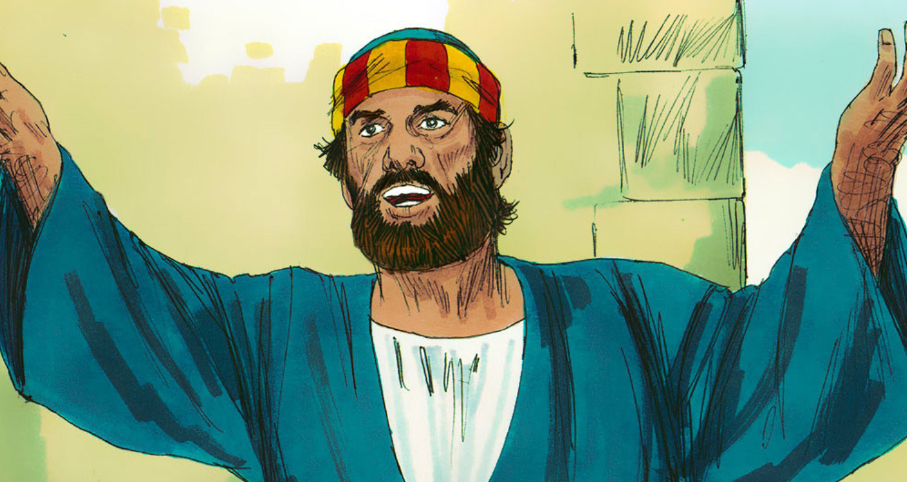
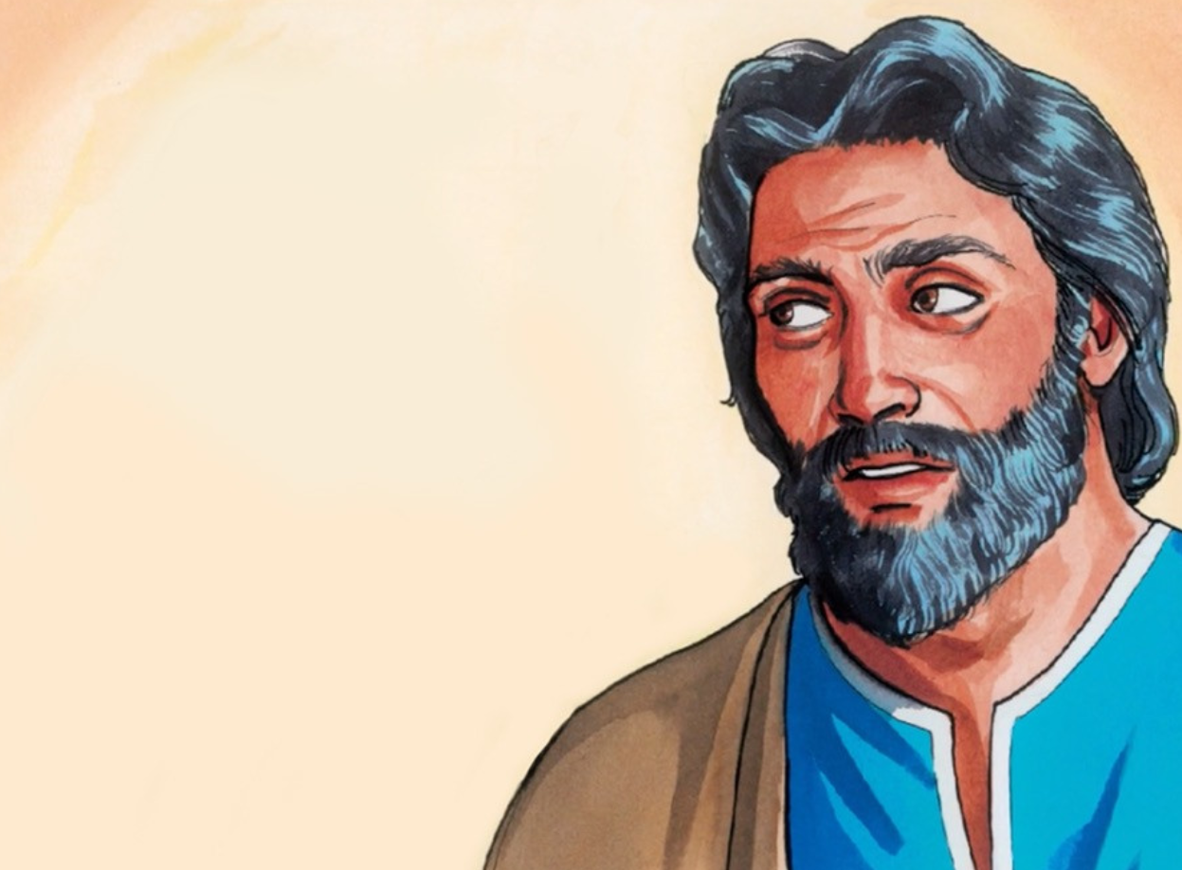
YEAR GROUP THREE
Background knowledge for teachers
CORE CONCEPT: SALVATION
The meaning of salvation:
It is through the death and resurrection of Jesus that the relationship between God and humanity is restored. In the death of Christ, forgiveness is offered for the sins of all people.
Judas:
Judas Iscariot was one of the original twelve disciples that were selected by Jesus Christ. He was known as Judas, son of Simon Iscariot.
The name Iscariot is said to have come from the Semitic root verb “sqr,” meaning “to lie,” so Judas’ very name insinuates that he is a liar, however, Judas’ name itself is said to have derived from Judas’s membership in the sicarii or “dagger wielders,” which was a band of religious terrorists of the time, so there is some speculation that Judas was aligned with the Zealots, a fanatical group that had included another apostle, Simon, and whose intent was to overthrow the Roman rule in Judea.
Judas carried the money bag. He was in charge of the common fund.
There is no scriptural evidence that Judas was ever saved. He never called Jesus “Lord,” like the other disciples did, but called Him “Rabbi.” This raise the question as to whether Judas believed Jesus was the Messiah, or He did know and wanted the Messiah to rule immediately.
Peter:
One of the first disciples to be chosen.
One of Jesus’ closest friends.
Fishermen by trade.
Immediately responded to Jesus’ call to follow him and changed his name from Simon to Peter – very significant as Peter in other languages means ‘rock.’ Jesus appointed Peter as the ‘rock’ on which he would build his church.
Peter is often portrayed in the Gospels as one who is very close to understanding who Jesus is and yet so far away from really understanding. EG: Jesus walking on water. Peter calls Jesus when he sees him walking on the water. When Peter steps out the boat, he becomes afraid when he sees the wind and begins to sink. Peter calls out to Jesus to save him. An example of Peter lacking in faith. On another occasion Peter says to Jesus: You are the Messiah – at last the penny has dropped and in Matthew’s Gospel, Jesus commends him for this but just moments later Peter receives Jesus' sharpest rebuke "Get behind me Satan!" because he tries to dissuade Jesus from the path of suffering and death.
Either way, Judas is often thought that he was only concerned about himself and his own agenda.
As the money bag holder, it is often felt that Judas didn’t really care about Jesus as much as he did the money. One example was when Mary anointed Jesus with a costly perfume. Judas was indignant, and asked, “Why was this ointment not sold for three hundred denarii and given to the poor?” He said this, not because he cared about the poor, but because he was a thief, and having charge of the moneybag he used to help himself to what was put into it” (John 12:5-6), so Judas said this, not because he cared about the poor, but because he was a thief, and having charge of the money bag he used to help himself to what was put into it. (John 12:7)
The motive for why Judas betrayed Jesus remains unknown with many scholars holding many different thoughts and opinions as to why Judas did what he did.
Peter shows he does not fully understand the nature of Jesus' Messiahship.
Peter is often the ‘spokesperson’ for the disciples but is often the one that says the wrong thing at the wrong time.
Peter denies knowing Jesus as predicted by Jesus himself
Peter is in the first male witness to the resurrection
Peter in the book of Acts is seen as one of the main leaders of the early church. Whatever his precise nature of his encounter with the resurrected Jesus, the result was that Peter was transformed from a scared and dejected failure into the leader Jesus had predicted at the outset.

Slide 3
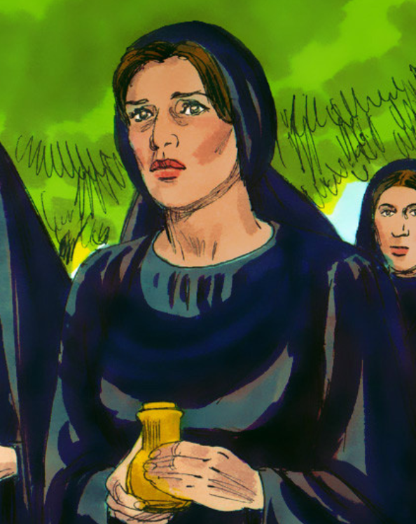
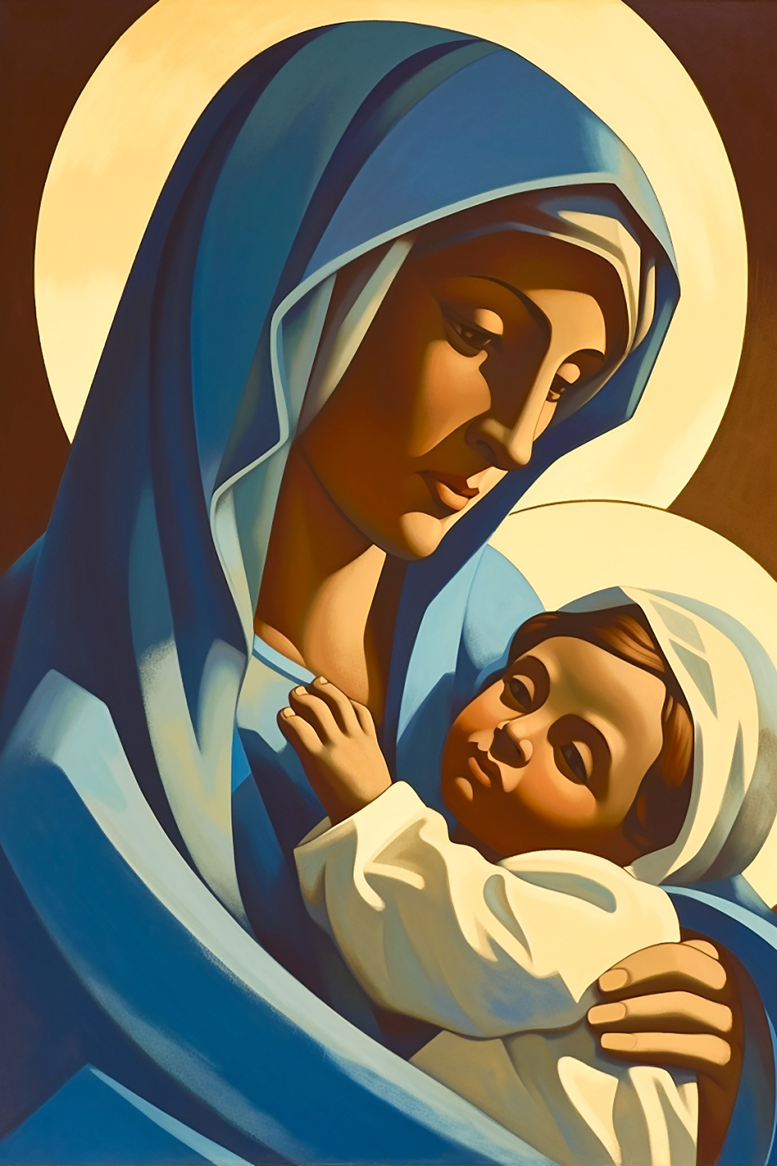
YEAR GROUP THREE
Background knowledge for teachers
CORE CONCEPT: SALVATION
The meaning of salvation:
It is through the death and resurrection of Jesus that the relationship between God and humanity is restored. In the death of Christ, forgiveness is offered for the sins of all people.
The women:
Many women were present at the foot of the cross because they had followed Jesus from Jerusalem. They were watching from a distance.
The Gospel writers give some names of the women who were there. Mary the mother of Jesus and Mary Magdalene being two of them. Seven in total are mentioned by name.
Culturally, it would have not been the norm for women to be at a crucifixion.
Many were there because they had known and experienced love, forgiveness and compassion from Jesus. Now it was time for them to express their love towards him.
Mary – the mother of Jesus:
Mary was a young Jewish girl when she gave birth to Jesus.
Mary was betrothed to be married. She was probably around the age of 12/13.
Mary is seen by the church as pure and holy.
Mary is at the heart of the Christian narrative.
Mary Magdalene:
Very little is known of Mary Magdalene.
Mary was from the town of Magdala which is where her second name comes from.
A very close friend of Jesus
Mary was one of Jesus’ most loyal followers as portrayed in the Gospels.
When Mary met Jesus, he cast out seven demons from her.
Mary Magdalene cared for Jesus and his disciples out of her own wealth.
Mary was present at Jesus’ death and burial.
Mary stayed with Jesus at the foot of the cross. She and other women bought spices to anoint the body of Jesus and appeared at his tomb in all four Gospels.
Mary is said to be the first to witness his resurrection.
It is western Christian doctrine, renaissance art and literature that have portrayed Mary as a prostitute but this is not mentioned in the Bible.
Mary Magdalene is the subject of much controversy, legend, and misconception. There is no evidence to back up claims that she was a reformed prostitute, the wife of Jesus, and the mother of his child.

Slide 4
YEAR GROUP THREE
Lesson 1: Why did Judas betray Jesus?
CORE CONCEPT: SALVATION
Intentions:
To give pupils opportunities to:
Know who Judas was and what he did to Jesus.
Know the meaning of betrayal.
Be able to express their own ideas and opinions.
Be able to make the link between betrayal and the Easter narrative.
To be able to ask questions about the moral decisions people make.
Key religious vocabulary: Last Supper, betrayal, Judas.
Implementation:
Outlining how to introduce the religious content in the classroom and create learning opportunities from it.
Introduction:
Display a range of paintings of the Last Supper.
Key questions:
What do you think this is a painting of?
Who do you think is in the painting?
Which one is Jesus and how do you know?
Which person do you think might be Judas? Why?
Explain to the class who Judas was from the little knowledge we are given of him.
Teacher subject knowledge: Refer to background information for teachers on Judas.
Main teaching input: (Investigate and explore)
Introduce this week’s question: Why did Judas betray Jesus?

Slide 5
YEAR GROUP THREE
Lesson 1: Why did Judas betray Jesus?
CORE CONCEPT: SALVATION
Implementation:
Outlining how to introduce the religious content in the classroom and create learning opportunities from it.
Key question:
What does the word ‘betrayal’ mean?
Can you give me an example of when someone might betray someone else?
How can the Gospel accounts help us to answer this week’s question?
Biblical text analysis:
Read: Matthew 26: 14 – 30 and verses 47 – 50 (This text is to be read with a focus being on Judas)
Matthew 26: 14 – 30: Judas agrees to betray Jesus and the Lord’s Supper
Matthew 26: 47 – 56: Jesus arrested
John: 13: 21 – 13: Jesus predicts His betrayal
Key questions: to use with both texts drawing out the differences between the two Gospel accounts as to why Judas betrayed Jesus.
Behind the text: Why was it written? Discipline: Theology
What was significant about this Passover that the author thought it was necessary to record it?
What kind of changes might have been expected from his disciples in the light of this account?
Within the text: What does the text mean? Are there any words that need explaining? Discipline: Theology
Why do think Judas betrayed Jesus? What do you think was his main motive for doing so? This is the main question that needs exploring and answering.
What do you think Judas was thinking when he kissed Jesus? (Taken from Matthew’s account.)
What questions are you left with?
In front of the text: This is concerned with the relationship between the text and the reader. Discipline: Theology
What one thing will you take away from reading this text that will make you think about your own behaviour?

Slide 6
YEAR GROUP THREE
Lesson 1: Why did Judas betray Jesus?
CORE CONCEPT: SALVATION
Implementation:
Outlining how to introduce the religious content in the classroom and create learning opportunities from it.
To note: It is important to explore the text as a whole class using the key questions as prompts. Allow time for pupils to discuss in pairs their responses. Record pupils’ answers so that they can use them as a reference point for the main activity.
Matthew 27: 1 – 10 - Judas hangs himself
To note: Be very aware of pupils’ circumstances in your class when looking at this passage.
Key questions:
What do you think stopped Judas from asking for forgiveness from Jesus?
Main Activity: (Evaluate and communicate)
Children complete an emotions graph which tracks Judas’ emotions through the events: (See appendix – lesson 1)
Before the Last Supper
At the Last Supper
At the point of the arrest
After the arrest
Key question:
At what point do you think Judas was most frightened? Can you explain why? Those who can, to provide a written response. Pupils share their responses with a partner
Return to this week’s question: Why did Judas betray Jesus?
In three’s pupils decide the main reason why they think Judas betrayed Jesus. They prepare their reasons for their choice in preparation to present to another group.
Plenary: (Reflect and express) Circle time
Key questions:
Have you ever experienced being betrayed? How did it make you feel?
Have you ever betrayed someone? If yes, why? How did it make you feel?
Is it ever right to betray someone?

Slide 7
YEAR GROUP THREE
Lesson 1: Why did Judas betray Jesus?
CORE CONCEPT: SALVATION
Resources
Artistic depictions of the Last Supper in various forms and styles.
Set of Bibles.
Sensitivities
Be aware of any pupils who feel betrayed by others and also those who may be responsible for betraying their friends.
Impact
What do you notice as a teacher?
What do pupils say?
In this box, note down anything that you heard a pupil say that would provide evidence towards their progress in RE.
Note down anything significant an additional adult has noticed.
Note down anything significant that happened in the lesson that will have an impact on the next lesson.

Slide 8
YEAR GROUP THREE
Lesson 2: What does Peter’s denial say about the challenges of the Christian faith?
CORE CONCEPT: SALVATION
Intentions:
To give pupils opportunities to:
Know who Peter was and what he did to Jesus.
Know what it means to be denied.
Be able to express their own ideas and opinions.
Be able to make the link between denial and the Easter narrative.
Be able to ask questions about the moral decisions people make.
Key religious vocabulary: Disciple, denial.
Implementation:
Outlining how to introduce the religious content in the classroom and create learning opportunities from it.
Introduction:
Recap on previous week’s learning.
Key knowledge checking:
Know who Judas was and what he did to Jesus.
Know the meaning of betrayal.
Key questions:
Think of a time, and share if you would like to, when you have fallen out with a friend. Describe how it made you feel?
Have you ever denied knowing someone? What was your reason for doing so?
Explain the meaning of the word denial and why people might deny someone.
Main teaching input: (Investigate and explore)
Introduce Peter to the class. What do they already know about Peter? Gather prior knowledge first before providing them with the background knowledge to who he was.

Slide 9
YEAR GROUP THREE
Lesson 2: What does Peter’s denial say about the challenges of the Christian faith?
CORE CONCEPT: SALVATION
Implementation:
Outlining how to introduce the religious content in the classroom and create learning opportunities from it.
Teacher subject knowledge: Refer to background information for teachers on Peter.
Display a painting of Peter’s denial: Choose paintings of your choice
What do you think the painting shows?
Why do you think Peter denied knowing Jesus?
What other things would you like to say about this painting?
Introduce this week’s question: What does Peter’s denial say about the challenges of the Christian faith?
Explain to the pupils that in the next two lessons together they will explore this question.
Biblical text analysis: John 13: 36 – 38 and Matthew 26: 57 – 60. 69 – 74
Key questions:
John 13: 36 – 38: Within the text Within the text: What does the text mean? Are there any words that need explaining? Discipline: Theology
What do we learn about Peter from these two verses?
Do you think Peter has any idea about what is about to happen to Jesus?
What do think makes Jesus not believe what Peter is saying to him?
Matthew 26: 57 – 60. 69 – 74: Within the text: What does the text mean? Are there any words that need explaining? Discipline: Theology
What do you think Peter was thinking and feeling as he watched on from a distance?
Why do you think Peter denies knowing Jesus?
What clues do we get from the text about Peter’s emotions at the point where he is questioned and denies knowing Jesus?
Do you think Peter is regretful for what he has just done?

Slide 10
YEAR GROUP THREE
Lesson 2: What does Peter’s denial say about the challenges of the Christian faith?
CORE CONCEPT: SALVATION
Implementation:
Outlining how to introduce the religious content in the classroom and create learning opportunities from it.
In front of the text: This is concerned with the relationship between the text and the reader. Discipline: Theology
Can you think of a time when you have been like Peter?
What made you deny knowing someone?
What do you think a Christian might learn from this text? (Responses to include: Being strong and knowing how to stand up for the Faith. Recognising how difficult it is to stand up for the Faith in face of persecution.)
What have you learnt from this text?
Watch the clip of Peter denying that he knew Jesus from The Miracle Maker film (see link).
https://www.youtube.com/watch?v=jRzL1Aca4Lw
Key question:
Are there any further things you wish to say to add to how Peter was feeling?
Main Activity: (Evaluate and communicate)
Place on the table different paintings that depict Peter’s denial
Silent conversation: Round 1
Pupils record the questions they want to ask Peter on thought bubbles that surround the painting.
Different paintings as long as they are contrasting of one another, will evoke different questions that pupils would want to ask Peter.

Slide 11
YEAR GROUP THREE
Lesson 2: What does Peter’s denial say about the challenges of the Christian faith?
CORE CONCEPT: SALVATION
Implementation:
Outlining how to introduce the religious content in the classroom and create learning opportunities from it.
Round 2:
Pupils imagine they are Peter. Pupils move around the room and taking a different colour thought bubble, respond to questions that most interest them.
Plenary: (Reflect and respond)
Return to the question of the lesson: What does Peter’s denial say about the challenges of the Christian faith?
Key questions:
How would you describe Peter as a person, drawing on the learning from the lesson?
What do you think Peter’s denial says about the challenge of the Christian faith?
If you were in Peter’s place, what would you have done?
Is it ever ok to deny someone you know?

Slide 12
YEAR GROUP THREE
Lesson 2: What does Peter’s denial say about the challenges of the Christian faith?
CORE CONCEPT: SALVATION
Resources
https://www.youtube.com/watch?v=jRzL1Aca4Lw
Set of Bibles.
Sensitivities
Be aware of any relationship problems in the class.
Impact
What do you notice as a teacher?
What do pupils say?
In this box, note down anything that you heard a pupil say that would provide evidence towards their progress in RE.
Note down anything significant an additional adult has noticed.
Note down anything significant that happened in the lesson that will have an impact on the next lesson.

Slide 13
YEAR GROUP THREE
Lesson 3: What does Peter’s denial say about the challenges of the Christian Faith?
CORE CONCEPT: SALVATION
Intentions:
To give pupils opportunities to:
To know who Peter was and what he did to Jesus.
To know what it means to be denied.
To be able to express their own ideas and opinions about the challenges Christians face today.
To be able to make the link between denial and the Easter narrative.
Key religious vocabulary: Disciple, denial, forgiveness, redemption.
Implementation:
Outlining how to introduce the religious content in the classroom and create learning opportunities from it.
Introduction:
Recap on previous week’s learning.
Key knowledge checking:
Know who Peter was and what he did to Jesus.
Know what it means to be denied.
Key questions:
What do we already know about Peter from last week’s learning?
Recap on key information from previous lesson:
Meaning of denial
Who Peter was
Why Peter denied Jesus – sharing of opinion
Do you think Peter is regretful for what has happened?
Main teaching input: (Investigate and explore)

Slide 14
YEAR GROUP THREE
Lesson 3: What does Peter’s denial say about the challenges of the Christian Faith?
CORE CONCEPT: SALVATION
Implementation:
Outlining how to introduce the religious content in the classroom and create learning opportunities from it.
Read: John chapter 20: 1 – 9:
To note:
Peter is one of the first to witness the empty tomb.
The text tells us that he saw and believed even though he still did not fully understand that Jesus had risen from the dead.
Introduce this week’s question: What does Peter’s denial say about the challenges of the Christian faith? Part 2
Biblical text analysis: John 21: 1 – 14 – Jesus and the miraculous catch of fish. The focus of the read is on Peter
Key questions:
Behind the text: Why was it written? Discipline: Theology
Why do you think the author felt the need to record this encounter?
Within the text: What does the text mean? Are there any words that need explaining? Discipline: Theology
How did Peter respond when Jesus called out and said, “throw your net on the right side of the boat and you will find some.” (Peter did not hesitate; he did not question. He responded immediately.
Why do you think, on hearing it was Jesus, Peter immediately jumped into the water and went towards Jesus?
In the past, Peter would have been the first to ask the questions. What do you think stopped Peter asking if it was Jesus on this occasion?
Has Peter, following the resurrection of Jesus, changed? Explain your answer using the evidence to support your view?

Slide 15
YEAR GROUP THREE
Lesson 3: What does Peter’s denial say about the challenges of the Christian Faith?
CORE CONCEPT: SALVATION
Implementation:
Outlining how to introduce the religious content in the classroom and create learning opportunities from it.
Read: John 21: 15 - 19
Within the text: What does the text mean? Are there any words that need explaining? Discipline: Theology
What does Jesus want to know from Peter?
Why do you think Jesus asks Peter three times? What is the significant of the number three?
How do you think Peter feels after his conversation with Jesus?
What is Jesus doing for Peter in this passage? (He is re-instating Peter – he is calling him again to follow him. He is showing Peter that he is forgiven?
In front of the text: This is concerned with the relationship between the text and the reader. Discipline: Theology
What does this text teach the Christian about Jesus’ relationship with his followers?
Do you think Jesus was right to forgive Peter?
How easy do you think you would find it to forgive someone who had denied you?
Read: Acts 2: 14 - 21 – Peter addresses the crowd
To note: This was Peter addressing the crowd, following the day of Pentecost. He was informing them that all that had happened to Jesus was true. Peter was calling people to repentance and to be baptised and to become followers of Christ.
Main activity: (Evaluate and communicate)
Returning to the question again: What does Peter’s denial say about the challenges of the Christian faith?

Slide 16
YEAR GROUP THREE
Lesson 3: What does Peter’s denial say about the challenges of the Christian Faith?
CORE CONCEPT: SALVATION
Implementation:
Outlining how to introduce the religious content in the classroom and create learning opportunities from it.
Give each pair the following words on separate cards:
Denial
Ordinary person
Forgiveness
Reconciliation
New life
Second chance
Leader – standing up for the Gospel
Come follow me
Feed my sheep
Key questions for pupils to answer through talk:
What three words do you think best describe Peter? Can you explain why?
How do these words link to Easter?
If you could only choose three of the words that best describe the meaning of Easter for a believer, what would they be and why these words?
Pairs to share their answers with a different pair. If they have chosen three different words, see if between them, they can come up with an agreed three for the first and last question.
Plenary: (Reflect and express)
For some Christians today, when might it be really difficult to stand up for the Faith? Can you name some situations? Think locally, nationally and globally? Provide pupils with a range of images to aid the discussion. Ie being in the minority. When your own life is being threatened because of your belief – i.e., war situation. Being teased by friends for not being able to play sport because you go to Church.

Slide 17
YEAR GROUP THREE
Lesson 3: What does Peter’s denial say about the challenges of the Christian Faith?
CORE CONCEPT: SALVATION
Resources
Set of Bibles.
Sensitivities
Be aware of any relationship problems in the class.
Impact
What do you notice as a teacher?
What do pupils say?
In this box, note down anything that you heard a pupil say that would provide evidence towards their progress in RE.
Note down anything significant an additional adult has noticed.
Note down anything significant that happened in the lesson that will have an impact on the next lesson.

Slide 18
YEAR GROUP THREE
Lesson 4 & 5: Why were there women at the crucifixion of Jesus?
CORE CONCEPT: SALVATION
Intentions:
To give pupils opportunities to:
Know the significance of the women being at the foot of the cross both at the time and now.
Describe what having the women at the foot of the cross means for believers today.
Be able to make the link between the theme of love/marginalised and how a believer lives their life today.
Be able to make the link between the concept of love and what it means to be marginalised and the Easter narrative.
Be able to express their own ideas and opinions.
Key religious vocabulary: Mary – the mother of Jesus, Mary Magdalene, love.
Implementation:
Outlining how to introduce the religious content in the classroom and create learning opportunities from it.
Introduction:
Recap the previous lessons focusing on the concepts identified through studying Judas and Peter: Betrayal/Denial/Forgiveness
Main teaching input: (Investigate and explore)
Introduce this week’s question: Why were there women at the crucifixion of Jesus?
Show pupils an image of two paintings: Make notes of the pupils’ responses for pupils to refer to in the main activity.
Painting 1: ‘The Yellow Christ’ by Gaugiun
http://www.albrightknox.org/artworks/19464-le-christ-jaune-yellow-christ
Key questions:
What do you notice?
Why do you think the artist used the colours he did?
What do you think the artist is trying to portray/say about the women by the way he has positioned and painted them?
If you had to describe in words what the women might be thinking and feeling, what words would you use?

Slide 19
YEAR GROUP THREE
Lesson 4 & 5: Why were there women at the crucifixion of Jesus?
CORE CONCEPT: SALVATION
Implementation:
Outlining how to introduce the religious content in the classroom and create learning opportunities from it.
Painting 2: ‘The Descent from the Cross’ by Rogier van der Weyden.
https://www.museodelprado.es/en/the-collection/art-work/the-descent-from-the-cross/856d822a-dd22-4425-bebd-920a1d416aa7
Key questions:
What do you notice?
What do you think the artist is trying to portray/say about the women by the way he has positioned and painted them?
If you had to describe in words what the women might be thinking and feeling, what words would you use and why?
Using the two paintings to map out the women’s emotions:
Key question: How do the women’s emotions change/intensify as the events unfold from observing Jesus dying to the point where he has died? Make a list of emotions.
Activity: Place the emotion words on a linear line to show the movement of emotions.
Read the Biblical text: Matthew 27: 45 – 61. Luke 23: 44 – 56 John 19: 25 – 27
Key questions:
Why do you think the Gospel writers mention the women?
Why do you think they were there? What do the women signify to the world/to believers today?
The Gospel writers mention nothing of the disciples? Why not? Where were they?
Explain to the pupils the following:
Culturally it was not the norm for women to be anywhere near a crucifixion.
The women had cared for Jesus all the way from Galilee.
Jesus had very close friends who were women.
The women wanted to show their love for Jesus. He had forgiven them, journeyed with them, shown them compassion and love throughout their whole ministry.
Identify Mary the mother of Jesus and Mary Magdalene in the painting – what do we know about these two women?
Jesus allows those who society rejects to come close to him. To follow him.

Slide 20
YEAR GROUP THREE
Lesson 4 & 5: Why were there women at the crucifixion of Jesus?
CORE CONCEPT: SALVATION
Implementation:
Outlining how to introduce the religious content in the classroom and create learning opportunities from it.
Lesson 5:
Main Activity: Diary entry: Teacher to model to ensure a high-quality outcome.
The last hours of Jesus’ life: Pupils to draw on the whole class discussion that has been generated from the analysis of the art and text.
Write from the viewpoint of one of the women of your choice.
Plenary: (Reflect and express)
Statement:
Jesus allows those who society rejects to come close to him. To follow him.
Key question:
Which groups do you think society rejects today but Jesus would draw close to? Are these groups the same worldwide or do you think culture/context has an influence on how humanity treats certain groups? What causes these decisions do you think?

Slide 21
YEAR GROUP THREE
Lesson 4 & 5: Why were there women at the crucifixion of Jesus?
CORE CONCEPT: SALVATION
Resources
http://www.albrightknox.org/artworks/19464-le-christ-jaune-yellow-christ
https://www.museodelprado.es/en/the-collection/art-work/the-descent-from-the-cross/856d822a-dd22-4425-bebd-920a1d416aa7
Set of Bibles.
Sensitivities
Be mindful of pupils who may feel that they don’t belong or may have experienced trauma /rejection.
Impact
What do you notice as a teacher?
What do pupils say?
In this box, note down anything that you heard a pupil say that would provide evidence towards their progress in RE.
Note down anything significant an additional adult has noticed.
Note down anything significant that happened in the lesson that will have an impact on the next lesson.

Slide 22
YEAR GROUP THREE
Lesson 6: Who is the most important person in the Easter story?
CORE CONCEPT: SALVATION
Intentions:
To give pupils opportunities to:
Recap on their knowledge from previous lessons.
Describe what a believer can learn from each person.
Know how the person might influence a believer’s life.
Express their own ideas and opinions.
Make links with their learning with their own behaviour
Consider how they make moral decisions and what might happen as a result of those decisions.
Key religious vocabulary: betray, denial, love,
Introduction:
Question for the whole unit: Who is the most important person in the Easter story?
Which one of them has taught you the most about what it means to be a follower or disciple of Jesus and live a Christian life?
Recap the previous lessons.
Recap religious vocabulary covered.
Recap the key characteristics of each person studied.
Recap what each person teaches a believer today about what it means to be a follower of Jesus and live a Christian life
Pupils are given the grid to complete found in the appendix: Lesson 6.
The aim of the task is for pupils to summarise their knowledge of each person in the context of the Easter story and to be given the opportunity to express their own ideas and opinions about who they think is the most important person because of what they have to teach a believer today, about living the Christian life.
Teachers to differentiate the task according to their classes needs.
Implementation:
Outlining how to introduce the religious content in the classroom and create learning opportunities from it.

Slide 23
YEAR GROUP THREE
Lesson 6: Who is the most important person in the Easter story?
CORE CONCEPT: SALVATION
Resources
Appendix - lesson 6
Sensitivities
Type sensitivities...
Impact
What do you notice as a teacher?
What do pupils say?
In this box, note down anything that you heard a pupil say that would provide evidence towards their progress in RE.
Note down anything significant an additional adult has noticed.
Note down anything significant that happened in the lesson that will have an impact on the next lesson.

Slide 24
London Diocesan Board for Schools
www.ldbs.co.uk 020 7932 1100
London Diocesan Board for Schools is a Charitable Company Limited by Guarantee. Company Registration No 198131. Charity Registration No 313000.
Registered Address: London Diocesan House, 36 Causton Street, London, SW1P 4AU
© Copyright London Diocesan Board for Schools 2023
All rights reserved. No part of these slides may be reproduced, stored in a retrieval system or transmitted in any form or by any other means, electronic or mechanical photocopying, recording or otherwise without the prior written permission of the London Diocesan Board for Schools. These slides may not be lent, resold, hired out or otherwise disposed of by way of trade without the prior consent of the London Diocesan Board for Schools.

