Slide 1
YEAR GROUP ONE
Big Question:
What does it mean to be a Muslim?
CORE CONCEPT:
WAYS OF LIVING QUESTIONS OF VALUES AND COMMITMENTS
Weekly questions:
Week 1: What do we know about Islam and what do we want to know? Why Is the Qur’an special to Muslims? Week 2: What do stories teach us about Muslim beliefs? Week 3: How are Muslim babies welcomed into the world? Week 4 and 5: How, why and to whom do Muslims pray? Week 6: What does it mean to be a Muslim? Assessment lesson.
What a child needs to know and remember by the end of the unit:
Islam is a way of life.
Muslims believe that there is One God and that the prophet Muhammed (pbhuh) is his messenger.
The Qur’an is the holy book for Muslims revealed to the prophet Muhammad (pbuh). Muslims believe it to be the word of God.
Babies are welcomed into the world by having the adhaan recited into their right ear.
Prayer is very important to a Muslim’s daily life and for many Muslims takes place five times a day.
Muslims often use a prayer mat to pray because the prayer space needs to be clean.
Muslims face towards the Ka’bah in Makkah when they pray.
What a child should be able to do (Assessment): Ways of living:
I can use the right names for things that are special to religious people. (WT))
I can talk about the welcoming ceremony for a new born baby and the importance of prayer. (Exp)
I can begin to explain the meanings behind the welcoming ceremony and prayer and why the Qur’an is important to many Muslims. (GD)
Questions of values and commitments:
I can say what is important to me. (WT)
I can say what is important to me and other people close to me. (Exp)
I can say what is important to me and to others with respect for their feelings. (GD)
Islam: An Arabic word meaning "submission" and in the religious context it means "submission to the will of God". Islam is derived from the Arabic word ‘sal'm’ which literally means peace.
Muslim: A believer in the religion of Islam. In Arabic, the word Muslim means ‘one who submits’ from the root word aslama, ‘he resigned.’
Allah: Arabic word for God,
Prophet Muhammad (pbuh): The final prophet to reveal to humanity the final and complete revelation of the faith.
Qur’an: Holy book for Muslims.
Arabic: Language of the Arab world.
Salah: Act of offering prayer to Allah.
Wudu: Ritual washing before prayer.
Prayer mat: Mat used to pray on.
Islamic compass: Provides direction.
Adhaan: Call to prayer
Aqilah: Celebration to mark the birth on a baby. It takes place on the seventh day.
Ka’bah: A cube-shaped structure in the centre of the grand mosque in Makkah. The first house built for the worship of the One True God.
Makkah: City where the Prophet Muhammad (pbuh) was born, and where the Ka’bah is located.
Sensitivities:
Be mindful of pupils’ cultural backgrounds and beliefs.
Respectful use of names and artefacts.
Awareness of acceptable representations in Islamic art.

Slide 2
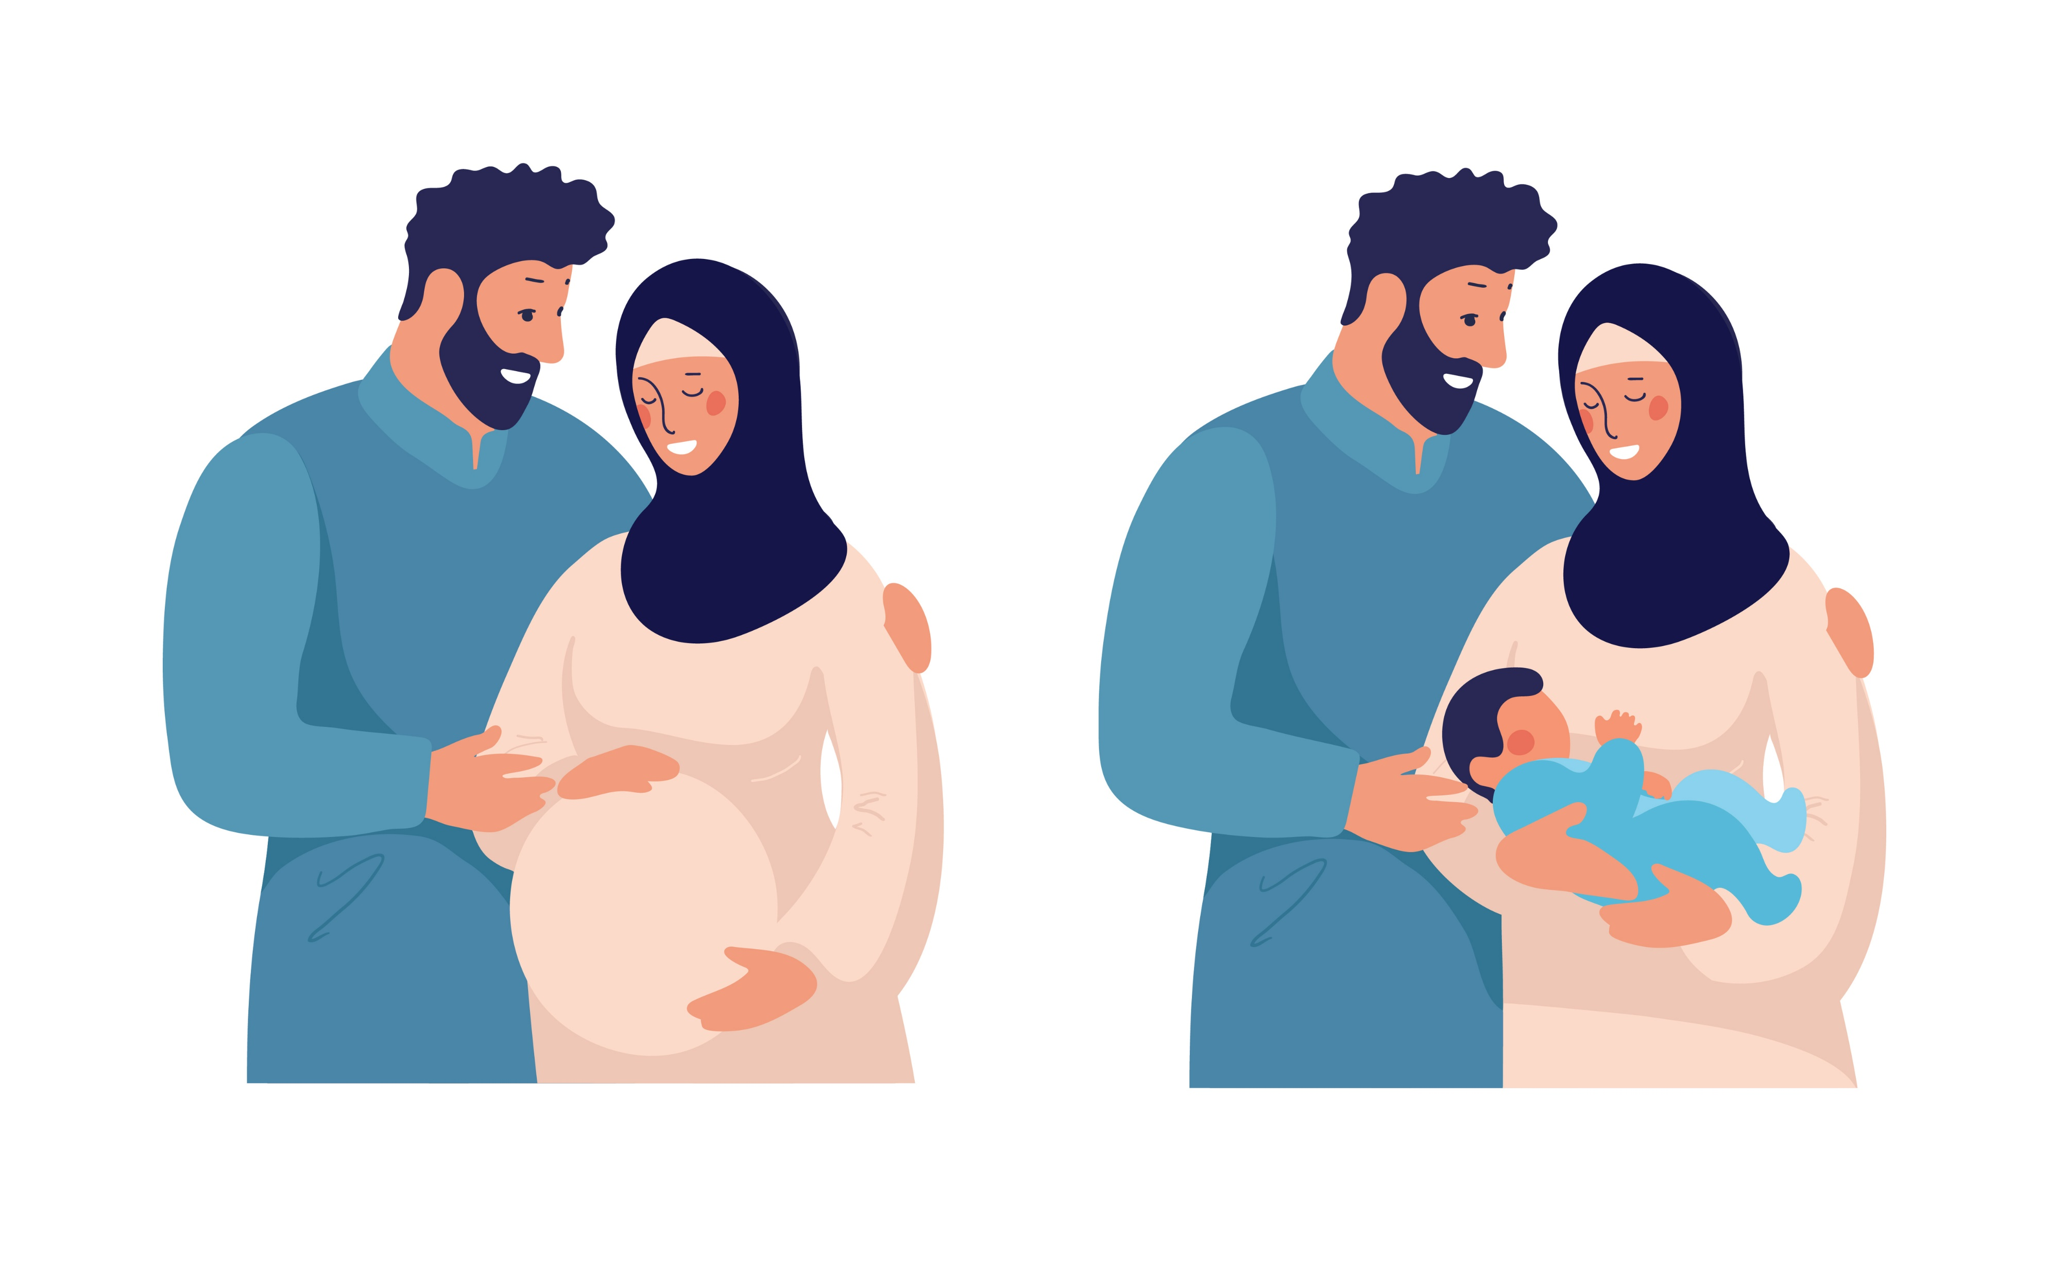
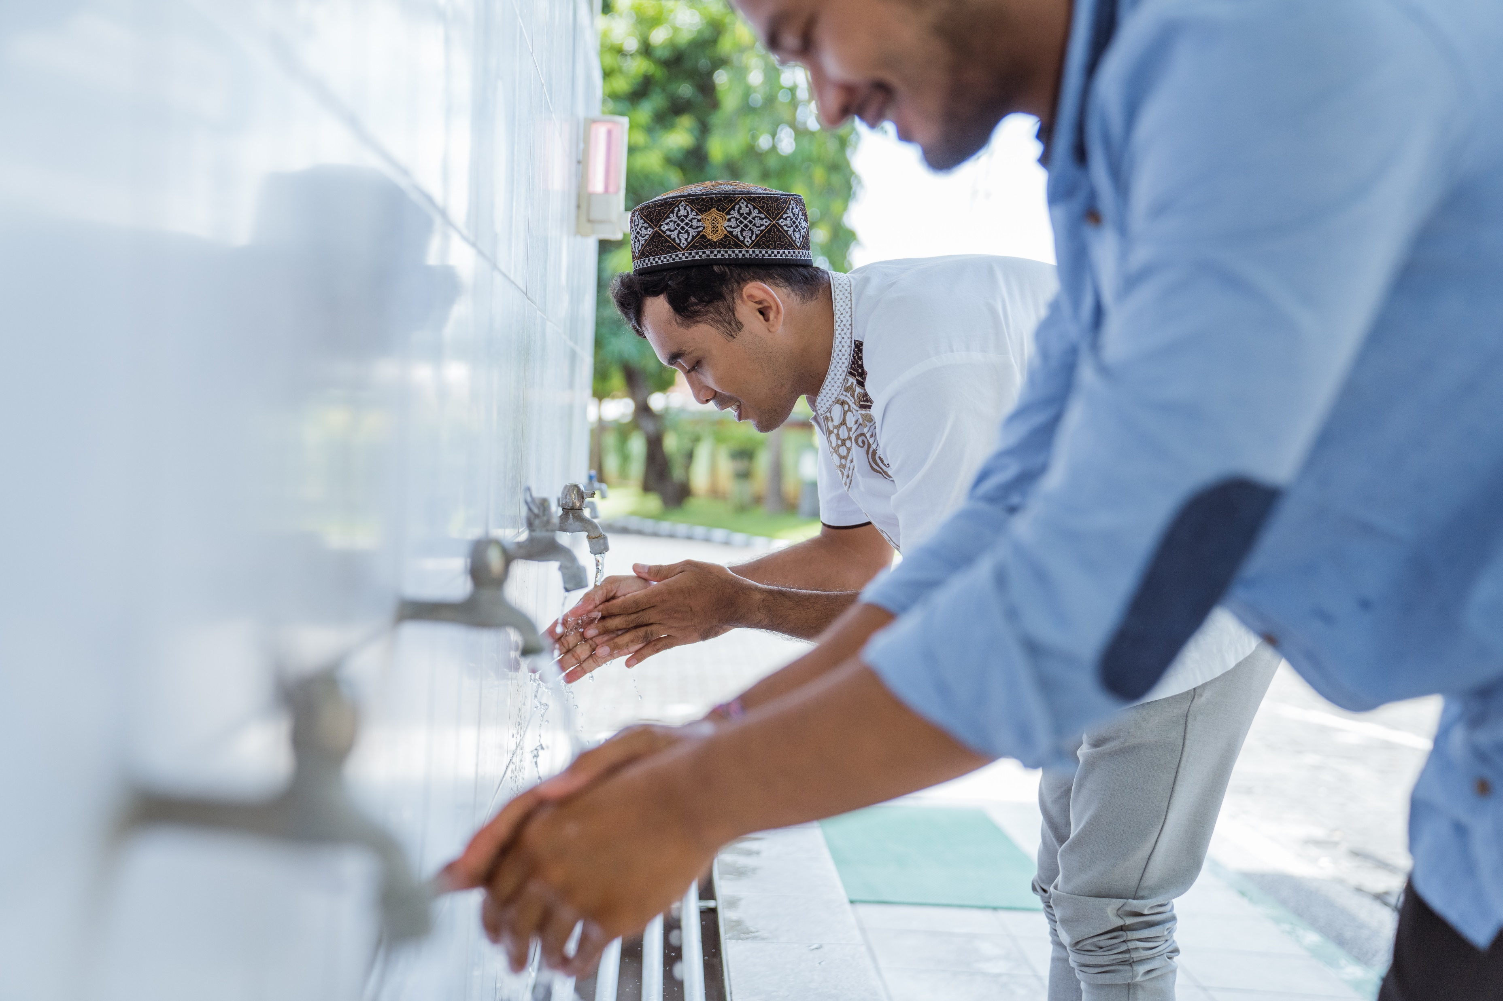
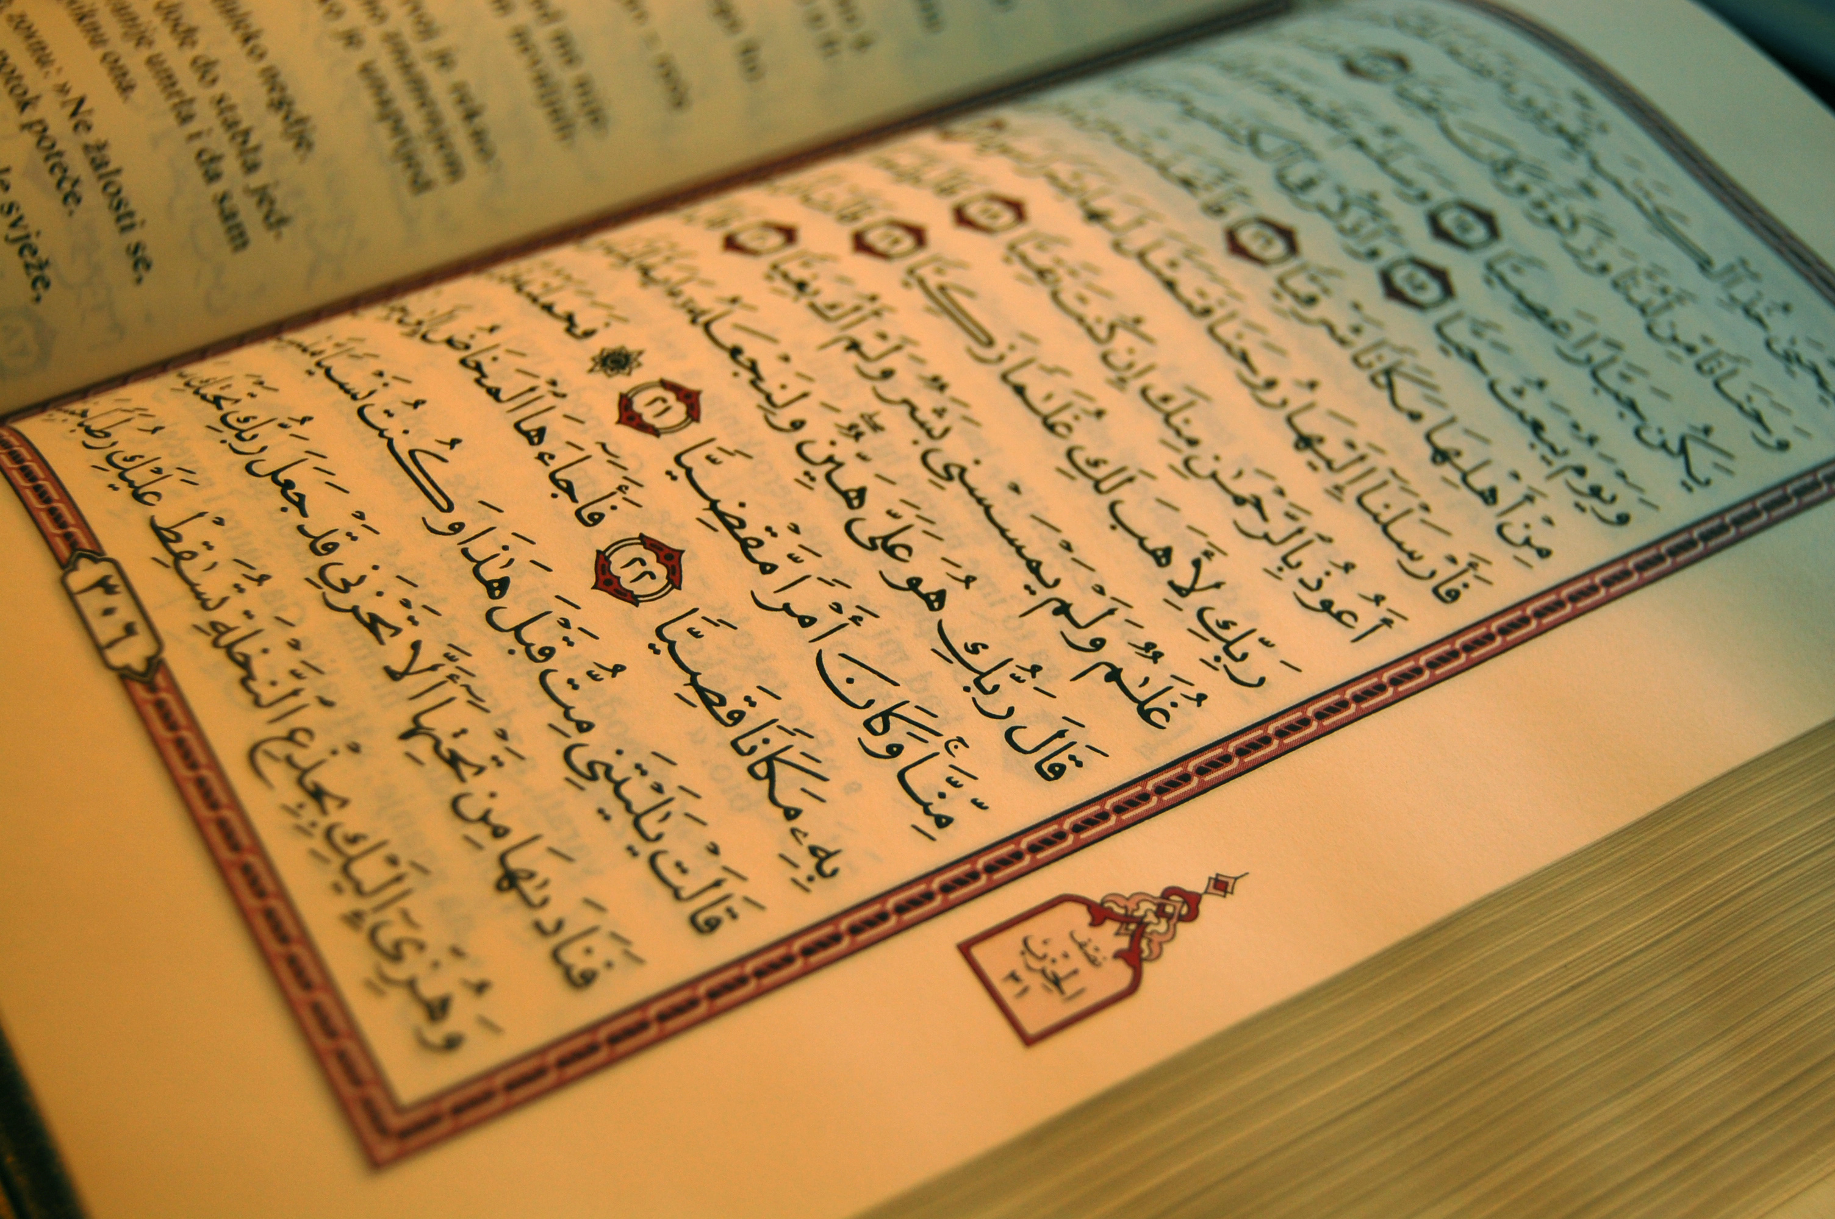
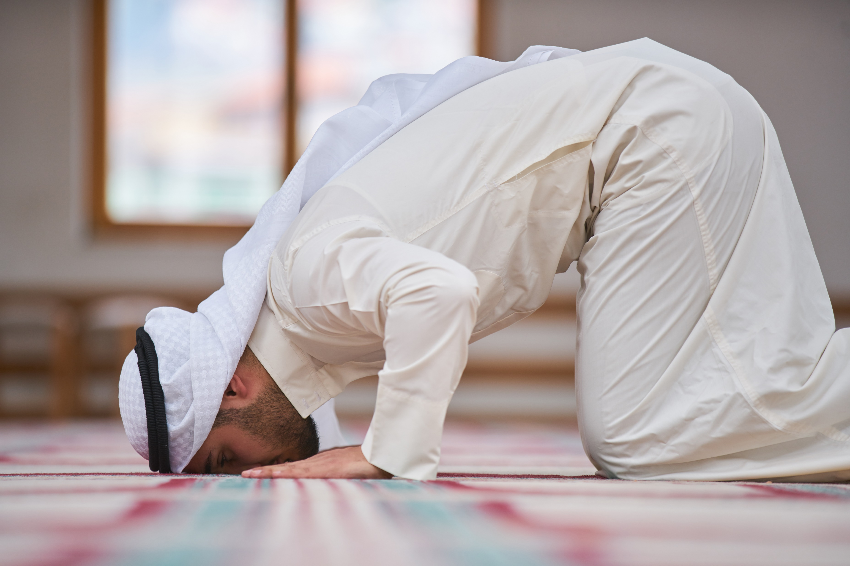
YEAR GROUP ONE
Background knowledge for teachers
CORE CONCEPT:
WAYS OF LIVING, VALUES AND COMMITMENTS
See the articles below on the ways of living, questions of values and commitments for Muslims.
Key things to note:
Birth Rites:
https://www.bbc.co.uk/religion/religions/islam/ritesrituals/birth.shtml
Prayer:
https://www.bbc.co.uk/religion/galleries/salah/
Wudu:
https://www.bbc.co.uk/religion/galleries/wudhu/
Extra things to note:
Basic articles of faith:
https://www.bbc.co.uk/religion/religions/islam/beliefs/beliefs.shtml
https://www.bbc.co.uk/religion/religions/islam/texts/quran_1.shtml

Slide 3
YEAR GROUP ONE
Lesson 1a: What do we know about Islam and what do we want to know?
CORE CONCEPT:
WAYS OF LIVING, VALUES AND COMMITMENTS
To note:
Allow 20 min - introductory lesson – knowledge gathering
Intention:
To give pupils opportunities to:
Talk about and ask questions related to the pictures and artefacts.
Share what knowledge they already have about Islam.
Key religious vocabulary: Islam, Muslim, Allah, prayer, wudu, prayer mat.
Implementation:
Outlining how to introduce the religious content in the classroom and create learning opportunities from it.
Introduction:
I wonder what we are going to be learning about this term?
Share with children a range of pictures/artefacts: (Photos can be found in appendix lesson 6 talking tub.)
Picture of Muslims praying
Picture/artefact of the Qur’an placed on a stand
Picture/object of a compass
Picture/artefact – prayer mat
Picture of Muslims carrying out wudu
Picture of a newborn baby having the Adhaan whispered into their right ear
Picture of Aqilah – welcoming ceremony
Symbol of Islam
The Arabic word for God – Allah
Gather from pupils their thoughts and what they can tell you about what they see. Record pupils’ responses as a record of pre-assessment – what we already know. Note down the name of the pupil against the response.
To note: Keep this pre-assessment as it will be required for lesson 6.

Slide 4
YEAR GROUP ONE
Lesson 1a: What do we know about Islam and what do we want to know?
CORE CONCEPT:
WAYS OF LIVING, VALUES AND COMMITMENTS
Implementation:
Outlining how to introduce the religious content in the classroom and create learning opportunities from it.
Main teaching input: (Investigate and explore)
Introduce some key religious vocabulary:
Islam
Muslim
Prayer
Wudu
Prayer mat
Allah (Arabic name for God) To note: Do address any misconception that some people refer to Allah as ‘their God’. This is a misconception and inaccurate.
Introduce the big question for the unit: What does it mean to be a Muslim?
Introduce this week’s question: What do we know about Islam and what do we want to know?
Explain to pupils that Muslims believe in one God. They have a Holy Book called the Qur’an. Prayer is very important to a Muslim. Islam is a way of life.
Plenary: (Reflect and express)
Key questions:
Does anyone know anything else about Islam? (Add to the class knowledge gathering document.)
Do you have any questions that you would like us to explore as we study this unit? Include pupils’ questions into the unit of learning.

Slide 5
YEAR GROUP ONE
Lesson 1a: What do we know about Islam and what do we want to know?
CORE CONCEPT:
WAYS OF LIVING, VALUES AND COMMITMENTS
Resources
Pictures and artefacts to stimulate discussion.
Appendix lesson 6 – talking tub.
Sensitivities
Ensure that artefacts are handled with respect and great care.
Ensure that the Qur’an is placed on a stand and on table.
Ensure no images of God or the prophet Muhammad (pbuh) are shown, as drawings of living things is prohibited in Islam.
Impact
What do you notice as a teacher?
What do pupils say?
In this box, note down anything that you heard a pupil say that would provide evidence towards their progress in RE.
Note down anything significant an additional adult has noticed.
Note down anything significant that happened in the lesson that will have an impact on the next lesson.

Slide 6
YEAR GROUP ONE
Lesson 1b: Why Is the Qur’an special to Muslims?
CORE CONCEPT:
WAYS OF LIVING, VALUES AND COMMITMENTS
Intention:
To give pupils opportunities to:
Know that the Qur’an was revealed to the prophet Muhammad (pbuh).
The Qur’an is the word of God for Muslims. It is written by the Creator.
The Qur’an was revealed in Arabic and is read in Arabic today.
Know how the Qur’an is looked after and the importance of treating it with respect and care.
Say what is special and important to them.
Key religious vocabulary: Qur’an, prophet Muhammad (pbuh), Arabic.
Implementation:
Outlining how to introduce the religious content in the classroom and create learning opportunities from it.
Introduction:
Recap on previous week’s learning.
Key knowledge checking:
Islam is a way of life.
Muslims believe in One God.
The holy book for Muslims is called the Qur’an.
Prayer is important in a Muslim’s life.
Allah is the Arabic word for God.
Key question:
Can you think of something that is very special to you?
How do you treat and look after this special thing?
To note: Pupils could be encouraged to bring in their special item or a photo of it. A ‘special table’ is set up in the classroom.

Slide 7
YEAR GROUP ONE
Lesson 1b: Why Is the Qur’an special to Muslims?
CORE CONCEPT:
WAYS OF LIVING, VALUES AND COMMITMENTS
Implementation:
Outlining how to introduce the religious content in the classroom and create learning opportunities from it.
Main teaching input: (Investigate and explore)
Introduce this week’s question: Why Is the Qur’an special to Muslims?
Play a recording of an Arabic reading of the Qur’an.
https://www.bbc.co.uk/bitesize/clips/z4fgkqt
Pause the clip at 0.53.
Show the pupils an image or artefact of the Qur’an and give some simple information about it. (Refer to background knowledge for teachers.)
Key things to note:
Muslims believe Muhammad (pbuh) was a prophet and received messages from God. These revelations were received over a period of 23 years and were delivered by the Angel Jibril (Gabriel).
The revelations form Al-Qu’ran (the Book), the sacred text of Islam.
The Qur’an is the word of God for Muslims. It is written by the Creator.
For many Muslims, the Qur’an provides meaning for life and gives guidance on how to live and how to behave.
The Qur’an was revealed in Arabic. Many Muslims believe it is only when it is read in Arabic can it fully be appreciated for its beauty.
Watch the video clip – Mohamed receiving the Qur’an. (A choice of two clips)
BBC Two - Watch, Celebrations, Islam, The Prophet Muhammad (pbuh), Allah and the Qur'an
Story of Quran Revelation - 4-6 age group
Recap the main teaching points from the clip checking for pupils’ understanding.

Slide 8
YEAR GROUP ONE
Lesson 1b: Why Is the Qur’an special to Muslims?
CORE CONCEPT:
WAYS OF LIVING, VALUES AND COMMITMENTS
Implementation:
Outlining how to introduce the religious content in the classroom and create learning opportunities from it.
Key questions:
Why do you think this holy book is treated with such care and respect?
Explain to pupils how the Qur’an must be treated and how it is taught. (Refer to background knowledge for teachers.)
Main activity: (Evaluate and communicate)
Key question:
Can you think of a story or book that is special to you?
Why is it so special to you?
Things to consider: What is the story/book about? Does it have a meaning? How does it make you feel when hear the story? Who first told you the story? Does that make the story even more special to you?
Share with pupils a book or story that is special to you and explain why.
Pupils are given six statements. In threes, pupils choose which three statement they think are the most important when it comes to showing care and respect for important stories and books. (See appendix lesson 1b)
Snowball: Pupils share their three statements with another group – do they agree or disagree. As a group of six, decide on three statements only.
Plenary: (Reflect and express)
Circle time
Key questions:
Why is the Qur’an special to Muslims?
How does a Muslim care for the Qur’an?
Why do Muslims treat the Qur’an with such respect?

Slide 9
YEAR GROUP ONE
Lesson 1b: Why Is the Qur’an special to Muslims?
CORE CONCEPT:
WAYS OF LIVING, VALUES AND COMMITMENTS
Resources
https://www.bbc.co.uk/bitesize/clips/z4fgkqt The reading of the Qur’an
BBC Two - Watch, Celebrations, Islam, The Prophet Muhammad (pbuh), Allah and the Qur'an
Story of Quran Revelation - 4-6 age group
Sensitivities
Ensure that artefacts are handled with respect and great care.
Ensure that the Qur’an is placed on a stand and on a table.
Impact
What do you notice as a teacher?
What do pupils say?
In this box, note down anything that you heard a pupil say that would provide evidence towards their progress in RE.
Note down anything significant an additional adult has noticed.
Note down anything significant that happened in the lesson that will have an impact on the next lesson.

Slide 10
YEAR GROUP ONE
Lesson 2: What do stories teach us about Muslim beliefs?
CORE CONCEPT:
WAYS OF LIVING, VALUES AND COMMITMENTS
Intention:
To give pupils opportunities to:
Know who the prophet Muhammad (pbuh) is.
Know and understand the meaning of an Islamic story and what Muslims can learn from the story.
Ask questions.
Know and explain which part of the story was most important to them.
Key religious vocabulary: Prophet Muhammad (pbuh).
Implementation:
Outlining how to introduce the religious content in the classroom and create learning opportunities from it.
Introduction:
Recap on previous week’s learning.
Key knowledge checking:
The Qur’an is the holy book for Muslims.
The Qur’an is special to Muslims because they believe it is the word of God.
The Qur’an was revealed to the prophet Muhammed (pbuh) and delivered by the Angel Jibril (Gabriel).
The Qur’an was written in Arabic and is best understood when read in Arabic.
The Qur’an is to be treated with the utmost respect and care.
Main teaching input: (Investigate and explore)
Introduce this week’s question: What do stories teach us about Muslim beliefs?
Introduce the prophet Muhammed (pbuh) to the pupils. (Refer to background knowledge for teachers.)
Explain to pupils that in Islam, stories are told that have a meaning behind them and often give an indication as to what many Muslims believe. They help people to understand how some Muslims choose to live their life. The teachings of the prophet Muhammed (pbuh) are often evident in these stories.

Slide 11
YEAR GROUP ONE
Lesson 2: What do stories teach us about Muslim beliefs?
CORE CONCEPT:
WAYS OF LIVING, VALUES AND COMMITMENTS
Implementation:
Outlining how to introduce the religious content in the classroom and create learning opportunities from it.
Recap on previous week’s learning when pupils reflected on a story/book that was important to them, reminding pupils of the reasons they gave as to why the story/book is important to them.
Share with pupils the story – the boy who threw stones at the tree. (See appendix lesson 2.)
To note: In the appendix you will find a creative storytelling process: step by step.
Key questions:
I wonder how the boy felt when he was told he’d damaged the date palm?
I wonder what would have happened if the farmer hadn’t forgiven him?
I wonder why the prophet Muhammed suggested this solution to the problem?
I wonder whether you have ever harmed something and regretted it?
Alternative stories that could be used:
https://www.bbc.co.uk/bitesize/clips/z9tqb82
The prophet and the ants.
The crying camel.
Key question:
What do you think the prophet’s message was?
How do you think the prophet wants humanity to treat all God’s living creatures?

Slide 12
YEAR GROUP ONE
Lesson 2: What do stories teach us about Muslim beliefs?
CORE CONCEPT:
WAYS OF LIVING, VALUES AND COMMITMENTS
Implementation:
Outlining how to introduce the religious content in the classroom and create learning opportunities from it.
Main activity: (Evaluate and communicate)
Pupils are given the opportunity to respond to the story creatively.
E.g.:
Pupils use collage or art materials to create a picture of the part of the story that they liked most/thought was the most important part.
Pupils use collage or art materials (these could include, modelling clay, plasticine, junk modelling) to make something the story has made them think about.
Teachers need to provide a range of materials for the pupils to access in order to get the best outcome.
The role of the teacher and teaching assistant, is to support the pupils and encourage them to talk through what they are doing and why they have decided to express themselves in the way they have.
Plenary: (Reflect and express)
Pupils return to the circle with their artwork. Pupils are encouraged to share their work with each other and explain what they have created.
Key questions:
How would you describe the prophet Muhammed (pbuh)?
What do think this story is trying to teach about caring for nature?
What do you think Muslims will learn from this story?
What have you learned from this story?
To note: These questions provide an opportunity for formative assessment to take place. Teachers to take note of pupils’ responses that demonstrate understanding and critical thinking.

Slide 13
YEAR GROUP ONE
Lesson 2: What do stories teach us about Muslim beliefs?
CORE CONCEPT:
WAYS OF LIVING, VALUES AND COMMITMENTS
Resources
Appendix lesson 2.
https://www.bbc.co.uk/bitesize/clips/z9tqb82
Range of collage and art materials.
Sensitivities
Ensure no images of God or the prophet Muhammad (pbuh) are drawn or created using art materials, as drawings of living things is prohibited in Islam.
Impact
What do you notice as a teacher?
What do pupils say?
In this box, note down anything that you heard a pupil say that would provide evidence towards their progress in RE.
Note down anything significant an additional adult has noticed.
Note down anything significant that happened in the lesson that will have an impact on the next lesson.

Slide 14
YEAR GROUP ONE
Lesson 3: How are Muslim babies welcomed into the world?
CORE CONCEPT:
WAYS OF LIVING, VALUES AND COMMITMENTS
Intention:
To give pupils opportunities to:
Know why it is important for Muslim parents that the Adhaan (call to prayer) is whispered in the right ear of the newborn baby,
Talk about the ceremonies that take place to welcome a baby and the reasons why they are important.
Tasting sweet food.
Shaving of the hair.
Welcoming ceremony – Aqilah.
Say what is important to them with respect to others feelings.
Key religious vocabulary: Adhaan, Aqilah.
Implementation:
Outlining how to introduce the religious content in the classroom and create learning opportunities from it.
Introduction:
Recap on previous week’s learning
Key knowledge checking:
The teachings of the prophet Muhammed (phub) are often explored through Islamic stories.
Key question:
What gift would you give a newborn baby? Can you explain the reason for your choice?
Main teaching input: (Investigate and explore)
Introduce this week’s question: How Are Muslim babies welcomed into the world?

Slide 15
YEAR GROUP ONE
Lesson 3: How are Muslim babies welcomed into the world?
CORE CONCEPT:
WAYS OF LIVING, VALUES AND COMMITMENTS
Implementation:
Outlining how to introduce the religious content in the classroom and create learning opportunities from it.
Watch the video clip below.
Key question:
I wonder what you think the father is going to whisper into the baby’s ear?
https://www.youtube.com/watch?v=lU3ywwtUSeI
This clip is the call to prayer (Adhaan) in which the father whispers the words of the call to prayer into the baby’s right ear.
"God is great, there is no God but Allah. Muhammad is the messenger of Allah. Come to prayer.“
Key question:
Why do you think for a Muslim parent it is important that these words are the first words that are whispered into a baby’s ears?
Watch the video clip below.
This clip below provides further explanation as to what some Muslim families do to welcome a baby into the world.
https://www.youtube.com/watch?v=ya5wYKKT4kc
Recap the main teaching points from the clips checking for pupils’ understanding. (Refer to background knowledge for teachers.)

Slide 16
YEAR GROUP ONE
Lesson 3: How are Muslim babies welcomed into the world?
CORE CONCEPT:
WAYS OF LIVING, VALUES AND COMMITMENTS
Implementation:
Outlining how to introduce the religious content in the classroom and create learning opportunities from it.
Main activity: (Evaluate and communicate)
Key questions:
What are the first words you would like said into a baby’s ear? Can you say why?
What gift would you give a baby? Can you say why?
Is there anything else you would choose to do to welcome a newborn baby into the world? Can you say why?
The teacher to model for the pupils what a high high-quality response would look like.
Pupils be given the opportunity to share their answers with another person.
Differentiate the activity accordingly.
Plenary: (Reflect and express)
Recap on the main teaching points.

Slide 17
YEAR GROUP ONE
Lesson 3: How are Muslim babies welcomed into the world?
CORE CONCEPT:
WAYS OF LIVING, VALUES AND COMMITMENTS
Resources
https://www.youtube.com/watch?v=lU3ywwtUSeI
https://www.youtube.com/watch?v=ya5wYKKT4kc
Sensitivities
Type sensitivities…
Impact
What do you notice as a teacher?
What do pupils say?
In this box, note down anything that you heard a pupil say that would provide evidence towards their progress in RE.
Note down anything significant an additional adult has noticed.
Note down anything significant that happened in the lesson that will have an impact on the next lesson.

Slide 18
YEAR GROUP ONE
Lesson 4 & 5: How, why and to whom do Muslims pray?
CORE CONCEPT:
WAYS OF LIVING, VALUES AND COMMITMENTS
To note: Two days before you teach lesson 5, each day when you ring the bell, pupils stand, face one direction and participate in a fitness routine to music for no more than 5 minutes. Do this 5 times during the day. At the end of each day ask pupils the following: How did you feel? Did it interrupt your day? Did you find it easier to learn afterwards? Would you choose to do that every day? (The aim of the task is to enable the pupils to experience something of what it means to be committed to something and the effort it requires.)
Intention:
To give pupils opportunities to:
Know why prayer is important to a Muslim.
Know why wudu is performed before prayer.
Know how the prayer is performed actions, direction and place.
Key religious vocabulary: Salah, wudu, Makkah, Ka’bah.
Implementation:
Outlining how to introduce the religious content in the classroom and create learning opportunities from it.
Introduction:
Recap on previous week’s learning.
Key knowledge checking:
To know why it is important for Muslim parents that the words of the Adhaan are the first words a baby hears.
To be able to talk about the other ceremonies that take place to welcome a baby and the reasons why they are important.
Main teaching input: (Investigate and explore)
Introduce this week’s question: How, why and to whom do Muslims pray?
Show children a prayer mat and a compass and discuss with the pupils what they think these things are used for and where they might have seen them before.
Key questions:
Are there times in the day when you are really quiet and still?
Are there times in the day when you might pray or you hear or see other people praying?
What do you think prayer is?

Slide 19
YEAR GROUP ONE
Lesson 4 & 5: How, why and to whom do Muslims pray?
CORE CONCEPT:
WAYS OF LIVING, VALUES AND COMMITMENTS
Implementation:
Outlining how to introduce the religious content in the classroom and create learning opportunities from it.
Preparing for prayer:
Key questions:
Why and when do you wash?
Can you think of a special occasion when you might wash and dress up? Why do you think you do this? (Going to a party, wedding, a special meal out, going to a place of worship for a service. Why - to show respect, to show you commitment to the occasion.)
Watch a video clip of a Muslim family carrying out wudu. Two examples – carrying out wudu at home and at the Mosque.
https://www.bbc.co.uk/programmes/p0114y8q
https://www.bbc.co.uk/programmes/p02mwhw0
Recap the main teaching points from the clip checking for pupils’ understanding. (Refer to background knowledge for teachers.)
Main activity: (Evaluate and communicate)
Pupils’ complete appendix lesson 4. Preparing for prayer. (Pupils if they prefer can design their own diagram.)
Extension: Pupils complete the following sentence: Performing wudu is important for many Muslims because……
Plenary: (Reflect and express)
Recap main teaching points.
Key question:
Why is it encouraged to perform wudu before prayer?
How do you feel when you wash and dress up for a special occasion? Do you think washing and dressing up makes a difference?

Slide 20
YEAR GROUP ONE
Lesson 4 & 5: How, why and to whom do Muslims pray?
CORE CONCEPT:
WAYS OF LIVING, VALUES AND COMMITMENTS
Implementation:
Outlining how to introduce the religious content in the classroom and create learning opportunities from it.
Lesson 5:
Recap on previous week’s learning.
Key knowledge checking:
Wudu is a washing ritual that helps prepare Muslims for prayer. Being physically clean helps you to also feel clean inside.
Muslims pray to be near to God/to communicate with him.
Watch the video clips of a Muslim family praying
https://www.bbc.co.uk/bitesize/clips/z4gkq6f
Watch the video clip that explains the actions and words that are carried out and said during the prayer.
Prayer:
Recap the main teaching points from the clip checking for pupils’ understanding. (Refer to background knowledge for teachers.)
Key questions:
Why do Muslims pray?
Where do they pray?
How many times a day do most practising Muslims pray?
Which direction does a Muslim face when praying and what is the reason for facing this way?
Discuss how the class felt about exercising 5 times a day – how easy did they find this? Did it help them to concentrate better? Did it get easier? When did it feel most difficult to do?
Explain to pupils that for a Muslim the most important thing to do is to communicate to God, to give thanks to God and to submit to God. Prayer therefore is the most important thing a Muslim can do.

Slide 21
YEAR GROUP ONE
Lesson 4 & 5: How, why and to whom do Muslims pray?
CORE CONCEPT:
WAYS OF LIVING, VALUES AND COMMITMENTS
Implementation:
Outlining how to introduce the religious content in the classroom and create learning opportunities from it.
Main activity:
Key question:
What three things do you think praying five times a day will help Muslims with?
Complete appendix lesson 5.
Plenary: (Reflect and express)
Recap key teaching points.
True or false:
The main reason Muslims pray is to be near to and communicate with God.
Many Muslims pray three times a day.
Muslims can pray anywhere.
Muslims can only pray if they have a prayer mat with them.
Muslims can face any way they want when praying.
Muslims must perform wudu before they pray.

Slide 22
YEAR GROUP ONE
Lesson 4 & 5: How, why and to whom do Muslims pray?
CORE CONCEPT:
WAYS OF LIVING, VALUES AND COMMITMENTS
Resources
Appendix lesson 4
Appendix lesson 5
Clips showing wudu:
https://www.bbc.co.uk/programmes/p0114y8q
https://www.bbc.co.uk/programmes/p02mwhw0
Clips showing prayer: https://www.bbc.co.uk/bitesize/clips/z4gkq6f
Sensitivities
Type sensitivities…
Impact
What do you notice as a teacher?
What do pupils say?
In this box, note down anything that you heard a pupil say that would provide evidence towards their progress in RE.
Note down anything significant an additional adult has noticed.
Note down anything significant that happened in the lesson that will have an impact on the next lesson.

Slide 23
YEAR GROUP ONE
Lesson 6: What does it mean to be a Muslim?
CORE CONCEPT:
WAYS OF LIVING, VALUES AND COMMITMENTS
Intention:
To give pupils opportunities to:
Know and remember knowledge learnt in the unit of learning.
Make connections.
Ask questions.
Key religious vocabulary: Recap all key vocabulary taught in the unit.
Implementation:
Outlining how to introduce the religious content in the classroom and create learning opportunities from it.
Formative assessment lesson:
Return to the big question of the unit: What does it mean to be a Muslim?
Options:
Pupils work in groups of three.
Pupils work in groups of three with some pupils working with a teaching assistant.
Pupils work as a whole class.
Pupils work in two groups – one led by the class teacher and one led by a teaching assistant.
To note: The role of the teacher during the task is to listen to pupils’ responses, to ask follow up questions and to address any misconceptions.

Slide 24
YEAR GROUP ONE
Lesson 6: What does it mean to be a Muslim?
CORE CONCEPT:
WAYS OF LIVING, VALUES AND COMMITMENTS
Implementation:
Outlining how to introduce the religious content in the classroom and create learning opportunities from it.
Each group is given a ‘talking tub’ that consists of the following: (See appendix lesson 6.)
Picture of Muslims praying
Picture/artefact of the Qur’an placed on a stand
Picture of the story told in lesson 3
Picture/object of a compass
Picture/artefact – prayer mat
Picture of a newborn baby having the adhaan whispered into their ear
The newborn baby being given something sweet to taste.
Picture of Aqilah – welcoming ceremony
Symbol of Islam
The Arabic word for God – Allah
The name of the prophet Muhammed (pbuh)
Pupils are encouraged to complete the following steps: You may wish to simplify these tasks or just do one of the steps.
Step 1:
Pupils are given the opportunity to talk about each artefact/photo in the tub. What can they remember from the unit of learning? Pupils are encouraged throughout to use religious vocabulary in their talk and conversation.
Step 2:
On strips of paper, pupils write down what they believe the key knowledge is for each item, using appropriate religious vocabulary.
Step 3:
On a different coloured strip of paper, pupils write down any links/connections they can make/see between the items. Alternatively, pupils group pictures and artefacts they believe go together and say why. Eg: Link between the Qur’an and the prophet Muhammed (pbuh). Link between the story and the prophet Mohammed (pbuh). Link between the picture of Muslims praying, the prayer mat and the compass. The link between the baby having the words of the adhaan whispered in their ear, tasting of sweet food and the Aqilah.
Step 4:
On speech bubbles, children write down any questions they still have related to the big question?

Slide 25
YEAR GROUP ONE
Lesson 6: What does it mean to be a Muslim?
CORE CONCEPT:
WAYS OF LIVING, VALUES AND COMMITMENTS
Implementation:
Outlining how to introduce the religious content in the classroom and create learning opportunities from it.
Plenary: (Reflect and express)
Return to the question: What does it mean to be a Muslim?
Ensure the following knowledge is secure:
Islam is a way of life.
Muslims believe that there is One God and that the prophet Muhammed (pbhuh) is his messenger.
The Qur’an is the holy book for Muslims. Muslims believe it to be the word of God.
Babies are welcomed into the world by having the adhaan recited into their right ear.
Prayer is very important to a Muslim’s daily life and for many Muslims takes place five times a day,
The teacher addresses any misconception they have noted during the task.
To note: Compare the knowledge children shared through the task from what they shared in lesson 1. KQ: Can you see evidence of pupil progress?

Slide 26
YEAR GROUP ONE
Lesson 6: What does it mean to be a Muslim?
CORE CONCEPT:
WAYS OF LIVING, VALUES AND COMMITMENTS
Resources
Talking tub – appendix lesson 6.
Sensitivities
Type sensitivities…
Impact
What do you notice as a teacher?
What do pupils say?
In this box, note down anything that you heard a pupil say that would provide evidence towards their progress in RE.
Note down anything significant an additional adult has noticed.
Note down anything significant that happened in the lesson that will have an impact on the next lesson.

Slide 27
London Diocesan Board for Schools
www.ldbs.co.uk 020 7932 1100
London Diocesan Board for Schools is a Charitable Company Limited by Guarantee. Company Registration No 198131. Charity Registration No 313000.
Registered Address: London Diocesan House, 36 Causton Street, London, SW1P 4AU
© Copyright London Diocesan Board for Schools 2023
All rights reserved. No part of these slides may be reproduced, stored in a retrieval system or transmitted in any form or by any other means, electronic or mechanical photocopying, recording or otherwise without the prior written permission of the London Diocesan Board for Schools. These slides may not be lent, resold, hired out or otherwise disposed of by way of trade without the prior consent of the London Diocesan Board for Schools.

