Slide 1
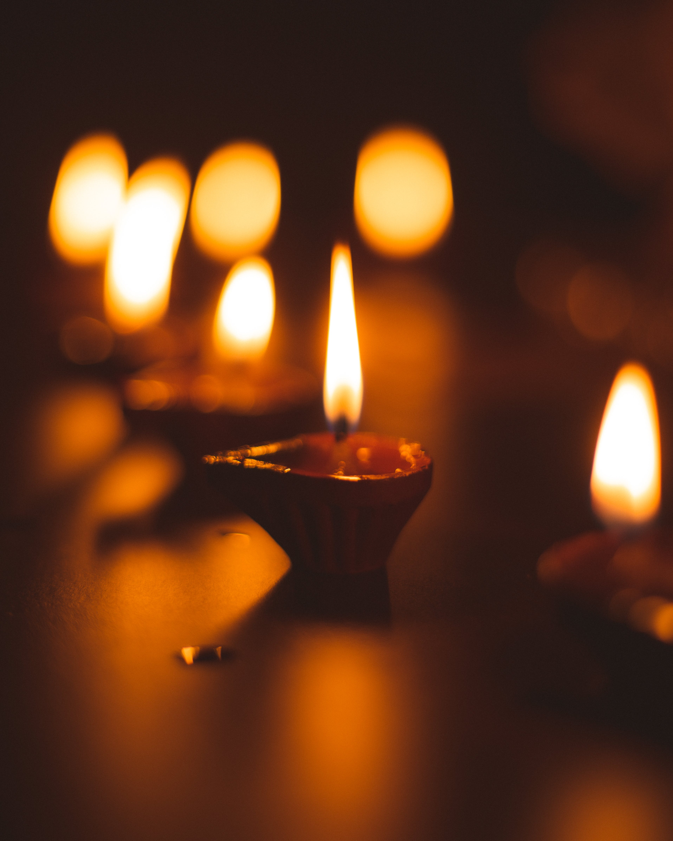
What does it mean to die as a Hindu?

Slide 2
https://www.youtube.com/watch?v=Uq6_HUMtQtI

Slide 3
“As a man casts off worn-out garments and puts on new ones, so the embodied atman casts off the worn-out body and enters other new ones.”
Hindu holy book

Slide 4
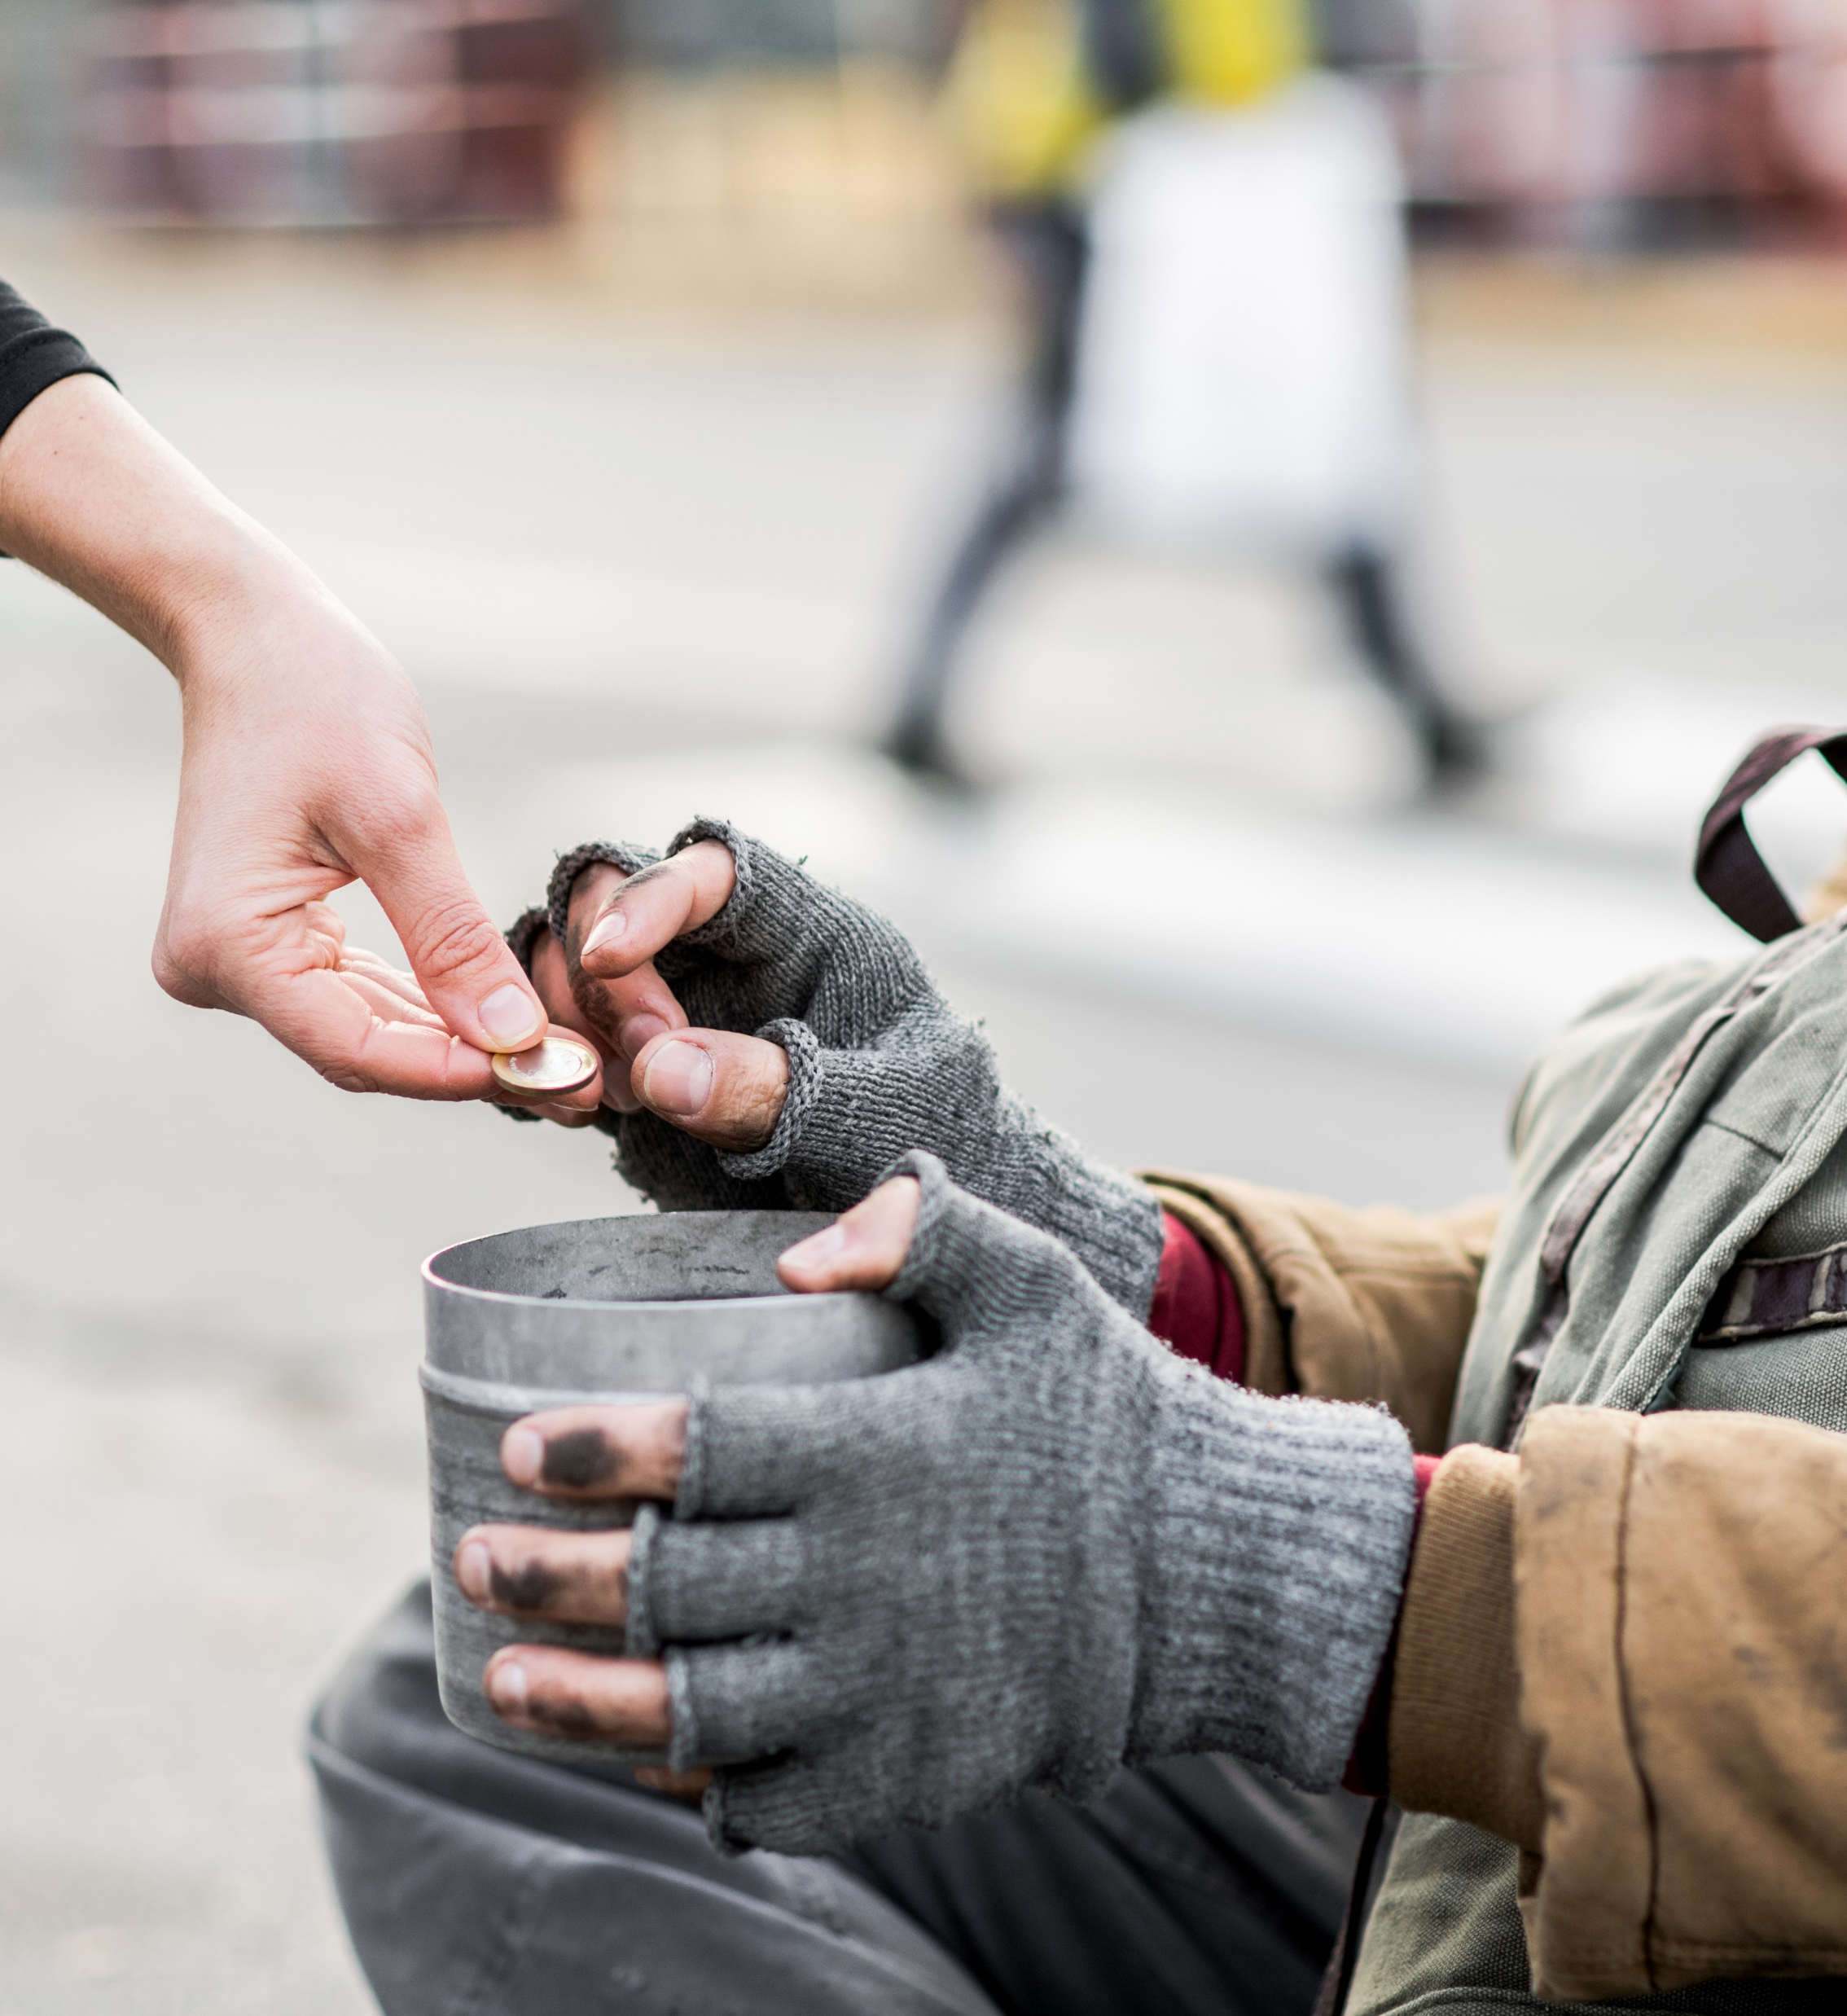
“The reward for a good deed performed in this life will be enjoyed in the next.”
Hindu holy book

Slide 5
Most Hindus prefer to die at home surrounded by family.

Slide 6
A small drop of holy water may be put in the dying person’s mouth and scripture is read.

Slide 7
The dead person’s body is washed, anointed with sandalwood paste and wrapped in a white shroud.

Slide 8
To guide the departed atman (soul) on its journey, a small lamp is lit.

Slide 9
Most Hindus are cremated, and their ashes sprinkled in a river.

Slide 10
Twelve days after the funeral offerings of rice and milk are made. Once this has happened the person’s soul is believed to have been rehoused in another form or body.

