Slide 1
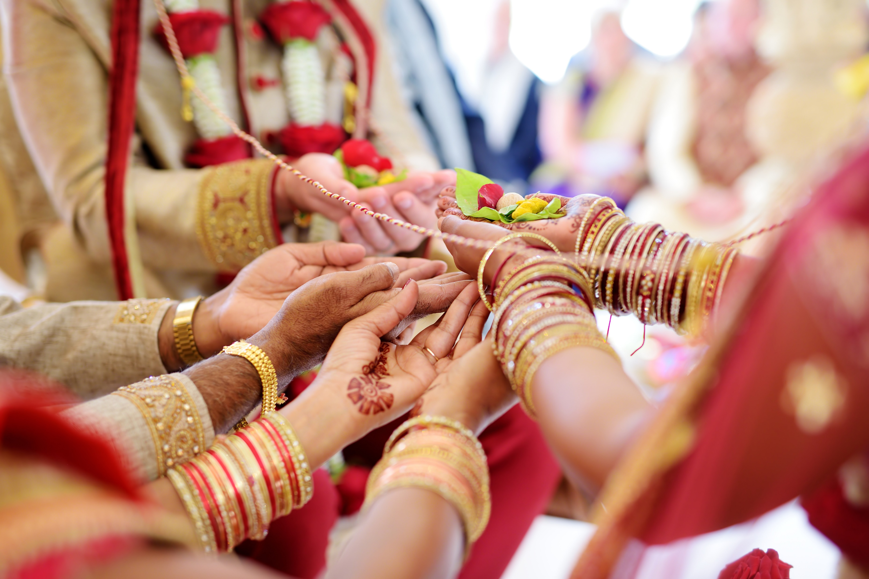
What does it mean to have a Hindu wedding?

Slide 2
https://www.youtube.com/watch?v=rs83rrB5E4E&list=PLcvEcrsF_9zLN3DArb_4G8Y5EHbSTRLDL&index=6

Slide 3
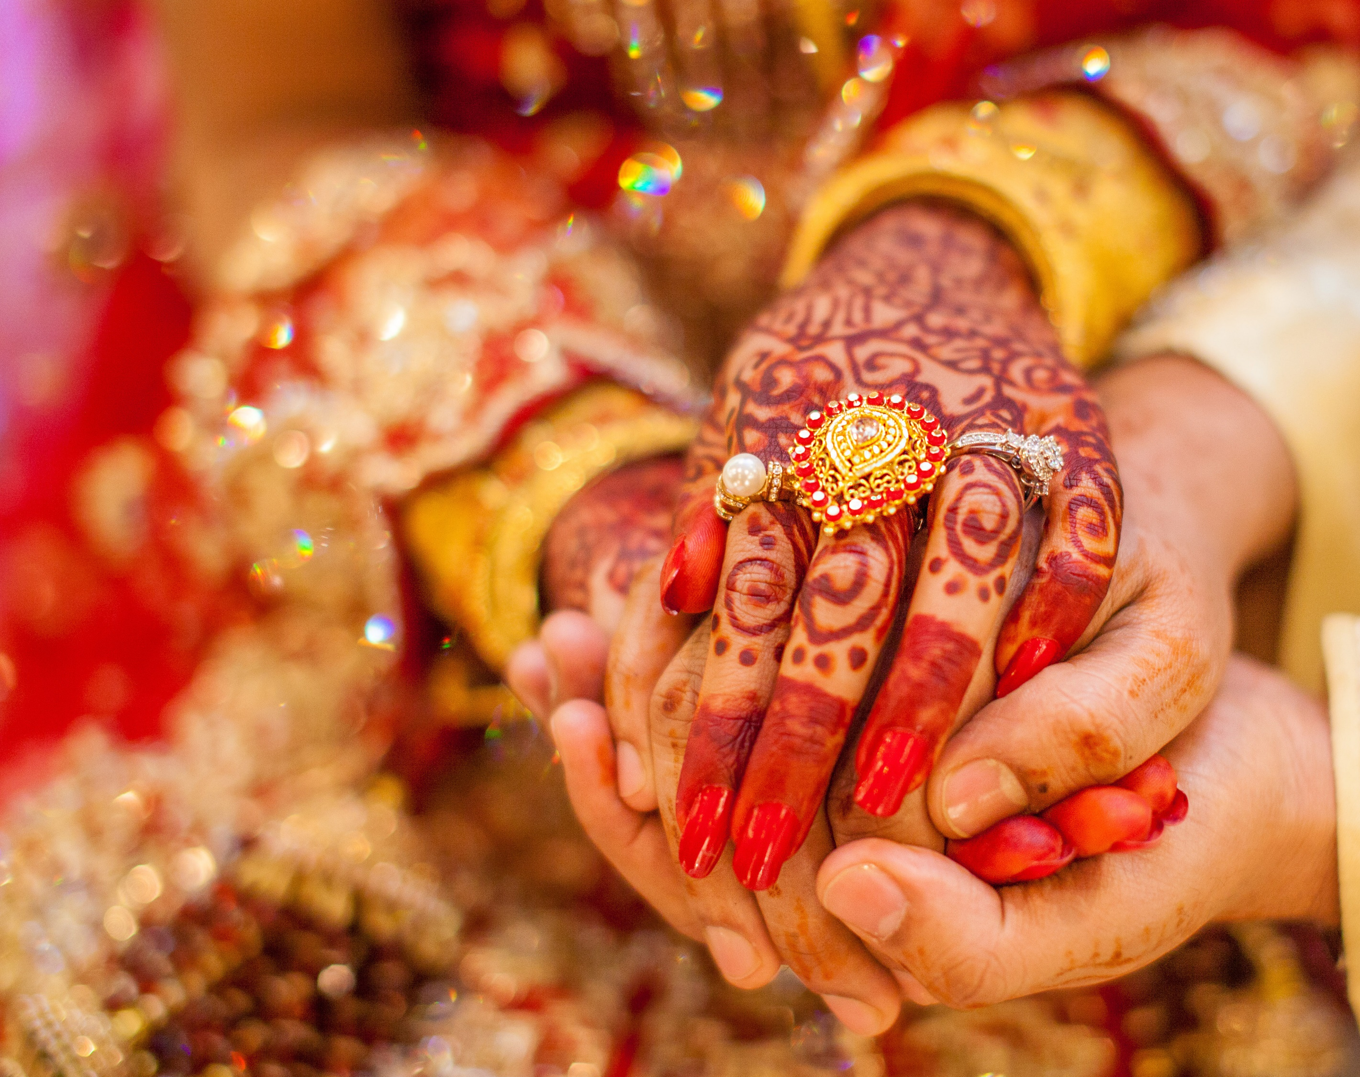
Kanyadaan – the bride is given to the groom and their hands are tied

Slide 4
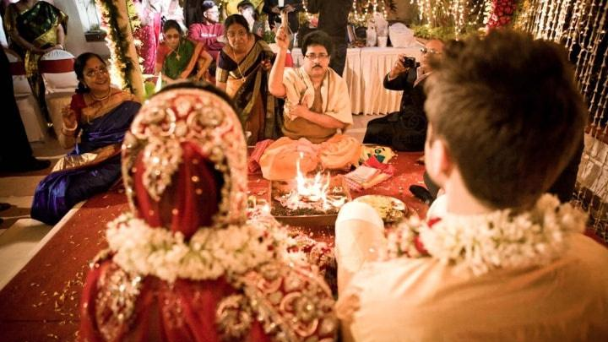
What can you see?
Image credit:
https://m.weddingz.in/real-weddings/sushmita-ross/

Slide 5
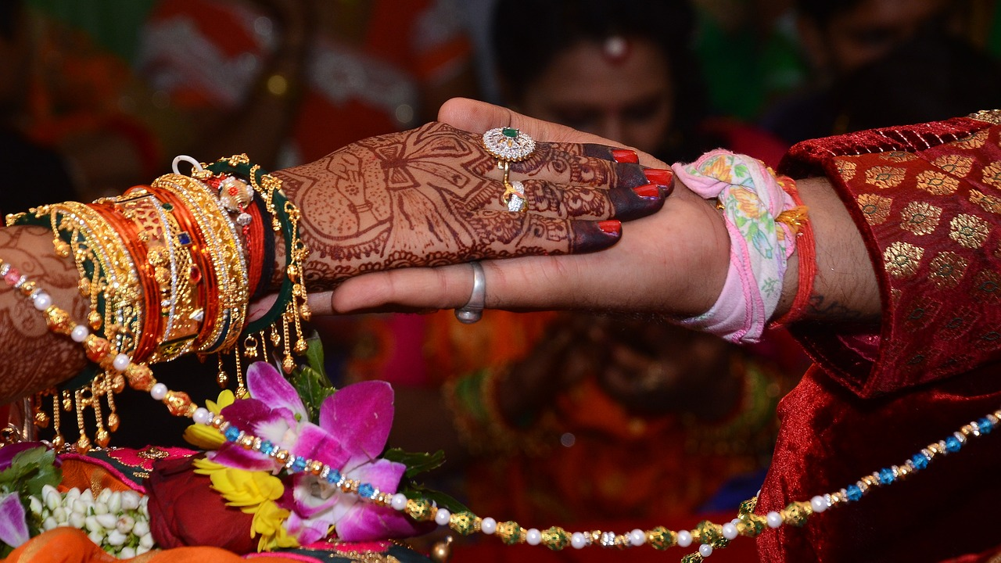
The bride and groom may be tied at the wrist or their garments may be tied together. Why do you think this is?

Slide 6
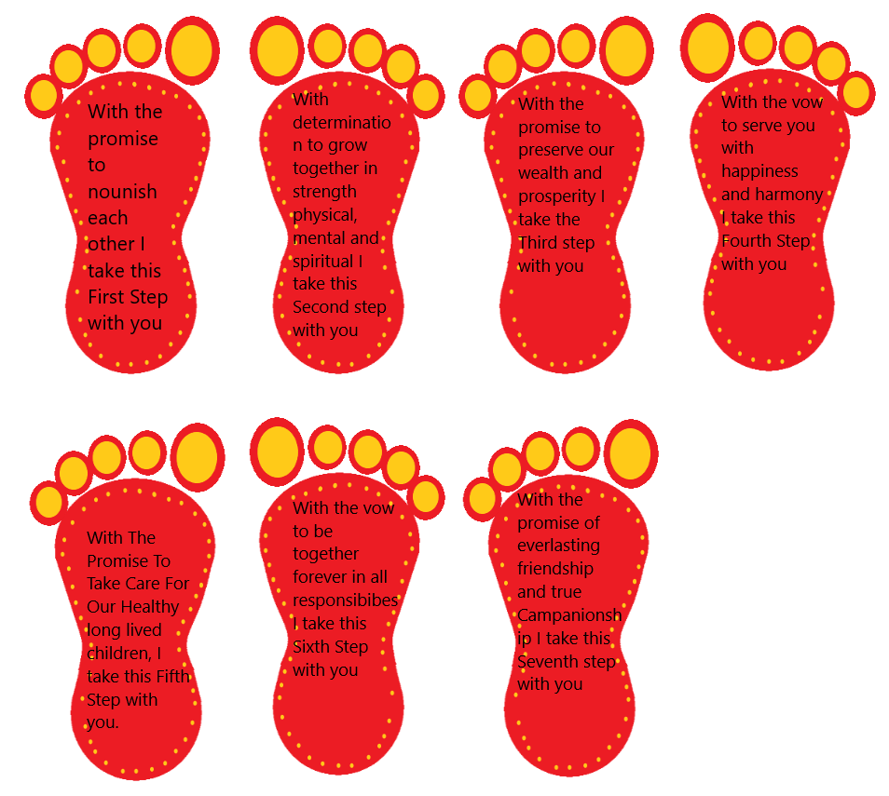
The seven steps

Slide 7
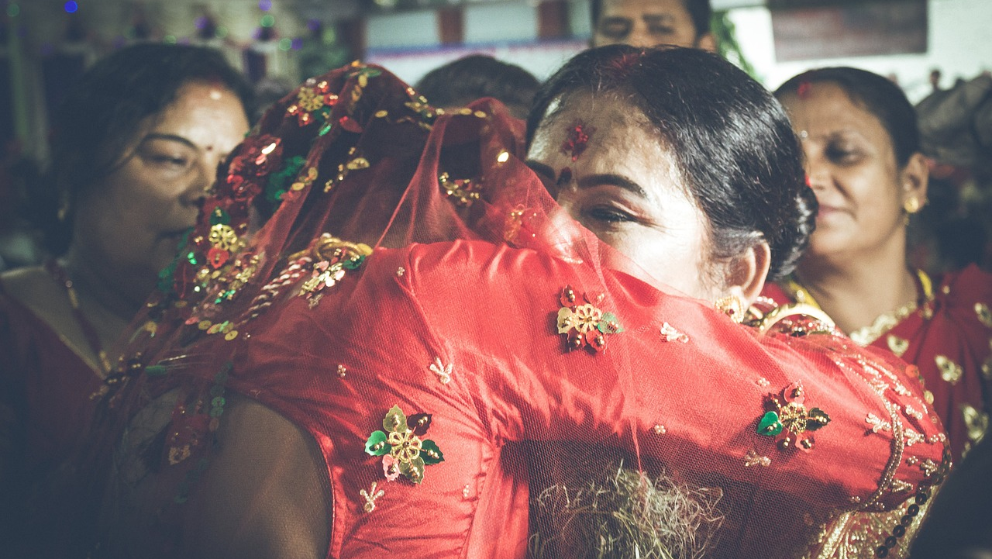
After the ceremony there is a reception

