Slide 1
What does it mean for a Hindu to live with a belief in ahimsa?

Slide 2
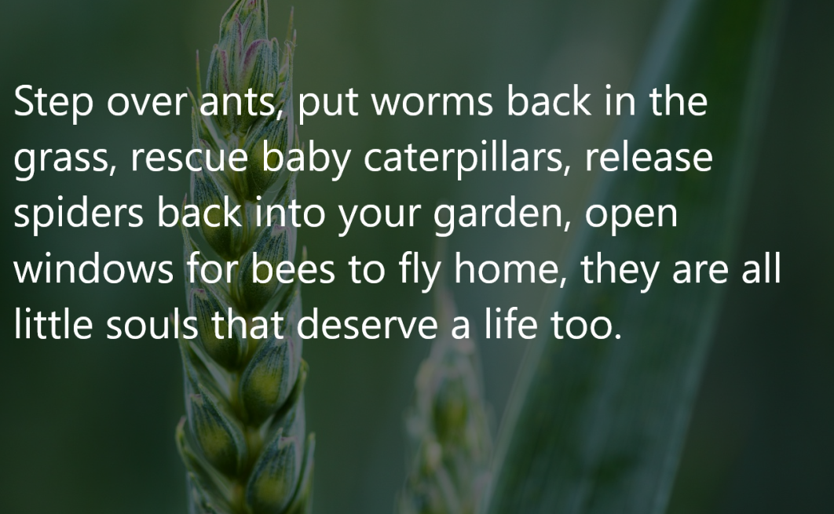
Do you agree? Why/why not?

Slide 3
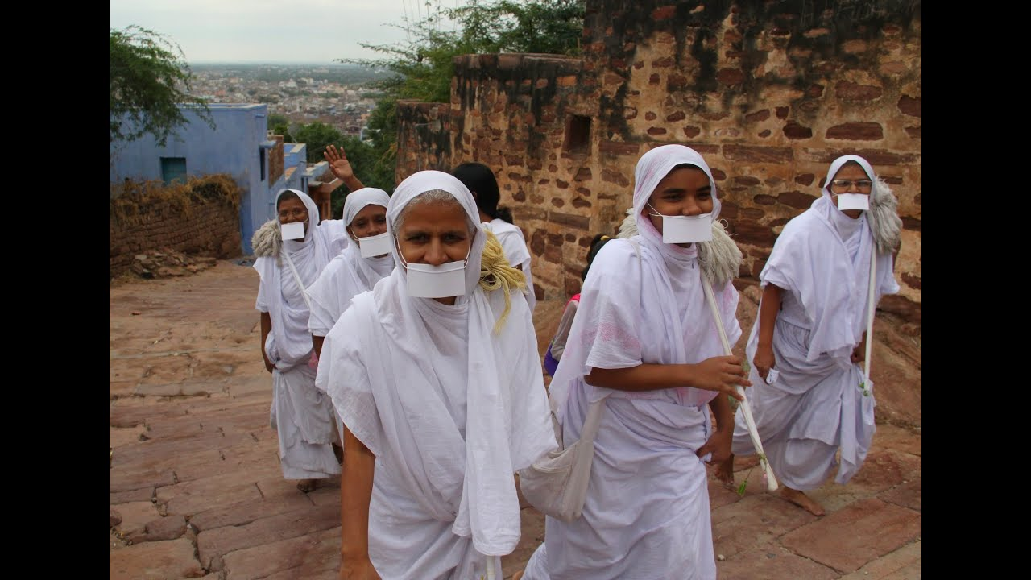
What do you notice in this picture?
Photo from Open Source

Slide 4
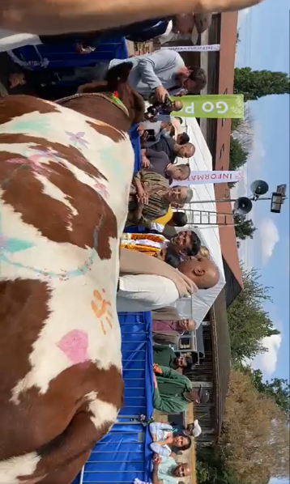
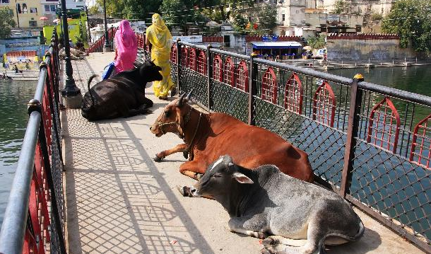
Cows are cared for by Hindus in Watford, UK and also in India
Celebrating cow day, UK
Cows in a city in India
Credit: Mairan Sewtahal Video screengrab from https://twitter.com/i/status/1561059639634042886

Slide 5
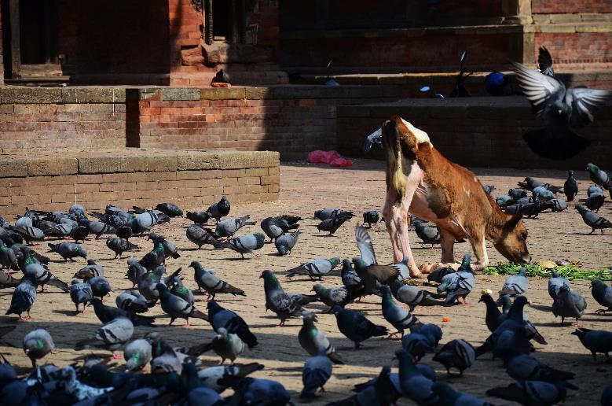
Caring for all creatures

Slide 6
Caring for people

