Slide 1
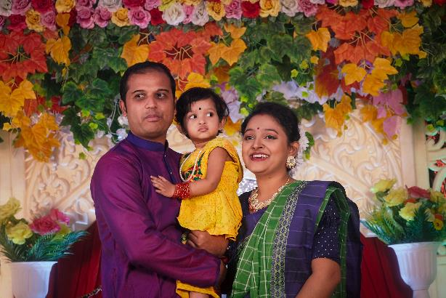
What does it mean to be born into a Hindu family?

Slide 2
Special prayers called samskars are prayed before the baby is born

Slide 3
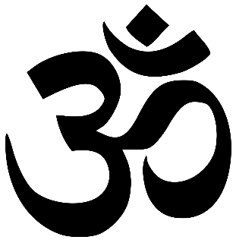
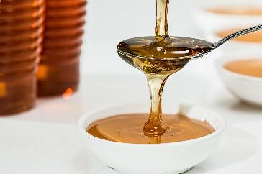
The father writes the aum symbol on the baby’s tongue in honey.

Slide 4
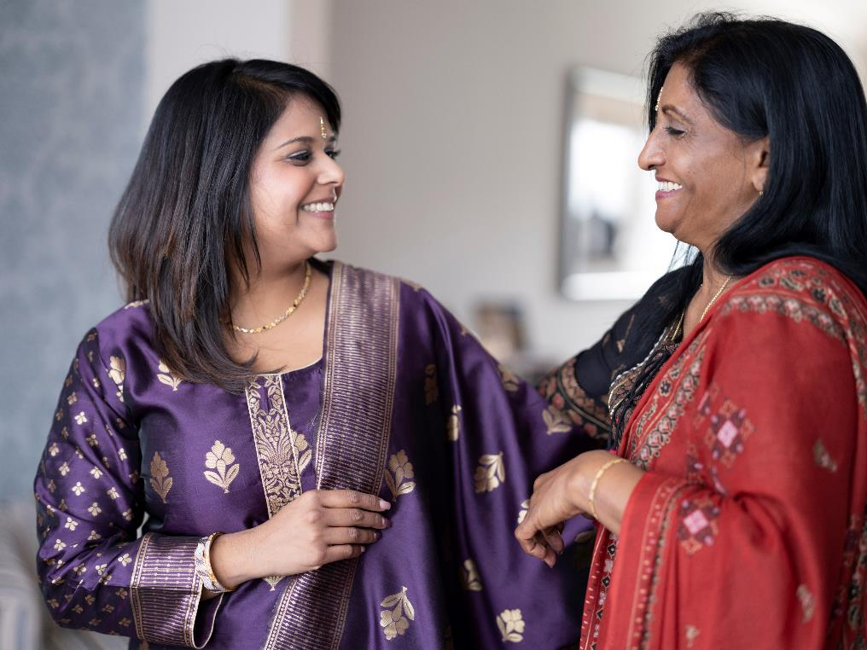
The oldest woman in the family announces the baby’s name.

Slide 5
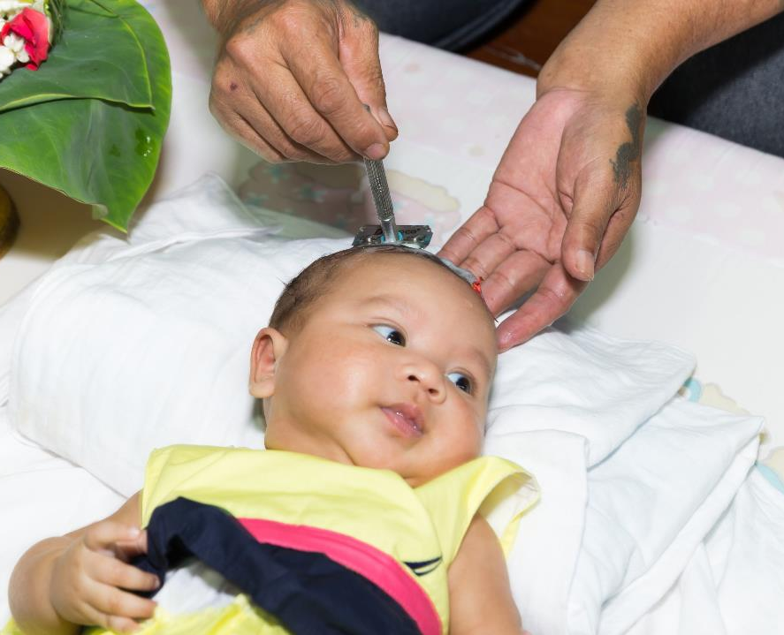
The baby has their head shaved to symbolise the removal of bad karma from their previous life.

Slide 6
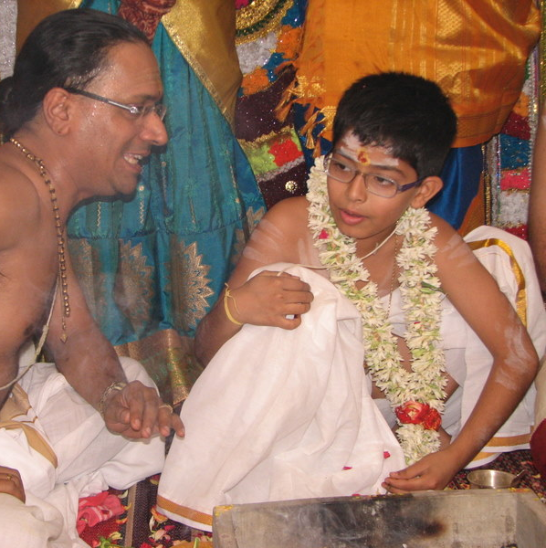
The Upanayana – Sacred thread ceremony
Credit: https://sankriti.blogspot.com/2012/07/upanayanam-or-sacred-thread-ceremoney.html

Slide 7
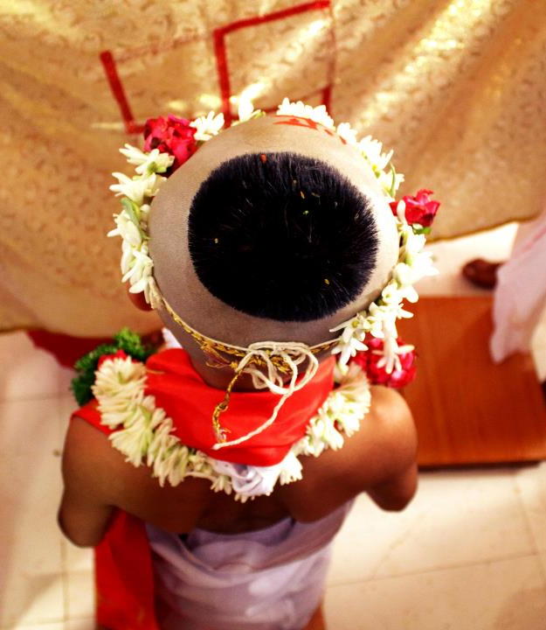
This ceremony is performed between the ages of 8 and 12. It marks the end of being a child and the start of being an adult in Hinduism.

Slide 8
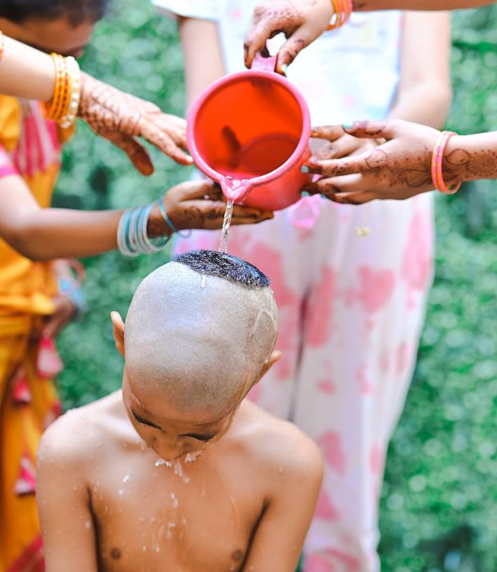
First the Hindu child bathes and their head is shaved. What might they be feeling as their head is shaved?

Slide 9
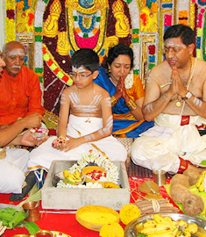
Next, they put on new clothes and receive money or gifts from relatives. What might they be feeling now?

Slide 10
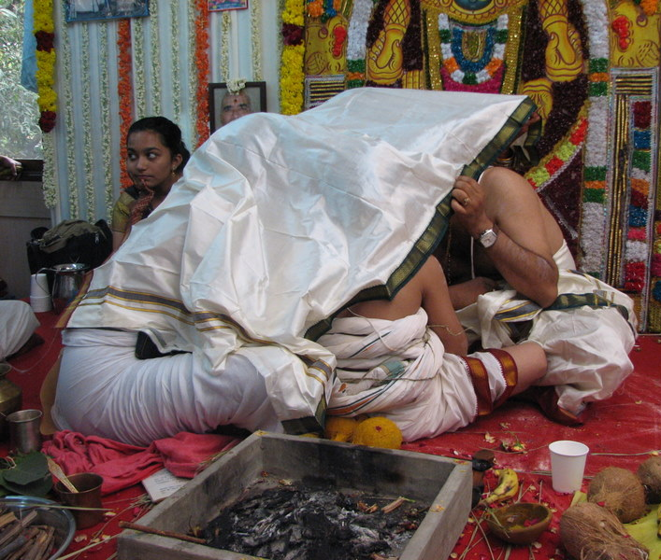
The guru (spiritual teacher says a special prayer which the child has to say three times a day.
Credit: https://sankriti.blogspot.com/2012/07/upanayanam-or-sacred-thread-ceremoney.html

Slide 11
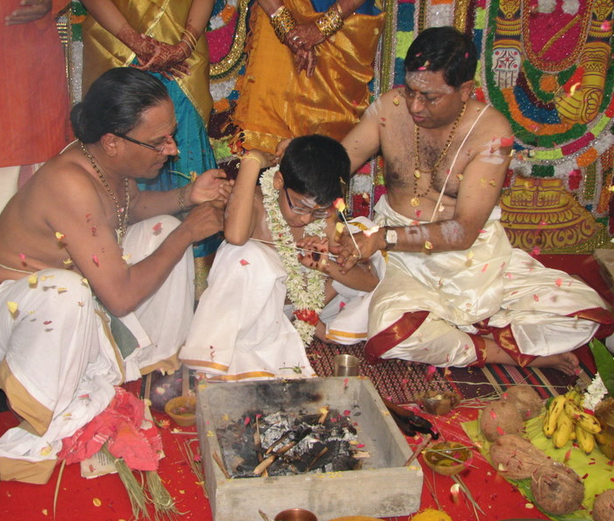
The three strands of the sacred thread are placed over the shoulder. The strands remind them of: - Duties to God - Duties to ancestors - Duties to their guru (religious teacher)
Credit: https://sankriti.blogspot.com/2012/07/upanayanam-or-sacred-thread-ceremoney.html

Slide 12
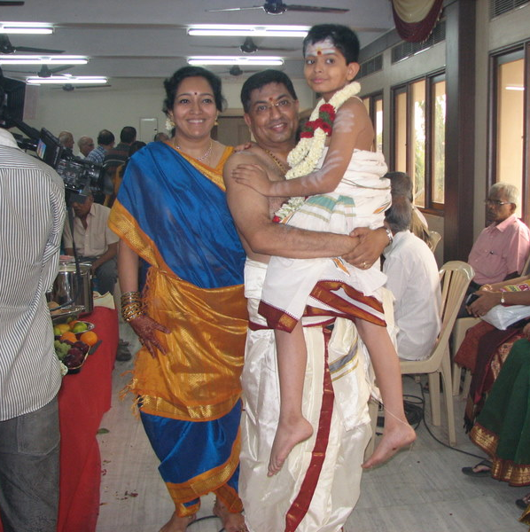
The child promises to study the Vedas (holy books) with the help of their guru.
Credit: https://sankriti.blogspot.com/2012/07/upanayanam-or-sacred-thread-ceremoney.html

