Slide 1
What does it mean for a Hindu to live with a belief in dharma and karma?

Slide 2
The Hindu cycle of birth, death and rebirth is called samsara.

Slide 3
Hindus believe in reincarnation. You keep being reborn, this may be as a human, an animal or plant.

Slide 4
Hindus hope to escape the constant wheel, going round and round. Moksha, becoming one with God, is freedom from the wheel of samsara.

Slide 5
What keeps you attached to the wheel of samsara?

Slide 6
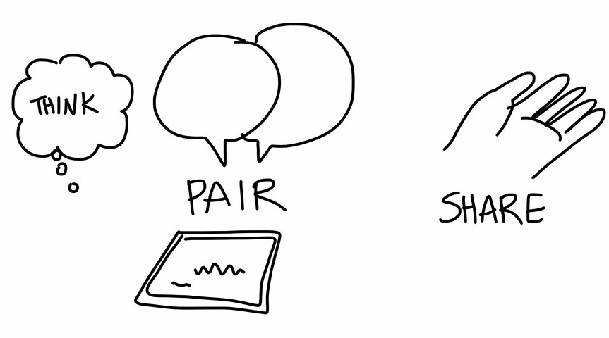
What sort of things do you think a Hindu would believe give you good karma? Bad karma?

Slide 7
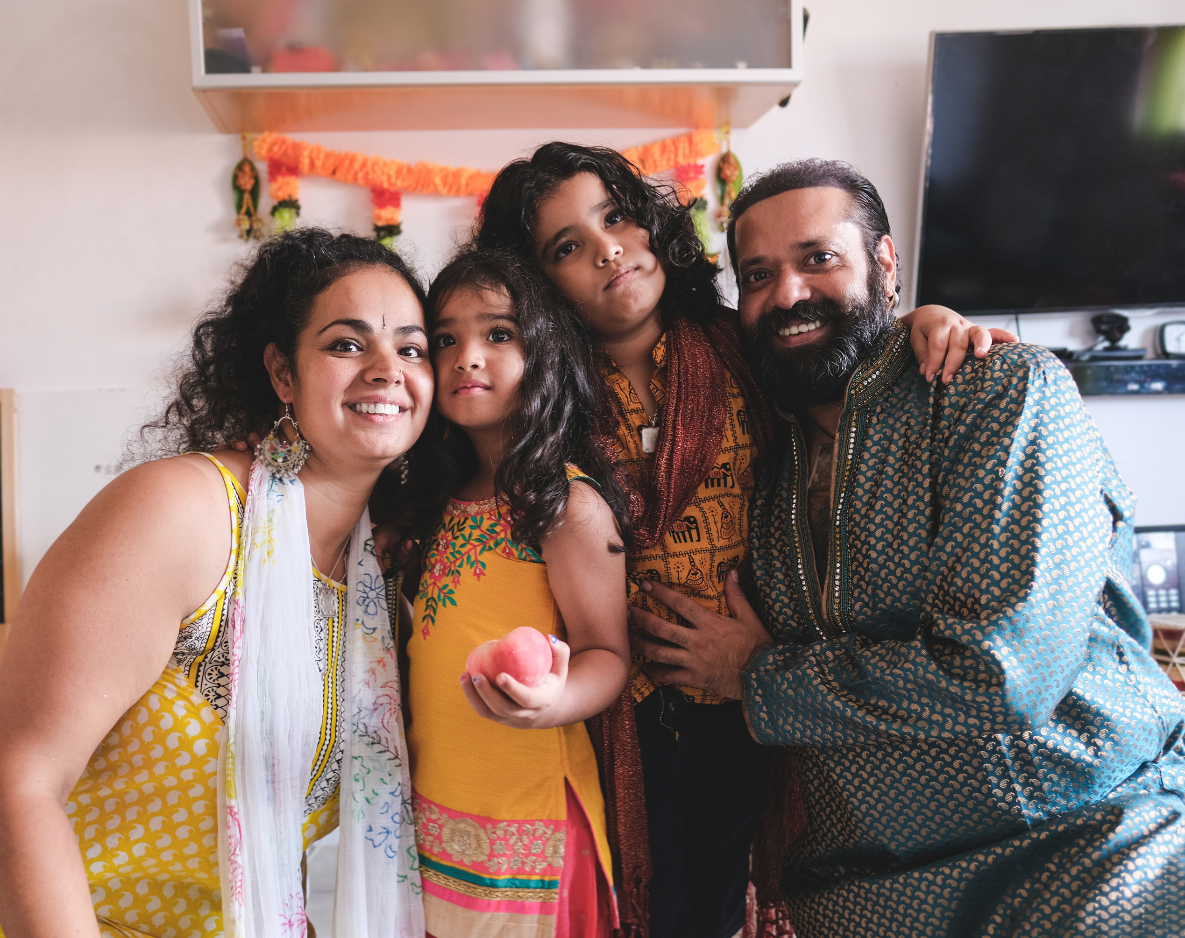
Hindus also believe that you have certain duties (dharma) that can add to your good karma.

Slide 8
The student stage: - Increase understanding of your religion - Develop good attitudes towards teachers and parents

Slide 9
The householder stage: - Earn an honest wage - Provide for your family - Enjoy the pleasures of life

Slide 10
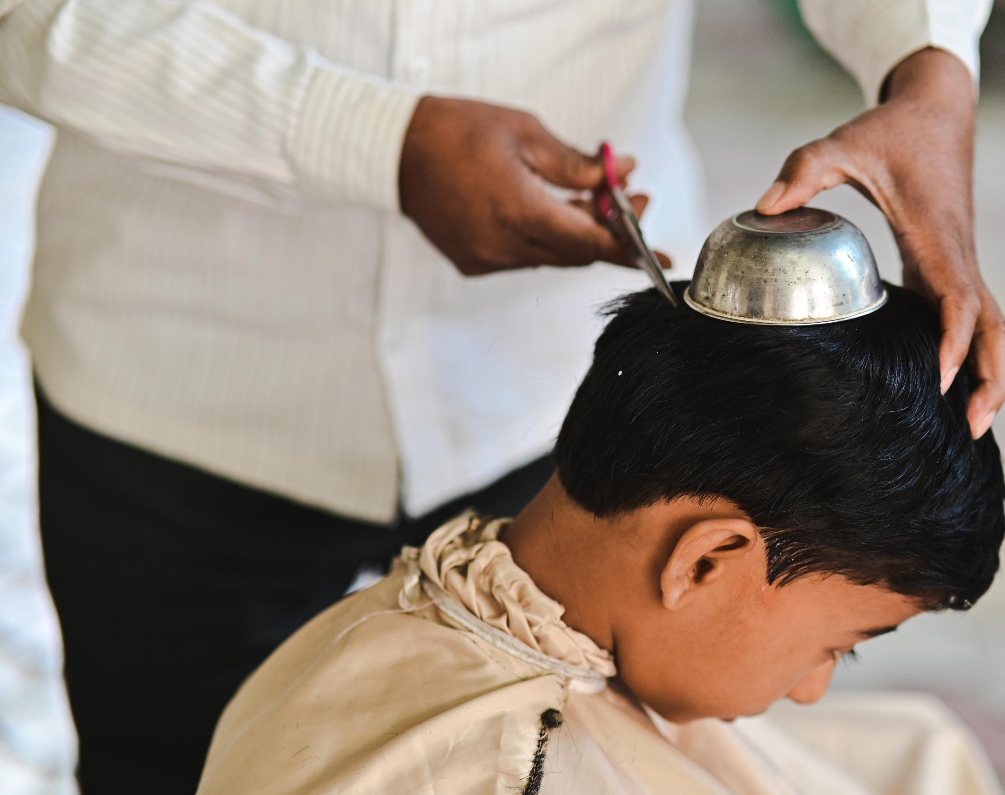
Retirement stage: - Don’t focus on material things - Meditate - Study Hindu scriptures

Slide 11
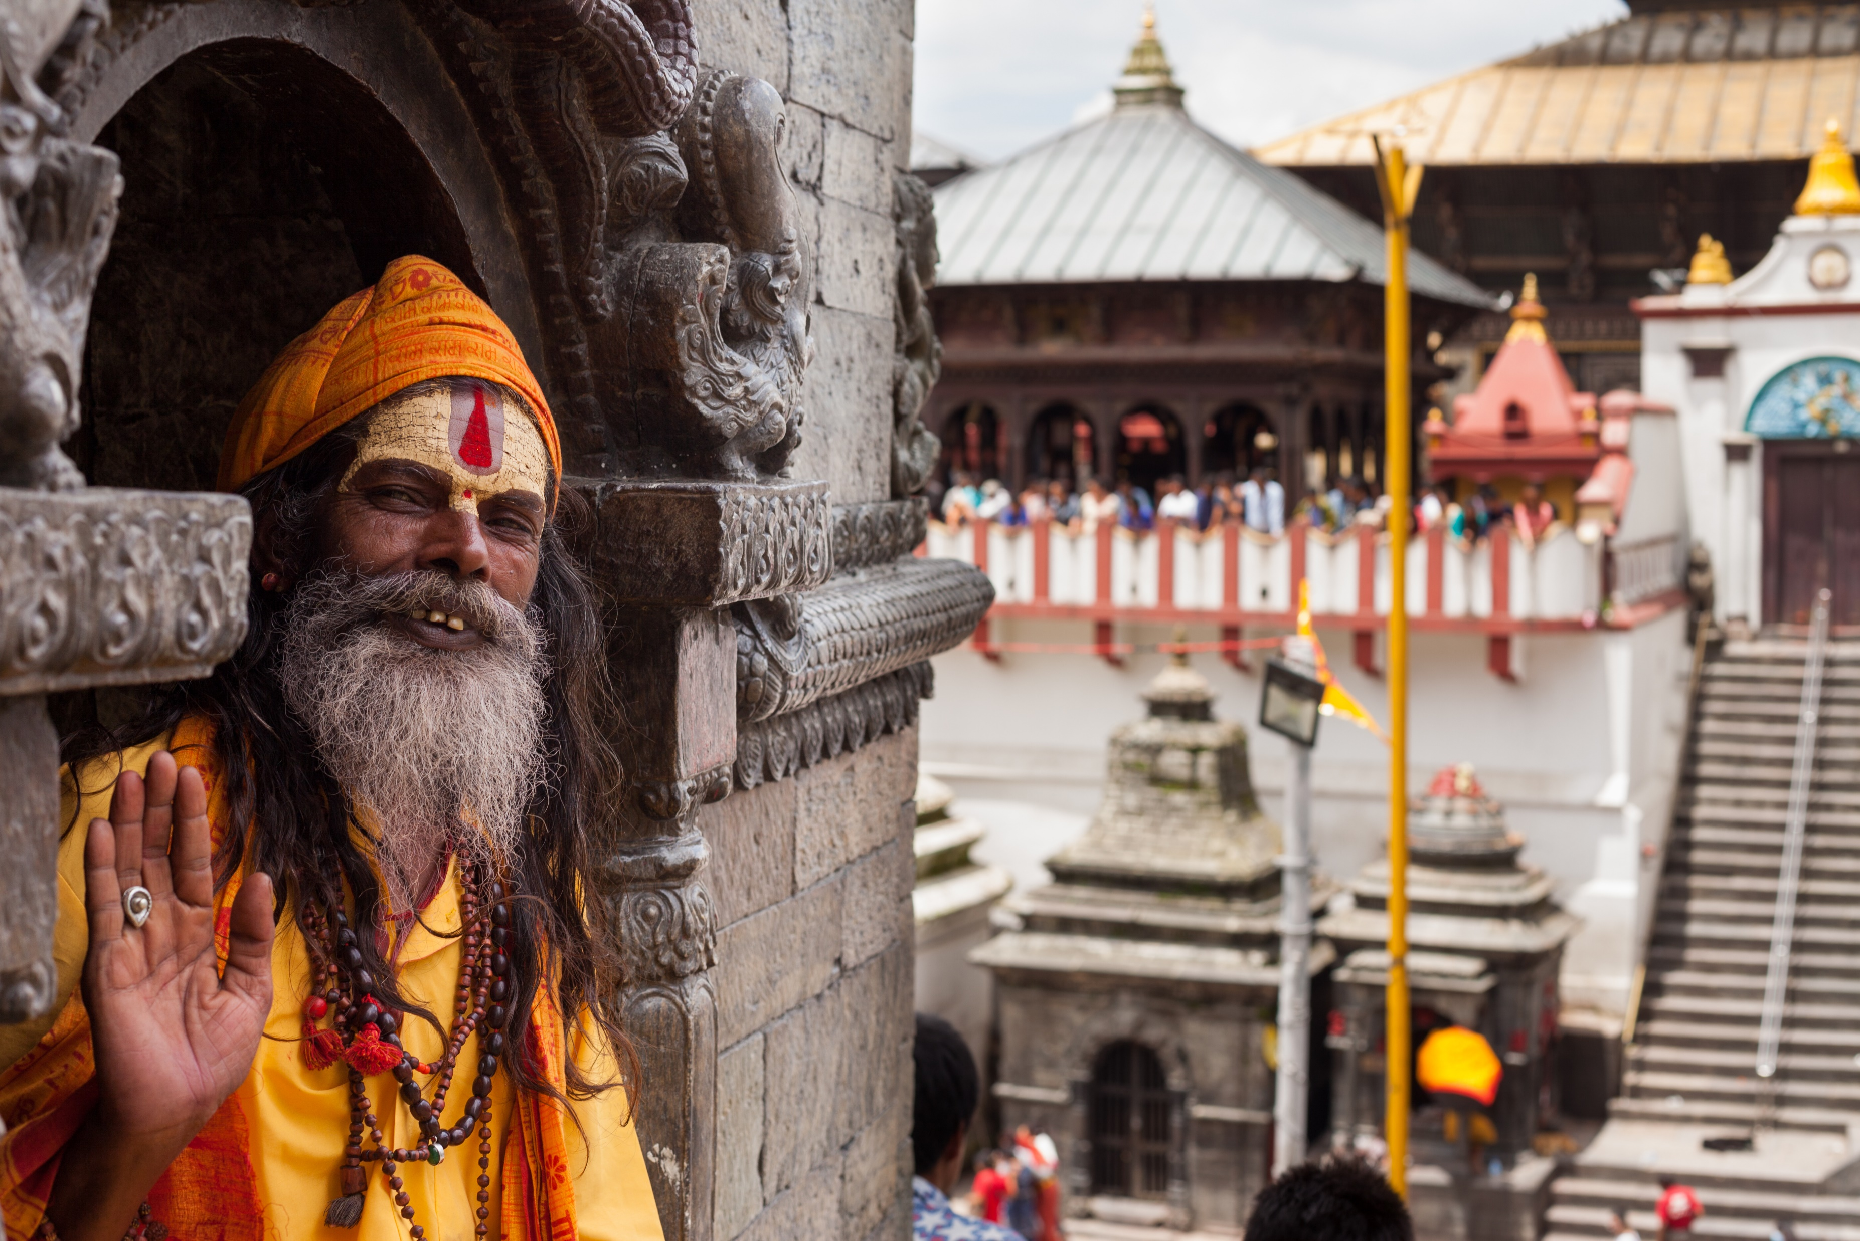
Sannyasin – world renouncer stage - Give up your home and possessions to become a holy person - Focus on escaping the wheel of samsara to reach moksha

