Slide 1
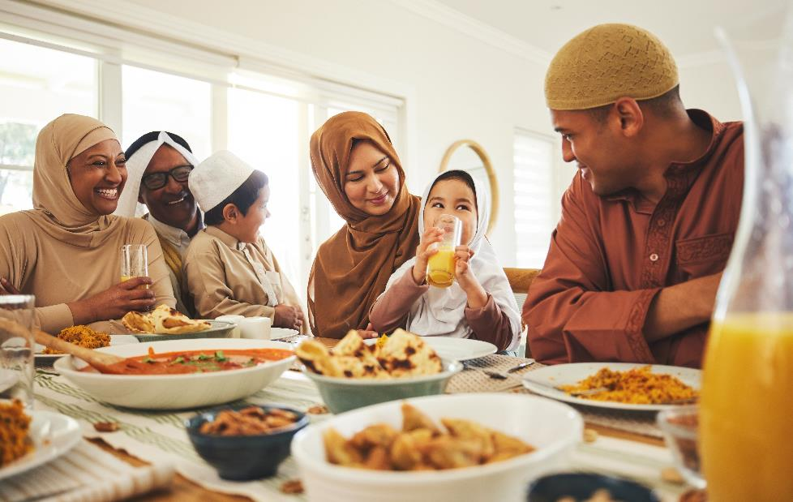
When do Muslims fast? Do all Muslims have to fast?
Whole class activity

Slide 2
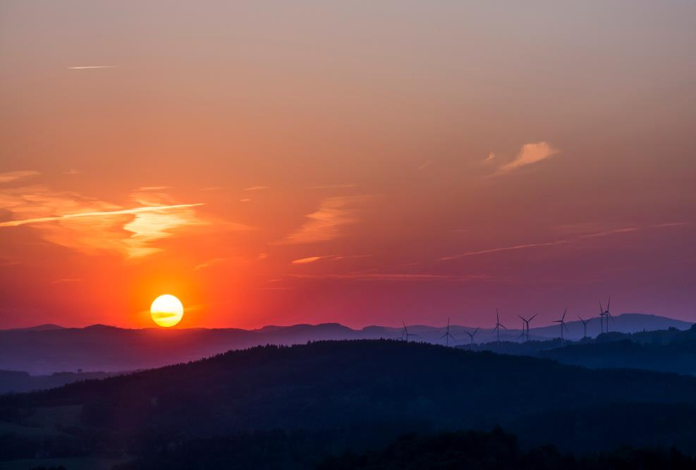
Circle the correct one
Fasting
Not fasting

Slide 3
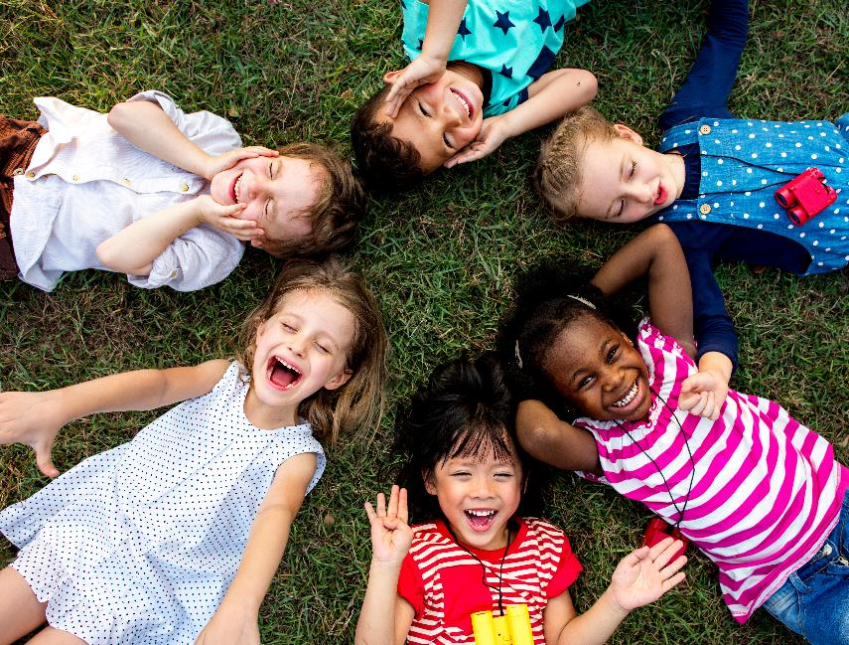
Circle the correct one
Fasting
Not fasting

Slide 4
Circle the correct one
Fasting
Not fasting

Slide 5
Circle the correct one
Fasting
Not fasting

Slide 6
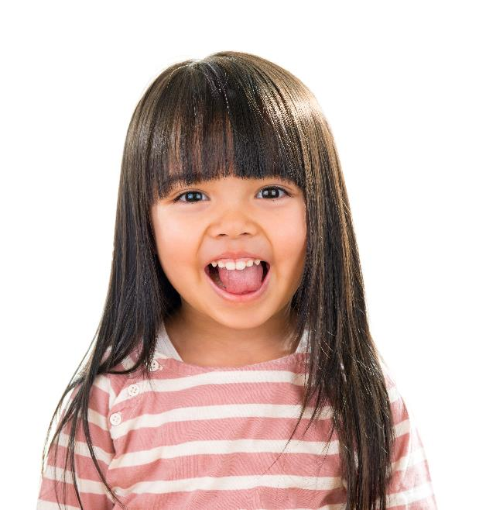
Do you think this person has to fast?
I think they have to fast because……
I don’t think they have to fast because......

Slide 7
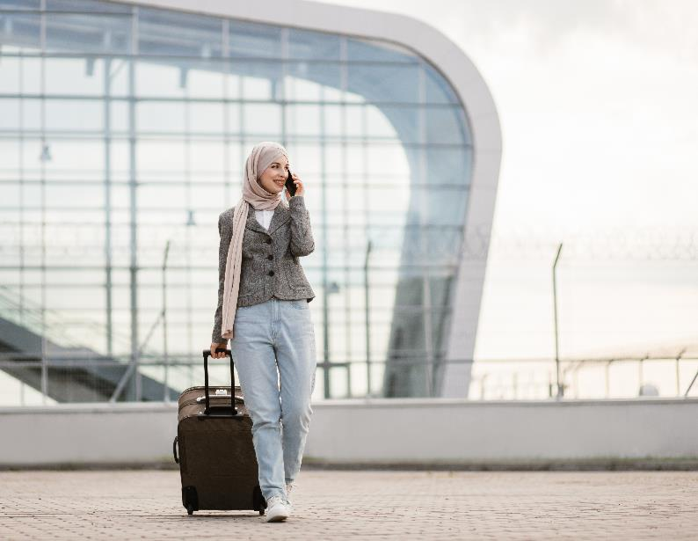
Do you think this person has to fast?
I think they have to fast because……
I don’t think they have to fast because......

Slide 8
Do you think this person has to fast?
I think they have to fast because……
I don’t think they have to fast because......

Slide 9
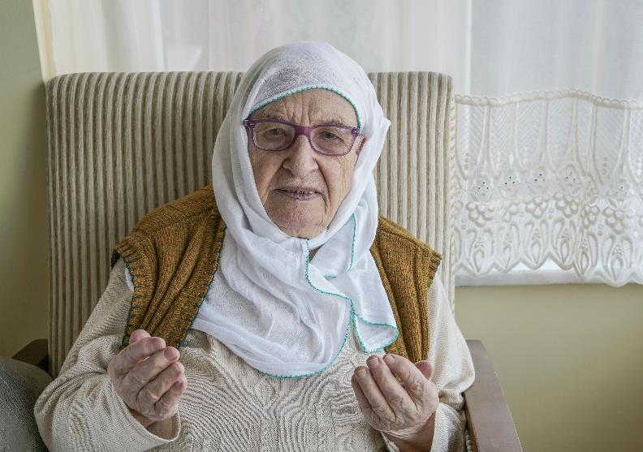
Do you think this person has to fast?
I think they have to fast because……
I don’t think they have to fast because......

Slide 10
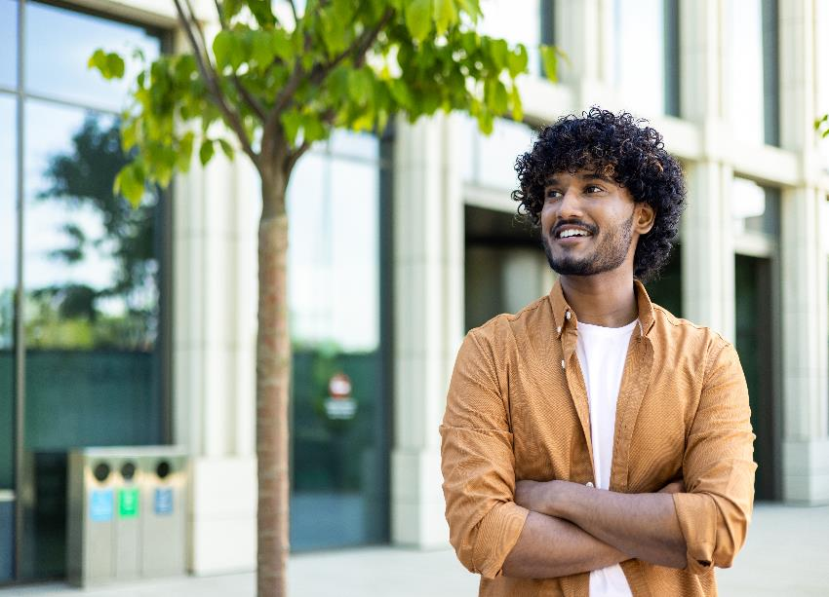
Do you think this person has to fast?
I think they have to fast because……
I don’t think they have to fast because......

Slide 11
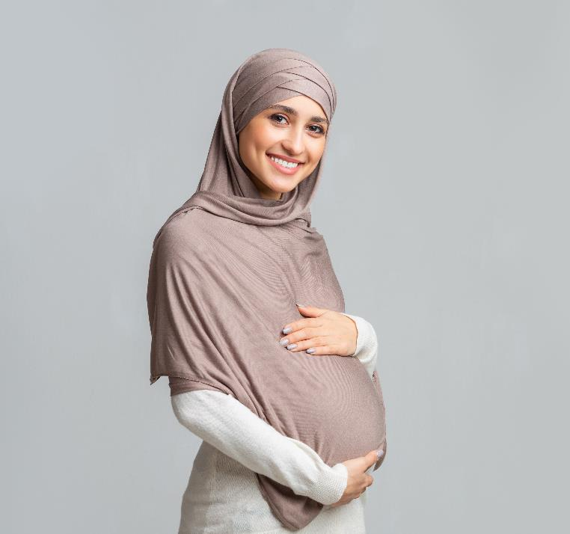
Do you think this person has to fast?
I think they have to fast because……
I don’t think they have to fast because......

Slide 12
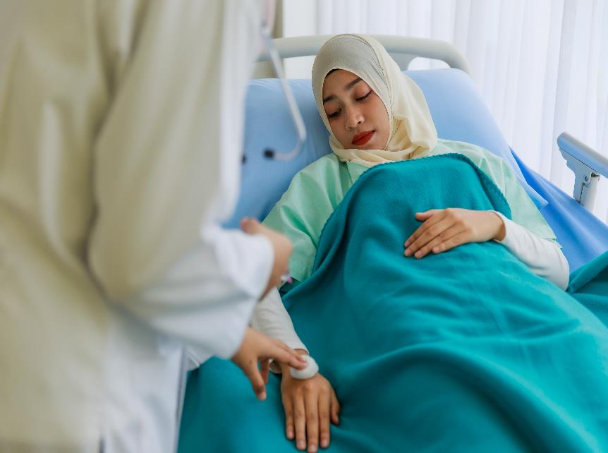
Do you think this person has to fast?
I think they have to fast because……
I don’t think they have to fast because......

