Slide 1
Discussion task
Key question
What could we give to help each child?

Slide 2
To help we could……
To help I could......
I wish I had a friend.

Slide 3
I am not sure which way to go.
To help we could……
To help I could……

Slide 4
I wish I had clean water to drink.
To help we could……
To help I could…….

Slide 5
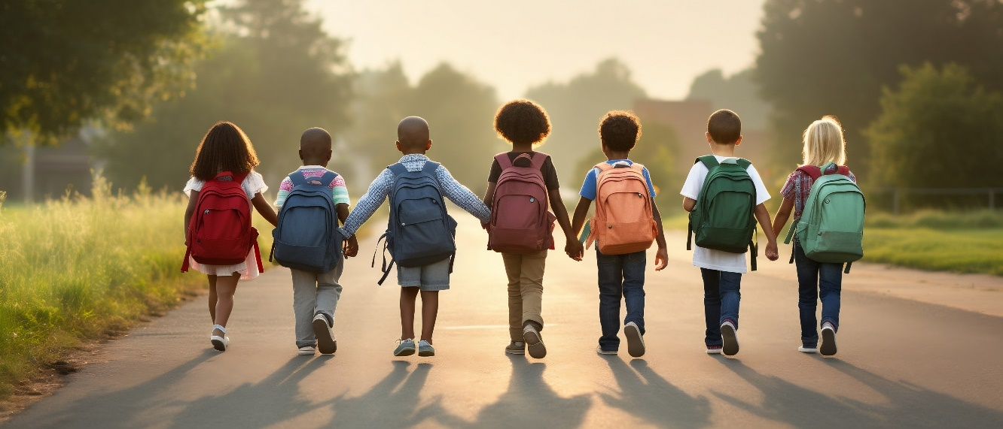
To help we could……
To help I could…….
There is a lot of litter on our street.

