Slide 1
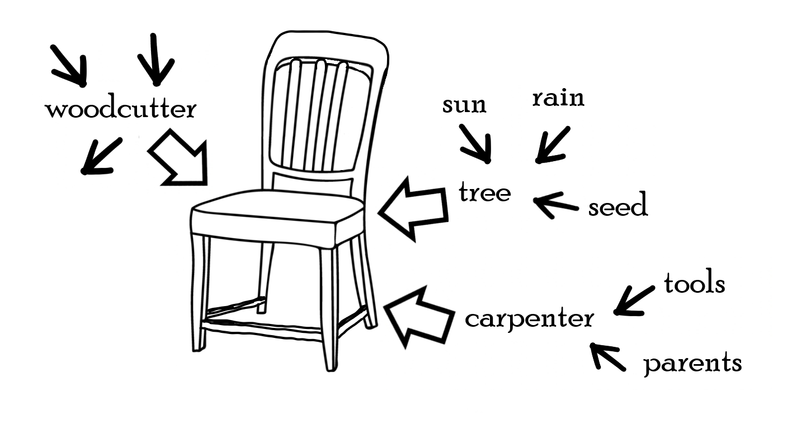
Interdependence web for a chair
LESSON 2 - YEAR 3
© Copyright London Diocesan Board for Schools 2023

Slide 2
Can you extend this interdependence web? What else is needed to make this chair the best it can be? Can the chair still be built if one part of the web is broken/doesn’t exist?
LESSON 2 - YEAR 3

Slide 3
An example of an interdependence web for an adult
Leant a new skill
Siblings
Meeting of new friends
Parents
Hobbies
Grandparents
Place of worship
Samuel
Faith
Friends
Lucy
Shelter
Food
Clothes
Belonging to a community of believers
Money
Job
LESSON 2 - YEAR 3

Slide 4
My interdependence web What things are you connected to that help you to flourish?
LESSON 2 - YEAR 3

