Slide 1
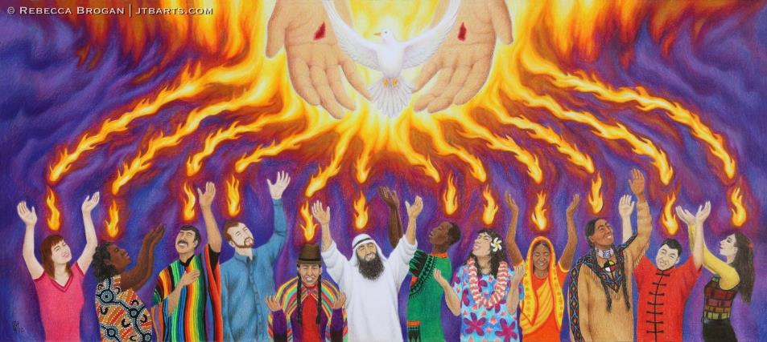
All credit to Artist Rebecca Brogan, https://jtbarts.com/gallery/pentecost-true-spiritual-unity-and-fellowship-in-the-holy-spirit/

Slide 2
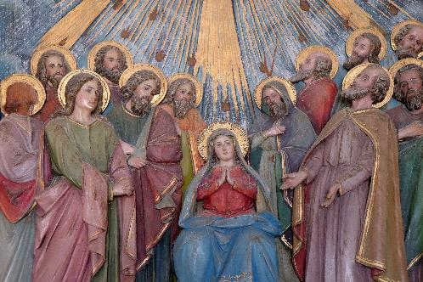
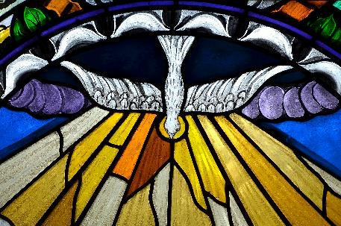
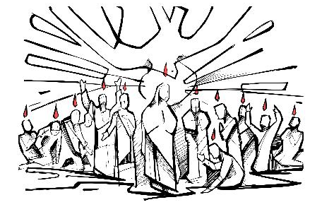

Slide 4
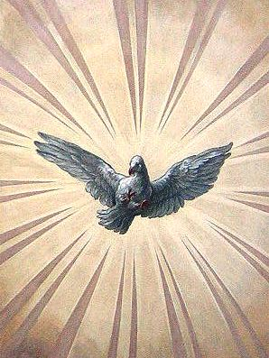
By Johann Michael Rottmayr - selfmade by User:Manfreeed, Public Domain, https://commons.wikimedia.org/w/index.php?curid=9396330

Slide 6
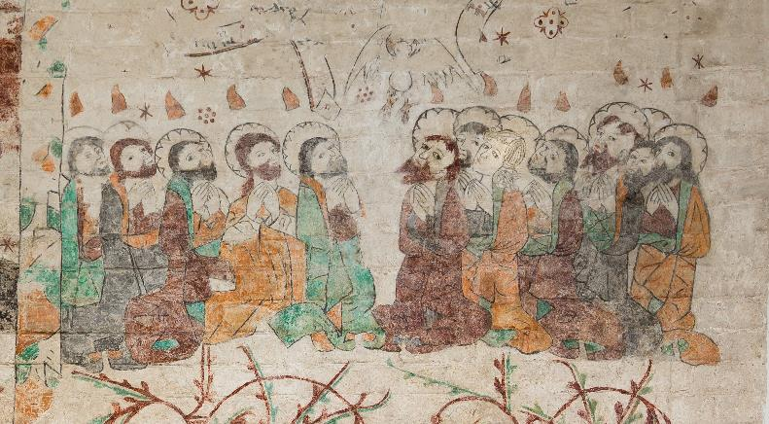

Slide 7
