Slide 1
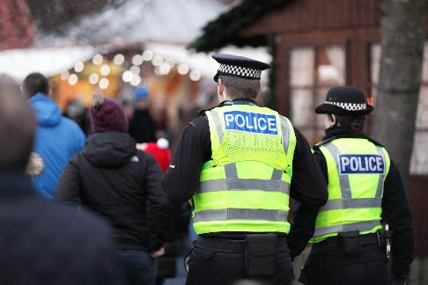
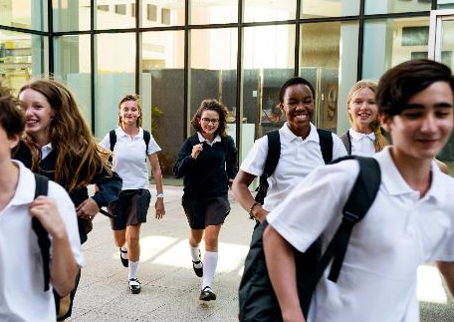
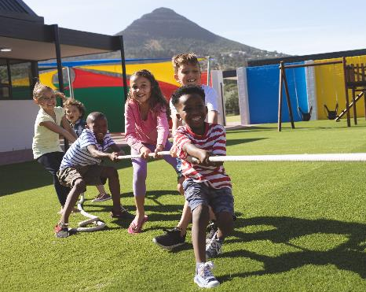
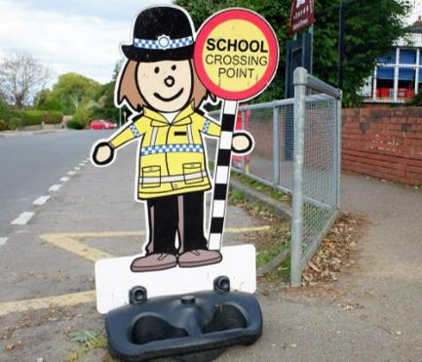

Slide 2
Guru Gobind Singh and the Khalsa
07 March 2024
Aim: How and why was the Sikh Khalsa formed?

Slide 3
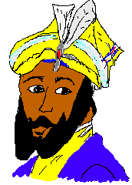
Guru Gobind Singh was the 10th Guru
His father had died for his faith (martyr)

Slide 4
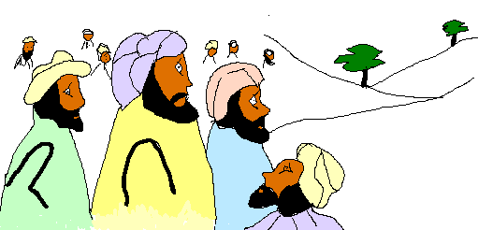
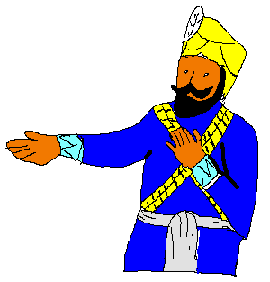
In 1699 Guru Gobind Singh got all the Sikh’s together and said:
I want the heads of five Sikh’s willing to die for what they believe
One person volunteered

Slide 5
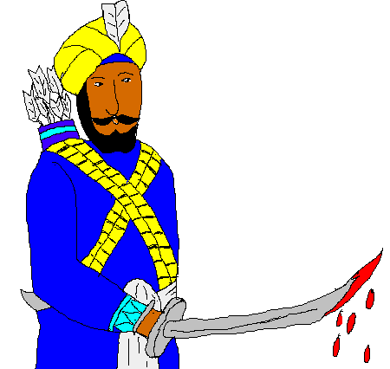
The Guru took the Sikh into his tent and when he came out his sword was dripping with blood!
I want four more heads!
Four more volunteered

Slide 6
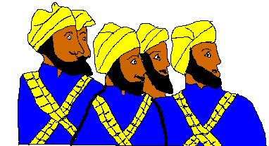
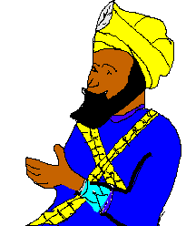
The Guru went back into the tent and brought out the five Sikh’s alive
These are my beloved five – my panj piare. They are the beginning of a new community

Slide 7
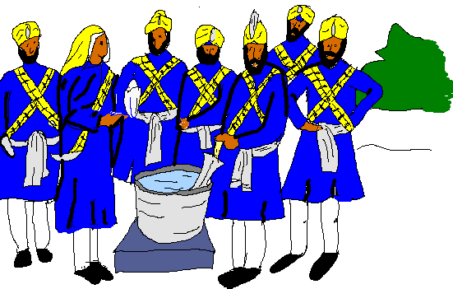
From now on each of you men will be called Singh (lion). You will grow your hair and beard (kesh), carry a khanga (comb), and a kirpan (sword) and wear a kara (bracelet) and kachera (pants)

Slide 8
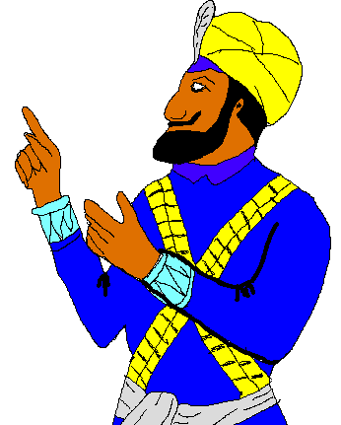
Guru Gobind Singh told the Khalsa that they must never harm the weak and should think of all people as equal.

Slide 9
The 5 K’s
These are the five items that identify Sikh’s as Khalsa Sikh’s.

Slide 10
Kesh
Uncut hair is a gift from God

Slide 11
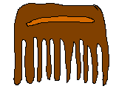
Kangha
A comb, Sikhs are always clean and tidy

Slide 12
Kirpan
A small dagger, to remind Sikhs to defend the weak

Slide 13
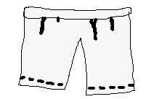
Kachera
Special shorts, so that Sikhs can be ready to defend others. They are easy to run, jump, climb in.

Slide 14
Kara
A bracelet, the unending circle remains them that God is eternal

Slide 15
Imagine you are Auntie Bimal. · What advise would you give these Khalsa Sikhs? · What might they have to sacrifice to stay true to their beliefs?
Khalsa Sikhs have three duties to fulfil:
· To read, learn and live by Sikh teachings (these include; wearing the 5K’s; earning money honestly; being willing to sacrifice for others; to share with the needy; not to have bad habits such as smoking, taking drugs or alcohol; treating others equally; working for peace; not eating meat killed in a religious ceremony).
· To pray only to the one Ultimate Reality (God)
· To serve the whole of humanity.

Slide 16
Dear Auntie Bimal
In six weeks time I am going on holiday to America. One of my Khalsa friends went there last year and said that they got a lot of hassle at the airport security because of their kirpan. They said they got stopped and questioned at every metal detector. I am worried that this will happen to me. I would be really
embarrassed if it did. I am thinking of leaving my kirpan at home. Am I doing the right thing?
Nervous traveller, Ramjeet

Slide 17
Dear Auntie Bimal
I have been saving up for some new trainers but it has been taking me ages. Last week my brother told me I could buy some doughnuts really cheaply and sell them to people at school for a big profit. I know my school doesn't allow this but he told me I could sell them secretly and everybody would be happy. What do you think?
Confused, Jasvir

