Slide 1
Guru Tegh Bahadur
Aim: In what ways was Guru Tegh Bahadur brave?

Slide 2
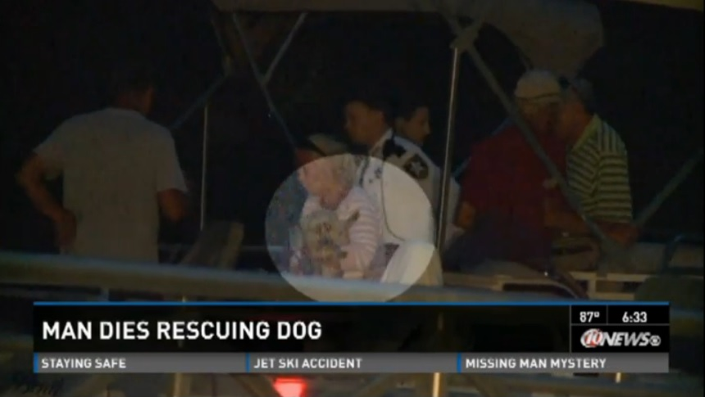
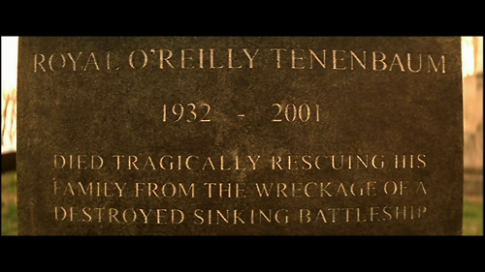
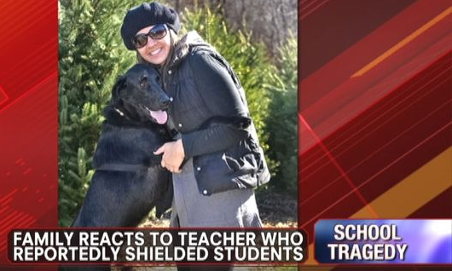
Who or what would you be willing to die for?
©Newtown
©The Royal Tenenbaums

Slide 3
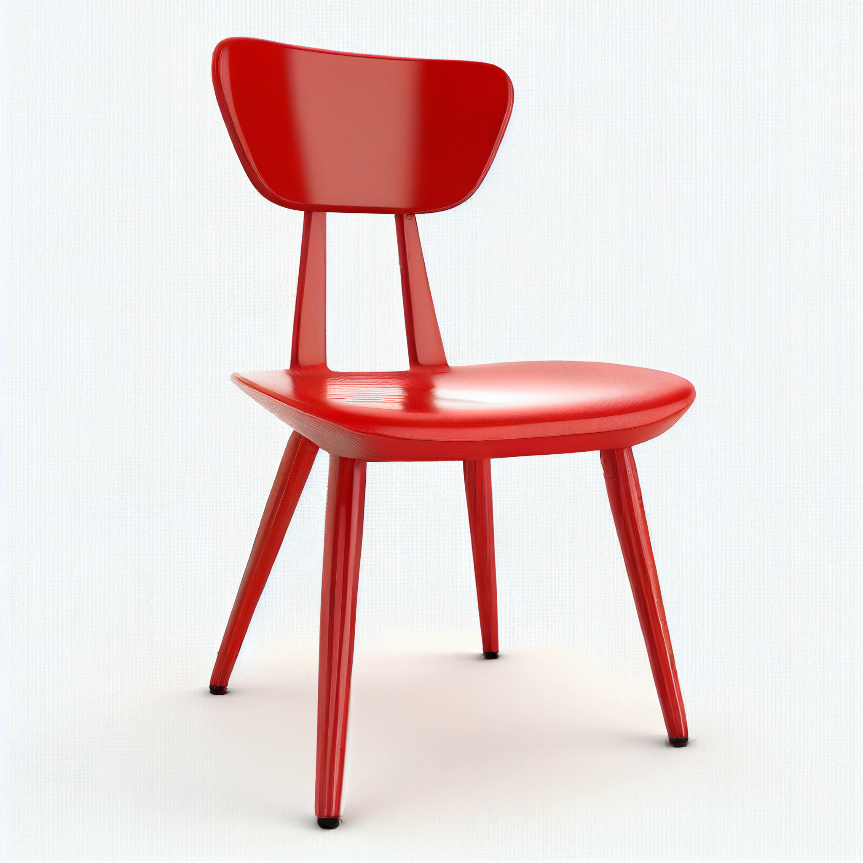
Hot Seat Preparation Work
Read through the story of the martyrdom of Guru Tegh Bahadur.
In your group of four you will produce a freeze-frame based on a scene from the story. Make sure the rest of the class can see from your expressions the feelings you are experiencing.

Slide 4
After seeing the freeze-frames
Individually write down the questions you would like to ask:
Guru Tegh Bahadur
The Guru’s Wife
The Emperor
The man who returned the Guru’s head

Slide 5
Question starters:
How did you feel when…?
Why did you….?
What made you…?
Who did you…?
Where were you…? Where did…?

Slide 6
Hot Seating begins:
Guru Tegh Bahadur
The Guru’s Wife
The Emperor
The man who returned the Guru’s head
Characters come to the front of the class and sit on the ‘Hot Seats’
Ask the characters their questions
and characters will answer them in role

