Slide 1
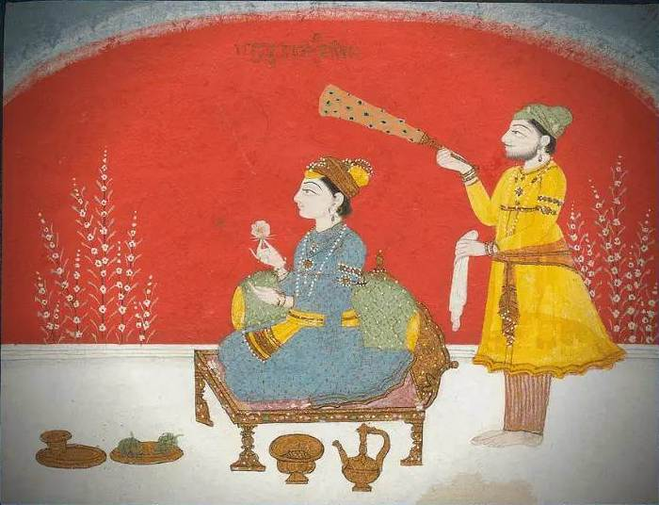
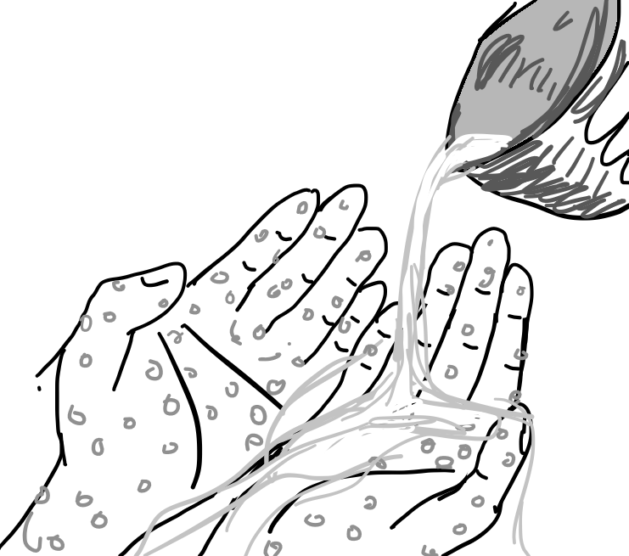
Guru Har Krishan
Aim: How did Guru Har Krishan care for those who were dying? What do Sikhs believe about death?

Slide 2
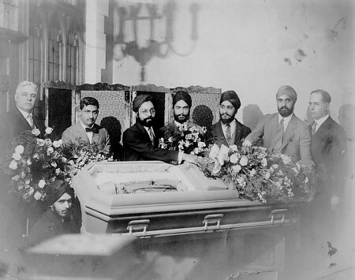
Pair and share- what does this hymn teach us about Sikh beliefs about life and death:
“The dawn of a new day is the herald of a sunset,
Earth is not our permanent home.
Life is like a shadow on a wall.”
Image credit: Sikhs at a funeral. Photographed 1920's, United States
By Unknown author - [1], Public Domain, https://commons.wikimedia.org/w/index.php?curid=135710036

Slide 3
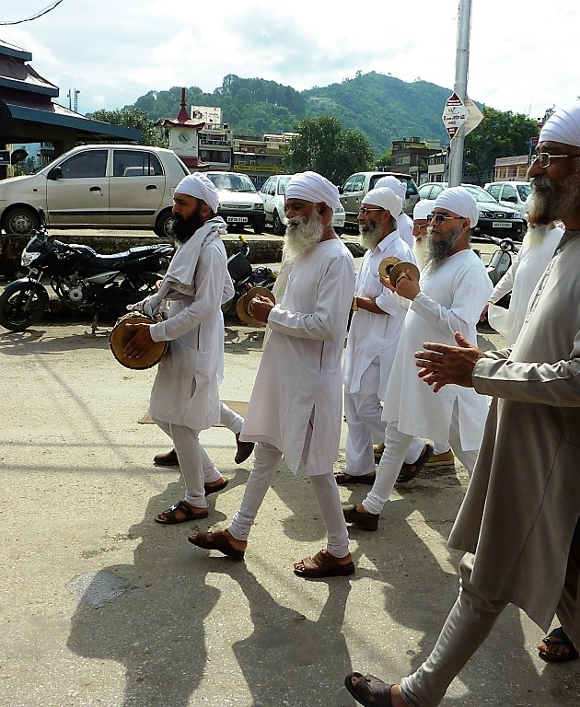
Sikh beliefs about death
Sikhs believe in reincarnation
Birth into the Sikh faith is the result of good karma
It has provided the soul with the opportunity to hear the words of the Gurus and to receive freedom from the cycle of death and rebirth and become one with God, this is called mukti.
Image Credit:
By John Hill - Own work, CC BY-SA 4.0, https://commons.wikimedia.org/w/index.php?curid=63727095

Slide 4
Life
Death
Mukti – freedom from the cycle, and union with God
Reincarnation

Slide 5
Guru Har Krishan
He was only 5 years old when he became the Guru
He was invited to Delhi, where he preached
Delhi became the centre of a smallpox outbreak, with 30% fatality rate
Guru Har Krishnan stayed to help the smallpox victims
Aged 8, he too died of smallpox
How might his beliefs about death
influenced his decision to help the sick?

Slide 6
A Sikh funeral
In India the body is usually cremated on the day of death but in the UK the funeral will take place as soon as possible.
First the body is washed and then dressed, usually with the traditional dress of a Khalsa Sikh

Slide 7
A service is held at the Gurdwara and then the body is taken to the crematorium. During the cremation hymns from the Guru Granth Sahib are sung and special prayers are said.

Slide 8
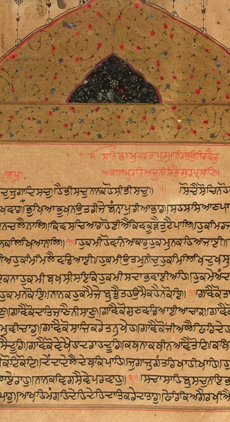
The Kirtan Sohila (Evening/ funeral prayer)
Know the real purpose of being here, gather up treasure under the guidance of the Sat Guru (True Guru). Make your mind God’s home. If God abides with you undisturbed you will not be reborn.
What do you think is the purpose of being here on earth?
Image credit:
By http://lakhvir.wordpress.com/2006/07/11/rarely-seen-images-of-the-sikh-past-part-i/, Public Domain, https://en.wikipedia.org/w/index.php?curid=28019116

Slide 9
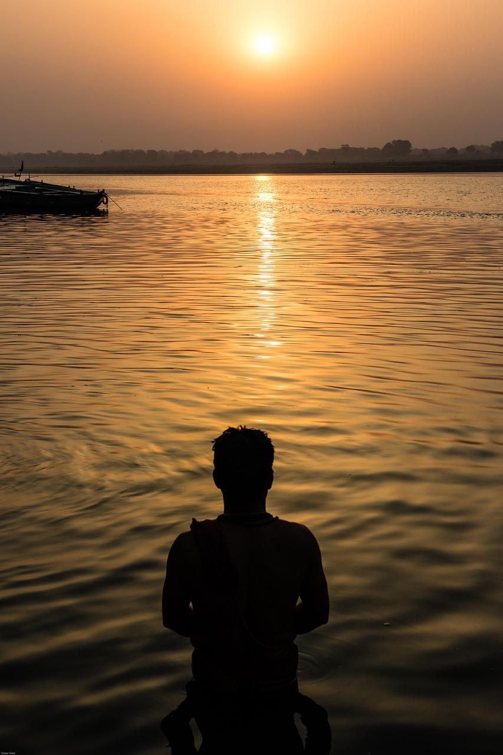
Often the ashes are placed in water (sea or river) or buried. Mourning lasts for up to ten days. During this time there is a complete reading of the Guru Granth Sahib. The mourning ends with the sharing of Karah Parshad.

Slide 10
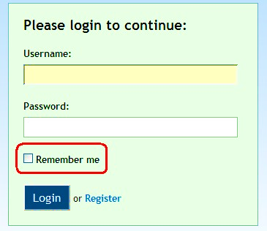
Sikhs do not have headstones or memorials to people who have died. They believe that the good things that a person has done in their life is the way they are remembered.
If there was no memorial
stone to commemorate
your life what good things
would you hope people
would remember you for?

