Slide 1
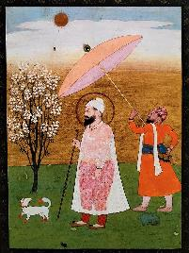
Guru Har Rai
Aim: Why do Sikhs look to Guru Har Rai about care for the creation?

Slide 2
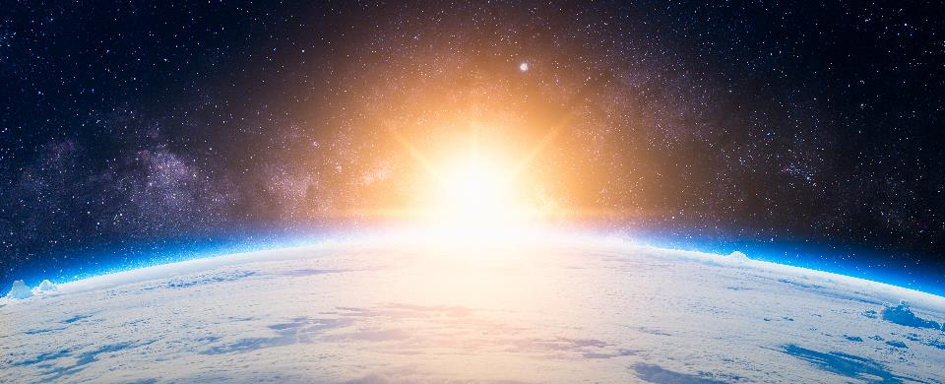
It’s a wonderful world – what amazes you about our earth?
https://www.youtube.com/watch?v=B8WHKRzkCOY

Slide 3
Compassion for humans
Compassion for Animals
Sikhs look to Guru Har Rai as an example of
compassion (love and kindness)
Compassion for planet Earth
Compassion for plants/flowers/trees
Notes:
This could potentially be a mind map for your revision week.

Slide 4
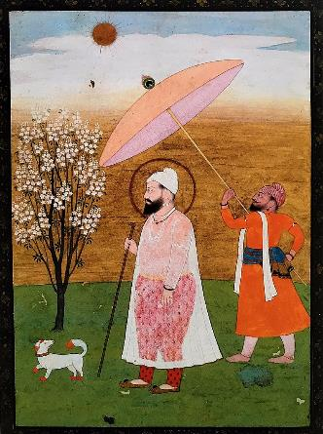
Compassion for Humans
Guru Har Rai opened hospitals, and employed the best doctors. People could come from all over and get healed of their different problems.
He started a dispensary for the sick and poor people.
He believed that the greatest sin was to hurt others.
He believed in serving langar with humility and kindness.
“Sleep little, eat little, speak little… and you will come under the Guru’s guidance. Work hard and do good actions. Don’t show off but be great.”

Slide 5
TASK: In the human outline, write down ways we can serve other people.

Slide 6
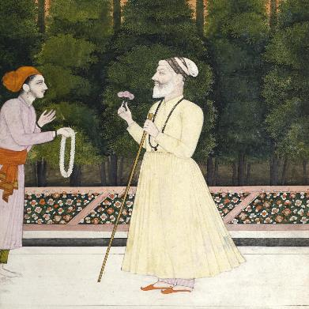
Compassion for Animals
Guru Har Rai hunted animals. This seems strange "why would he hunt animals when he couldn't even hurt a flower?
However, he would never hunt to kill. Instead he would capture sick or injured animals, then give them medicine and heal them.
The animals were kept in the Guru’s beautiful gardens. When the time was right, the Guru would release the animals back to the wild.

Slide 7
TASK: In the animal outline, write down ways we can care for animals.

Slide 8
Compassion for Plants and Wildlife
Guru Har Rai grew fruit and herbs for healing. This was to be very useful when the Emperor’s eldest son became sick. The son had been poisoned by his jealous younger brother who had put chopped tigers’ whiskers in his brothers food. It looked like the eldest son would die.
Then someone remembered that the Guru was an expert in healing plants. The Emperor begged for the Guru’s help, even though they had previously been enemies. The Guru agreed to help and provided plants that would help the son to pass the tigers’ whiskers.

Slide 9
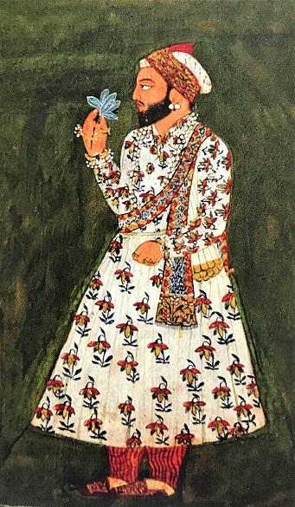
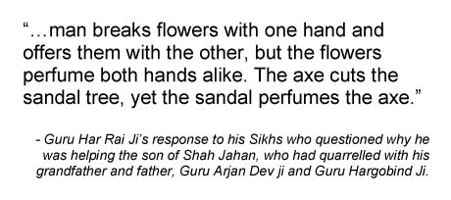
Not everyone could understand why the Guru would help the Emperor, who had been his enemy.
What did the Guru mean?

Slide 10
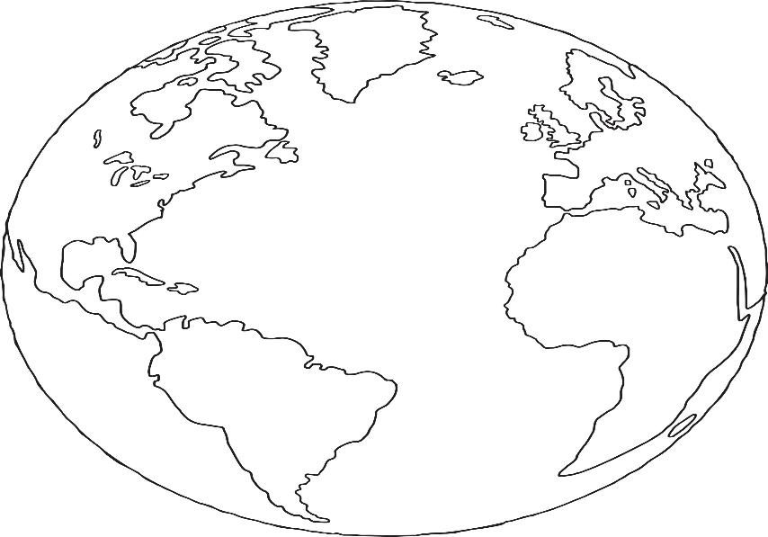
TASK: In the earth outline, write down ways we can look after the environment.
Notes:
Transport eco friendly
Plant trees and plants
Garden more
Less litter etc

Slide 11
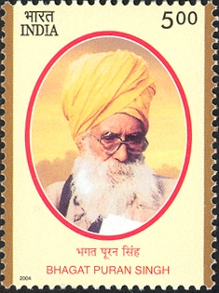
Bhagat Puran Singh(1904 –1992)
As a young man Puran began visiting the gurdwara, providing water for visitors to wash before entering, helping manage the Gurdwara's cattle, and cleaning, and working in the kitchen.While working there, he decided to dedicate himself to humanitarian work. In 1934, Bhagat Puran Singh took into his care a four-year-old child with leprosy who had been left at the door of the Gurdwara and he later worked as a medic in a refugee camp withover 25,000 refugees.
See for copyright: https://commons.wikimedia.org/wiki/File:Bhagat_Puran_Singh_2004_stamp_of_India.jpg
Notes:
Student or teacher to pick category or suggested topic

Slide 12
Puran Singh also worked for the care of the environment, organising tree planting drives, providing talks and lectures on environment topics, and writing. He also distributed free pamphlets and books about environmental issues.
See for copyright: https://commons.wikimedia.org/wiki/File:Bhagat_Puran_Singh_2004_stamp_of_India.jpg

Slide 13
Commit to making personal changes in your life that will help the environment. Write up a report about i) why you chose that change ii) what you did iii) what difference it has made
Notes:
Student or teacher to pick category or suggested topic

