Slide 1
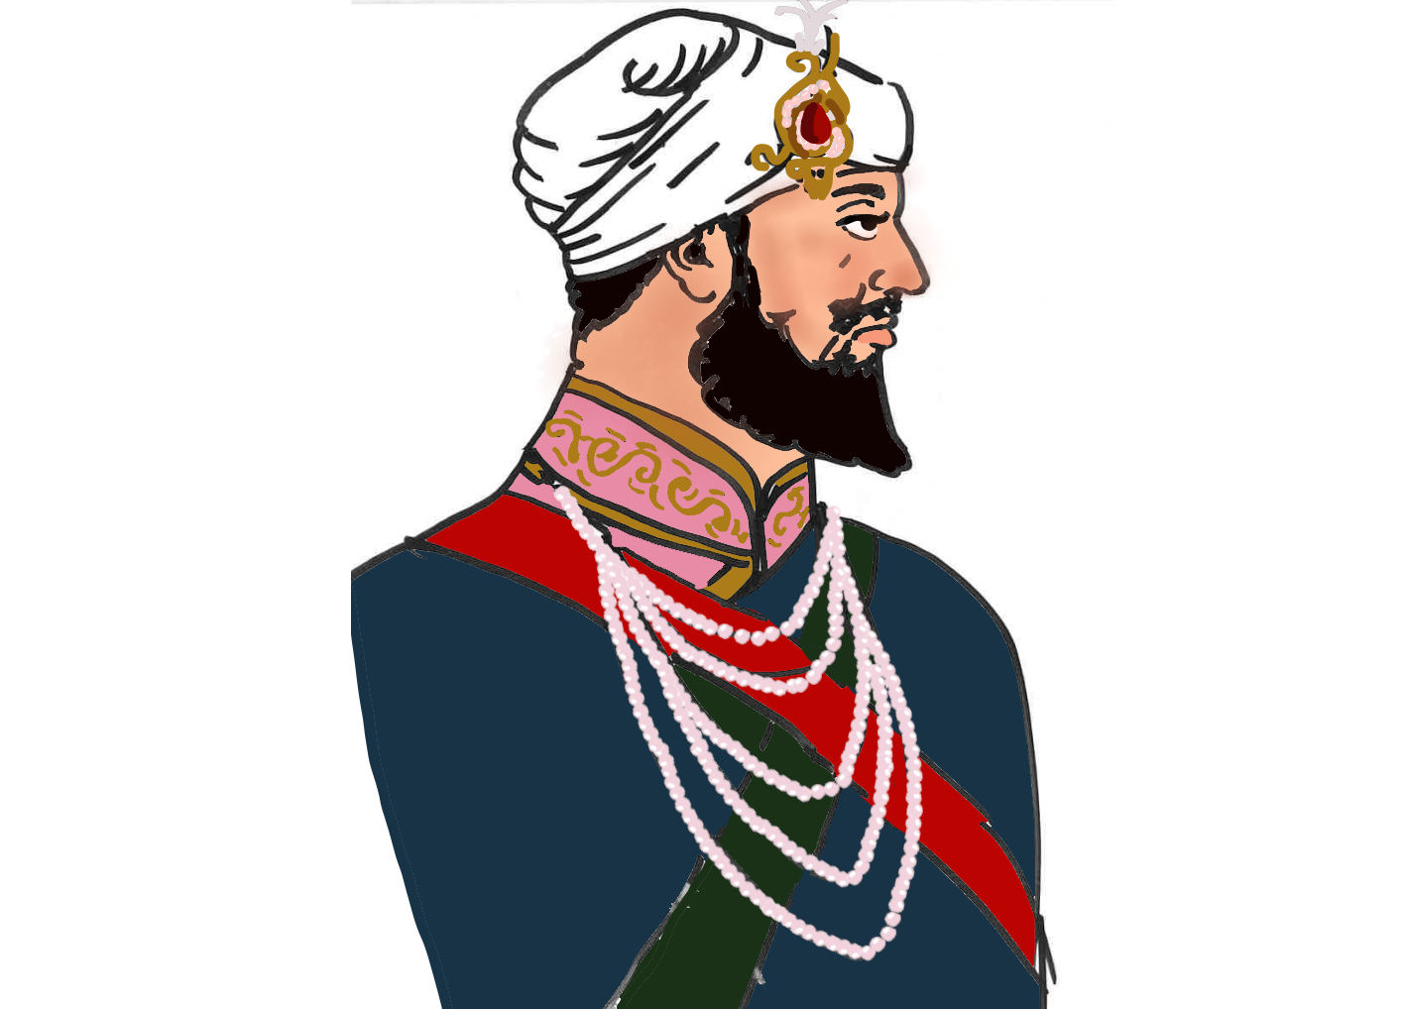
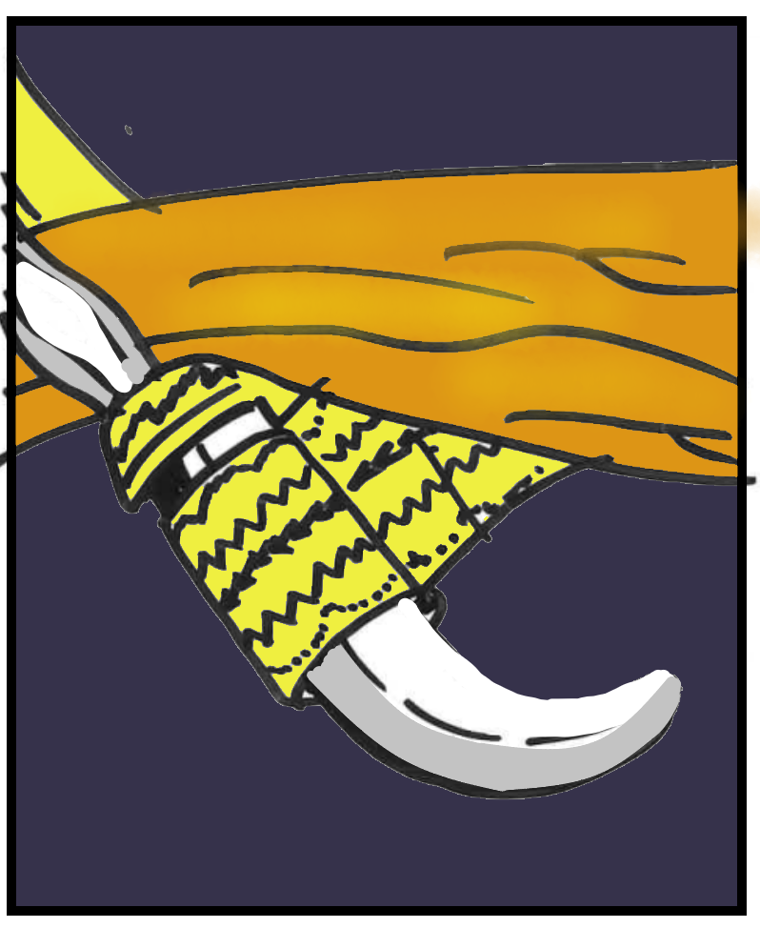
Guru Hargobind
Aim: Why did Guru Hargobind wear two kirpans?

Slide 2
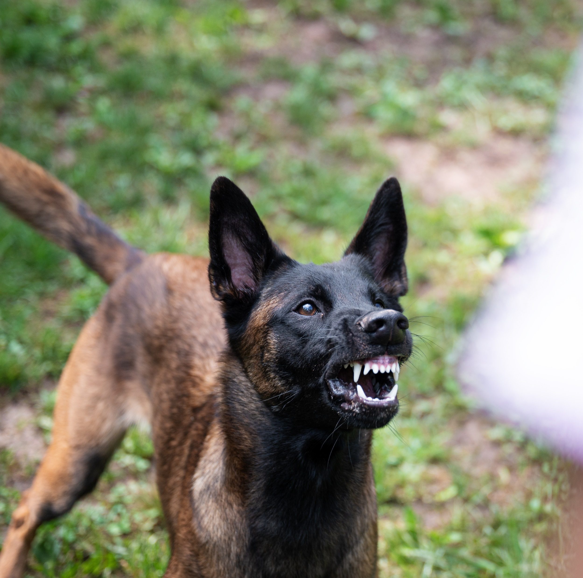
How do people protect their most valued possessions?
What’s your most important possessions-things that you just can’t live without?
What do you do to try to protect them from being lost or stolen?
Notes:
locks, burglar alarms, bats near bed, mace, dogs etc
2

Slide 3
Guru Hargobind
Guru Hargobind was the only child of Guru Arjan Dev, who had been killed for his beliefs.
From a young age Guru Arjan Dev insisted his son be educated in the sciences, sports, sword fighting, wrestling and religion.
Guru Hargobind was the tallest Guru. He was 6ft 5”
Notes:
3

Slide 4
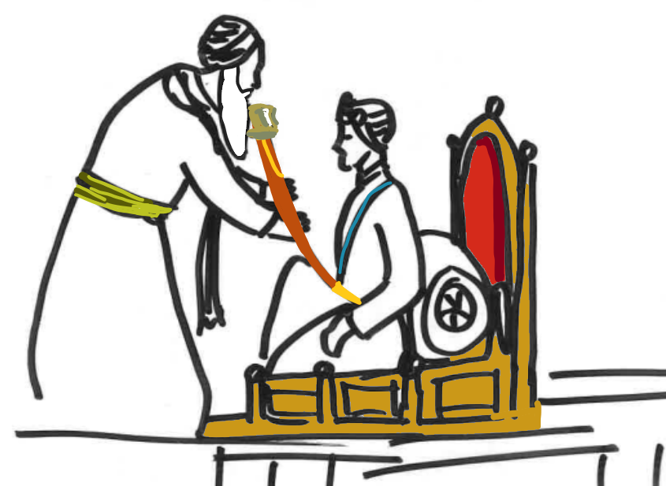
Guru Hargobind becoming the next Guru....
Three days before Guru Arjan Dev death, Guru Hargobind at the age of 11 was proclaimed the 6th Guru of the Sikhs.
Even though Guru Hargobind was young, he knew that his Sikhs were afraid and that he had to ensure that the Sikhs felt safe.
Notes:
http://www.youtube.com/watch?v=3_SV6nj0VrU
Ask kids to answer Questions 2

Slide 5
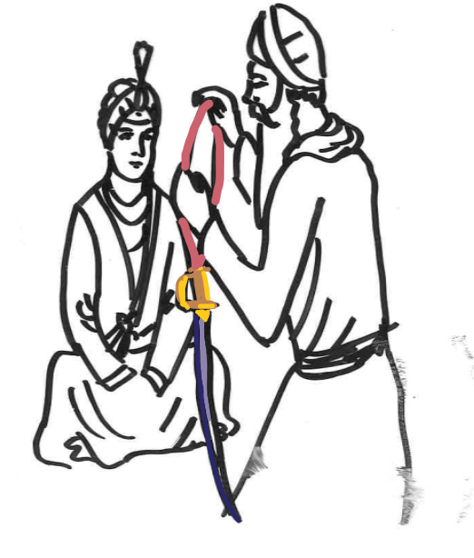
Guru Hargobind wore two Kirpans (swords) – Miri & Piri
Guru Hargobind began wearing two Kirpans. Each represented a very important quality all Sikhs should have.
Piri = Spiritual
That a Sikh should build a personal relationship with their Guru. It’s a very internal quality.
Miri = Temporal
That a Sikh should apply their spiritual practice to help others and stand up against injustice. It’s an external quality.
Notes:
5

Slide 6
The Warrior Guru
From then on, Guru Hargobind always maintained an army of Sikhs who were always ready to protect the innocent in case any tyrants like the Emperor Jahangir ever tried to attack the Sikhs again.
Is this any different than Britain having the British Army to protect Britain?
Notes:
6
6

Slide 7
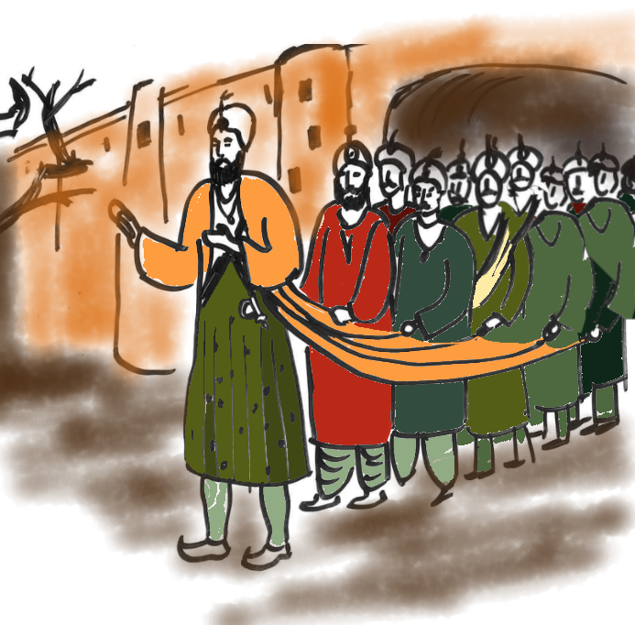
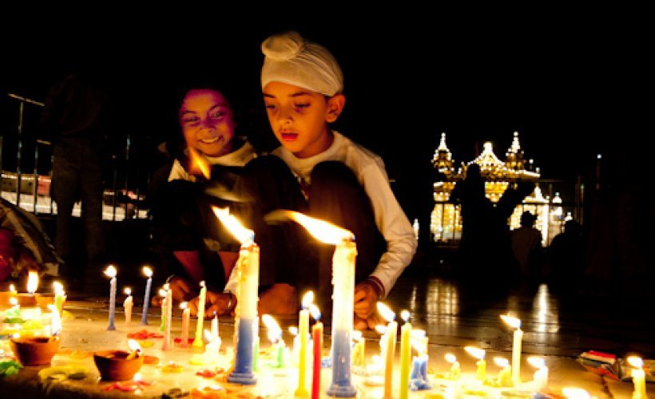
What do you think links these two pictures?
© https://www.sikhnet.com/news/sikh-diwali-bandi-chhor-diwas

Slide 8
Can you be religious and fight in an army?
While Guru Hargobind was travelling, he met a local Saint called Samrath Ramdaas. Samrath Ramdaas saw the Guru dressed like a warrior, with weapons and riding a horse with his Army and asked the Guru, “I hear you are the Sixth Guru of the Sikhs but how can you dress like a warrior and still call yourself a Guru?”
Guru Hargobind replied “Internally I live the life of a Saint but externally I live the life of a warrior. I dress like a warrior to protect Saints like you from Tyrants who try to harm God’s Saints…like you”
Samrath Ramdaas was so touched by the Guru’s reply that he fell at the Guru’s feet and became a Sikh.
Notes:
8

Slide 9
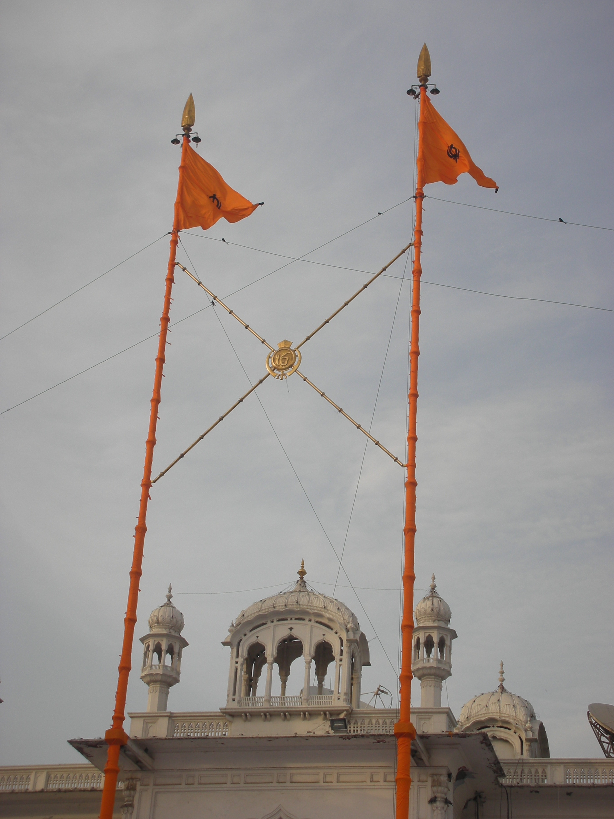
Where else do we see the concept of Miri Piri?
Outside every Gurdwara there is a flagpole called the Nishan Sahib. The flag was originally used by Guru Hargobind’s troops in battle. Just near Sri Harmandir , in Amritsar, there are two Nishan Sahibs. One Nishan Sahib represents Miri (temporal) and the other Piri (Saintly)
The Piri Nishan Sahib is higher than the Miri Nishan Sahib. Why do you think this is?
© Bunny blizzard https://commons.wikimedia.org/wiki/File:AKal_Takhat(_golden_temple).JPG
Notes:
9
1) The Colour is called Kesri. It is the colour which reminds of those who have died for their Guru.
2) is called the Farla. When it flaps in the wind it invites everyone to the home of the guru
3) The Khanda Symbol reminds us to be a Saint and Soldier. To always remember god and also stand for truth
4) Kamarkasa – reminds the Sikh to always be ready for serving/helping others
5) are the promises we tie to follow sikhi – keep our hair and take amrit to become better sikhs
6) are the ropes which hold the nishan sahib in place. There are four of them which means people from all directions can receive a message from Guru Granth Sahib jee.
7) is called the Thara. If the flag of a religion flies high, it is a sign that the people it belongs to are free and strong.
A nishan sahib is high from the ground which fits in with
“jab lag khalsa rahe niyara, tab lag tej deeyo mein sara”
Until the khalsa remains unique I will give it my support – Guru Gobind Singh Jee Maharaj
8) is the world which the Sikh lives and works in but does not forget vaheguru
9) The khanda top reminds us to always focus on simran and take our thoughts higher and to think better actions
9

Slide 10
On the flag are the four parts of the Khanda (Sikh Emblem)
Draw a Khanda in the middle of one of your pages and write out the 4 elements of the Khanda
Khanda = It represents truth to cut through illusion and ignorance
Chakkar = God has no beginning or end
Piri = Spiritual
Miri = Temporal
All 4 parts of the Khanda are weapons but each of these weapons has a great teaching for Sikhs to implement in their lives.
Notes:
10
10

