Slide 1
YEAR GROUP FOUR
Big Question:
How did belief in God affect the actions of people in the Old Testament?
CORE CONCEPT:
PEOPLE OF GOD
Weekly questions:
Week 1 and 2: How did Abra(ha)m demonstrate his faith in God? Week 3: How did Moses follow God’s ‘calling’ for his life?
Week 4: What does it mean for a believer to follow God’s call? Week 5: How did Ruth demonstrate faith in God through selflessness? Week 6: Assessment.
What a child needs to know and remember by the end of the unit:
To know and remember the core concept: People of God.
To know and remember the following stories - Abra(ha)m, Moses, Ruth.
To know and understand how each person’s belief in God affected their actions.
To know how sacred stories can impact on a believer’s life and what they can teach them about their faith and life.
What a child should be able to do (Assessment):
Beliefs, teaching, sources of wisdom and authority:
I can describe what a believer might learn from an Old Testament story and reflect and respond thoughtfully. (WT)
I can make links between the teachings of the text and show how they are connected to a believer’s life. (Exp)
I can begin to suggest reasons for how the teachings of the text provide important answers about life and morality. (GD)
Questions of values and commitments:
I can make links between the messages behind the Biblical stories and the way I think and behave. (WT)
I can confidently ask questions about the moral decisions raised in the Biblical texts and suggest what might have happened if a different decision had been made. (Exp)
I can begin to apply and express my own ideas about questions related to right and wrong and what is fair and just. (GD)
Religious vocabulary:
Bible: Holy scriptures for Christians.
Old Testament: That part of the Canon of Christian Scriptures which the Church shares with Judaism, comprising of 139 books.
Faith: Trust, obedience, loyal, devotion. A gift from God,
Blessing: A special favour between God and the induvial/humankind.
Covenant: Agreement/promise made between two or more people.
Vocation: See background knowledge for teachers.
Calling: Following the voice of God.
Selflessness: More concerned with the needs of others rather than self.
Sacrifice: Making an offering to God. Offering oneself for God’s service.
Trust: A bold, confident, sure security or action based on that security.
Prayer: Having a conversation with God.
Sensitivities:
Be mindful of pupils’ cultural backgrounds and beliefs.

Slide 2
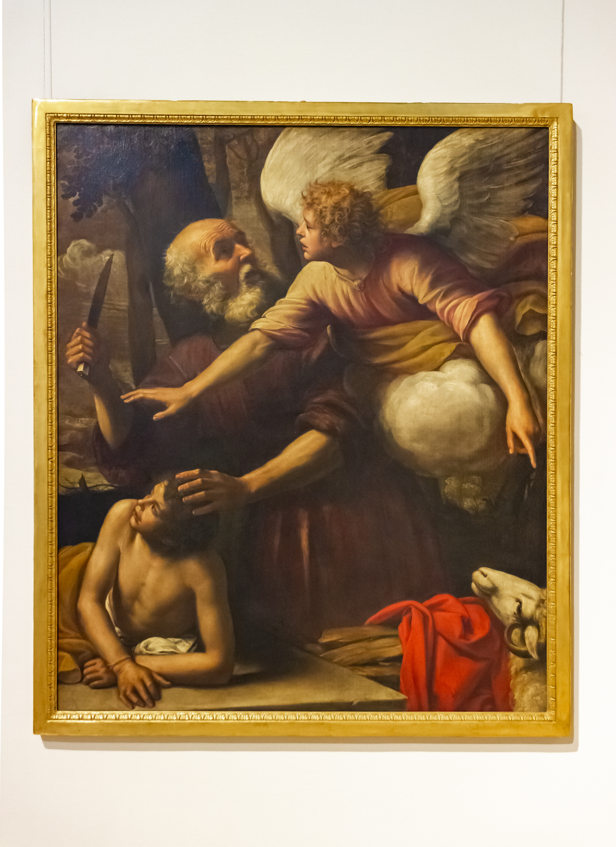
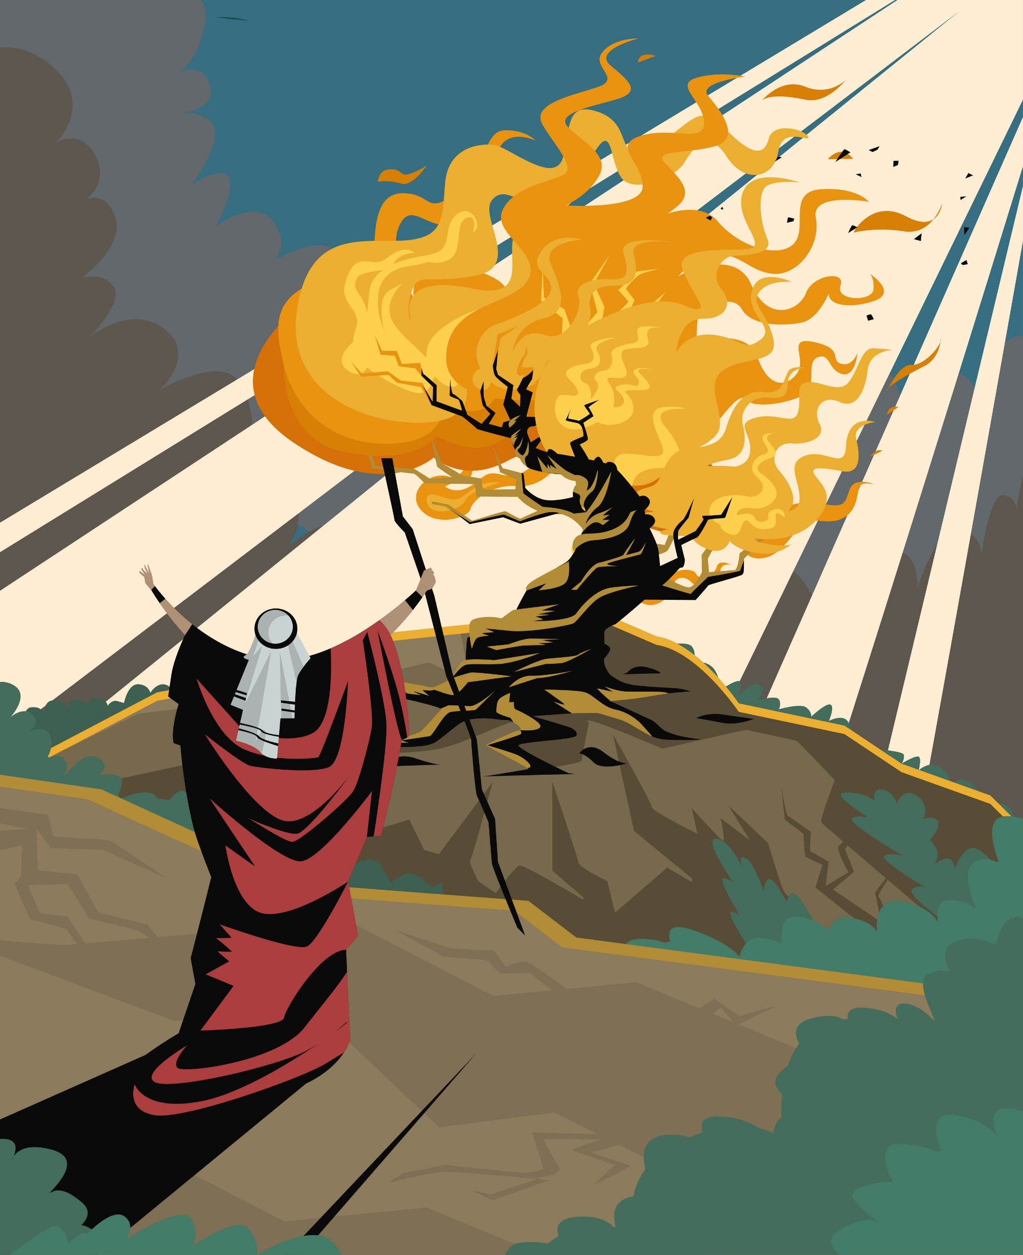
YEAR GROUP FOUR
Background knowledge for teachers
CORE CONCEPT:
PEOPLE OF GOD
The meaning of People of God:
The Old Testament is the story of God’s plan to save humanity and to restore the relationship between God and His people. There are many accounts in the Old Testament that demonstrate the ebs and flows of the plan. The message of many of the prophets was to try and encourage people to remain with God’s plan. However, this plan ends with the people of God exiled and then returning and waiting the coming of the Messiah – the anointed one
Religious vocabulary:
Vocation:
The word vocation comes from the Latin vocare, or voice – meaning to follow the voice of God, or to do what we are called to do.
A vocation is a calling that merges one’s mission in life with God’s mission on earth.
“The place God calls you is the place where your deep gladness and the world’s deep hunger meet.” Frederick Buechner: American theologian.
That intersecting point is your calling, your vocation.
Stories in context:
Abra(ha)m:
https://www.bbc.co.uk/religion/religions/judaism/history/abraham_1.shtml
Moses:
https://www.bbc.co.uk/religion/religions/judaism/history/moses_1.shtml
Notes:
Include any key information here…
https://www.learnreligions.com/the-book-of-ruth-117383
‘Naomi, Ruth and Obed‘, Thomas Matthews Rooke, 1876–7 | Tate

Slide 3
YEAR GROUP FOUR
Lesson 1: How did Abra(ha)m demonstrate faith in God?
CORE CONCEPT:
PEOPLE OF GOD
Intention:
To give pupils opportunities to:
Know the story of Abra(ha)m.
Be introduced to the concept: People of God.
Key religious vocabulary: Bible, Old Testament, People of God, faith.
Implementation:
Outlining how to introduce the religious content in the classroom and create learning opportunities from it.
Introduction:
Prior knowledge gathering:
Key questions:
What is the Old Testament?
What stories have you heard of, which can be found in the Old Testament?
What do you understand by the concept: ‘People of God’?
Introduce the unit of learning.
Explain the meaning of the core concept – People of God (Refer to background knowledge for teachers.)
Refer to the Biblical timeline and ensure pupils understand how these stories fit into the overall big story of the Bible.
To note: Ensure reference is made to the core concept throughout the whole unit.
Introduce the big question for the unit: How did belief in God affect the actions of people in the Old Testament?

Slide 4
YEAR GROUP FOUR
Lesson 1: How did Abra(ha)m demonstrate faith in God?
CORE CONCEPT:
PEOPLE OF GOD
Implementation:
Outlining how to introduce the religious content in the classroom and create learning opportunities from it.
Main teaching input: (Investigate and explore)
Introduce this week’s question: How did Abra(ha)m demonstrate faith in God?
Class thought gathering
Key questions:
What do you understand the word ‘faith’ to mean?
How do you think people show that they have faith in someone/something?
How might someone behave if they had faith in God?
Introduce pupils to the person of Abraham. (Refer to background knowledge for teachers.)
Watch the clip of the story of Abraham.
https://www.youtube.com/watch?v=8JeYA2x1OIk
Key questions:
How would you feel if you were told you had to move house?
How would you feel about moving from a house to living in a tent?
Consider the thoughts and feelings of the people you would have to leave behind and yourself.
Re-read the story from the Bible – Genesis chapter 12: 1- 9. Ensure all pupils can access the text and understand it. Address any vocabulary that may be new to pupils.
Main activity: (Evaluate and communicate)

Slide 5
YEAR GROUP FOUR
Lesson 1: How did Abra(ha)m demonstrate faith in God?
CORE CONCEPT:
PEOPLE OF GOD
Implementation:
Outlining how to introduce the religious content in the classroom and create learning opportunities from it.
Biblical text analysis:
Pupils to work in pairs to explore the following questions:
Alternatively, set up tables under the headings – behind, within and in front
To note: It is important for pupils to understand what the discipline of theology means and how looking through that lens helps us to get a real understanding of the text.
Looking through the lens of a theologian – (Believing) -
Place the questions below, under each heading. Pupils either in pairs or as a group, answer the questions.
Behind the text: Why was it written? Discipline: Theology
What is God asking Abram to do?
What does God promise Abram?
How does Abram respond to God’s request?
What does Abram do when he arrives in the land?
What do you think this text teaches about God and his relationship with his people?
Within the text: What does the text mean? Are there any words that need explaining? Discipline: Theology
What questions do you have about the text?
What puzzles you most about the text?
How do you think Abram felt as he was leaving his country? What is your reason for your answer?
What surprises you about the text?

Slide 6
YEAR GROUP FOUR
Lesson 1: How did Abra(ha)m demonstrate faith in God?
CORE CONCEPT:
PEOPLE OF GOD
Implementation:
Outlining how to introduce the religious content in the classroom and create learning opportunities from it.
In front of the text: This is concerned with the relationship between the text and the reader. Discipline: Theology
What do you think a believer can learn from this story?
What difference do you think this story might make to a believer’s life?
Plenary: (Reflect and express)
Whole class discussion:
Pupils share their responses. As a whole class, create a grid of responses under the following headings, providing a good understanding of the text through the lens of a theologian.
Behind | Within | In front

Slide 7
YEAR GROUP FOUR
Lesson 1: How did Abra(ha)m demonstrate faith in God?
CORE CONCEPT:
PEOPLE OF GOD
Resources
Bibles.
https://www.youtube.com/watch?v=8JeYA2x1OIk
Sensitivities
Be mindful of pupils who may have had to leave their home suddenly.
Be mindful of the current global situation where fleeing from one country to another is a ‘live’ situation.
Impact
What do you notice as a teacher?
What do pupils say?
In this box, note down anything that you heard a pupil say that would provide evidence towards their progress in RE.
Note down anything significant an additional adult has noticed.
Note down anything significant that happened in the lesson that will have an impact on the next lesson.

Slide 8
YEAR GROUP FOUR
Lesson 2: How did Abra(ha)m demonstrate faith in God?
CORE CONCEPT:
PEOPLE OF GOD
Intention:
To give pupils opportunities to:
Understand how Abraham demonstrated faith in God.
Understand what covenant God made between him and Abraham.
Make links between the text and what a believer can learn from the story about trusting and having faith in God.
Key religious vocabulary: Bible, Old Testament, People of God, faith, covenant.
Implementation:
Outlining how to introduce the religious content in the classroom and create learning opportunities from it.
Introduction:
Recap on previous week’s learning:
Key knowledge checking:
Check for understanding of the story of Abram so far.
Main teaching input: (Investigate and explore)
Introduce this week’s question:
Explore another part of the story of Abram: (Refer to background knowledge for teachers.)
God’s covenant with Abram and the birth of Isaac based on Genesis chapter 17 – 21.
Two possible clips to watch:
https://www.youtube.com/watch?v=NNxuukP6mgU – this clip explains the covenant.
https://www.youtube.com/watch?v=-rrcqpgEoug – the birth of Isaac.

Slide 9
YEAR GROUP FOUR
Lesson 2: How did Abra(ha)m demonstrate faith in God?
CORE CONCEPT:
PEOPLE OF GOD
Implementation:
Outlining how to introduce the religious content in the classroom and create learning opportunities from it.
Key points to pull out:
The meaning of the word covenant.
God promised three things for Abram – millions of descendants, a place to call home and God’s special blessing for him to share.
The significance of the changing of names.
The importance of patience and trust.
God always keeps his promise.
Main activity: (Evaluate and communicate)
Each pupil is given three thought bubbles and one question bubble. Pupils to provide a written response to the following questions:
What surprises you most about this part of the story?
What can a believer learn from both Abraham and Sarah?
What have you learnt from listening to this this story?
What question/s do you still have about this story?
Plenary: (Reflect and express)
Return to the lesson’s question: How did Abra(ha)m demonstrate faith in God?
Provide the pupils with the following words:
Trusted/obeyed/waited patiently/didn’t give up/listened/responded to what God asked him to do.
Key question:
Which word do you think best answers the question? Give a reason for your answer.

Slide 10
YEAR GROUP FOUR
Lesson 2: How did Abra(ha)m demonstrate faith in God?
CORE CONCEPT:
PEOPLE OF GOD
Resources
https://www.youtube.com/watch?v=NNxuukP6mgU – this clip explains the covenant.
https://www.youtube.com/watch?v=-rrcqpgEoug – the birth of Isaac.
Sensitivities
Be mindful of pupils who may have had to leave their home suddenly.
Be mindful of the current global situation where fleeing from one country to another is a ‘live’ situation.
Impact
What do you notice as a teacher?
What do pupils say?
In this box, note down anything that you heard a pupil say that would provide evidence towards their progress in RE.
Note down anything significant an additional adult has noticed.
Note down anything significant that happened in the lesson that will have an impact on the next lesson.

Slide 11
YEAR GROUP FOUR
Lesson 3: How did Moses follow God’s calling for his life?
CORE CONCEPT:
PEOPLE OF GOD
Intention:
To give pupils opportunities to:
Know what the word ‘vocation’ means.
Know the story of Moses and the burning bush and the key message behind it.
Make links between the text and what a believer can learn about what it means to listen and follow God’s call.
Key religious vocabulary: Vocation.
Implementation:
Outlining how to introduce the religious content in the classroom and create learning opportunities from it.
Introduction:
Recap on previous week’s learning:
Key knowledge checking:
How Abraham demonstrated faith in God.
The way God made a covenant with Abraham.
What a believer can learn from the story about trusting and having faith in God.
Prior knowledge gathering:
What do you already know about Moses? Who was he? What is he known for? Pupils will be recapping on knowledge learnt in K.S 1: Flight from Egypt. Receiving of the ten commandments.
Watch the clip below to secure prior knowledge and introduce new knowledge.
https://www.youtube.com/watch?v=0eEHT6dCKbI

Slide 12
YEAR GROUP FOUR
Lesson 3: How did Moses follow God’s calling for his life?
CORE CONCEPT:
PEOPLE OF GOD
Quick activity: In pairs sequence the key event in Moses life.
Main teaching input: (Investigate and explore)
Introduce this week’s question: How did Moses follow God’s calling for his life?
Watch the clip: A further in-depth look at Moses and the burning bush. Exodus 3: 1 – 4: 17.
Moses and the burning bush: https://www.youtube.com/watch?v=SZ9ZL1dRghQ
Explain the story of Moses: (Refer to background knowledge for teachers.)
Key questions:
How did Moses feel about following God’s ‘call’? (God’s instructions for what he wanted Moses to do in order to save the Israelites.)
Why was Moses reluctant to do what God said? (doubted himself, was afraid, found the whole thing hard to believe etc.)
How did God enable Moses to do what he was asking of him?
What signs did God give Moses to reassure him that he could achieve what is being asked of him?
Do you think God ever asks people to do something they are not able to do? What do you think stops people from following God’s call on their lives?
Christians believe that God ‘calls’ people to do certain things. Why do you think God called Moses? What was special about him?
Describe to pupils what the word ‘vocation’ means. (Refer to background knowledge for teachers.)
Key questions:
Who do you think has a vocation?
What is the difference do you think between a ‘job’ and a ‘vocation’?
What difference do you think it makes to a person if they believe that God ‘has’ called them to do a particular job? Do you think it changes the way they do a job?
Implementation:
Outlining how to introduce the religious content in the classroom and create learning opportunities from it.

Slide 13
YEAR GROUP FOUR
Lesson 3: How did Moses follow God’s calling for his life?
CORE CONCEPT:
PEOPLE OF GOD
Implementation:
Outlining how to introduce the religious content in the classroom and create learning opportunities from it.
Main activity: (Evaluate and communicate)
In groups of three:
Sorting activity.
Venn diagram – vocation, job, either.
(See appendix lesson 3.)
Plenary: (Reflect and express)
Questions to reflect on:
What was the outcome of Moses’ response to God’s call (The Israelites leaving Egypt to go to the ‘promised land.’)
What do you think a believer can learn from the story of Moses and the burning bush?
Do you think a believer feels they have a choice to say no if they think God is calling them to do something?
To note: Before lesson 4, pupils to prepare a number of questions to ask believers about what it means to them to follow God’s call – to see their job as a vocation. The sorts of things they might do to try and discover what God is asking of them. What difference does this make to the way they carry out their job and to their daily life?

Slide 14
YEAR GROUP FOUR
Lesson 3: How did Moses follow God’s calling for his life?
CORE CONCEPT:
PEOPLE OF GOD
Resources
https://www.youtube.com/watch?v=0eEHT6dCKbI – overview of the story of Moses.
https://www.youtube.com/watch?v=SZ9ZL1dRghQ – Moses and the burning bush.
Appendix lesson 3.
Sensitivities
Type sensitivities…
Impact
What do you notice as a teacher?
What do pupils say?
In this box, note down anything that you heard a pupil say that would provide evidence towards their progress in RE.
Note down anything significant an additional adult has noticed.
Note down anything significant that happened in the lesson that will have an impact on the next lesson.

Slide 15
YEAR GROUP FOUR
Lesson 4: What does it mean for a believer to follow God’s call?
CORE CONCEPT:
PEOPLE OF GOD
Intention:
To give pupils opportunities to:
Understand what the word vocation means.
Talk to believers and non-believers about their understanding of the word vocation.
Consider what they personally understand by the word vocation and whether they think it makes a difference in how someone lives their life or how they might make a decision in life.
Key religious vocabulary: Vocation.
Implementation:
Outlining how to introduce the religious content in the classroom and create learning opportunities from it.
Introduction:
Recap on previous week’s learning:
Key knowledge checking:
To know what the word ‘vocation’ means.
To know the story of Moses and the burning bush and the key message behind it.
Revisit sequencing activity from previous week’s lesson to ensure that pupils have a good understanding of the story of Moses.
Main teaching input: (Investigate and explore)
Introduce this week’s question: What does it mean for a believer to follow God’s call?

Slide 16
YEAR GROUP FOUR
Lesson 4: What does it mean for a believer to follow God’s call?
CORE CONCEPT:
PEOPLE OF GOD
Invite a number of people to the lesson for pupils to interview about what it means to have a vocation and what difference it makes to their daily work and lives. You may choose to have people from different faiths or you may choose to explore different understanding of vocation from a Christian perspective.
People you could consider inviting:
Religious vocation:
Bishop
Priest
Monk
Nun
A person of faith who believes they are carrying out a vocation God has called them to. This may include someone who is doing a voluntary job or a full-time parent.
Include in the panel someone who believes what they are doing is vocational but does not have a faith. How do they understand the word vocation and how does seeing what they do as a vocation differ from seeing it just as a job/task?
Ensure the panel is diverse in thought and what they bring to the discussion. This will help pupils to get an understanding that from a Christian perspective, God calls all people to do different things.
Alternatively: Christians in sport.
Listen to a podcast: Eg Look at https://www.christiansinsport.org.uk/resources/the-podcast/gavin-peacock/ (First 5 minutes – key. Listen to all and pick out sections that will open up the discussion for you.) or use another podcast of your choice.
Key question:
What difference did it make to Gavin, when he became a Christian, to his response to being a professional footballer?
What motivates him?
What comes first – football or Christ for Gavin? (Go to 30 min in.)
Implementation:
Outlining how to introduce the religious content in the classroom and create learning opportunities from it.

Slide 17
YEAR GROUP FOUR
Lesson 4: What does it mean for a believer to follow God’s call?
CORE CONCEPT:
PEOPLE OF GOD
Implementation:
Outlining how to introduce the religious content in the classroom and create learning opportunities from it.
Main activity: (Evaluate and communicate)
Having listened to a number of people about vocation or a podcast from a Christian who is a sports person and how that influences his/her response to sport, pupils independently answer the following questions:
What is your understanding of the word vocation?
From what you have heard, what difference does it make for a believer/person seeing what they do as a vocation/calling rather than just a job?
What would you like to do in the future? How do you think this will bring you joy? How might it help someone else? Why have you chosen what you have chosen – what motivates you most about your choice?
To note: Model a written response to question three to ensure a high-quality response is given.
Plenary: (Reflect and express)
Only believers have vocations. Agree or disagree with the statement.
Discuss:
The aim of this task is to see how pupils understand and interpret the word vocation.

Slide 18
YEAR GROUP FOUR
Lesson 4: What does it mean for a believer to follow God’s call?
CORE CONCEPT:
PEOPLE OF GOD
Resources
A panel of believers/non-believers.
https://www.christiansinsport.org.uk/resources/the-podcast/gavin-peacock/
Sensitivities
Type sensitivities…
Impact
What do you notice as a teacher?
What do pupils say?
In this box, note down anything that you heard a pupil say that would provide evidence towards their progress in RE.
Note down anything significant an additional adult has noticed.
Note down anything significant that happened in the lesson that will have an impact on the next lesson.

Slide 19
YEAR GROUP FOUR
Lesson 5: How did Ruth demonstrate faith in God through selflessness?
CORE CONCEPT:
PEOPLE OF GOD
To note:
Allow 1.5 hours for this lesson. You may wish to teach this lesson in two parts.
Intention:
To give pupils opportunities to:
Explore and understand the story of Ruth and Naomi.
Begin to understand what the words selflessness and sacrifice mean.
Ask questions.
Make links between the text and what a believer can learn about what it means to live a life of selflessness and sacrifice.
Key religious vocabulary: Selflessness, sacrifice.
Implementation:
Outlining how to introduce the religious content in the classroom and create learning opportunities from it.
Introduction:
Part 1:
Recap on previous week’s learning:
Key knowledge checking:
Prior knowledge learnt from lessons 1 – 4.
Prior knowledge gathering in small groups:
Key questions:
Can you name some key woman in the Bible?
What was their role in the Bible? How were they important? What can we learn from them?
Main teaching input: (Investigate and explore)
Introduce this week’s question: How did Ruth demonstrate faith in God through selflessness?

Slide 20
YEAR GROUP FOUR
Lesson 5: How did Ruth demonstrate faith in God through selflessness?
CORE CONCEPT:
PEOPLE OF GOD
Watch the clip – Ruth and Naomi. Pause the clip at key points to ensure understanding and to recap key points.
https://www.youtube.com/watch?v=VovWbGnt4BY
Key questions:
What choices did Ruth make?
What do think helped Ruth in making these choices?
What promises does Ruth make to Naomi?
Do you think Ruth made the right choices? Why?
Would you have made the same choice as her, or would you have done what Orpah did and have gone back to Moab and the people she knew?
Make the links between Ruth’s tough decision and ones that the pupils have had to make.
Ensure pupils understand the main themes in this story. (Refer to background information for teachers.)
What do you think this story teaches believers about love, friendship, doing what is right and self-sacrifice? Can you think of any other stories that illustrate the same point?
Part 2:
Main activity: (Evaluate and communicate)
Options: Task 1 or 2
Task 1a:
List the decisions Ruth had to make.
Stay with Naomi when she first leaves.
Stay with Naomi when Orpah leaves.
Go to the fields to get food for her and Naomi.
Ask for help from Boaz.
Marry Boaz.
Include Naomi in her family
Implementation:
Outlining how to introduce the religious content in the classroom and create learning opportunities from it.

Slide 21
YEAR GROUP FOUR
Lesson 5: How did Ruth demonstrate faith in God through selflessness?
CORE CONCEPT:
PEOPLE OF GOD
Task 1b:
What could the alternatives have been?
Task 1c:
Do you think she always made the right decision? Explain your answer.
Task 2:
Look at the triptych painting of the story of Ruth by Thomas Rooke which shows Ruth supporting Naomi, then meeting Boaz, then Naomi holding Ruth’s son (ancestor of David).
In pairs pupils record on thought bubbles what each character might be thinking/feeling.
‘Naomi, Ruth and Obed‘, Thomas Matthews Rooke, 1876–7 | Tate
Plenary: (Reflect and express)
The story of Ruth is a story of absolute selflessness. If Ruth hadn’t chosen to trust God and show love to Naomi throughout, the story would have been a very different one.
Key questions:
Why do you think Ruth made the choices she did?
Can you think of a time when you have had to make a choice between doing what you wanted and helping someone else? What choice did you make? How did it feel to make that choice?
Why do you think God asks his followers to put others first?
Implementation:
Outlining how to introduce the religious content in the classroom and create learning opportunities from it.

Slide 22
YEAR GROUP FOUR
Lesson 5: How did Ruth demonstrate faith in God through selflessness?
CORE CONCEPT:
PEOPLE OF GOD
Resources
https://www.youtube.com/watch?v=VovWbGnt4BY
Sensitivities
Be mindful of pupils who have had to make difficult decisions or seen difficult decisions having to be made in their family homes.
Be mindful of pupils who have experienced death or who may be currently grieving.
Impact
What do you notice as a teacher?
What do pupils say?
In this box, note down anything that you heard a pupil say that would provide evidence towards their progress in RE.
Note down anything significant an additional adult has noticed.
Note down anything significant that happened in the lesson that will have an impact on the next lesson.

Slide 23
YEAR GROUP FOUR
Lesson 6: Assessment
CORE CONCEPT:
PEOPLE OF GOD
Intention:
To give pupils opportunities to:
Revisit prior learning taught in the unit.
Demonstrate knowledge learnt.
Make links.
Ask questions.
Key religious vocabulary: Bible, Old Testament, People of God, faith, vocation, selflessness, sacrifice.
Implementation:
Outlining how to introduce the religious content in the classroom and create learning opportunities from it.
Assessment activity:
Groups of three:
Pupils work in groups of three.
To note: The role of the teacher during the task is to listen to pupils’ responses, to ask follow up questions and to address any misconceptions.
Each group is given a ‘talking tub’ that consists of the following: (See appendix lesson 6a.)
Paintings of Abraham, Moses and Ruth.
Key words and images that are associated with each person.

Slide 24
YEAR GROUP FOUR
Lesson 6: Assessment
CORE CONCEPT:
PEOPLE OF GOD
Pupils are encouraged to complete the following steps: You may wish to simplify these tasks or just do one of the steps.
Step 1:
Pupils are given the opportunity to talk about each item/painting/words in the tub. What can they remember from the unit of learning? What things would they link together? Pupils are encouraged throughout to use religious vocabulary in their talk and conversation.
Step 2:
On strips of paper, pupils write down what they believe the key knowledge is for each item, using appropriate religious vocabulary. (Key events that took place for each person, what actions did each person take, how did they respond to what God was requiring of them? What can believers learn from each person?)
Step 3:
On a different coloured strip of paper, pupils write down any links/connections they can make/see between the different paintings/images and words (Trust, obedience, faith, commitment to God, leaders.) Eg Do some of the words belong to more than one story?
Step 4:
On speech bubbles, pupils write down any questions they still have related to the decisions each person made?
Plenary: (Reflect and express)
Return to the big question: How did belief in God affect the actions of people in the Old Testament?
Recap on how belief in God affected each person’s actions.
(See appendix 6b.)
Abraham – had faith in God and so left his land and all his possessions just as God had requested him to. God made him the Father of all the nations.
Moses – listened and followed God’s call which enabled him lead the Israelites to the promised land.
Ruth – showed unconditional love, what it means to be selfless and what self-sacrifice really means.
Implementation:
Outlining how to introduce the religious content in the classroom and create learning opportunities from it.

Slide 25
YEAR GROUP FOUR
Lesson 6: Assessment
CORE CONCEPT:
PEOPLE OF GOD
Implementation:
Outlining how to introduce the religious content in the classroom and create learning opportunities from it.
Making a decision:
In groups of 4, pupils are presented with the following scenario. (Be mindful of your school context and re-write it if it is not appropriate for your current setting.)
Millie is eight years old. She comes from a Christian family. Millie attends church every week and her faith is very important to her. She knows the two greatest commandments – love God and love your neighbour as yourself.
A new child joins her class. His name is Fred. Fred is very shy and doesn’t speak even when children try to speak to him. At lunchtime Fred tries to join in playing football but soon becomes upset because his team are losing. Millie sees Fred sitting on the bench crying. Millie loves sport and she is meant to be attending football training this particular lunchtime. It is the last training before the big match against another school. If she doesn’t attend training, she can’t play in the match. What do you think Millie should do? Go training or sit with Fred and try and cheer him up? Or do something different? What might influence her decision?
Things to consider before making the decision.
Millie is a Christian.
Millie loves football and is very good at it. Her team rely on her.
Fred is shy and doesn’t talk to anyone.
Who might Millie go to, to ask for guidance?
What might Millie do before she makes a decision?
Each group decides on what Millie should do with a clear reason for their answer.
Snowball: One group joins another group and listens to their response. As a group of eight, having heard each other’s responses – what is their new response? Does the group agree to accept one of the group’s decision or do they come up with a different decision and reason for their choice?

Slide 26
YEAR GROUP FOUR
Lesson 6: Assessment
CORE CONCEPT:
PEOPLE OF GOD
Resources
Appendix lesson 6a and 6b
Sensitivities
Be mindful of any new pupils or pupils who may struggle with friendships.
Impact
What do you notice as a teacher?
What do pupils say?
In this box, note down anything that you heard a pupil say that would provide evidence towards their progress in RE.
Note down anything significant an additional adult has noticed.
Note down anything significant that happened in the lesson that will have an impact on the next lesson.

Slide 27
London Diocesan Board for Schools
www.ldbs.co.uk 020 7932 1100
London Diocesan Board for Schools is a Charitable Company Limited by Guarantee. Company Registration No 198131. Charity Registration No 313000.
Registered Address: London Diocesan House, 36 Causton Street, London, SW1P 4AU
© Copyright London Diocesan Board for Schools 2023
All rights reserved. No part of these slides may be reproduced, stored in a retrieval system or transmitted in any form or by any other means, electronic or mechanical photocopying, recording or otherwise without the prior written permission of the London Diocesan Board for Schools. These slides may not be lent, resold, hired out or otherwise disposed of by way of trade without the prior consent of the London Diocesan Board for Schools.

