Slide 1
YEAR GROUP ONE
Big Question:
Why is Easter the most important festival for Christians?
CORE CONCEPT:
SALVATION
Weekly questions:
Week 1: What happened on Palm Sunday and what does it teach us about Jesus? Week 2: What happened at the Last Supper and what does it teach us about Jesus? Week 3: What happened on Good Friday and what does it teach us about Jesus? Week 4: What happened on Easter Sunday and what does it teach us about Jesus?
What a child needs to know and remember by the end of the unit:
To know and remember the meaning of the core concept: Salvation – to save
To know and remember what happened on:
Palm Sunday - Jesus’ entry into Jerusalem
Maundy Thursday – The events of the Last Supper
Good Friday – Jesus’ death and the build up to this
Easter Sunday – Jesus’ Resurrection
What a child should be able to do (Assessment): Beliefs, teachings, sources of wisdom and authority:
I can talk about the Easter story (WT)
I can retell the Easter story in order of events and talk about it. (Exp)
I can retell the Easter story and give some meaning about what each event teaches us about Jesus and why it is the most important festival for Christians. (GD) E.g. – Palm Sunday – Kingship of Jesus. Last Supper – Jesus came to serve. Good Friday – Jesus was prepared to suffer for the world because He loved humanity. Easter Sunday – Jesus is able to conquer death because Christians believe He is God.
Questions of purpose, meaning and truth:
I can recall an occasion and say whether it made me feel happy or sad. (WT)
I can think and talk about special things that have happened to me and what they mean. (Exp)
I can talk about the events that occur in the Easter story and ask and answer questions about what they might mean for a Christian and why Easter is the most important festival for Christians. (GD) E.g.: Palm Sunday – what does seeing Jesus as a King mean for a Christian? The Last Supper – Jesus came to serve – what is Jesus saying about how people should treat one another? Good Friday – Jesus suffered because he loved humanity. How do people show love to others? Easter day – resurrection – new life. What do Christians do to remember Jesus is alive today in the lives of people – e.g. go to church, try and be like Jesus through their actions and words.
Religious vocabulary:
Salvation: To be rescued/saved by God. Relationship between God and humankind is restored.
Jesus: The central figure in Christianity. The second person of the Trinity.
Disciple: A follower of Jesus
Pharisee: Jewish religious leader
Palm Sunday: The day Christians remember the triumphal entry of Jesus into Jerusalem.
King: A person who has absolute authority.
Hosanna: Hebrew word that means to ‘save/rescue.’
Last Supper: The last meal Jesus ate with his disciples.
Servant: Someone who comes to serve others from a place of humility
Gethsemane: The garden Jesus went to pray before he was arrested.
Good Friday: The day on which Christians remember Jesus’ death.
Crucifixion: A method used to execute criminals.
Forgiveness: To ‘let go’ of those things that hurt us.
Love: Giving to others in a selfless way. Not expecting anything back
Cross: The instrument on which Jesus died. A symbol of forgiveness and sacrifice.
Tomb: The place where Jesus was laid.
Easter Sunday: The day Christians celebrate the resurrection of Jesus Christ
Resurrection: The rising from the dead of Jesus Christ
Sensitivities:
This unit will cover the facts related to Jesus’ death and resurrection. Some pupils may find this upsetting as they may have experienced the death of a loved one. Also be aware that some pupils may be worried about dying themselves.
Although the story and message of Easter is integral to the Christian faith, be aware of pupils of other faiths in the class.

Slide 2
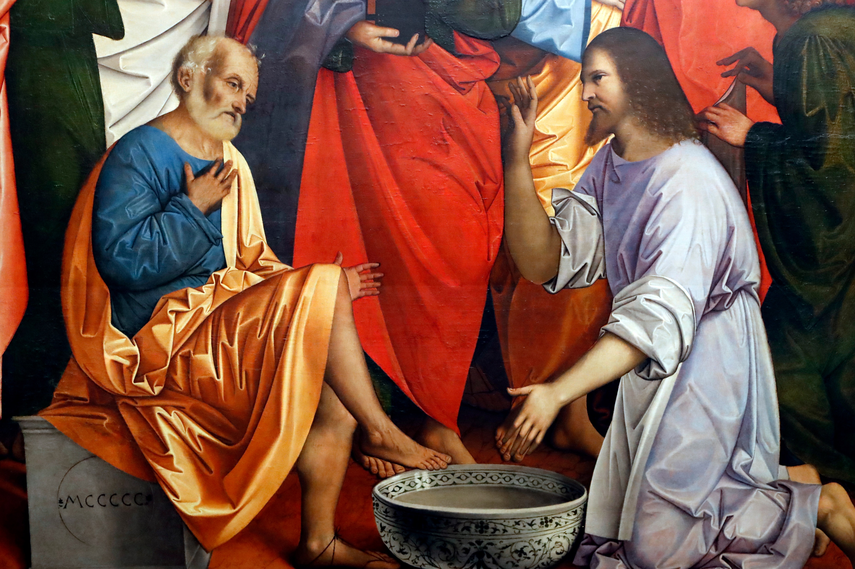
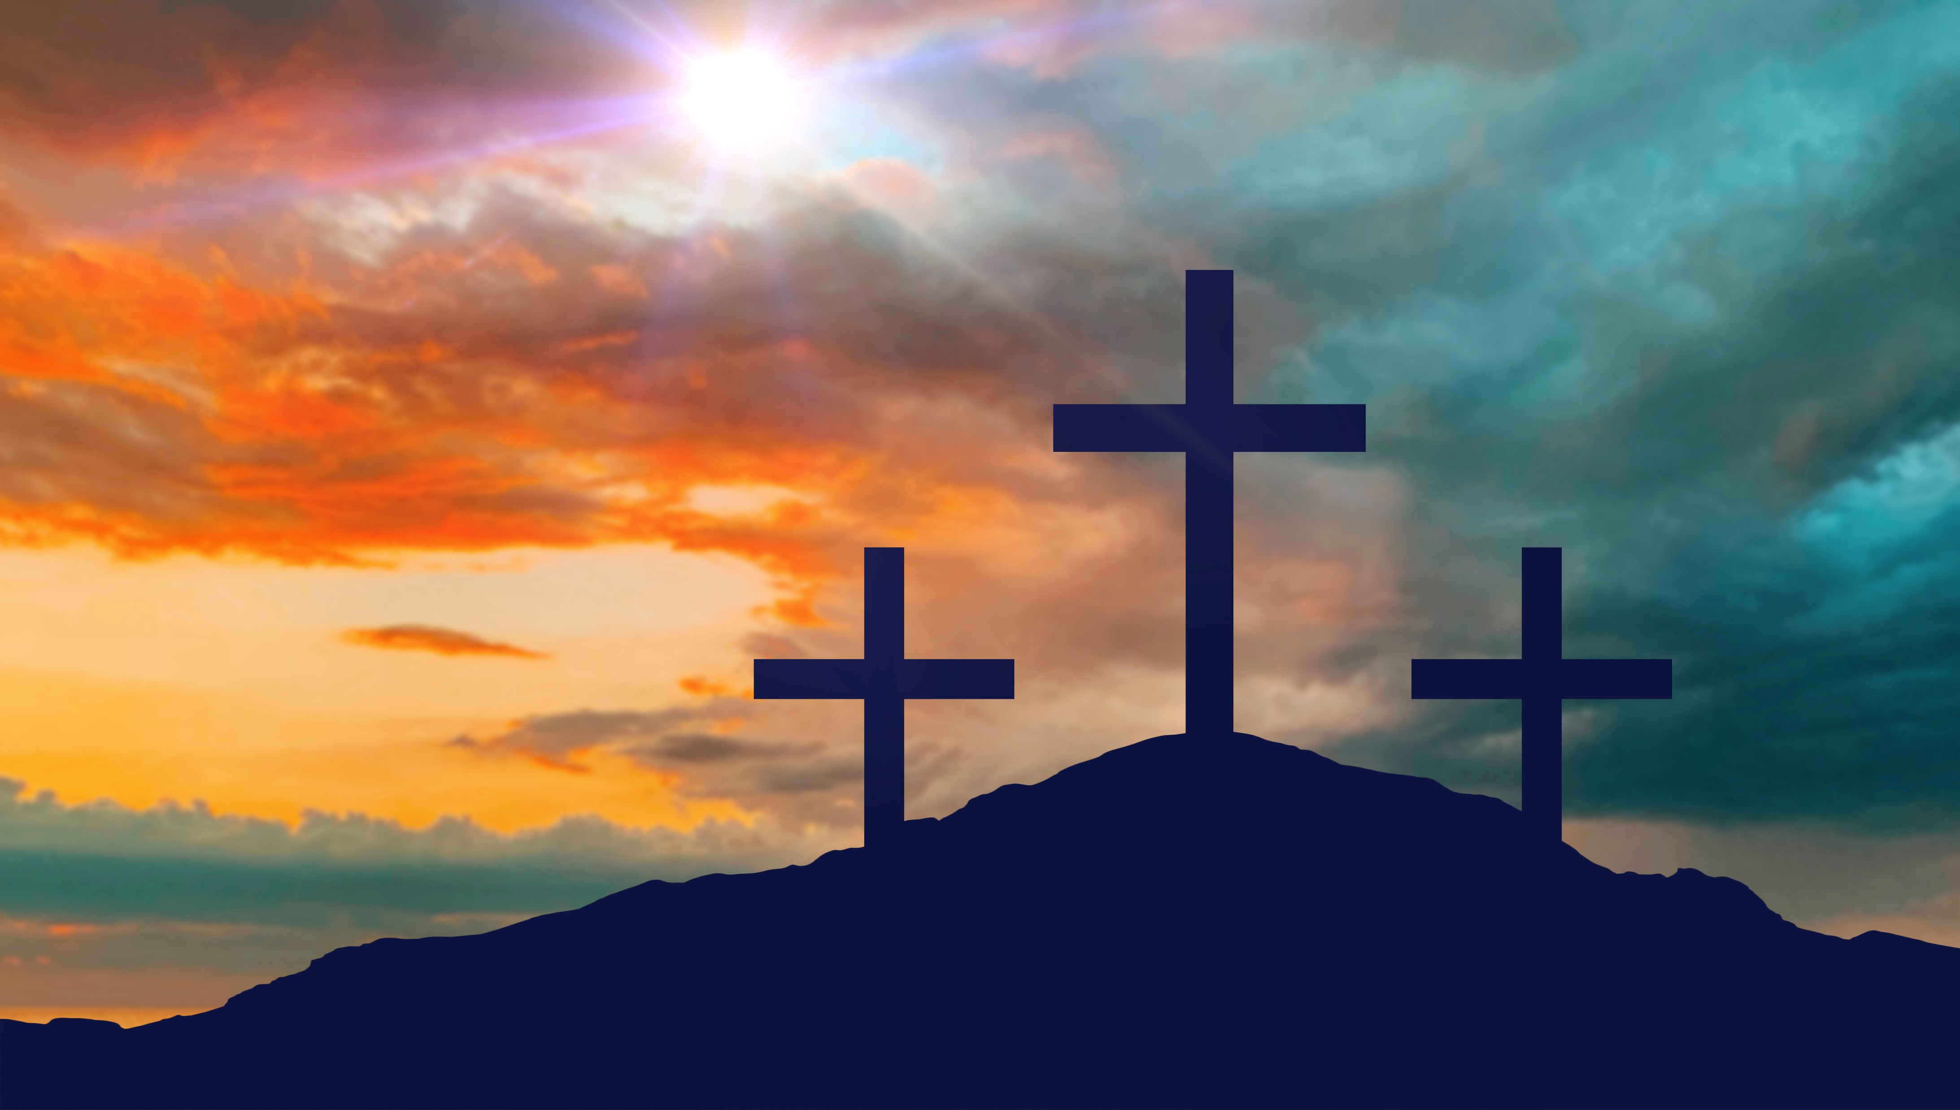
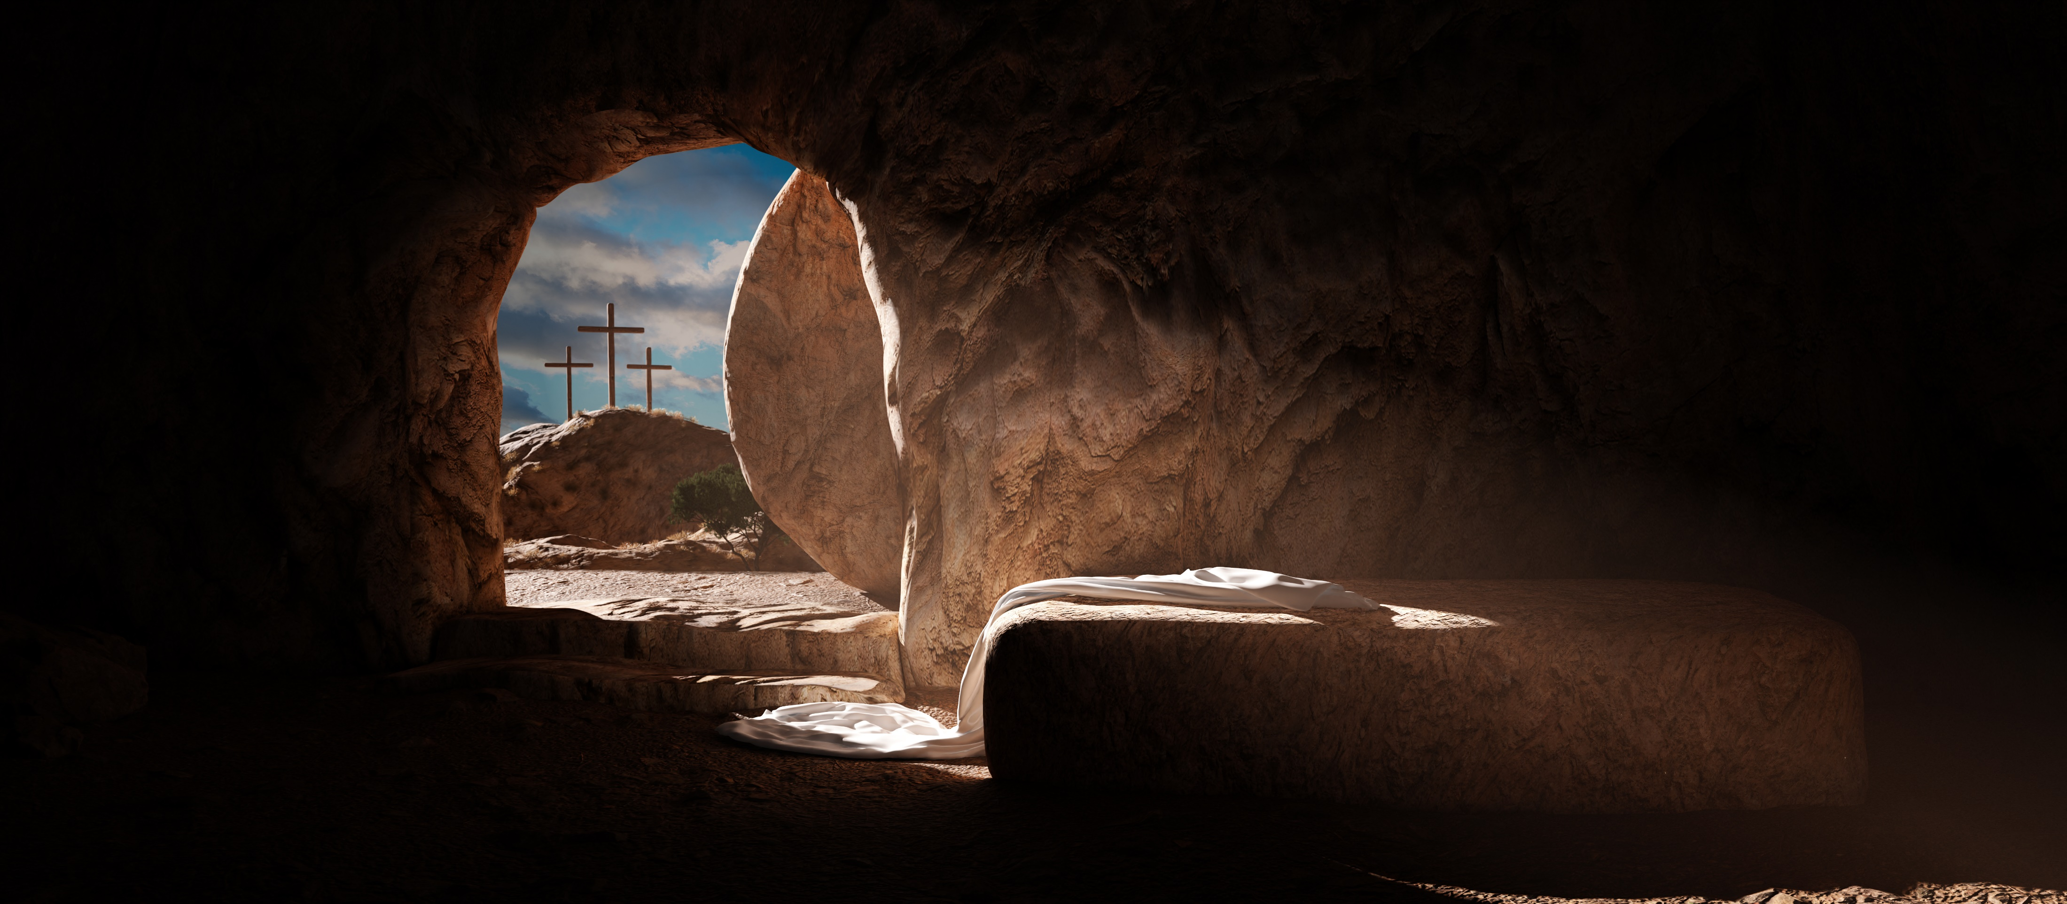
YEAR GROUP ONE
Background knowledge for teachers
CORE CONCEPT:
SALVATION
The meaning of salvation:
It is through the death and resurrection of Jesus that the relationship between God and humanity is restored. In the death of Christ, forgiveness is offered for the sins of all people.
Palm Sunday:
Holy week begins with Palm Sunday. On this day the focus is on the triumphal entry of Jesus into Jerusalem. Jesus sends two of his disciples ahead to the village of Bethphage to look for an unbroken colt. They brought the colt to Jesus and placed their cloaks on his back. As Jesus sat on the young donkey, he slowly made his humble entrance into Jerusalem. People welcomed Jesus in the traditional way of honouring a worthy person, by throwing down their cloaks and waving palm branches.
The crowds that went ahead of him and those that followed shouted, "Hosanna to the Son of David! Blessed is he who comes in the name of the Lord! Hosanna in the highest heaven!" (Matthew 21:9, NIV)
The shouts of "Hosanna" meant "save now," and the palm branches symbolised goodness and victory.
Maundy Thursday: The Last Supper
Whilst Maundy Thursday was the night on which the Lord’s Supper was first celebrated, there is a deeper meaning. The actual Latin word from which "maundy" is derived means "command." The central theme of that first Lord’s Supper was one of humble service. Jesus washed the feet of the disciples and commanded that the disciples do the same for each other. Jesus taught that he came not to be served but to serve, to share the hospitality of God and the intimacy of breaking bread together.
Good Friday:
Good Friday is the Friday before Easter Day. Good Friday was the day when Jesus stood trial before the Priests and later a Roman Governor called Pilate. Although Pilate could not find any wrong in Jesus, he was still sentenced to death by crucifixion. Later that day after having been beaten and mocked, Jesus was crucified. He died in the afternoon. His body was taken from the cross and put into a guarded tomb.
Easter Sunday:
Easter is the most significant Christian festival, remembering and celebrating the salvation offered through Jesus.
On Easter Sunday, the women on visiting Jesus’ tomb, found the stone had been moved, and his body gone. The Gospels recall the resurrection accounts slightly differently, presenting different details and perspectives but all presented as eye-witness reports. Jesus appears to the women and his disciples on a number of different occasions. He first appears in the garden. He appears on the road to Emmaus. He appears among them while they were still talking about the events of the day. He appears again to his disciples by the Sea of Tiberias during the miraculous catch of fish. On Easter Sunday, hope comes. The disciples cannot believe it at first and are not able to believe until they encounter the living Christ.

Slide 3
YEAR GROUP ONE
Lesson 1: What happened on Palm Sunday and what does it teach us about Jesus?
CORE CONCEPT:
SALVATION
Intention:
To give pupils opportunities to:
Know what happened on Palm Sunday.
know that Palm Sunday teaches us that Jesus was humble (riding on a donkey) and was seen as a King who came to bring peace to the world.
Be able to talk about a special occasion and how it made them feel.
Key religious vocabulary: Palm Sunday, disciple, King, hosanna.
Implementation:
Outlining how to introduce the religious content in the classroom and create learning opportunities from it.
Introduction:
Key questions:
Have you ever been part of a large, crowd celebrating a special occasion?
What was the occasion?
What did it feel like?
What did people do?
How was it different from normal?
Watch a video clip/ look at pictures of famous people eg a royal wedding
How does the crowd respond? (cheer, wave, shout, etc)
What is the feeling of the crowd? (excitement, anticipation, joy)
Why is there a crowd? (they want to see the important people)
Main teaching input: (Investigate and explore)
Introduce the big question for the unit: Why is Easter the most important festival for Christians?
Introduce this week’s question: What happened on Palm Sunday and what does it teach us about Jesus?

Slide 4
YEAR GROUP ONE
Lesson 1: What happened on Palm Sunday and what does it teach us about Jesus?
CORE CONCEPT:
SALVATION
Implementation:
Outlining how to introduce the religious content in the classroom and create learning opportunities from it.
Read from the story of Jesus entering Jerusalem or use a video clip which tells the story of the triumphal entry into Jerusalem - Luke 19: 28 – 44
Palm Sunday for Kids: The Triumphal Entry: Easter Sunday https://www.youtube.com/watch?v=VIUk0YCi15w
Discuss Jesus’ entry into Jerusalem on Palm Sunday and what it tells us about who people thought Jesus was.
Key questions:
Why were there so many people? (they had heard about Jesus and what he had been doing - miracles, or met Jesus before)
Who did the people think Jesus was? (they thought he might be the new King, person who was going to save them, knew he was special because of his miracles)
Why would some people, particularly the Pharisees, not have been happy about Jesus’ arrival? (jealous, threatened, scared of change etc)
Teacher subject knowledge:
Jesus was Jewish. It was the feast of the Passover. Large crowds gathered for the Feast every year. It is important to inform the pupils of this as often pupils think Jesus was a Christian – a very common misconception.
The Pharisees were not happy neither were the Romans because Jesus was challenging both the Roman and Jewish authorities. Jesus was a threat to the establishment of the day and had been throughout his whole ministry.
It is important to understand that Jesus’ entry into Jerusalem showed his Kingship. He was the King who came to bring peace. A very different type of King to what they people had ever known.
Main activity: (Evaluate and communicate)
Purpose of the activity:
To prepare palm branches/banners to wave to welcome Jesus as he enters into Jerusalem in the re-enactment of the Palm Sunday procession that will take place at the end of the lesson.

Slide 5
YEAR GROUP ONE
Lesson 1: What happened on Palm Sunday and what does it teach us about Jesus?
CORE CONCEPT:
SALVATION
Implementation:
Outlining how to introduce the religious content in the classroom and create learning opportunities from it.
Key questions:
What words would you have shouted if you were welcoming Jesus? Why have you chosen these words? (From children’s response, teachers can identify those children who have an understanding of who Jesus was.)
Can you think of some adjectives to describe how you might have been feeling if you had been in that crowd? Can you explain why these adjectives?
Option 1:
Pupils make individual palm branches and write their response to the above questions on the branch.
Teachers to model what a quality response looks like:
E.g.: Welcome Jesus. You are the King who brings peace.
Hosanna in the highest. Thank you for coming to save us.
You are the best because you healed people and loved everyone.
Welcome to Jerusalem. The King has arrived.
Hurray for King Jesus. The man that has healed and performed miracles.
I would have felt very excited because everyone was gathered together to celebrate Jesus’ arrival.
I would have been a little bit worried with so many people being there. Not everyone liked Jesus.
I would have been excited but also shocked to see Jesus riding on a donkey. I thought Kings came on horses.
I would have been happy to be celebrating with everyone just like when we celebrate with our friends and family on someone’s Birthday
I would have been a little confused because when our King visits, she arrives in a smart coach pulled by horses or in a very nice car so why did Jesus come on a donkey?
Differentiation: Provide a word bank of appropriate adjectives to choose from. For pupils who struggle to write, focus on the making on of the palm branch using a range of collage materials a verbally encourage them to give a response to the question. Record on a post it notes.

Slide 6
YEAR GROUP ONE
Lesson 1: What happened on Palm Sunday and what does it teach us about Jesus?
CORE CONCEPT:
SALVATION
Implementation:
Outlining how to introduce the religious content in the classroom and create learning opportunities from it.
Option 2:
Pupils work in groups of three to create a group banner.
On the banner, they place their written responses to the above questions and decorate the banner with appropriate images linked with Palm Sunday. E.g.: Palm branches, donkey, Jesus, other words that might have been shouted out – eg: Hosanna
Teachers to provide pupils with an example of what makes for a high-quality banner.
Plenary: (Reflect and express)
Act out on the playground if possible, (to get a sense of space/being outside and there being a crowd,) the arrival into Jerusalem. Give someone the role of being Jesus. You may like to also have people outside of the crowd – Roman Soldiers and Pharisees, looking in as a way of making it clear to the pupils that not everyone was celebrating Jesus’ arrival.
Pupils encouraged to shout out their phrases. Pupils could be encouraged to sing a Palm Sunday song: Hosanna (Out of the Ark) Sing Hosanna, You are the King of Glory.
Conclude the session with the key question for the lesson: What happened on Palm Sunday and what does it teach us about Jesus?
Draw out ideas about Jesus as a leader and King (but not the sort of ‘King’ people expected), humble (on a donkey not a grand horse or chariot) and saviour (‘Hosanna’ means ‘save us’).
To note: Keep the palm branches/banners as evidence of the learning. Add them to the learning journey.

Slide 7
YEAR GROUP ONE
Lesson 1: What happened on Palm Sunday and what does it teach us about Jesus?
CORE CONCEPT:
SALVATION
Resources
Palm Sunday for Kids: The Triumphal Entry: Easter Sunday https://www.youtube.com/watch?v=VIUk0YCi15w
Bible
Songs linked to Palm Sunday
A range of collage materials
Sensitivities
Children having worries/ memories of being part of a big crowd.
Other religions will not view Jesus in the same way that Christians do, and some children may find it hard to ‘welcome’ Jesus as part of a drama scenario. Compare other situations where people wave things eg flags at Royal events. Scarves at football matches
Impact
What do you notice as a teacher?
What do pupils say?
In this box, note down anything that you heard a pupil say that would provide evidence towards their progress in RE.
Note down anything significant an additional adult has noticed.
Note down anything significant that happened in the lesson that will have an impact on the next lesson.

Slide 8
YEAR GROUP ONE
Lesson 2: What happened at the Last Supper and what does it teach us about Jesus?
CORE CONCEPT:
SALVATION
Intention:
To give pupils opportunities to:
Recall and retell the events of the Last Supper.
Know that the Last Supper teaches us that Jesus came to serve.
Ask and answer questions related to the Last Supper from their own view point and from the view point of a disciple
Ask and answer questions about what Christians might learn from the Last Supper about how to live their lives.
Talk about a special meal, they have participated in and how it made them feel.
Religious vocabulary: Last Supper, Pharisees, remembrance, Servant King.
Implementation:
Outlining how to introduce the religious content in the classroom and create learning opportunities from it.
Introduction:
Recap on previous week’s learning.
Key knowledge checking:
To know what happened on and the meaning of Palm Sunday.
Key questions:
Have you ever had a special meal?
How did it make you feel?
Who did you share it with?
Discuss with the pupils what made their meal particularly special. Was it a celebration of some kind, or did it mark a special occasion?
Explain that today they are going to learn about a very special meal that Jesus had with his disciples (special friends), which people call the ‘Last Supper’.
Main teaching input: (Investigate and explore)
Introduce this week’s question: What happened at the Last Supper and what does it teach us about Jesus?

Slide 9
YEAR GROUP ONE
Lesson 2: What happened at the Last Supper and what does it teach us about Jesus?
CORE CONCEPT:
SALVATION
Implementation:
Outlining how to introduce the religious content in the classroom and create learning opportunities from it.
Recap: Palm Sunday was a time when people welcomed Jesus into Jerusalem like a king. Look back at any evidence captured in the previous lesson e.g. palm branches/ banners. How did people feel about Jesus on Palm Sunday?
However, after only a few days (count the days on a calendar – Sunday to Thursday), people had started to turn against Jesus. The religious leaders (‘Pharisees’) didn’t like how popular Jesus was and were worried that he might become more powerful than them.
Read the events of the Last Supper from the Bible or watch a video clip showing the same events – Luke 22: 7 – 38. John 13 – 1 – 17 (Both accounts need be read as Luke refers to the bread and wine and John to the washing of feet.)
Watch clip: The Story of #Easter (The Last Supper) – pause the video at 5.21 min in
Key questions:
What did Jesus do that was different at this Passover Meal?
Bread and wine: have you ever heard the words ‘do this in remembrance of me’ before? What do you think Jesus meant by this?
Washing the disciples’ feet: why was this a strange thing for Jesus to do?
What do you think Jesus was trying to show his disciples by washing their feet? What does it teach us about Jesus?
How do you think the disciples were feeling at this meal?
It is called the ‘Last Supper’. Why?
Teacher subject knowledge: This was the Passover Meal that Jesus and the disciples would be very familiar with. Jewish people celebrate the feast to commemorate the liberation of the Children of Israel who we led out of Egypt by Moses. The Children of Israel had been slaves in Egypt for 210 years. God promised he would release them from slavery but not before Pharaoh had refused their release and God had visited ten plagues on Egypt to demonstrate his power. The Egyptians become very frightened, and they summon Moses to banish the Israelites there and then.
The central theme of that first Lord’s Supper was one of humble service. Jesus washed the feet of the disciples and commanded that the disciples do the same for each other. Jesus taught that he came not to be served but to serve, to share the hospitality of God and the intimacy of breaking bread together.
Look at Leonardo Da Vinci’s painting of the Last Supper, referring back to the Bible story.

Slide 10
YEAR GROUP ONE
Lesson 2: What happened at the Last Supper and what does it teach us about Jesus?
CORE CONCEPT:
SALVATION
Implementation:
Outlining how to introduce the religious content in the classroom and create learning opportunities from it.
Explain to the pupils the scene Leonardo Da Vinci is trying to show in his painting:
Teacher subject knowledge: The painting depicts Jesus's last meal with his disciples before he was captured and crucified. But more specifically, Leonardo da Vinci wanted to capture the scene just after Jesus reveals that one of his friends will betray him, complete with reactions of shock and rage from the disciples. In Leonardo da Vinci's interpretation, the moment also takes place just before the birth of the Eucharist, with Jesus reaching for the bread and a glass of wine that would then become the key symbols of this Christian sacrament.
Key questions:
What can you see?
What is on the table?
Who is there? What are they doing?
What do their facial expressions tell you?
Why do you think Jesus in the middle of the painting?
What do you think the disciples might be saying to each other?
Main activity: (Evaluate and communicate)
Carousal of activities and children choose where to go or go with one option:
Option 1: Model what a high-quality response would look like.
Provide a copy for each child of the Last Supper painting
Provide each child with a speech bubble.
Pupils imagine they are a disciple sitting at the table. What is it they are saying to one of their friends or to Jesus directly?
Option 2:
Pupils are given the option to wash either each other’s feet or their teacher washes their feet. How do they feel washing the feet of their friend and how do they feel having their feet washed? How do you think the disciples felt having their feet washed by Jesus? Can you explain your answer?
Record the conversation on video and take photos of the action.

Slide 11
YEAR GROUP ONE
Lesson 2: What happened at the Last Supper and what does it teach us about Jesus?
CORE CONCEPT:
SALVATION
Implementation:
Outlining how to introduce the religious content in the classroom and create learning opportunities from it.
Option 3: This activity strengthens the teaching of what the Last Supper has to teach Christians today.
Showing love to others through acts of service.
Pupils decide either in groups or pairs an act of service they could do for someone else. This could be for a member of their family or another friend or another class. Eg – playing with the reception children at playtime. Helping in the dining hall. Offering to do a job for a member of staff. Bringing an item of food in for the local food bank. Having a coffee morning and serving drinks and home-made biscuits to their parents.
Plenary: (Reflect and express)
Return to the question of the lesson: What happened at the Last Supper and what does it teach us about Jesus?
Recap on the main teaching points:
Jesus asked the disciples to break bread and drink wine to remember him.
Jesus washed his disciples’ feet as a sign that he had come to serve and not be to be served. He commanded them to do the same to each other out of love.
The Last Supper teaches us that Jesus came to serve. That he was humble and never saw himself better than anyone else.
The Last Supper gives Christians a clear example of how they should treat one another.
Children should now know that Jesus was a King who came to bring peace and to serve. He is often known as the Servant King
Key question: Provide a picture of the disciple Peter and Jesus.
What do you think Peter would want to say to Jesus?
What do you think Jesus would want to say to his disciples?
How do you think Jesus would want his followers (Christians) to treat others? The aim of this question is to see if children have made the link between Jesus’ act of service and commandment to his disciples to serve one another, with how Christians should love and serve each other and others today.

Slide 12
YEAR GROUP ONE
Lesson 2: What happened at the Last Supper and what does it teach us about Jesus?
CORE CONCEPT:
SALVATION
Resources
The Story of #Easter (The Last Supper)
Painting of the Last Supper by Leonardo Da Vinci
Sensitivities
Be aware of pupils who may find the topic of dying and death difficult and upsetting.
Be aware of pupils who may have experienced violence.
Important to point out the hope that the resurrection brings to Christians.
Impact
What do you notice as a teacher?
What do pupils say?
In this box, note down anything that you heard a pupil say that would provide evidence towards their progress in RE.
Note down anything significant an additional adult has noticed.
Note down anything significant that happened in the lesson that will have an impact on the next lesson.

Slide 13
YEAR GROUP ONE
Lesson 3: What happened on Good Friday and what does it teach us about Jesus?
CORE CONCEPT:
SALVATION
Intention:
To give pupils opportunities to:
Recall and retell the events of Good Friday.
Know that Good Friday teaches us that Jesus came to forgive and to show love through dying so that people could be friends with God again.
Be able to ask and answer questions related to the events of Good Friday.
Ask and answer questions about what Christians might learn from the events of Good Friday about how to live their lives.
Be able to talk about things that make them feel sad.
Religious vocabulary: Salvation, Good Friday, Gethsemane, crucifixion, tomb.
Implementation:
Outlining how to introduce the religious content in the classroom and create learning opportunities from it.
Introduction:
Recap on previous week’s learning.
Key knowledge checking:
Recall and retell the events of the Last Supper.
Know that the Last Supper teaches us that Jesus came to serve.
Key questions:
Have you ever had a hot cross bun?
Can you remember what they tasted like?
Do you know why they have crosses on them?
Teacher subject knowledge: There isn’t one clear explanation for why hot cross buns are eaten on Good Friday. Some theories rest in Christian symbolism, though there are several stories (and even some tales) about their origins. Some talk about hot cross buns (which may have at one time been called Good Friday buns) being baked and eaten solely on Good Friday, while others mentioned them being eaten throughout Lent. The origins of hot cross buns may go back as far as the 12th century. According to the story, an Anglican monk baked the buns and marked them with a cross in honour of Good Friday. Over time they gained popularity, and eventually became a symbol of Easter weekend.

Slide 14
YEAR GROUP ONE
Lesson 3: What happened on Good Friday and what does it teach us about Jesus?
CORE CONCEPT:
SALVATION
Implementation:
Outlining how to introduce the religious content in the classroom and create learning opportunities from it.
Look at a hot cross bun with the class and point out the cross shape on the top.
Explain that Christians have made these for hundreds of years to help them celebrate ‘Good Friday’.
Key questions:
Has anyone heard of Good Friday?
Does anyone know what happened on Good Friday?
Main teaching input: (Investigate and explore)
Introduce this week’s question: What happened on Good Friday and what does it teach us about Jesus?
Recap:
Palm Sunday, many people welcomed Jesus into Jerusalem like a king,
By Thursday, many people had been turned against Jesus by the religious leaders (‘Pharisees’). At the Last Supper, Jesus broke bread and drank wine. He told his disciples to do this to remember him. He also washed their feet to show them that he had come to serve not to be served and that they were to love and serve one another.
Read the story of Good Friday from a children’s Bible or watch a video clip of this (but be very careful that it is appropriate for children and not too upsetting for them to watch) – Luke 22: 26 – 49
Watch the clip: Videos of The Story of Easter (Jesus’ Sacrifice) Youtube

Slide 15
YEAR GROUP ONE
Lesson 3: What happened on Good Friday and what does it teach us about Jesus?
CORE CONCEPT:
SALVATION
Implementation:
Outlining how to introduce the religious content in the classroom and create learning opportunities from it.
If you use the video, pause it at various points to ask the following questions: If using the video recommended – pause at the point the body is placed in the tomb.
Why did the Pharisees (Jewish leaders) not like Jesus?
How do you think Judas felt when he saw Jesus being arrested?
How do you think the disciples felt when they saw their friend Jesus being taken away?
Why do you think the crowd were not happy with Pilate’s decision to let Jesus go free?
How do you think Jesus felt carrying his own cross?
How do you think Jesus’ mother felt when Jesus died?
How do you feel?
What things make you feel sad?
To note: Ensure children understand what is meant by the high council and role Pilate played.
Explain that after Jesus’ special meal with his friends (The Last Supper), he went out into a garden called Gethsemane with the disciples to pray. There he was arrested, taken to stand trial and finally put on a cross to die. Point out the reason why Jesus had to die – so that everyone could be forgiven for their sins. It was God’s ultimate sacrifice for the whole of humanity – a sign of love.
Draw children’s attention back to scene in the video where there are three crosses.
Explain how the other two crosses were for thieves who had done wrong things, but Jesus had never done anything wrong. Christians believe he died on the cross so that everyone could be forgiven for their sins and to show people how much he loves them. Jesus’ death was necessary so people could be friends with God again.

Slide 16
YEAR GROUP ONE
Lesson 3: What happened on Good Friday and what does it teach us about Jesus?
CORE CONCEPT:
SALVATION
Implementation:
Outlining how to introduce the religious content in the classroom and create learning opportunities from it.
Carousal of activities and children choose where to go or go with one option:
Main activity: (Evaluate and communicate) - Allow 30 minutes minimum for this activity to ensure high-quality outcome. Model expectations.
Option 1:
Create a silhouette picture of the three crosses, with a dramatic sky behind. Talk about who the three crosses were for (Jesus, with 2 criminals either side). What do you think Jesus might have said to the criminals on the cross? Write this in a speech bubble to go next to your picture. Encourage the pupils to explain either in writing or verbally why they have chosen those words for Jesus. (Inform the children once they have come up with their saying of the words Jesus actually did say: “I tell you the truth, today you will be with me in paradise.” Luke 23: 43
Option 2:
Create the final scene at the foot of the cross using collage materials. Things to include: The three crosses with Jesus in the middle. A group of women who were standing at a distance (culturally women did not make themselves noticeable in public) The Gospel accounts refer to different people but these are the names that are mentioned: Mary, Jesus’ mother, Mary Magdalene and Mary the mother of James and Jose. Soldiers.
Focus in on Mary: Children to write some sentences/phrases/words (differentiate accordingly) in response to these key questions:
What do you think Mary’s last words to Jesus might have been? How do you think Mary would have been feeling? Who do you think would have comforted Mary? Who comforts you when sad things happen?
Option 3:
Make hot cross buns and talk about the meaning of the cross on the top. Talk about the spices used to flavour the buns. In Jesus’ time, people put spices on the bodies of people who had died so they didn’t smell.

Slide 17
YEAR GROUP ONE
Lesson 3: What happened on Good Friday and what does it teach us about Jesus?
CORE CONCEPT:
SALVATION
Plenary: (Reflect and express)
Review: What happened on ‘Good Friday’ and what does it teach us about Jesus? (Christians believe that God loves people so much that Jesus was willing to die to show that love and to help people to be friends with God. Jesus hadn’t done anything wrong, but was still willing to die)
Return to the question: What happened on Good Friday and what does it teach us about Jesus?
Show pupils the following pictures:
Someone showing forgiveness
Heart to represent love
The cross
A picture of Jesus
Key questions:
Which two pictures would you put together? Can you explain why?
If you had to choose either the picture of forgiveness or the heart to explain what Good Friday teaches us about Jesus which one would you choose and why.
Review:
Christians believe Jesus died on the cross so that everyone could be forgiven for their sins.
Christians believe that Jesus died on the cross to show people how much he loves them.
Jesus’ death was necessary so people could be friends with God again.
Show a picture of a person wearing a cross to remind children that yes, the story can be seen as a very sad story, but it also is a story all about love and forgiveness. People and many Christians wear crosses to remind themselves and to show others, that Jesus loved them so much that he was prepared to die for them. Christians believe that Good Friday reminds them of the importance to show forgiveness and love to others.
Key question:
How do you show someone you really love them?
Implementation:
Outlining how to introduce the religious content in the classroom and create learning opportunities from it.

Slide 18
YEAR GROUP ONE
Lesson 3: What happened on Good Friday and what does it teach us about Jesus?
CORE CONCEPT:
SALVATION
Resources
Videos of The Story of Easter (Jesus’ Sacrifice) Youtube
Bible
Collage materials
Sensitivities
Be aware of pupils who may find the topic of dying and death difficult and upsetting.
Important to point out the hope that the resurrection brings to Christians.
Other faiths will not believe the same interpretation of the death of Jesus, so it is important to point out this is what Christians believe.
Impact
What do you notice as a teacher?
What do pupils say?
In this box, note down anything that you heard a pupil say that would provide evidence towards their progress in RE.
Note down anything significant an additional adult has noticed.
Note down anything significant that happened in the lesson that will have an impact on the next lesson.

Slide 19
YEAR GROUP ONE
Lesson 4: What happened on Easter Sunday and what does it teach us about Jesus?
CORE CONCEPT:
SALVATION
Intention:
To give pupils opportunities to:
Recall and retell the events of Easter Sunday.
Know that Easter Sunday teaches us that Jesus rose from the dead so that humankind could be rescued/saved (salvation) and be friends with God again.
Know that Easter is about new life – a fresh start for all. That life continues into eternal life.
Be able to ask and answer questions related to the events of Good Friday.
Religious vocabulary: Easter Sunday, tomb, resurrection, new life.
Implementation:
Outlining how to introduce the religious content in the classroom and create learning opportunities from it.
Introduction:
Recap on previous week’s learning.
Key knowledge checking:
Recall the story of what happened on Good Friday.
Key question:
Why do Christians celebrate such a sad event? What ‘good’ things does it show them about Jesus? (Key thing to draw out here are the concept of forgiveness and love.)
Main teaching input: (Investigate and explore)
Introduce this week’s question: What happened on Easter Sunday and what does it teach us about Jesus?

Slide 20
YEAR GROUP ONE
Lesson 4: What happened on Easter Sunday and what does it teach us about Jesus?
CORE CONCEPT:
SALVATION
Implementation:
Outlining how to introduce the religious content in the classroom and create learning opportunities from it.
Retell the story of Good Friday and then Easter Sunday with the children in a circle, and start building an Easter Garden as the story goes along (using a simple tray of soil).
Begin with 3 crosses, and talk about who these were for.
Key question: What does this tell us about Jesus?
Add a path of pebbles which shows the path that Jesus was taken on by Joseph of Arimathea (an important Jewish man who offered to bury Jesus in his own family tomb).
Use larger stones to create a tomb – the place where Jesus’ body was put after he died, with a large stone over its entrance to stop anyone getting in or out. Explain why Jesus’ friends would have gone to the tomb on the Sunday (Saturday was the Sabbath, so not allowed, and they needed to anoint the body for burial).
Then show how the tomb was empty with the stone rolled away. How would Jesus’ friends have felt to see the empty tomb?
Add in a ‘gardener’ – Mary asked the ‘gardener’ why the tomb was empty and who had rolled away the stone.
John 20: 1 – 18
Key questions:
Who did the ‘gardener’ turn out to be?
Why did Mary think he was a gardener? (She thought Jesus was dead, so it had to be someone else)
When did she realise it was Jesus? (when he spoke – she recognised his voice and he called her by name)
Explain that Christians believe Jesus rose from the dead and is still alive today. Sprinkle the garden with grass seed (or equivalent) and water it (over time, the grass seed will grow: a sign of new life). They believe everyone can have a fresh start because of Jesus, and can be friends with God. Humankind receive salvation through the death and the resurrection. They have been rescued. The relationship between God and humankind has been restored.
Main activity: (Evaluate and communicate)
Create individual Easter gardens (or working in pairs), using them to retell the story. Ensure children have all the resources they need to include every aspect of the scene in their garden
Differentiation: Children to add labels to their garden with key religious vocabulary associated with Easter Day:

Slide 21
YEAR GROUP ONE
Lesson 4: What happened on Easter Sunday and what does it teach us about Jesus?
CORE CONCEPT:
SALVATION
Implementation:
Outlining how to introduce the religious content in the classroom and create learning opportunities from it.
Plenary: (Reflect and express)
Refer back to the big question of the unit: Why is Easter the most important festival for Christians?
Give each pair a picture of:
Palm Sunday
The Last Supper
Good Friday
Easter day
King
Servant
Forgiveness
Love
New life
In pairs, pupils link concept to event.
Assessment: Pupils are then given four statements. Individually they decide which order they go in and say why they have chosen the top one.
Statements:
Easter is the most important festival for Christians because it celebrates new life.
Easter is the most important festival for Christians because it shows Christians through Jesus how to forgive, serve and love others.
Easter is the important festival for Christians because it shows them how it is possible to be friends with God.
Easter is the most important festival for Christians because if Jesus hadn’t died or come back to life then people would still be separated from God because of sin.
Key question: Circle time
What is/was the most important event/occasion in your life? Why is/was it so important to you?

Slide 22
YEAR GROUP ONE
Lesson 4: What happened on Easter Sunday and what does it teach us about Jesus?
CORE CONCEPT:
SALVATION
Resources
Props to retell the Easter story
Resources to make Easter gardens
Pictures of: Palm Sunday, The Last Supper, Good Friday, Easter day, King, Servant, Forgiveness, Love, New life
Sensitivities
Be aware of pupils who may find the topic of dying and death difficult and upsetting.
Important to point out the hope that the resurrection brings to Christians.
Other faiths will not believe the same interpretation of the death of Jesus, so it is important to point out this is what Christians believe.
Impact
What do you notice as a teacher?
What do pupils say?
In this box, note down anything that you heard a pupil say that would provide evidence towards their progress in RE.
Note down anything significant an additional adult has noticed.
Note down anything significant that happened in the lesson that will have an impact on the next lesson.

Slide 23
London Diocesan Board for Schools
www.ldbs.co.uk 020 7932 1100
London Diocesan Board for Schools is a Charitable Company Limited by Guarantee. Company Registration No 198131. Charity Registration No 313000.
Registered Address: London Diocesan House, 36 Causton Street, London, SW1P 4AU
© Copyright London Diocesan Board for Schools 2023
All rights reserved. No part of these slides may be reproduced, stored in a retrieval system or transmitted in any form or by any other means, electronic or mechanical photocopying, recording or otherwise without the prior written permission of the London Diocesan Board for Schools. These slides may not be lent, resold, hired out or otherwise disposed of by way of trade without the prior consent of the London Diocesan Board for Schools.

