Slide 1
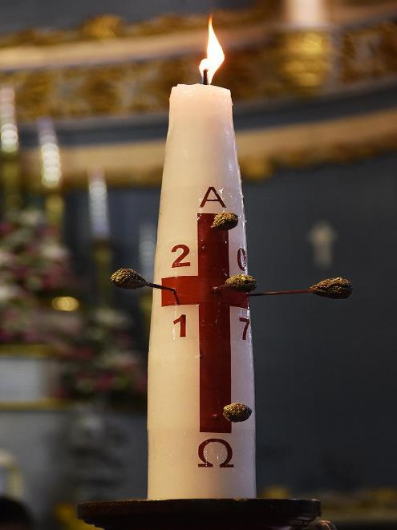
Notes:
Paschal candle
5 grains of incense are pressed into the candle to remind people of the 5 wounds Jesus received in his hands, feet and side when he died on the cross

Slide 2
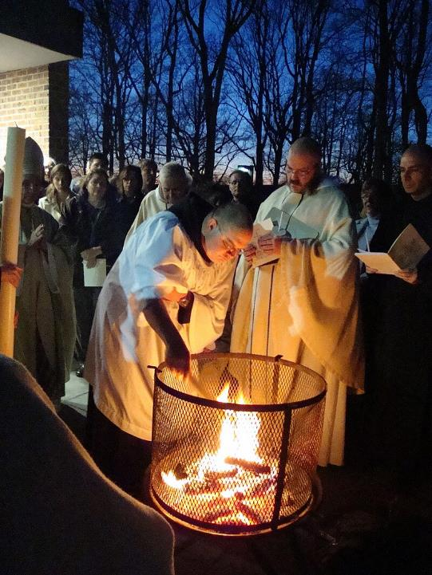
Credit:
Benedictine monks preparing to light the Christ candle prior to Easter Vigil mass, Morristown, New Jersey
Roman Catholic monks of the Order of Saint Benedict preparing to light the Christ candle prior to Easter Vigil mass at St. Mary's Abbey in Morristown, New Jersey
CC BY-SA
File:BenedictineEasterVigil.jpg
Created: 11 April 2009

Slide 3
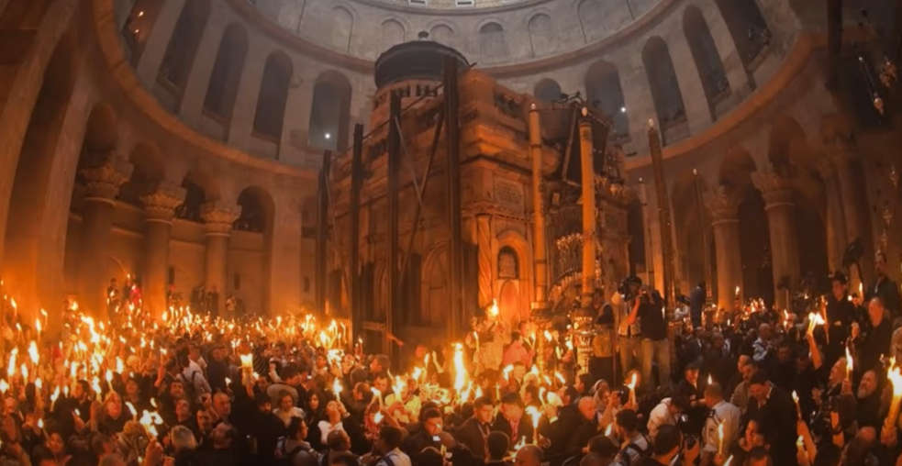
Credit:
https://www.youtube.com/watch?app=desktop&v=noetoc2W4Pc
Notes:
Jerusalem - candles lit from the Paschal candle

Slide 4
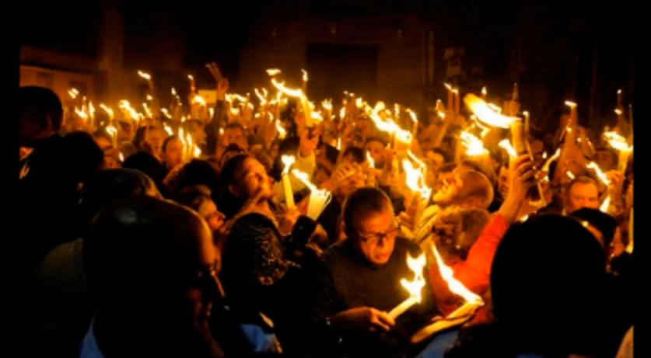
Credit:
https://www.youtube.com/watch?app=desktop&v=noetoc2W4Pc
Notes:
Serbia

Slide 5
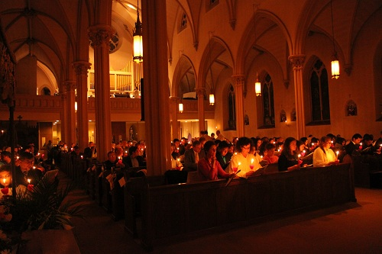
Notes:
The light of Christ – representing the risen Lord.

Slide 6
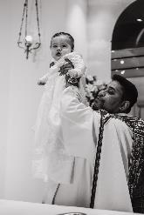
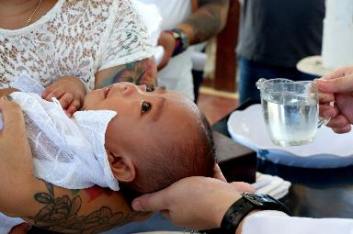
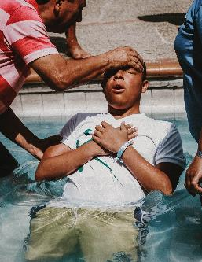
Notes:
Many people get baptised at Easter. All Christians are encouraged to renew the baptismal vows at Easter.

