Slide 1
The Eucharist/Holy Communion/Mass
The purpose of this PowerPoint is to explain the meaning of the Eucharist to teachers and support staff. The explanations have been kept simple so as not to complicate or lead to mis-understanding of the key meaning behind each part of the liturgy.
To note: In schools where the Eucharist/Mass is regularly celebrated, it would be worth ensuring that the explanations given in this PowerPoint are in line with the teachings of the school church, mindful that there are differences in understanding.
LESSON 2a - YEAR 4
© Copyright London Diocesan Board for Schools 2023

Slide 2
Slide 3 could be used as an assessment tool.
Each child has 8 pieces cut up before the lesson
Each child sticks them in their book in the order that they think each event happens in the Mass.
Slides 4 and 5 explains the correct order.
Children may want to know what each symbol represents i.e., saying sorry etc before they begin.

Slide 3
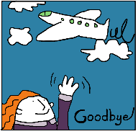
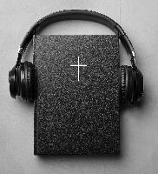
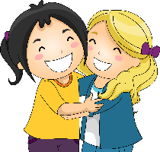
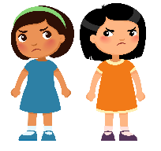
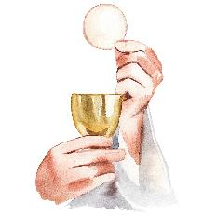
I wonder which order these things come in the Eucharist/ Mass?

Slide 4
Order (For the teacher)
Greeting (Picture of people hugging.)
Saying sorry – confession and absolution. (Picture of the sad faces.)
Singing – Gloria – praising God because the people have been forgiven.
The Liturgy of the Word:
Hearing the word of God from the Bible. Old Testament/New Testament/psalm/Gospel reading
Intercessions – saying our prayers – remembering the world/our community/the sick/those who are dying/those who have died.
The Liturgy of the Sacrament:
The peace – wishing the peace of Christ for your neighbour. (Picture of the globe.)
The Eucharistic Prayer
The Dismissal:
The Blessing – sending out. (Picture of someone saying goodbye.)

Slide 5
The order of the Eucharist/Mass

Slide 6
Welcome
The Eucharist begins with a greeting:
Priest: The Lord be with you.
Children: And also with you OR And with your spirit.
Make a list of all the different words we use and ways we greet and welcome people.

Slide 7
Saying sorry to God (Confession)
It is important when we come into God’s presence to say sorry:
The words we use in the Eucharist/Mass to do this are:
Lord have mercy.
Christ has mercy.
What would you like to say sorry to God for?
Silence
The priest lets us know in a special prayer that God forgives us.
(Absolution)

Slide 8
We sing to God in praise.
Glory to God
What things would you like to give thanks to God for?

Slide 9
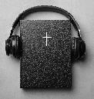
Listening to God’s word and talk (sermon)
Readings are always read from the Old and New Testament.
A reading from one of the Gospels is always read. Often and procession will take place. The congregation stand and candles are held up. Incense in some churches will be used. Particular importance is giving to the reading of the Gospel because it is about Jesus’ life. It is the most important reading in the liturgy.
The priest will then talk to the people about the readings of the day and the key message that lies behind them.
The Bible tells Christians how to live their lives.

Slide 10
Can you think of other Holy books that help tell people how to live?
Who else helps show us how to live?

Slide 11
Teacher notes:
Assessment opportunity:
Can children list other Holy Books?
Do children know the names of the Gospels? Matthew, Mark, Luke, John.
Do children know the Gospels are the books in the New Testament that tell people about Jesus’ life on earth?

Slide 12
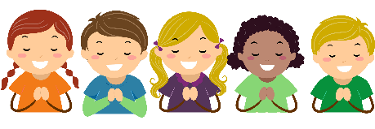
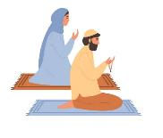
Prayers (Intercessions)
During the prayer time the following things are brought before God:
The world
The community
People who are ill and dying
People who have died

Slide 13
The peace
The peace is a time to offer God’s peace to people around you.
The priest: The peace of the Lord be always with you.
Children: And also with you.
Who would you like to give a sign of God’s peace to today?

Slide 14
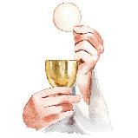
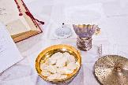
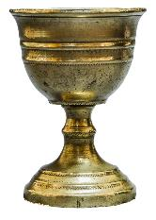
Preparing for the meal. (Eucharist/Communion/Mass)
Laying the altar.
Bringing the gifts of bread and wine to the altar.
Washing of hands.
Praying a special prayer over the bread and wine.
The special words:
This is my body, broken for you.
This is my blood, shed for you.

Slide 15
Teacher notes:
Make the connection here with the following:
Laying the altar: Laying the table for a special meal.
Bringing the gifts: Preparing special food.
Washing hands: Washing hands before a meal.
The special words: Link with the last supper – Jesus’ words the night before he was betrayed by Judas.

Slide 16
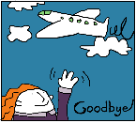
The Blessing
The priest: The peace of God, which passes all understanding, keep your hearts and minds in the knowledge and love of God, and of his Son Jesus Christ our Lord; and the blessing of God almighty, the Father, the Son, and the Holy Spirit, be among you and remain with you always.
All: Amen.
A minister says: Go in peace to love and serve the Lord.
All: In the name of Christ. Amen.
Make a list of all the different words we use and ways we say goodbye to people.

Slide 17
Return to the first exercise
Can you put the pictures in order?
Can you link these words to the pictures?
Can you explain what these words mean?
reading and sermon
welcome
intercessions
confession and absolution
peace
The Eucharist/Communion/Mass
The Blessing
Gloria
Assessment activity: Review against the first time this activity was done.

