Slide 1
How does Holy Communion build a Christian Community?
LESSON 2 - YEAR 4
© Copyright London Diocesan Board for Schools 2023

Slide 2
Slide 3 could be used as an assessment tool.
Each child has 8 pieces cut up before the lesson
Each child sticks them in their book in the order that they think each event happens in the Holy Communion liturgy.
Slides 4 and 5 explains the correct order.
Children may want to know what each symbol represents i.e., saying sorry etc before they begin.
LESSON 2 - YEAR 4

Slide 3
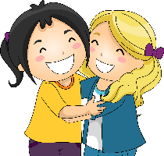
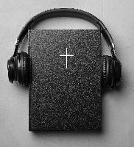
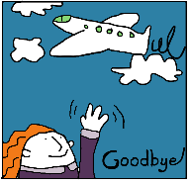
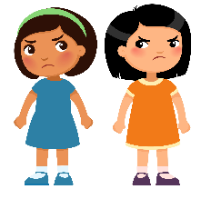
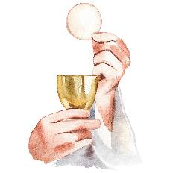
I wonder which order these things come in the Holy Communion liturgy?
LESSON 2 - YEAR 4

Slide 4
Order (For the teacher)
Greeting (Picture of people hugging.)
Saying sorry – confession and absolution. (Picture of the sad faces.)
Singing – Gloria – praising God because the people have been forgiven.
The Liturgy of the Word:
Hearing the word of God from the Bible. Old Testament/New Testament/psalm/Gospel reading
Intercessions – saying our prayers – remembering the world/our community/the sick/those who are dying/those who have died.
The Liturgy of the Sacrament:
The peace – wishing the peace of Christ for your neighbour. (Picture of the globe.)
The Eucharistic Prayer
The Dismissal:
The Blessing – sending out. (Picture of someone saying goodbye.)
LESSON 2 - YEAR 4

Slide 5
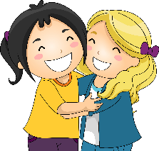
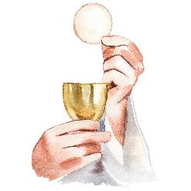
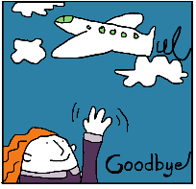
The order of the Holy Communion liturgy
LESSON 2 - YEAR 4

