Slide 1
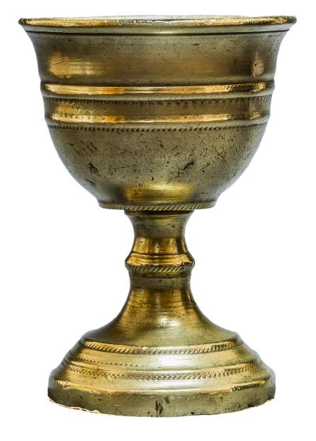
LESSON 1a - YEAR 4
© Copyright London Diocesan Board for Schools 2023
Notes:
Chalice

Slide 2
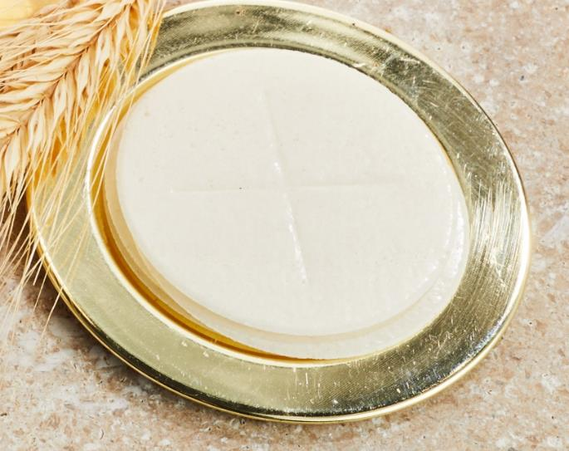
LESSON 1a - YEAR 4
Notes:
Paten – special plate with the consecrated host placed on it.

Slide 3
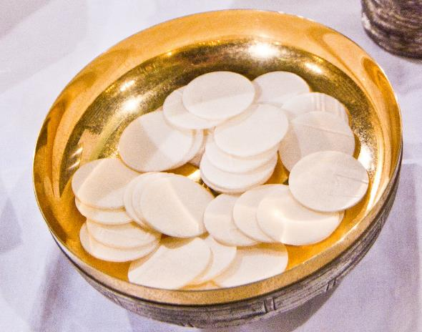
LESSON 1a - YEAR 4
Notes:
Ciborium with the individual hosts in it.

Slide 4
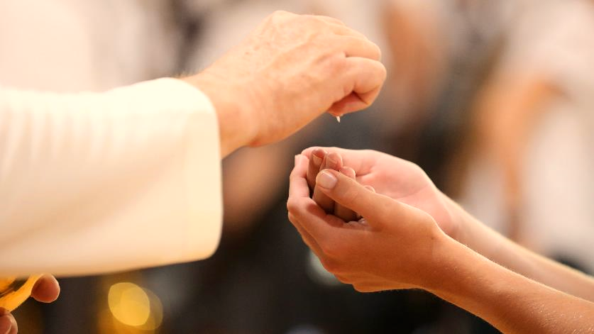
LESSON 1a - YEAR 4
Notes:
Receiving of communion

Slide 5
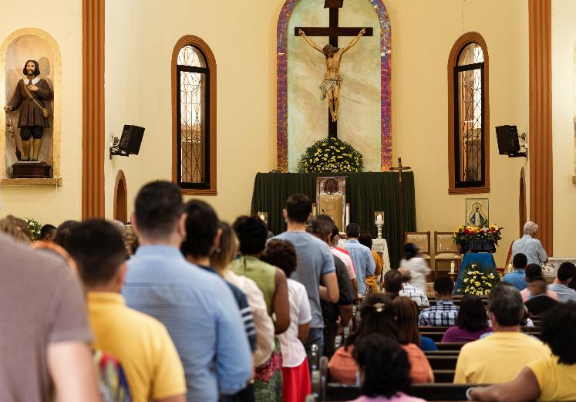
LESSON 1a - YEAR 4

Slide 6
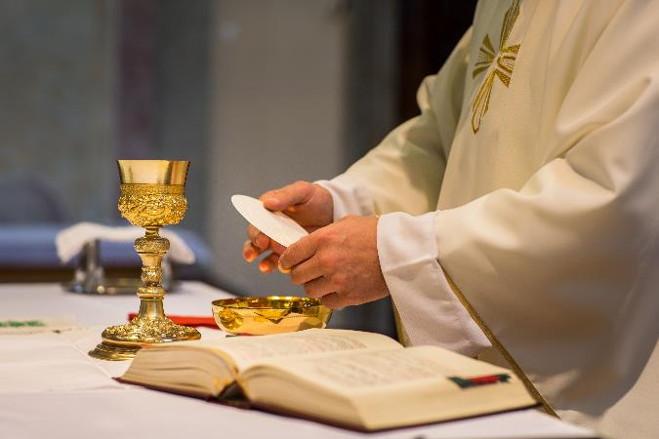
LESSON 1a - YEAR 4
Notes:
Celebrating Holy Communion.

Slide 7
LESSON 1a - YEAR 4
Notes:
Celebrating Holy Communion.

Slide 8
LESSON 1a - YEAR 4
Notes:
The giving of Holy Communion.

Slide 9
LESSON 1a - YEAR 4
Notes:
The giving of Holy Communion.

Slide 10
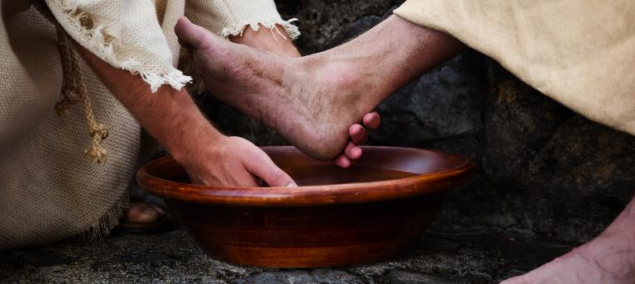
LESSON 1a - YEAR 4

Slide 11
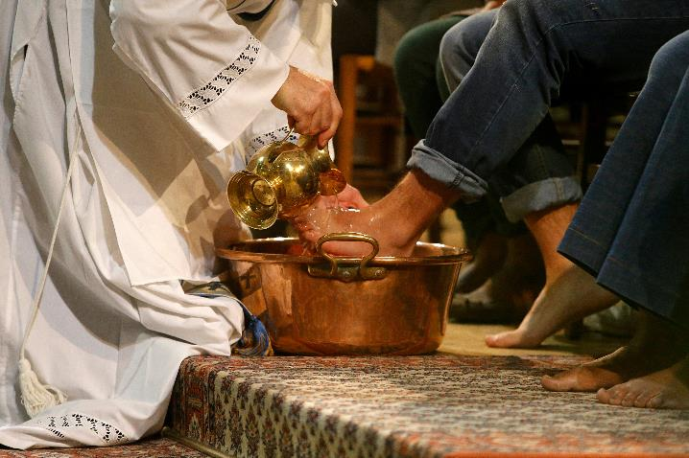
LESSON 1a - YEAR 4

Slide 12
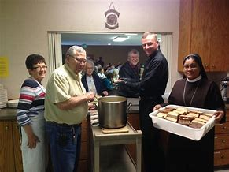
LESSON 1a - YEAR 4

Slide 13
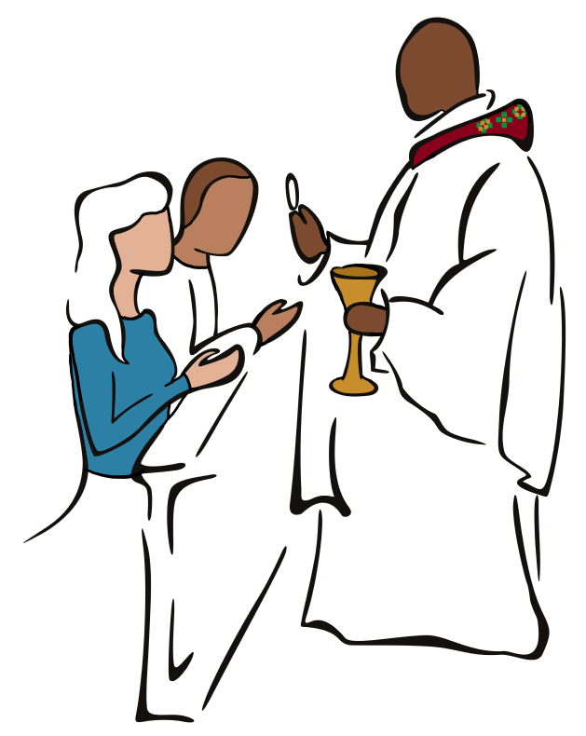
LESSON 1a - YEAR 4

Slide 14
LESSON 1a - YEAR 4

Slide 15
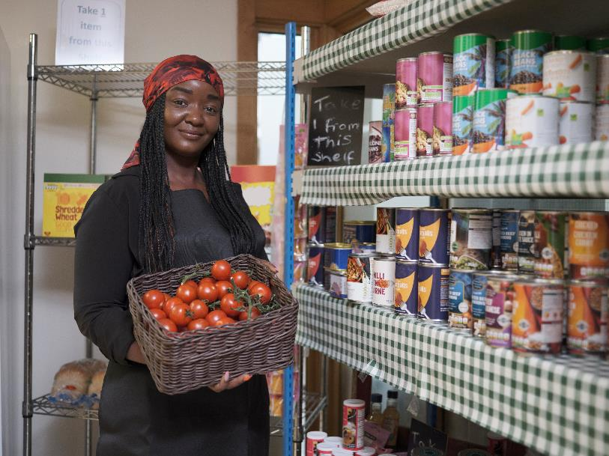
LESSON 1a - YEAR 4

Slide 16
LESSON 1a - YEAR 4

Slide 17
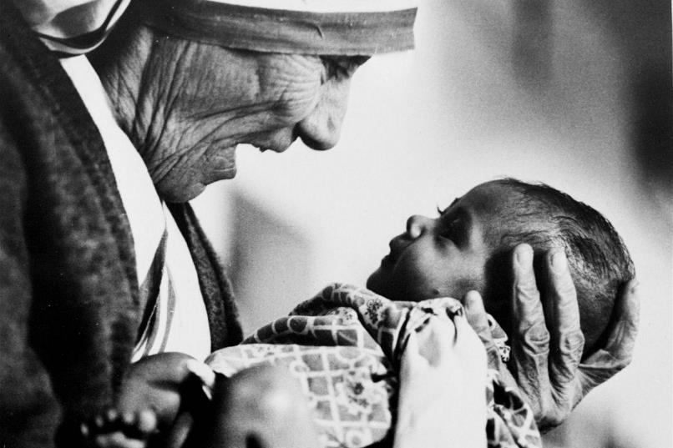
LESSON 1a - YEAR 4

Slide 18
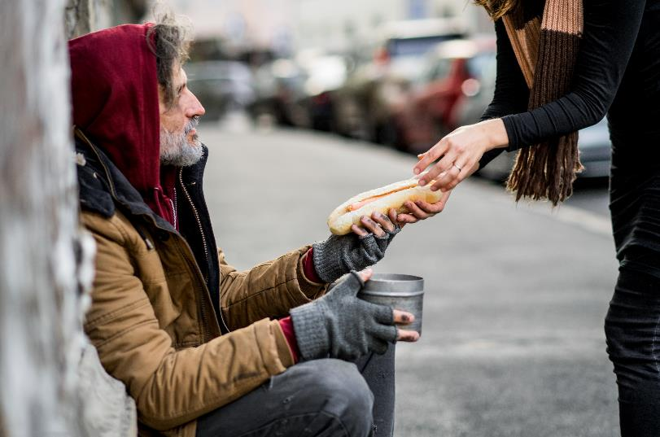
LESSON 1a - YEAR 4

Slide 19
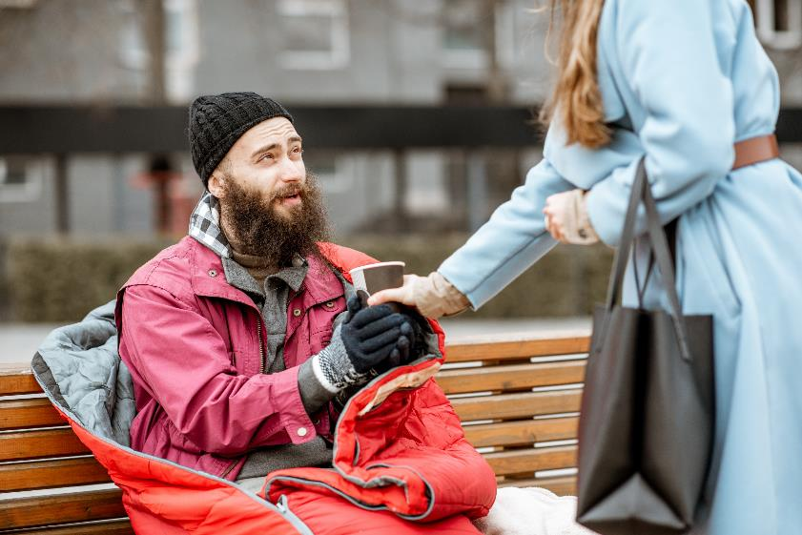
LESSON 1a - YEAR 4

