Slide 1
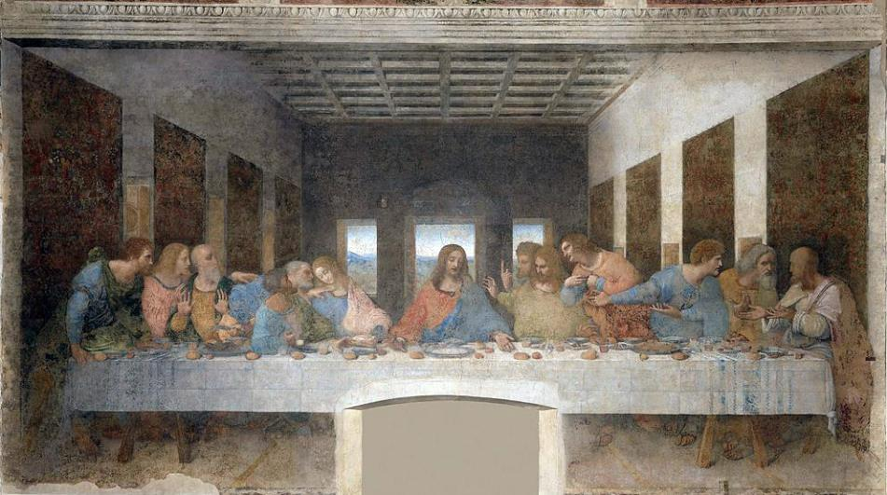
Leonardo da Vinci: The Last Supper 1495–1498
LESSON 1 - YEAR 4
© Copyright London Diocesan Board for Schools 2023

Slide 2
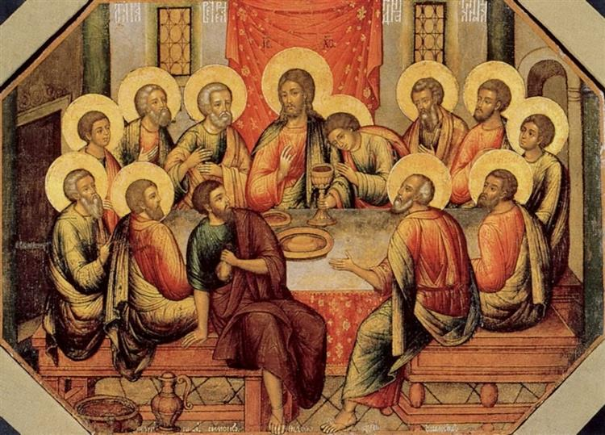
The Last Supper
Simon Ushakov
Original Title: Тайная вечеря
Date: 1685
LESSON 1 - YEAR 4
© Copyright London Diocesan Board for Schools 2023

Slide 3
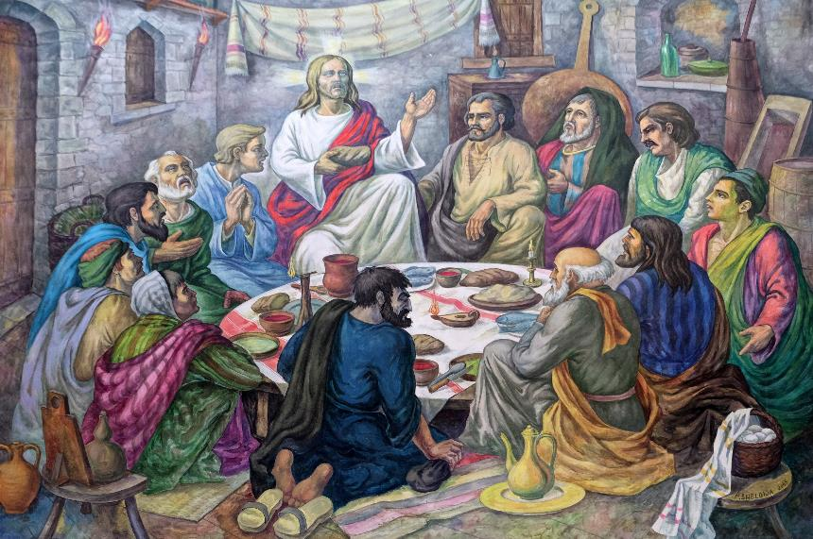
Last supper altarpiece in Mother Teresa cathedral in Vau i Dejes, Albania.
LESSON 1 - YEAR 4
© Copyright London Diocesan Board for Schools 2023

Slide 4
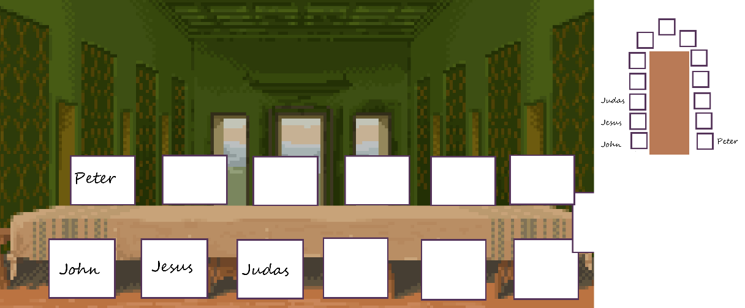
LESSON 1 - YEAR 4
© Copyright London Diocesan Board for Schools 2023
Notes:
The Betrayal by Marilyn Todd-Daniels

Slide 5
The Last Supper by Sarah Jenkins (African American Art) – The Black Art Depot
LESSON 1 - YEAR 4
© Copyright London Diocesan Board for Schools 2023

