Slide 1
YEAR GROUP TWO
Big Question:
Why are they having a party?
CORE CONCEPT:
WAYS OF LIVING
QUESTIONS OF VALUES AND COMMITMENTS
Weekly questions:
Week 1: Why are they having a party? Week 2: What is Rosh Hashanah? Week 3: What is Yom Kippur? Week 4 and 5: Why are they having another Jewish party? (Sukkot) What are the Jewish people remembering at the festival of Sukkot? Week 6: What are the Jewish people celebrating at their festival of Hanukkah?
What a child needs to know and remember by the end of the unit:
To know some of the key festivals that are important to Jewish people: Rosh Hashanah, Sukkot, Hanukkah)
To know how each festival is celebrated and its meaning.
To know that the festivals are key points for the Jewish people in helping them remember their history.
What a child should be able to do (Assessment): Ways of living:
I can recall and name the different Jewish festivals. (WT)
I can ask questions and respond to questions about why the Jewish people celebrate each festival. (Exp)
I can begin to describe things that make being a Jewish person different from a non-Jewish person but similar to other faith believers. (GD)
Questions of values and commitments:
I can talk about things that are important to me. (WT)
I am beginning to be able to express my own opinion and recognise there is often more than one answer. (Exp)
I am beginning to make links between things that are important to me and the way I think and behave. (E.g. My family are important to me, and I therefore make time for them. It is important that I remember family and friends’ Birthdays so I will always send a card.) (GD)
Religious vocabulary:
Jewish people: People who follow the Jewish Faith.
Festival: A day of celebration.
Remembering: Having an awareness of the past.
Rosh Hashanah: See background knowledge for teachers.
Yom Kippur: See background knowledge for teachers.
Sukkot: See background knowledge for teachers.
Sukkah: See background knowledge for teachers,
Hanukkah: See background knowledge for teachers.
Hanukkiah: A candelabrum which has nine branches that is lit during the festival of Hanukkah.
Sensitivities:
Be mindful of pupils’ cultural backgrounds and beliefs.

Slide 2
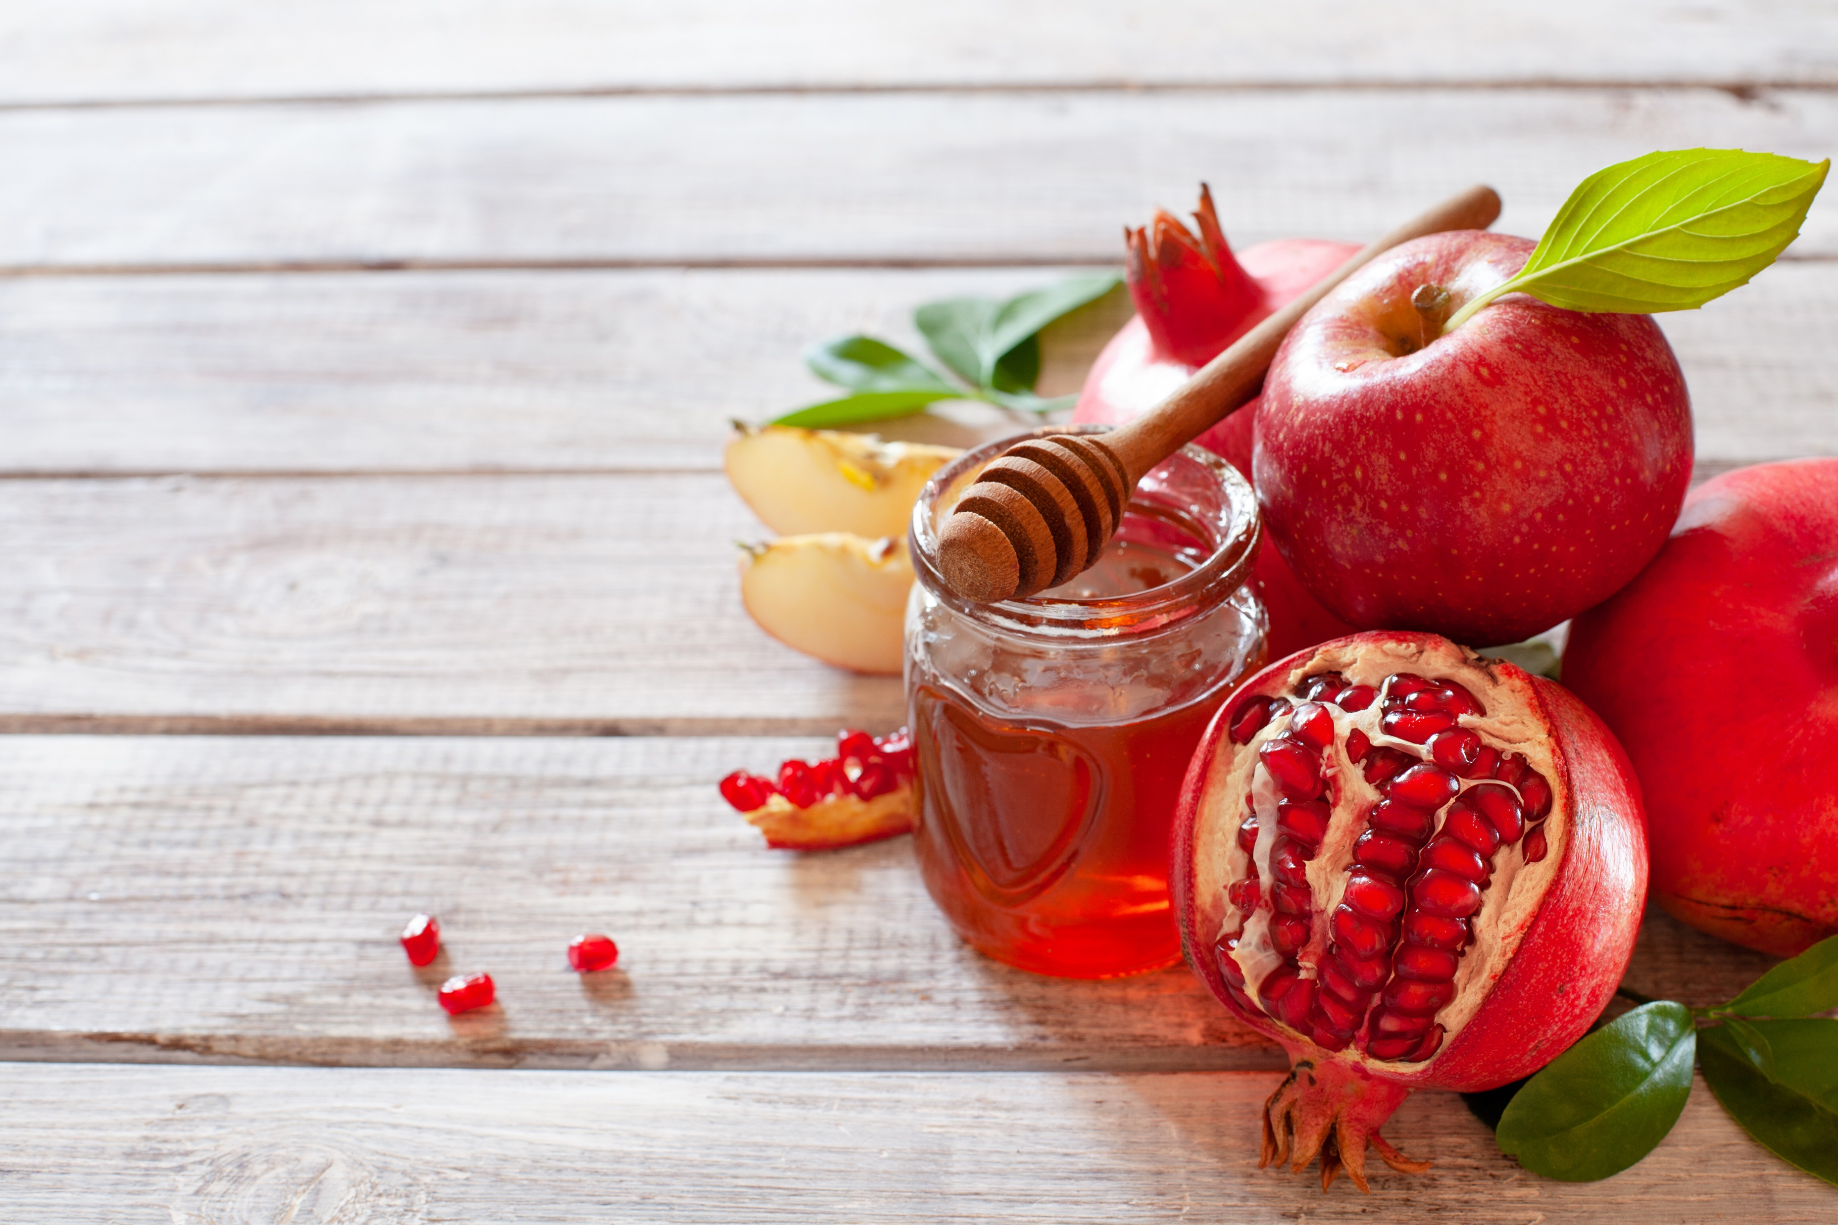
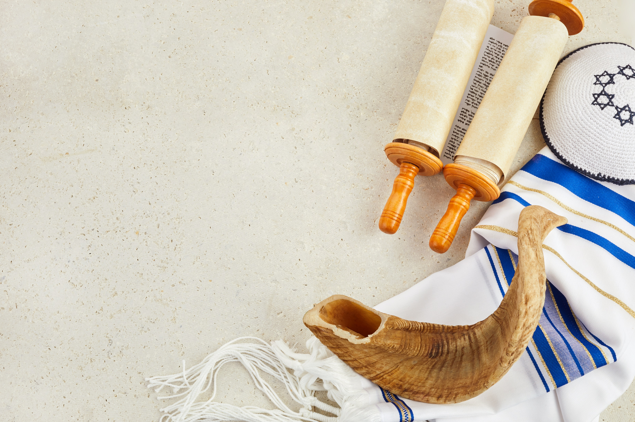
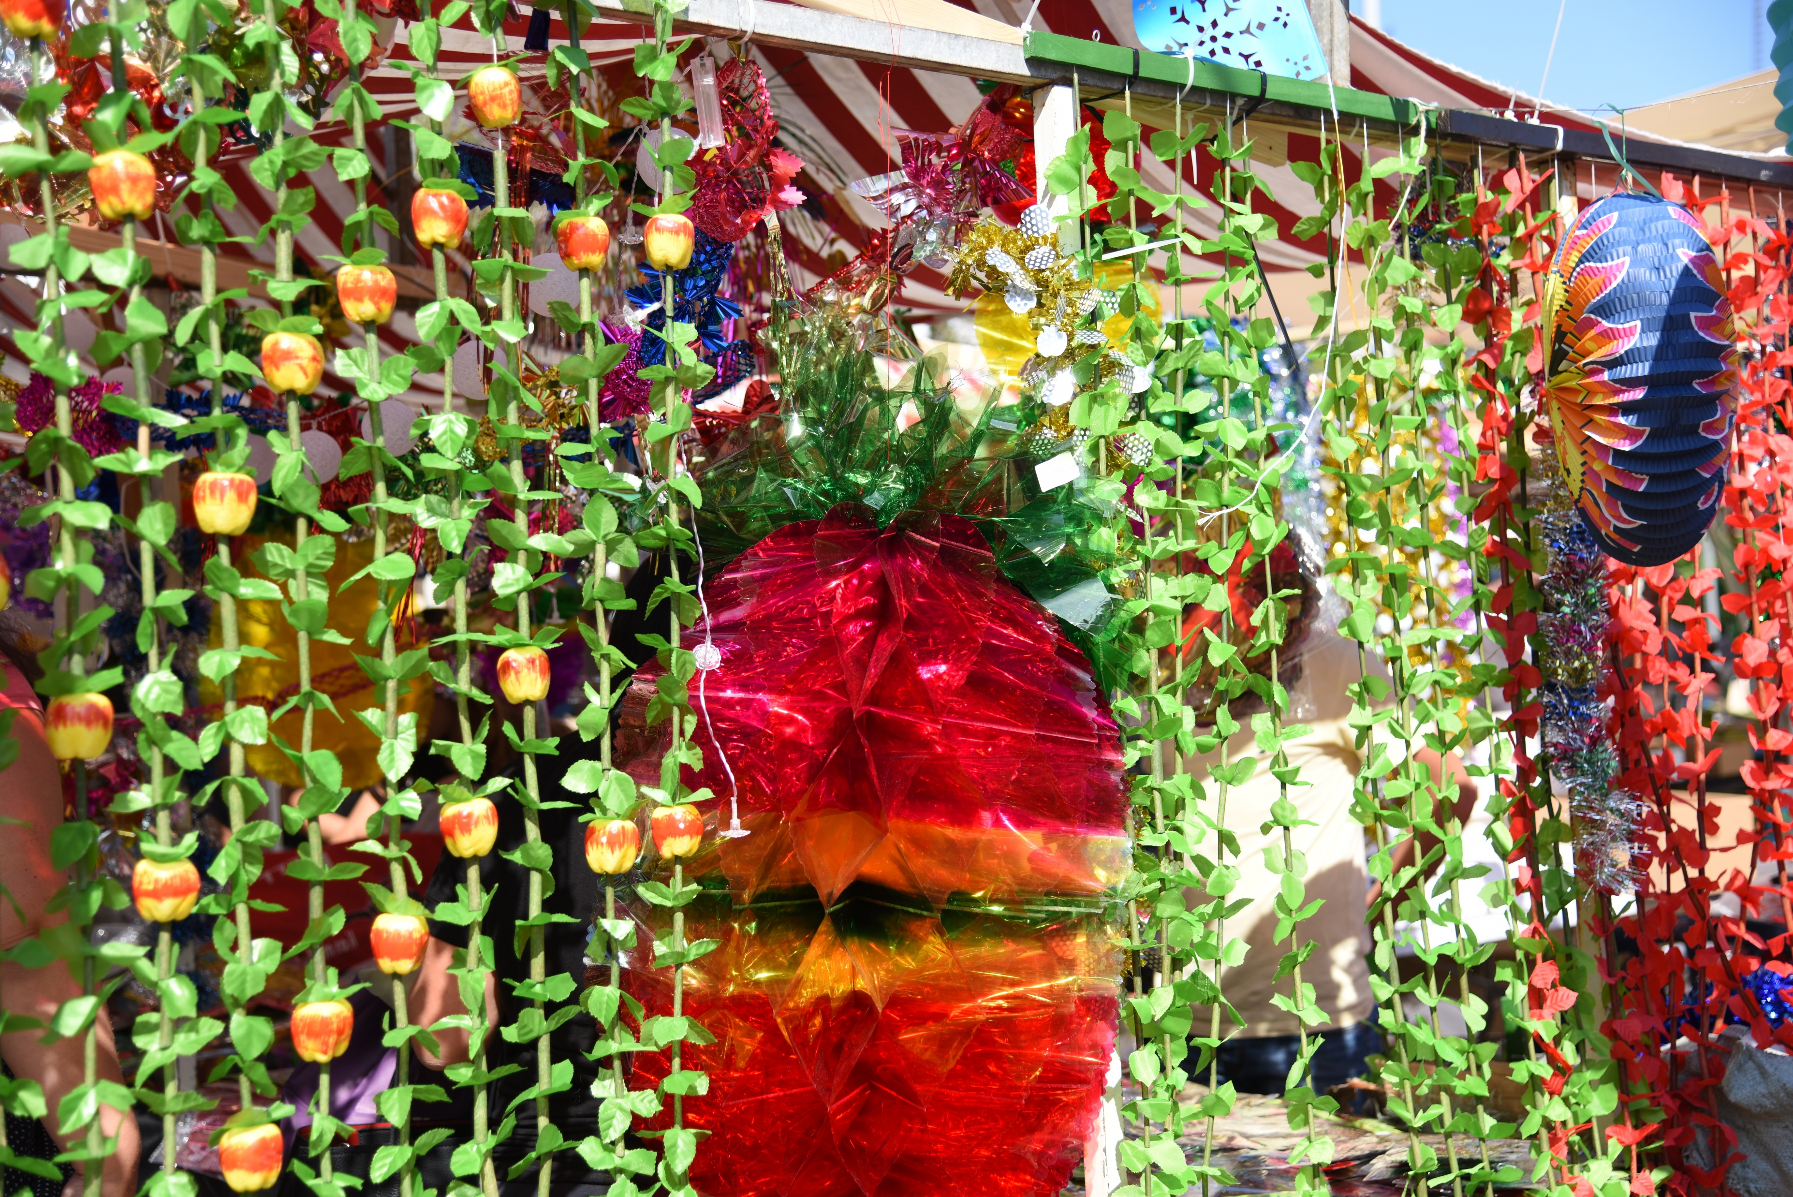
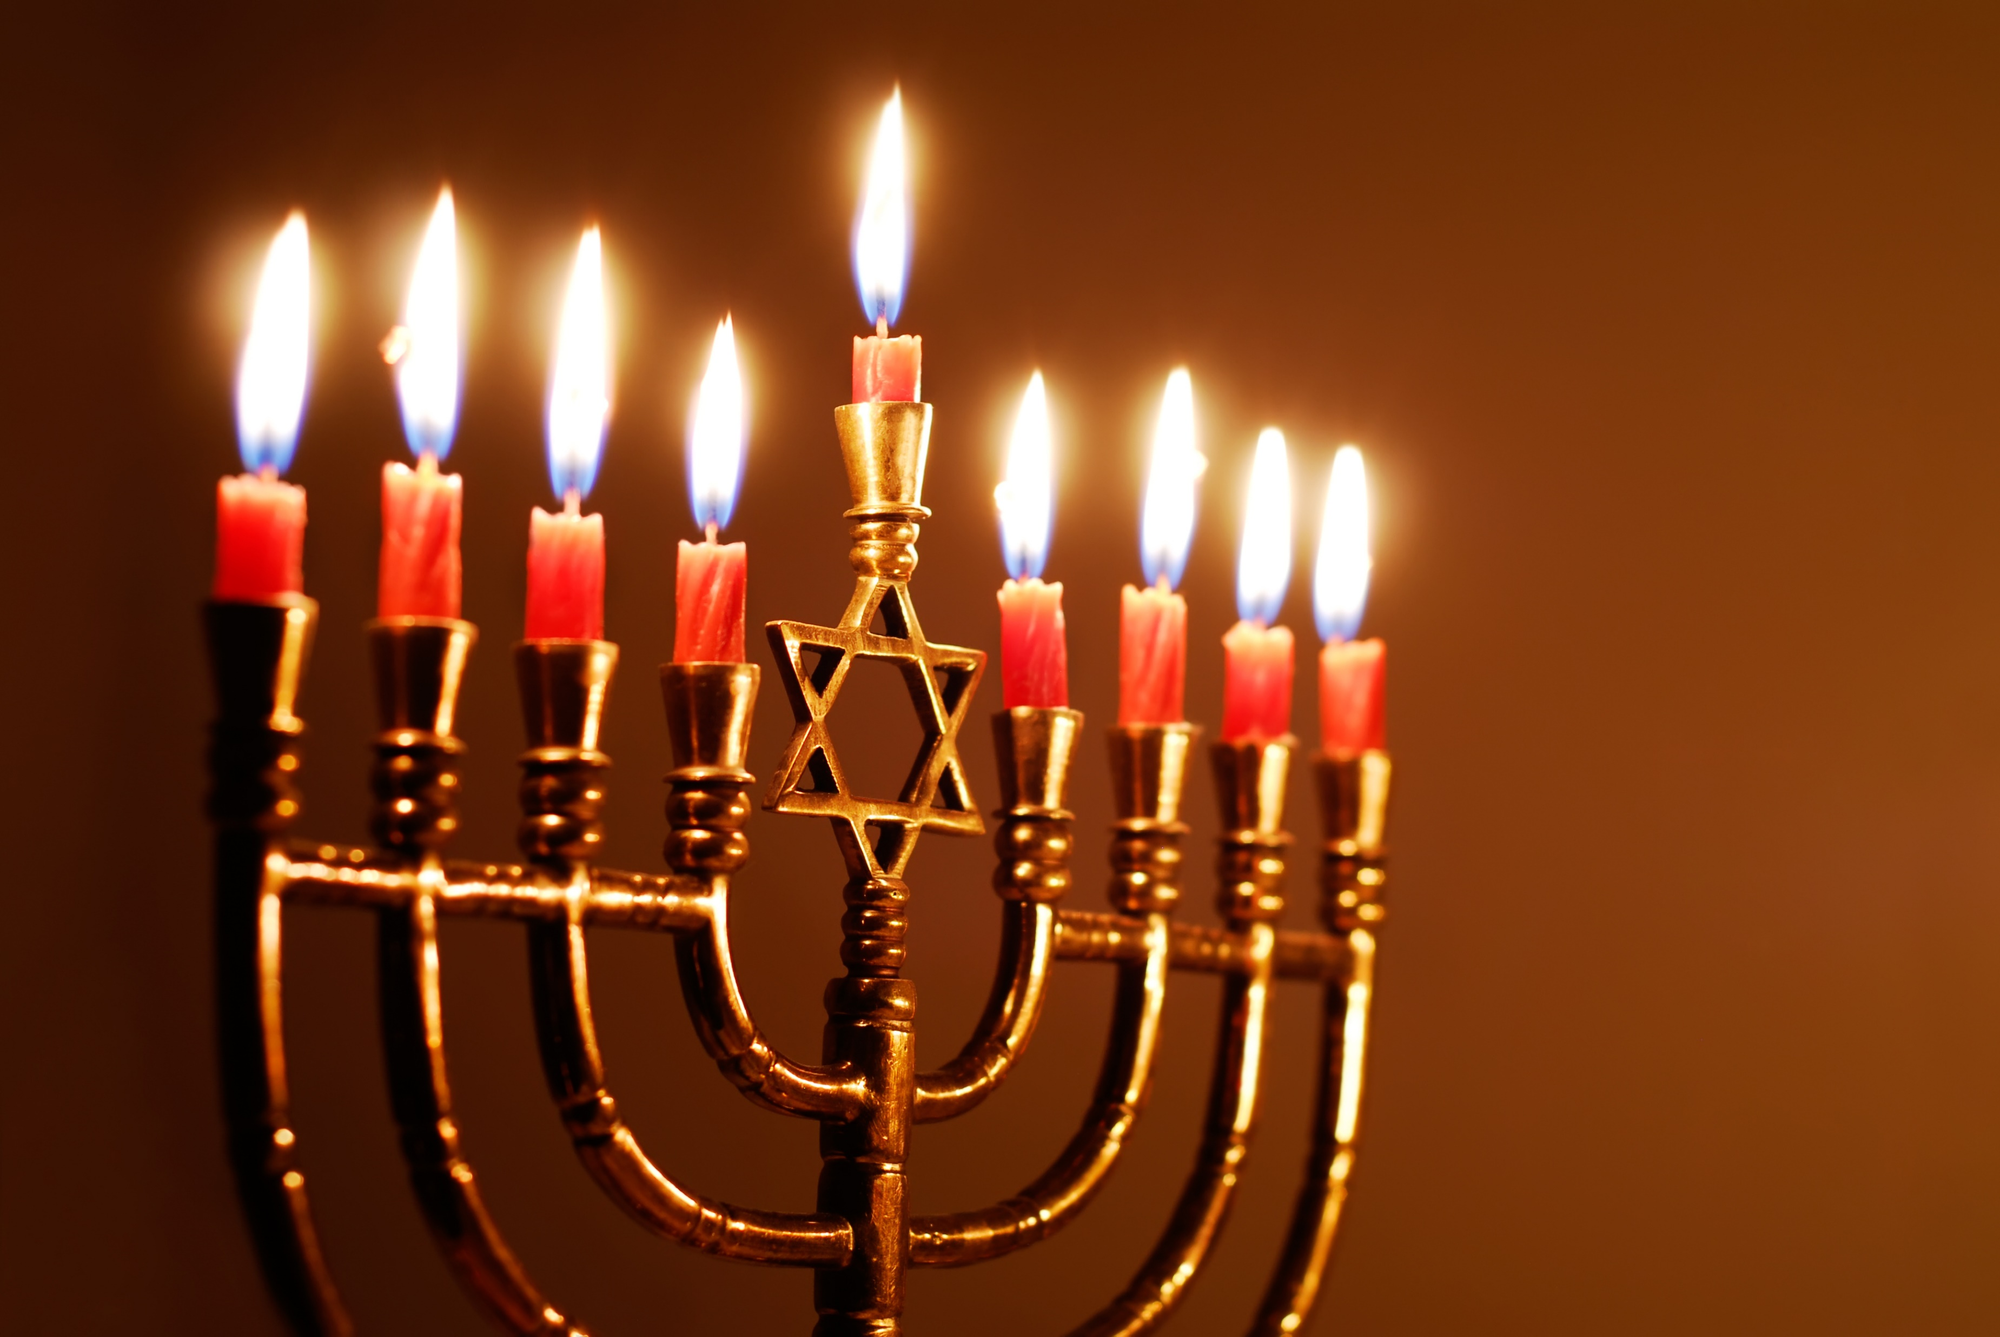
YEAR GROUP TWO
Background knowledge for teachers
CORE CONCEPT:
WAYS OF LIVING
QUESTIONS OF VALUES AND COMMITMENTS
See these links for the definitions of key religious vocabulary.
Key things to note:
Rosh Hashanah:
https://www.bbc.co.uk/religion/religions/judaism/holydays/roshhashanah.shtml
Yom Kippur:
https://www.bbc.co.uk/religion/religions/judaism/holydays/yomkippur.shtml
Sukkot:
https://www.bbc.co.uk/religion/religions/judaism/holydays/sukkot_1.shtml
Hanukkah:
https://www.bbc.co.uk/religion/religions/judaism/holydays/hanukkah.shtml

Slide 3
YEAR GROUP TWO
Lesson 1: Why are they having a party?
CORE CONCEPT:
WAYS OF LIVING
QUESTIONS OF VALUES AND COMMITMENTS
Intention:
To give pupils opportunities to:
Know the meaning of festival.
Talk about celebrations that are important to them.
Express their own opinions.
Key religious vocabulary: Festival.
Implementation:
Outlining how to introduce the religious content in the classroom and create learning opportunities from it.
Introduction:
Have a selection of items from a Birthday party in a bag e.g. balloons, party poppers, cake, candles, Birthday hat, present etc. Show the objects one by one, giving pupils times to make connections.
Key questions:
What do you think these things have in common? Why?
Open an invitation and read it to the class inviting pupils to a party which is to take place today.
Main teaching input: (Investigate and explore)
Introduce the big question for the unit: Why are they having a party?

Slide 4
YEAR GROUP TWO
Lesson 1: Why are they having a party?
CORE CONCEPT:
WAYS OF LIVING
QUESTIONS OF VALUES AND COMMITMENTS
Implementation:
Outlining how to introduce the religious content in the classroom and create learning opportunities from it.
Enjoy playing some party games together. Following the games, discuss the following questions:
Key questions:
How did you feel playing the games?
What makes you feel special when it’s your Birthday? Why?
What parties have you been to?
What is your favourite part of a party? Why?
Talk about how all religions have special times to celebrate and special things that have happened in the past which are important for religions today.
Share a selection of photos from a range of different religious festivals and secular celebrations. (See appendix lesson 1)
Key questions:
What do you think is happening in these photos?
Can you name any of these celebrations?
What do you think they all have in common?
Introduce the word festival and its meaning.
Explain that religious festivals are important because they help people to remember, acknowledge and celebrate a significant event/belief.
Main activity: (Evaluate and communicate)
Each pupil to have a triangle of bunting and to write on it their favourite part of either the party they have just experienced or a party/celebration/festival they have taken part in and say why.
Teacher to model: My favourite part of the party/celebration/party is …….because……
Plenary: (Reflect and express)
Connect the pieces of bunting together and give pupils the opportunity to share their reflections with the class.

Slide 5
YEAR GROUP TWO
Lesson 1: Why are they having a party?
CORE CONCEPT:
WAYS OF LIVING, QUESTIONS,
VALUES, COMMITMENTS
Resources
Items associated with a party.
Appendix lesson 1.
Sensitivities
Be mindful of pupils for whom the concept of a party is unfamiliar or is associated with difficult memories.
Be mindful of pupils with ASD who find parties difficult to navigate.
Impact
What do you notice as a teacher?
What do pupils say?
In this box, note down anything that you heard a pupil say that would provide evidence towards their progress in RE.
Note down anything significant an additional adult has noticed.
Note down anything significant that happened in the lesson that will have an impact on the next lesson.

Slide 6
YEAR GROUP TWO
Lesson 2: What is Rosh Hashanah?
CORE CONCEPT:
WAYS OF LIVING, QUESTIONS,
VALUES, COMMITMENTS
Intention:
To give pupils opportunities to:
Know what Rosh Hashanah means.
Know how Jewish people celebrate the festival.
Know the significance of the shofar, apple and honey.
Talk about their own wishes and hopes.
Express their own opinions.
Begin to make links between things that are important to them and how they think and behave.
Key religious vocabulary: Festival, Rosh Hashanah.
Implementation:
Outlining how to introduce the religious content in the classroom and create learning opportunities from it.
Introduction:
Recap on previous week’s learning.
Key knowledge checking:
To know what a festival is and what it means.
Main teaching input: (Investigate and explore)
Introduce the special box.
To include in the box:
Shofar – used for waking people up
Apple and honey
Pomegranate
Challah bread
Shanah Tovah – phrase meaning good year – this is how Jewish people would greet one another at Rosh Hashanah.
Introduce each item to the class.

Slide 7
YEAR GROUP TWO
Lesson 2: What is Rosh Hashanah?
CORE CONCEPT:
WAYS OF LIVING, QUESTIONS,
VALUES, COMMITMENTS
Implementation:
Outlining how to introduce the religious content in the classroom and create learning opportunities from it.
I wonder what each of these items are used for and why they are so important?
Introduce this week’s question: What is Rosh Hashanah?
Watch the clip to help explain the festival.
BBC Two - My Life, My Religion, Judaism, Rosh Hashanah
Jumpin' Jerusalem! Rosh Hashana Video for Kids - Bing video
For further knowledge: See background knowledge for teachers.
Explain the meaning of the festival.
Main activity: (Evaluate and communicate)
Key question:
What are your wishes and hopes for the year ahead? Consider wishes and hopes for you/your family/our world.
Pupils record their responses in whatever way the teacher feels best fits.
Plenary: (Reflect and express)
Explain to pupils that during Rosh Hashanah, Jewish people also reflect on these important questions:
What is the most meaningful thing in my life?
Who in my life means most to me and how often do I tell them?
What are the most significant things I have achieved over the last year and in my life so far?
What do I hope to achieve next year and in my life generally?
End with a circle time, giving pupils the opportunity to reflect on the above questions and share their responses if they wish to. Pupils could enjoy eating apple dipped in honey as they do this.

Slide 8
YEAR GROUP TWO
Lesson 2: What is Rosh Hashanah?
CORE CONCEPT:
WAYS OF LIVING
QUESTIONS OF VALUES AND COMMITMENTS
Resources
Items for the special box.
BBC Two - My Life, My Religion, Judaism, Rosh Hashanah
Jumpin' Jerusalem! Rosh Hashana Video for Kids - Bing video
Sensitivities
Be mindful of pupils for whom the past year has been very difficult and for whom the year ahead is difficult to consider due to their personal circumstances.
Impact
What do you notice as a teacher?
What do pupils say?
In this box, note down anything that you heard a pupil say that would provide evidence towards their progress in RE.
Note down anything significant an additional adult has noticed.
Note down anything significant that happened in the lesson that will have an impact on the next lesson.

Slide 9
YEAR GROUP TWO
Lesson 3: What is Yom Kippur?
CORE CONCEPT:
WAYS OF LIVING, QUESTIONS,
VALUES, COMMITMENTS
Intention:
To give pupils opportunities to:
Know what Yom Kippur means.
Know what Jewish people practice at Yom Kippur
Talk and express their own opinions.
Key religious vocabulary: Yom Kippur.
Implementation:
Outlining how to introduce the religious content in the classroom and create learning opportunities from it.
Introduction:
Recap on previous week’s learning.
Key knowledge checking:
What Rosh Hashanah means.
How Jewish people celebrate the festival.
To know the significance of the shofar, apple and honey.
Main teaching input: (Investigate and explore)
Introduce this week’s question: What is Yom Kippur?

Slide 10
YEAR GROUP TWO
Lesson 3: What is Yom Kippur?
CORE CONCEPT:
WAYS OF LIVING
QUESTIONS OF VALUES AND COMMITMENTS
Watch the clip to help explain the festival. Pupils will have seen this video in the previous week – opportunity to recap and focus on the Yom Kippur section of the clip.
BBC Two - My Life, My Religion, Judaism, Rosh Hashanah
Alternative clips:
https://www.bbc.co.uk/bitesize/topics/znwhfg8/articles/z4vvjhv
https://www.bbc.co.uk/programmes/p010x9my
Explain the meaning of Yom Kippur. See background knowledge for teachers.
Main activity: (Evaluate and communicate)
Activity based around the story of Jonah that is told at Yom Kippur.
Conscience alley:
Listen to the story of Jonah up until 1.42 where the captain asks Jonah what he had done to make God so angry.
https://www.bbc.co.uk/teach/school-radio/assemblies-saying-sorry-jonah-and-the-whale/zwrftrd
Set up an alley. Pupils on one side of the alley try to encourage ‘Jonah’ why he should admit that it is his fault that they are caught in a terrible storm. Pupils on the other side of the alley, try to persuade ‘Jonah’ why he should keep quiet and say nothing.
One pupil is chosen to be Jonah and walks down the alley asking what advice the other pupils could give them. What do you think I should do?’
The teacher asks the pupil after they have walked down the alley, what they are going to do – tell the captain the truth, make up an excuse, keep quiet? Teacher opens the wondering question to all pupils – ‘I wonder what you would have done’ in that position.’
Pupils return to the clip and listen to the end of the story.
Implementation:
Outlining how to introduce the religious content in the classroom and create learning opportunities from it.

Slide 11
YEAR GROUP TWO
Lesson 3: What is Yom Kippur?
CORE CONCEPT:
WAYS OF LIVING, QUESTIONS,
VALUES, COMMITMENTS
Implementation:
Outlining how to introduce the religious content in the classroom and create learning opportunities from it.
Key questions:
What do you think a Jewish person could learn from this story?
What have you learnt from this story?
Plenary: (Reflect and express)
Key question:
As we move into a new year, is there anything you would like to say sorry for and if you would like to, to ask for forgiveness for?
Do you think saying sorry is important? If yes, why?
Pupils are invited to write what they are sorry for on a post it note and then to fold it up and place it in a bowl in the middle of the circle.
Alternative: Pupils reflect on things in our world which are not as they should be e.g. Hunger, greed, abuse of power, selfishness. Key question: If there was one thing you would like to see changed in our world, what would it be and why? Who could help change things?
To note: The alternative option, allows for pupils who find it difficult to self-reflect, to consider the concept from another view point.
Pupils are invited to have a moment of quiet and to reflect on what they have written. You may choose to light a candle or sing a song related to saying sorry and seeking forgiveness.

Slide 12
YEAR GROUP TWO
Lesson 3: What is Yom Kippur?
CORE CONCEPT:
WAYS OF LIVING
QUESTIONS OF VALUES AND COMMITMENTS
Resources
BBC Two - My Life, My Religion, Judaism, Rosh Hashanah
https://www.bbc.co.uk/bitesize/topics/znwhfg8/articles/z4vvjhv
https://www.bbc.co.uk/programmes/p010x9my
https://www.bbc.co.uk/teach/school-radio/assemblies-saying-sorry-jonah-and-the-whale/zwrftrd
Sensitivities
Be mindful of pupils for whom the concept of saying sorry and seeking forgiveness is difficult to comprehend.
Impact
What do you notice as a teacher?
What do pupils say?
In this box, note down anything that you heard a pupil say that would provide evidence towards their progress in RE.
Note down anything significant an additional adult has noticed.
Note down anything significant that happened in the lesson that will have an impact on the next lesson.

Slide 13
YEAR GROUP TWO
Lesson 4 & 5: Why are they having another Jewish party? (Sukkot) What are the Jewish people remembering?
CORE CONCEPT:
WAYS OF LIVING
QUESTIONS OF VALUES AND COMMITMENTS
Intention:
To give pupils opportunities to:
Know the meaning of Sukkot.
Know what the Jewish people are remembering during the festival of Sukkot.
Know what Jewish people practice at Sukkot.
Know the names and meaning of the plants/fruit used.
Talk and express their own opinions about things that are important to them.
Begin to make links between things that are important to them and the way they think and behave.
Key religious vocabulary: Sukkot, sukkah.
Implementation:
Outlining how to introduce the religious content in the classroom and create learning opportunities from it.
Introduction:
Lesson 4:
Recap on previous week’s learning.
Key knowledge checking:
What Yom Kippur means.
How Jewish people remember the festival.
Main teaching input: (Investigate and explore)
Introduce the special box.
To include in the box:
Item to represent the desert – (sand/yellow piece of cloth)
Figures to represent the people
An etrog (a citron fruit)
A palm branch
A myrtle branch
A willow branch
Image of a sukkah
Introduce each item to the class.

Slide 14
YEAR GROUP TWO
Lesson 4 & 5: Why are they having another Jewish party? (Sukkot) What are the Jewish people remembering?
CORE CONCEPT:​
WAYS OF LIVING​
QUESTIONS OF VALUES AND COMMITMENTS
Implementation:
Outlining how to introduce the religious content in the classroom and create learning opportunities from it.
Lesson 4 continued:
I wonder what all these items have in common? I wonder what the Jewish people might be celebrating/remembering?
Provide pupils with the opportunity to smell and feel the items creating a multi-sensory approach.
Gather pupils’ thoughts and reflections.
Introduce this week’s question:
Why are they having another Jewish party? (Sukkot) What are the Jewish people remembering?
Watch the following clips:
Jumpin’ Jerusalem:
https://www.youtube.com/watch?v=h_W1pGtlRsY
https://www.bbc.co.uk/programmes/p0193b73
For further knowledge: See background knowledge for teachers.
Explain the meaning of the festival.
Main activity: (Evaluate and communicate)
Carousal of activities: Teachers decide how many pupils they wish to have in each group.
Group one: Builds a sukkah for the class to gather under/next to using natural objects and scented items. If you can, build this outside but if this is not possible, then build one inside.
Group two: To make some food for the class to enjoy whilst in the sukkah.
Group three: To learn a Jewish song that they can teach the rest of the class and sing together whilst in the Sukkah.

Slide 15
YEAR GROUP TWO
Lesson 4 & 5: Why are they having another Jewish party? (Sukkot) What are the Jewish people remembering?
CORE CONCEPT:
WAYS OF LIVING
QUESTIONS OF VALUES AND COMMITMENTS
Implementation:
Outlining how to introduce the religious content in the classroom and create learning opportunities from it.
Lesson 5: (This can continue immediately on from lesson 4)
Return to this question: What are the Jewish people remembering?
Explain to the pupils what the Jewish people are remembering at this festival.
Explain to the pupils what the Jewish people are giving thanks to God for.
Sukkot: The Arbah Minim - Four Species - YouTube
Refer to: 5.01 min in where the four plants/fruits are explained and from 7.23 where the blessing is given.
Pupils encouraged to think around the themes Jewish people consider at Sukkot: being thankful for what they have been given, giving thanks for creation/thanking God for protecting them.
Key question:
What things are important to you that would you like to give thanks for? Who do you wish to thank for these things?
What are you grateful for and why?
Can you think of a time when you have felt protected from someone or something? Who protected you? How did they make you feel safe again?
Make links with the Christian festival of Harvest. Harvest is a time to give thanks for creation and what the land provides for humanity.
Both Sukkot and Harvest are celebrated either in September or October.
Pupils record what they would like to give thanks for.

Slide 16
YEAR GROUP TWO
Lesson 4 & 5: Why are they having another Jewish party? (Sukkot) What are the Jewish people remembering?
CORE CONCEPT:
WAYS OF LIVING
QUESTIONS OF VALUES AND COMMITMENTS
Implementation:
Outlining how to introduce the religious content in the classroom and create learning opportunities from it.
Lesson 5 continued:
Drama: Pupils re-enact out the journey from Egypt to the promised land which took forty years.
Pupils go on a short walk around their school grounds/local streets near their school, pausing as they go and reflecting on the questions below:
Key questions:
How do you think the Jewish people felt as they journeyed from Egypt to the Promised Land – Israel? From slavery to freedom?
What do you think they might have been scared of?
How would you feel if you were heading to a land where you would experience freedom for the first time?
Can you think of people today that are escaping from places of danger? How do you think they feel when they arrive somewhere new?
How do you think they felt when they built their sukkahs – do you think the sukkah made them feel safe? If yes how?
What makes you feel safe?
How do you welcome the stranger?
Pupils enjoy spending time in the sukkah – sharing food, singing songs and sharing with each other what they are thankful for.
Plenary: (Reflect and express)
Return to the special box.
Key questions:
What do you remember about each item in the box?
Why is Sukkot so important to Jewish people, what are they remembering?
How did you feel when you were in the sukkah?

Slide 17
YEAR GROUP TWO
Lesson 4 & 5: Why are they having another Jewish party? (Sukkot) What are the Jewish people remembering?
CORE CONCEPT:
WAYS OF LIVING
QUESTIONS OF VALUES AND COMMITMENTS
Resources
Items for the special box.
Ingredients for the food.
A Jewish song.
Jumpin’ Jerusalem: https://www.youtube.com/watch?v=h_W1pGtlRsY
https://www.bbc.co.uk/programmes/p0193b73
Sensitivities
Be mindful of pupils who may have experienced having to flee from a country/difficult situation.
Be mindful of pupils who have experienced trauma
Impact
What do you notice as a teacher?
What do pupils say?
In this box, note down anything that you heard a pupil say that would provide evidence towards their progress in RE.
Note down anything significant an additional adult has noticed.
Note down anything significant that happened in the lesson that will have an impact on the next lesson.

Slide 18
YEAR GROUP TWO
Lesson 6: What are the Jewish people celebrating at their festival of Hanukkah?
CORE CONCEPT:
WAYS OF LIVING
QUESTIONS OF VALUES AND COMMITMENTS
Intention:
To give pupils opportunities to:
Know the meaning of Hannukah.
Know what the Jewish people are remembering during the festival of Hanukkah.
Talk and express their own opinions about things that are important to them.
Begin to make links between things that are important to them and the way they think and behave.
Key religious vocabulary: Hanukkah
Implementation:
Outlining how to introduce the religious content in the classroom and create learning opportunities from it.
Introduction:
Recap on previous week’s learning.
Key knowledge checking:
The meaning of Sukkot.
For pupils to recall what the Jewish people are remembering during the festival of Sukkot.
The names and meaning of the plants/fruit used.
Main teaching input: (Investigate and explore)

Slide 19
YEAR GROUP TWO
Lesson 6: What are the Jewish people celebrating at their festival of Hanukkah?
CORE CONCEPT:
WAYS OF LIVING
QUESTIONS OF VALUES AND COMMITMENTS
Implementation:
Outlining how to introduce the religious content in the classroom and create learning opportunities from it.
Introduce the special box.
To include in the box:
A hanukkiah
Candles
Oil
A dreidel
A gift
Pictures of food eaten during Hannukah - potato pancakes
Image of Jewish people celebrating Hannukah
Introduce each item to the class.
I wonder what all these items have in common. I wonder what the Jewish people might be celebrating/remembering?
Main teaching input: (Investigate and explore)
Introduce this week’s question: What are the Jewish people celebrating at their festival of Hanukkah?
Watch the following clips:
The Jewish story of Hanukkah:
Religions of the world:
https://www.youtube.com/watch?v=zsXQfCeMHs8
The story of Hannukah and how they celebrate from the viewpoint of a 11-year-old child:
https://www.bbc.co.uk/teach/class-clips-video/religious-studies-ks2-what-is-hannukkah/zm6d7nb
Jumpin’ Jerusalem! Hanukkah video for kids: https://www.youtube.com/watch?v=P8WcSAADpDI

Slide 20
YEAR GROUP TWO
Lesson 6: What are the Jewish people celebrating at their festival of Hanukkah?
CORE CONCEPT:
WAYS OF LIVING
QUESTIONS OF VALUES AND COMMITMENTS
Implementation:
Outlining how to introduce the religious content in the classroom and create learning opportunities from it.
For further knowledge: See background knowledge for teachers.
Explain the meaning of the festival.
To note: A Hannukah has 8 candle holders and a ninth placed in the middle at a higher level. It is different to a Menorah which has seven candle branches and was lit in the temple before it was destroyed.
Key question:
Can you think of other festivals where the symbol of light is important for different reasons?
Can you name any other miracles you may know? What do you think all miracles have in common?
Main activity: (Evaluate and communicate)
Formative assessment:
Complete task: (See appendix lesson 6)
Plenary: (Reflect and express)
Recap the following:
The meaning of each festival.
Why and how each festival is remembered by the Jewish community.

Slide 21
YEAR GROUP TWO
Lesson 6: What are the Jewish people celebrating at their festival of Hanukkah?
CORE CONCEPT:
WAYS OF LIVING
QUESTIONS OF VALUES AND COMMITMENTS
Implementation:
Outlining how to introduce the religious content in the classroom and create learning opportunities from it.
Key questions:
If you were a Jewish person, what festival do you think is the most significant one in helping a Jewish person live their faith today? Can you say why?
Which Jewish festival do you think is most important?
Do you celebrate a religious festival in your family and if so, what does it help you to remember?
What events/people are important in your life? Can you say why? How do you think these important events/people influence they way you think and behave?
Return to the big question: Why are they having a Jewish party?
In pairs, pupils to share their reflections and answers. The teacher to listen in and address any misconceptions and make note of any significant responses from individuals.
Teachers to ensure that pupils understand that Jewish festivals are all to do with remembering and acknowledging the past and God’s faithfulness to His people.

Slide 22
YEAR GROUP TWO
Lesson 6: What are the Jewish people celebrating at their festival of Hanukkah?
CORE CONCEPT:
WAYS OF LIVING
QUESTIONS OF VALUES AND COMMITMENTS
Items for the special box.
The Jewish story of Hanukkah: Religions of the world: https://www.youtube.com/watch?v=zsXQfCeMHs8
https://www.bbc.co.uk/teach/class-clips-video/religious-studies-ks2-what-is-hannukkah/zm6d7nb - the story of Hannukah and how they celebrate from the viewpoint of a 11-year-old child.
Jumpin’ Jerusalem! Hanukkah video for kids: https://www.youtube.com/watch?v=P8WcSAADpDI
Appendix lesson 6.
Resources
Sensitivities
Type sensitivities...
Impact
What do you notice as a teacher?
What do pupils say?
In this box, note down anything that you heard a pupil say that would provide evidence towards their progress in RE.
Note down anything significant an additional adult has noticed.
Note down anything significant that happened in the lesson that will have an impact on the next lesson.

Slide 23
London Diocesan Board for Schools
www.ldbs.co.uk 020 7932 1100
London Diocesan Board for Schools is a Charitable Company Limited by Guarantee. Company Registration No 198131. Charity Registration No 313000.
Registered Address: London Diocesan House, 36 Causton Street, London, SW1P 4AU
© Copyright London Diocesan Board for Schools 2023
All rights reserved. No part of these slides may be reproduced, stored in a retrieval system or transmitted in any form or by any other means, electronic or mechanical photocopying, recording or otherwise without the prior written permission of the London Diocesan Board for Schools. These slides may not be lent, resold, hired out or otherwise disposed of by way of trade without the prior consent of the London Diocesan Board for Schools.

