Slide 1
YEAR GROUP FOUR
Big Question: Is the Christmas message of peace still relevant for today’s world?
CORE CONCEPT: INCARNATION
Weekly questions:
Week 1: What do I understand Christmas to mean for many Christians? What does it mean to me? Week 2: What do you think the word ‘peace’ means?
Week 3: Jesus is described as the Prince of Peace – what does this mean? Week 4: What does the Bible say about Jesus’ message of peace?
Week 5 and 6: Is this Christmas message of peace still relevant for today’s world?
What a child needs to know and remember by the end of the unit:
To know and remember the meaning of the core concept: Incarnation
To have an understanding of the meaning of internal and external peace.
To have an understanding of why Jesus is referred to as the Prince of Peace.
To know and remember what the Bible says about Jesus’ message of peace.
What a child should be able to do (Assessment): Ways of expressing meaning:
I can use religious vocabulary to describe some of the ways people express the meaning of Christmas. (WT)
I can express my own belief about what Christmas and peace means to me. (Exp)
I can understand the importance of peace for many Christians and how they might live their life accordingly. (GD)
Questions of meaning, purpose and truth:
I can understand why peace is important to me and others. (WT)
I can begin to apply my own and others’ ideas about the meaning of peace. (Exp)
I can ask questions and suggest how peace can make a significant difference for ourselves and the world. (GD)
Religious vocabulary:
Incarnation: See background knowledge for teachers.
Christmas: Christian Festival that marks the birth of Jesus Christ.
Prophet: Someone appointed by God to be His messenger.
Prophecy: A message inspired by God – Divine revelation.
Advent: See background knowledge for teachers.
Gold, frankincense and myrrh: See background knowledge for teachers.
Biblical meaning of peace: The experience of salvation that comes from God or the harmonious relationships between persons.
Prince of Peace: Title given to Jesus in the book of Isaiah to describe the awaited Messiah - the anointed one.
Sensitivities:
Be mindful of pupils’ cultural backgrounds and beliefs.

Slide 2
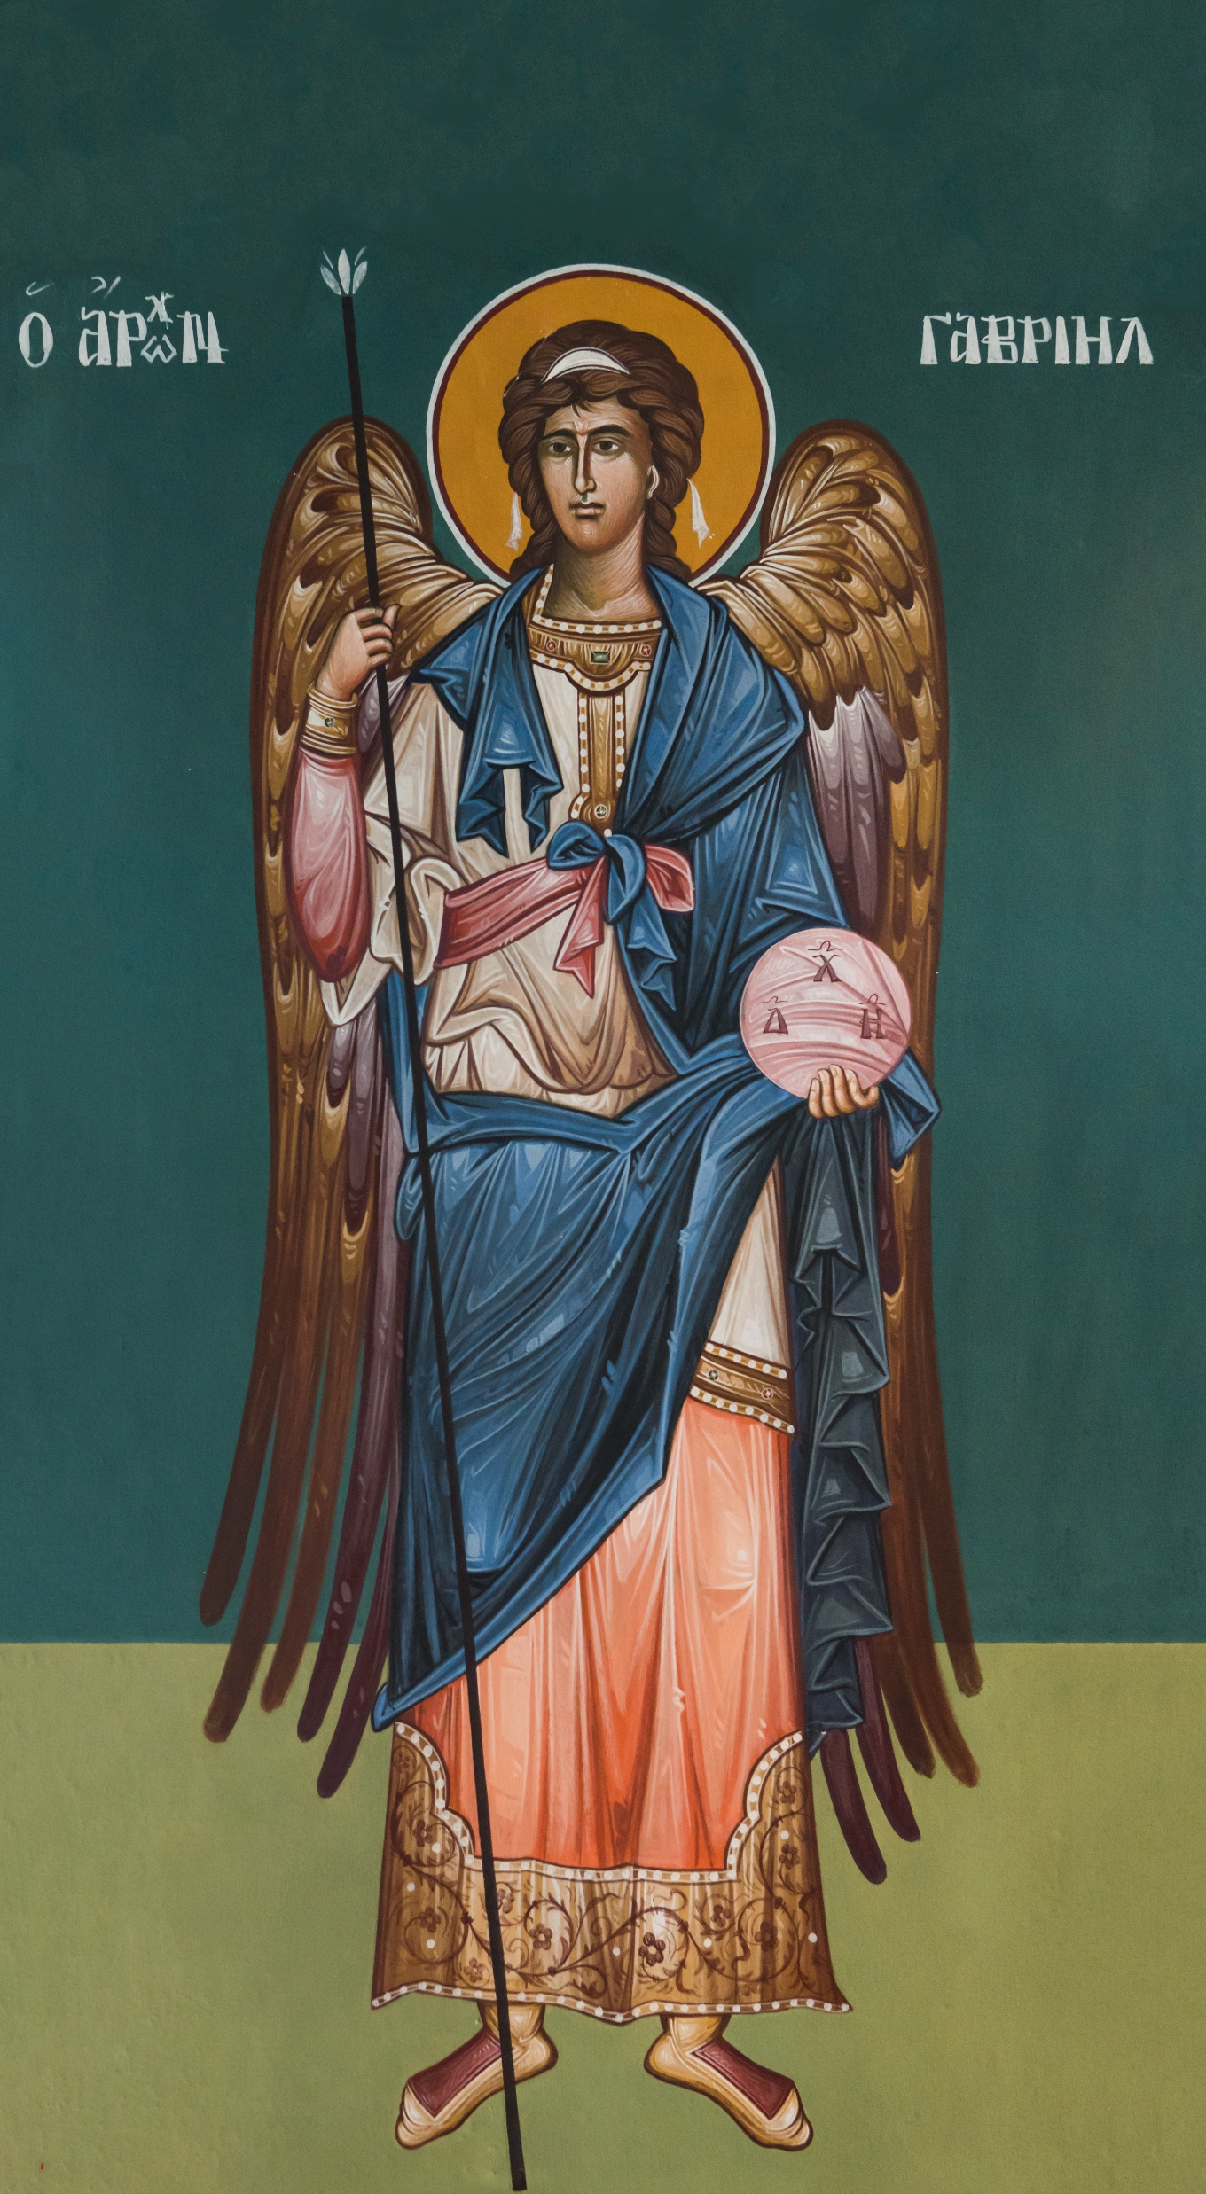
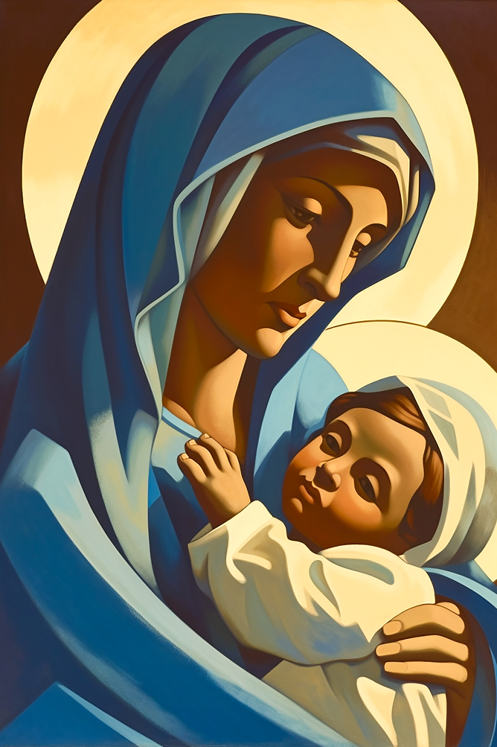
YEAR GROUP FOUR
Background knowledge for teachers
The meaning of incarnation: God comes to live amongst His creation in the form of Jesus. Jesus is both human and divine. Incarnation means that Jesus is God in the flesh.
To note: Jesus has always existed as God. He is part of the Trinity that has been present from the very beginning of time. Misconception: Jesus appeared at Christmas and was not in existence before then.
CORE CONCEPT: INCARNATION
Key things to note:
Archangel Gabriel:
After the annunciation of Mary, Gabriel is not spoken of again.
Misconception: Angels have wings. In the Bible, angels are not depicted as having wings.
Mary:
Mary accepted the will of God. She gave birth to His son and stood by Jesus throughout his whole ministry. John’s Gospel recalls her being at the foot of the cross when Jesus was crucified.
Mary was an ordinary Jewish girl who accepted the most extraordinary task, to be the God bearer of His one and only son Jesus Christ.
Importance: Without Mary, Jesus could not have been born. Mary is therefore essential to the Nativity story.
Prominent female figure in the New Testament.
Mary is fully human but has a very important and intimate place in the story of Jesus. She is the God bearer.
Mary is often described as the role model for motherhood.
Mary was a young Jewish girl probably around the age of 13.
Mary, like many Jewish girls of her time, would have spent most of her days working.
Mary was betrothed to be married. This would often happen about a year before she would move to live with her husband and his family. It would be at this point that she would have been considered married.
Mary though afraid said ‘yes’ to God.
Gabriel is known as an archangel – meaning chief angel.
The word Gabriel means God is strong/powerful/mighty.
Gabriel is God’s messenger.
Gabriel appears in both the Old and New Testament.
Gabriel appears to Daniel in the Old Testament.
In the New Testament, Gabriel first appears to Zachariah, father of John the Baptist, to let him know that Elizabeth shall bear a son who shall be called John.
Gabriel then appears again to Mary to announce that she will conceive God’s son.

Slide 3
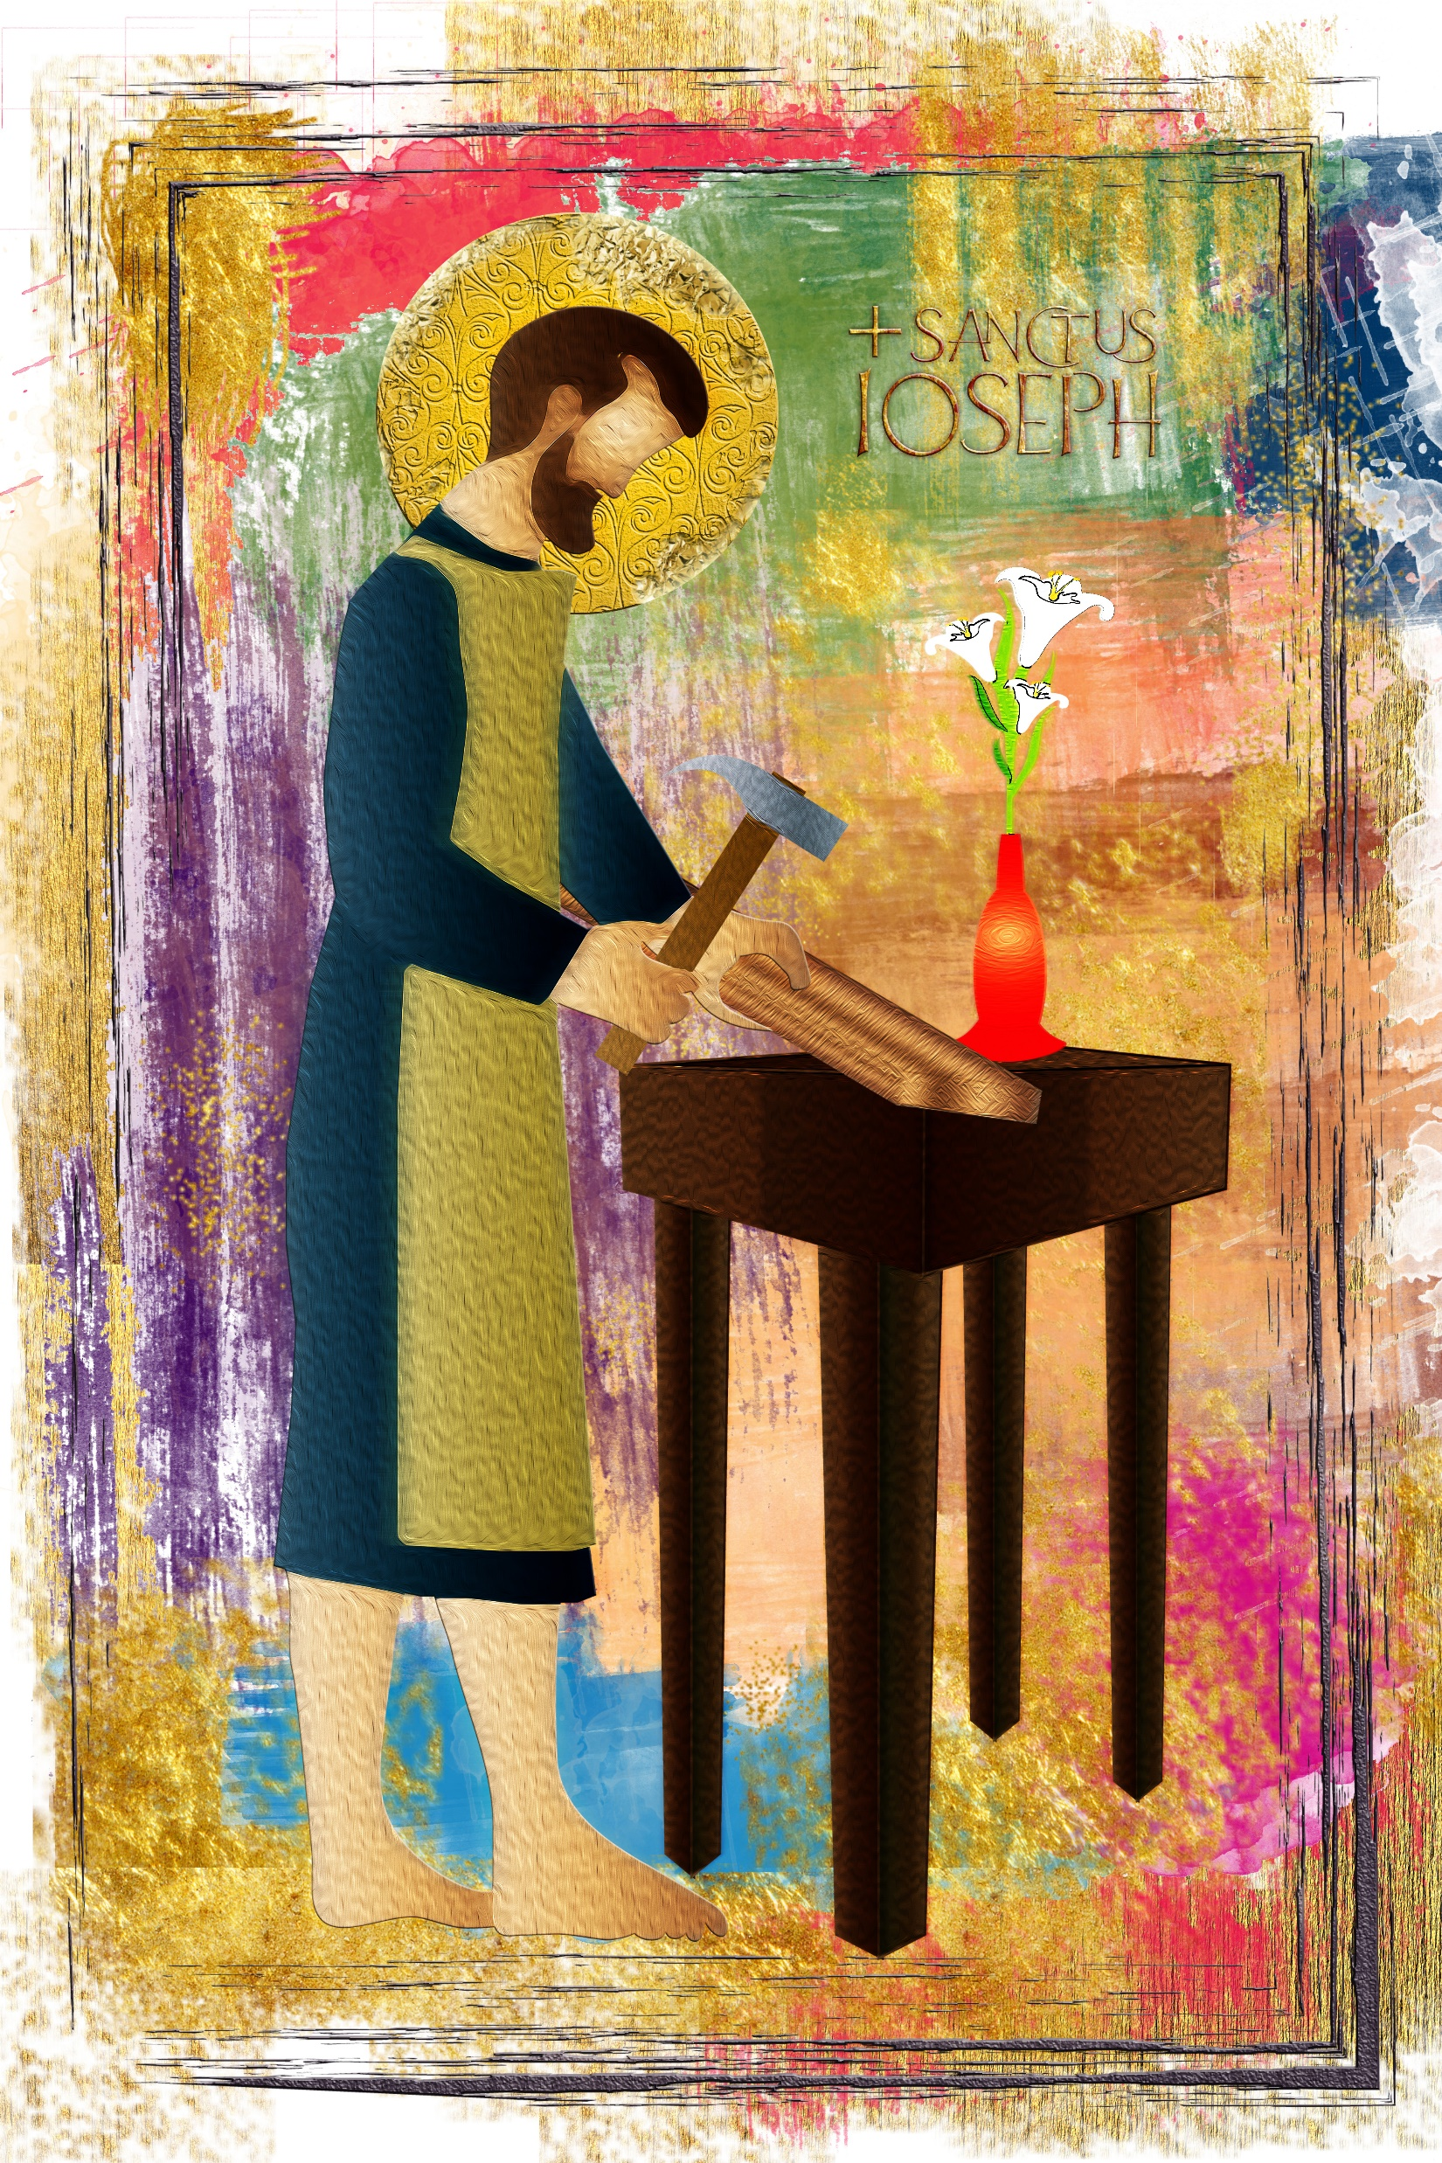
YEAR GROUP FOUR
Background knowledge for teachers
The meaning of incarnation: God comes to live amongst His creation in the form of Jesus. Jesus is both human and divine. Incarnation means that Jesus is God in the flesh.
To note: Jesus has always existed as God. He is part of the Trinity that has been present from the very beginning of time. Misconception: Jesus appeared at Christmas and was not in existence before then.
CORE CONCEPT: INCARNATION
Joseph: From the Gospel of Matthew
https://www.learnreligions.com/joseph-earthly-father-of-jesus-701091
Joseph was a righteous man.
His actions towards Mary were kind and sensitive.
Joseph could have broken off the engagement and he did consider this. To be with a pregnant woman would not have been accepted and would have brought significant shame on the family. However, Joseph was reassured in a dream, of God’s plan, which he accepted in spite of the public humiliation he would face.
We are told little about what he was like as a father. We are given indications that he acted with integrity and righteousness.
God honoured Joseph’s integrity by entrusting him with His son.
Joseph took his job seriously. He protected Jesus right from the beginning – the escape to Egypt when he was told in a dream to go there to get away from King Herod.
Joseph ensured that Jesus learnt at the synagogue from an early age, in preparation for his ministry.
Joseph did not know all the details of what was to happen to Jesus, but he responded in faith to what God was asking of him.
Importance: God chose Joseph. Joseph was righteous, loyal, committed and kind. He took his role seriously and acted with integrity.
Shepherds: From the Gospel of Luke
Jesus had come to serve and save all of humanity.
God revealing the good news to the shepherds must not be underestimated. It is saying a very clear statement – that this Christ child was for all people and for all times.
Other possibilities as to why the shepherds were the first to know
These were Bethlehem shepherds, the shepherds who raised the sheep offered as sacrifices at Passover. So, even at Jesus' birth, we are reminded of Jesus' sacrificial death.
Abraham, Moses, and David were all shepherds and God made great promises to them about deliverance and a Messiah. God, therefore, is now showing he honours his promises by announcing the coming of the Christ, the Messiah, to shepherds first.
The image of a shepherd is the image Jesus chooses to use for his example of a leader — one who pastors, who shepherds his sheep and is even willing to lay down his life for his sheep.
In Luke’s Gospel, an angel appeared to the shepherds to tell them the good news. A whole company of angels appeared before the shepherds, praising God.
The shepherds were seen as the nobodies in society. They were often viewed as the unwanted people, often left out and rejected and often seen as people from the lower classes. They did not live in the cities and their jobs brought in little money. The shepherds were not seen as important personally, politically or economically.
Shepherds were often seen as outsiders because they were unable able to keep the Jewish Law – they had to work looking after their sheep on the Sabbath.
It is significant that God chose the shepherds to be the first people to hear the good news of Jesus’ birth, signifying to the world that Jesus had come for all people regardless of race, background, gender, class etc.

Slide 4
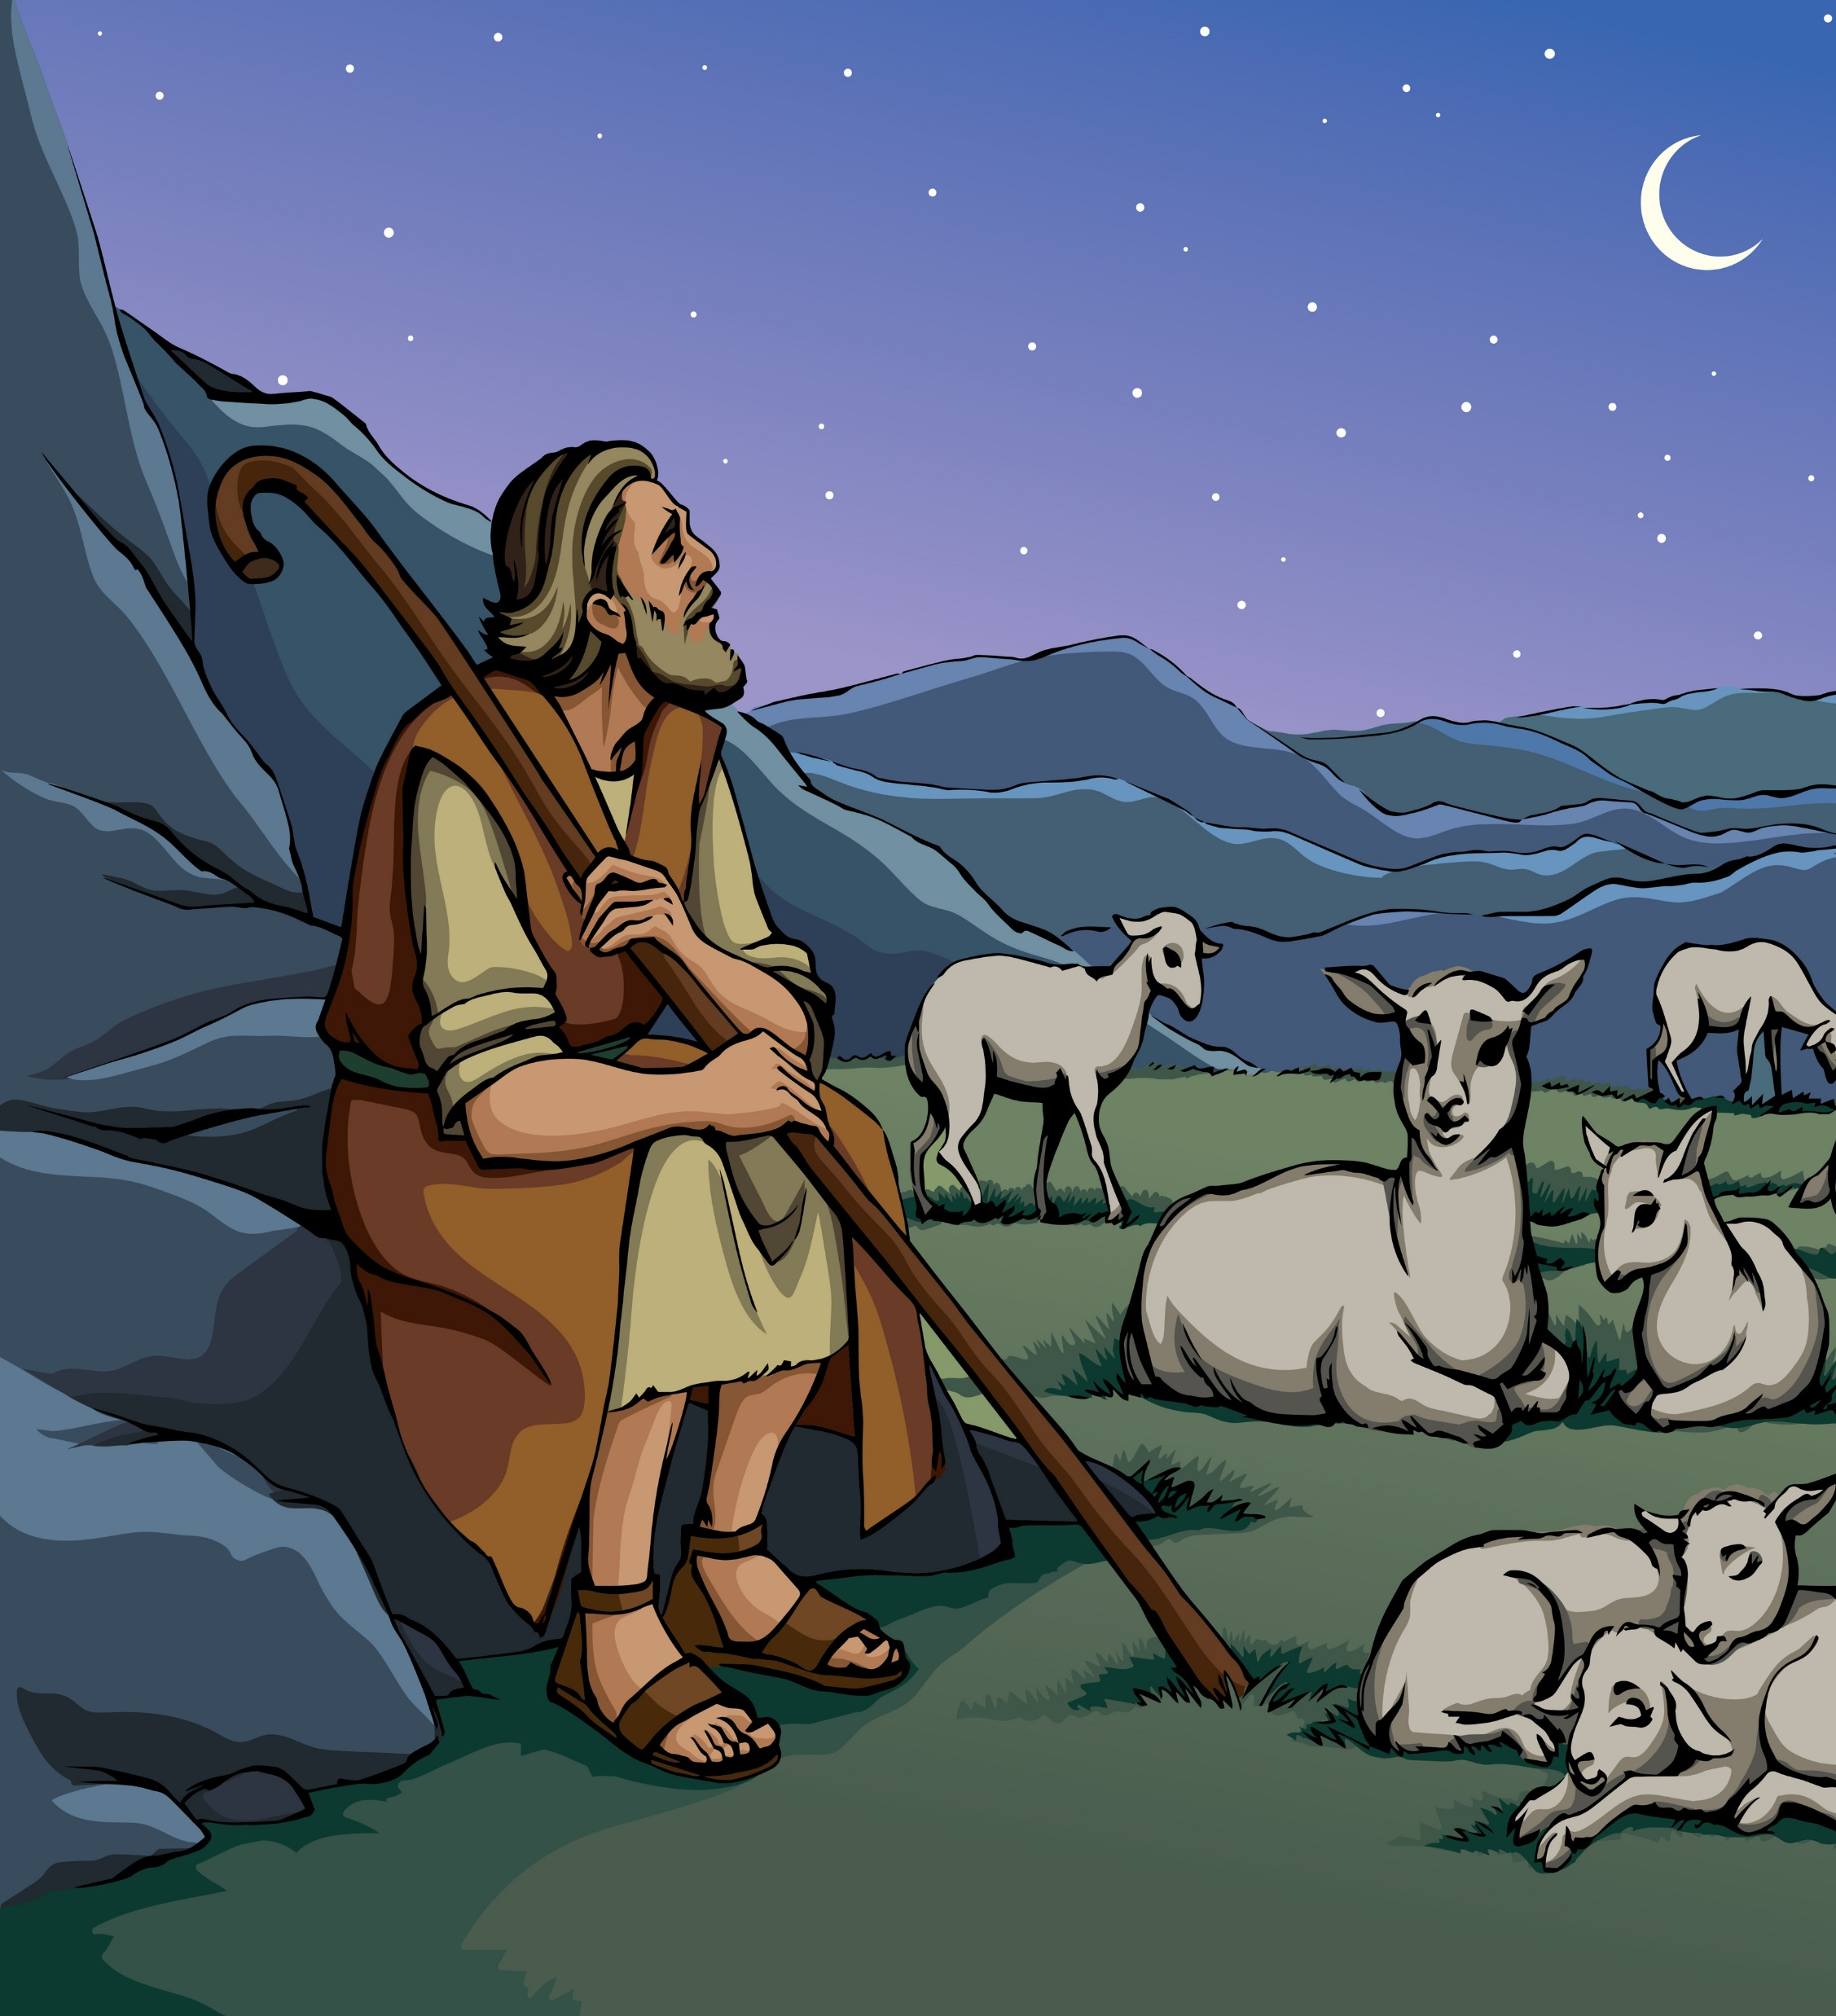
YEAR GROUP FOUR
Background knowledge for teachers
The meaning of incarnation: God comes to live amongst His creation in the form of Jesus. Jesus is both human and divine. Incarnation means that Jesus is God in the flesh.
To note: Jesus has always existed as God. He is part of the Trinity that has been present from the very beginning of time. Misconception: Jesus appeared at Christmas and was not in existence before then.
CORE CONCEPT: INCARNATION
God is frequently identified as the loving, tender Shepherd of his people (Psalm 23:1-6; Isaiah 40:11; Ezekiel 34:11-16). Jesus identifies himself as the Good Shepherd (John 10:1-18).
Importance: The shepherds represent humanity – the ordinary people.
Wisemen: From the Gospel of Matthew
https://www.bbc.co.uk/bitesize/guides/zvxtgwx/revision/6
Meaning behind the gifts:
Gold symbolising the Kingship of God
Frankincense symbolising the High Priest of God. Jesus being the High Priest. Frankincense is often seen as a symbol of prayer. Frankincense is sometimes used in worship in churches to symbolise the prayers of the people rising upwards.
Myrrh pointing to Jesus’ suffering and death. Myrrh was a spice used for medicine, cosmetics, and anointing oil. It was mixed into the oil that was used to anoint prophets for the divinely appointed work of revealing God and communicating His will and words to His people. It was also a perfume that was used to anoint the dead.
The Christingle: (Extract from the Children’s Society)
https://www.childrenssociety.org.uk/how-you-can-help/fundraise-and-events/christingle/what-is-christingle
The meaning of Advent:
Advent means ‘to come’. The season of Advent for Christians is a time of reflection and penitence in preparation for Christmas. The predominant theme is one of hope linked to the ‘coming of the kingdom.’ It is a time of waiting. Advent is the beginning of the Christian year.
Advent wreaths are popular especially in churches. They are made with fir branches and five candles. Candles are lit throughout Advent.
First candle represents the Patriarchs: Abraham, Isaac, Jacob: (A patriarch is the male head of the family – the highest ranking.) Abraham is known as the founder of the Jewish faith upon which Christianity developed out of. Genesis 12-25.

Slide 5
YEAR GROUP FOUR
Background knowledge for teachers
The meaning of incarnation: God comes to live amongst His creation in the form of Jesus. Jesus is both human and divine. Incarnation means that Jesus is God in the flesh.
To note: Jesus has always existed as God. He is part of the Trinity that has been present from the very beginning of time. Misconception: Jesus appeared at Christmas and was not in existence before then.
CORE CONCEPT: INCARNATION
Second candle represents the prophets: The Jewish prophets wrote a great deal about the age of the Messiah (Messiah with a capital ‘M’ refers to the future leader). The Jews were waiting for their future leader to come – waiting for the time when God’s presence would be felt by all people. Their future leader would be just and fair and he would bring peace and love. Jesus was the Messiah – the anointed future leader – but the Jews did not recognise or accept him – he did not come in the way they expected.
Third candle represents John the Baptist: John the Baptist was the cousin of Jesus. His mother was Elizabeth. He preached the need for repentance and to be baptised. He prepared the way for Christ. He is known as the forerunner of Christ. He told people that he baptises with water but the one that follows will baptise with the Holy Spirit.
Fourth candle represents Mary: Mary – very young girl (around about the age of 12/13). Engaged to be married to Joseph, an ordinary carpenter. She was an ordinary Jewish girl. She was a virgin – means young girl as well as someone who has not had intercourse. Obedient to God. Mary was poor.
Fifth candle represents Jesus: Christians believe Jesus to be the incarnation of God. God’s ultimate gift of love to the world.
The prophets:
The prophet Isaiah:
Isaiah was best known as the Hebrew prophet who predicted the coming of Jesus Christ to salvage mankind from sin. Isaiah lived about 700 years before the birth of Jesus Christ.
Synopsis:
Isaiah was a Hebrew prophet who was believed to have lived about 700 years before the birth of Jesus Christ. Born in Jerusalem, Israel, he was said to have found his calling as a prophet when he saw a vision in the year of King Uzziah’s death. Isaiah prophesised the coming of the Messiah, Jesus Christ. He was believed to have written chapters 1-39 in The Book of Isaiah with the balance of the book authored by several other prophets.
“A child has been born to us, “For to us a child is born, to us a son is given.
and the government will be on his shoulders. And he will be called
Wonderful Counsellor, Mighty God,
Everlasting Father, Prince of Peace. Of the greatness of his government and peace
there will be no end.”
(Isaiah 9: 6 – 7 – NIV)

Slide 6
YEAR GROUP FOUR
Background knowledge for teachers
The meaning of incarnation: God comes to live amongst His creation in the form of Jesus. Jesus is both human and divine. Incarnation means that Jesus is God in the flesh.
To note: Jesus has always existed as God. He is part of the Trinity that has been present from the very beginning of time. Misconception: Jesus appeared at Christmas and was not in existence before then.
CORE CONCEPT: INCARNATION
Context for the Bible passages that will be explored in lesson 4:
Context and chapter summary: Matthew chapter 5 https://www.bibleref.com/Matthew/5/Matthew-5-9.html
Matthew 5: 9
“Blessed are the peacemakers
for they will be called children of God.” (NIV)
Context and chapter summary: Matthew chapter 11 https://www.bibleref.com/Matthew/11/Matthew-11-28.html
Matthew 11: 28 - 30
“Come to me, all you who are weary and burdened, and I will give you rest. ²⁹ Take my yoke upon you and learn from me, for I am gentle and humble in heart, and you will find rest for your souls. ³⁰ For my yoke is easy and my burden is light.” (NIV)
Context and chapter summary: John chapter 14 https://www.bibleref.com/John/14/John-chapter-14.html
John 14: 27
“Peace I leave with you; my peace I give you. I do not give to you as the world gives. Do not let your hearts be troubled and do not be afraid.” (NIV)
Context and chapter: John chapter 16 https://www.bibleref.com/John/16/John-chapter-16.html
John 16: 33
“I have told you these things, so that in me you may have peace. In this world you will have trouble. But take heart! I have overcome the world.” (NIV)
Context and chapter summary: John chapter 20 https://www.bibleref.com/John/20/John-20-19.html
John 20: 19
On the evening of that first day of the week, when the disciples were together, with the doors locked for fear of the Jewish leaders, Jesus came and stood among them and said, “Peace be with you!”

Slide 7
YEAR GROUP FOUR
Lesson 1: What do I understand Christmas to mean for many Christians? What does it mean to me?
CORE CONCEPT: INCARNATION
Intentions:
To give pupils opportunities to:
Recap and revisit prior knowledge learnt in previous years.
Begin to understand what Christmas means for many Christians.
Explore their own understanding of Christmas.
Key religious vocabulary: Names of the key people in the nativity story, advent, prophet, prophecy, gold, frankincense, myrrh, Incarnation
Implementation:
Outlining how to introduce the religious content in the classroom and create learning opportunities from it.
Introduction:
Main teaching input: (Investigate and explore)
Introduce the big question for the unit:
Is the Christmas message of peace still relevant for today’s world?
A line is placed on the carpet – one end ‘yes’. The other end ‘no’. In the middle ‘not sure.’
Pupils place themselves along the line.
Teachers to make an assessment of pupils’ responses.
Key question:
Talk to you partner and explain why you have positioned yourself where you have on the line.
To note: This exercise will be repeated at the end of the unit. Do the pupils respond differently?

Slide 8
YEAR GROUP FOUR
Lesson 1: What do I understand Christmas to mean for many Christians? What does it mean to me?
CORE CONCEPT: INCARNATION
Implementation:
Outlining how to introduce the religious content in the classroom and create learning opportunities from it.
Introduce this week’s question: What do I understand Christmas to mean for many Christians? What does it mean to me?
Set up a carousel of enquiry-based activities to include the following:
Table one: Picture/artefact/object of the Angel Gabriel, Mary and Joseph?
Table two: Picture/artefact/object of the shepherds and wisemen
Table three: Picture /artefact/object of the three gifts – gold, frankincense and myrrh
Table four: Picture/statute of baby Jesus
Table five: Picture/real thing – Christingle
Table six: Advent wreath
Divide the class into six groups. Pupils hold a conversation in groups of three. Each group to visit three tables. If time allows, more tables can be visited.
Model what a quality conversation looks like. Highlight the importance of using religious vocabulary during the conversation.
Key questions to explore at each table:
What do you already know about what is in front of you?
How is the ‘item’ connected to Christmas?
What meaning and significance does the ‘item’ give to Christmas for many Christians?
Main activity: (Evaluate and communicate)
Circle time:
An opportunity to draw on the independent enquiry that has taken place, to address misconceptions and fill in the knowledge gaps.
Discussion one: Place the key people (not Jesus) in the nativity story in the middle of the circle.

Slide 9
YEAR GROUP FOUR
Lesson 1: What do I understand Christmas to mean for many Christians? What does it mean to me?
CORE CONCEPT: INCARNATION
Key questions:
What do we know about each of these people?
Why are they significant in helping to understand the meaning of Christmas?
Discussion two: Place the Christingle in the middle of the circle.
Key questions:
Describe the symbolism of the Christingle.
How does the Christingle connect to Jesus?
Discussion three: Place the Advent wreath in the middle of the circle.
Key questions:
What can you tell me about Advent?
What can you tell me about the significance of each candle?
Discussion four: Place baby Jesus in the middle of the circle
Key questions:
I wonder what you can tell me about this person
I wonder what this person has to do with the meaning of Christmas for many Christians
Introduce pupils to the word – incarnation. Are pupils able to recall what it means? Explain that this is the core concept that will be explored throughout the whole unit of learning.
Plenary: (Reflect and express)
Each pupil is given a post it note and asked to respond to the question/s. (Choose the ones that best suits the make up of your class)
I wonder what Christmas means to you?
I wonder what Christmas means to a believer?
I wonder what feelings/emotions/activities you associate with the days that surround the festival of Christmas?
If you had to choose three words to describe the meaning of Christmas either for you or for the Christian community, what would they be?
Post notes to go on to the RE learning journey wall.
Implementation:
Outlining how to introduce the religious content in the classroom and create learning opportunities from it.

Slide 10
YEAR GROUP FOUR
Lesson 1: What do I understand Christmas to mean for many Christians? What does it mean to me?
CORE CONCEPT: INCARNATION
Resources
Pictures/artefacts/objects for each table.
Sensitivities
Be mindful of pupils who do not celebrate Christmas either religiously or culturally.
Be mindful of pupils for whom Christmas is a difficult time.
Impact
What do you notice as a teacher?
What do pupils say?
In this box, note down anything that you heard a pupil say that would provide evidence towards their progress in RE.
Note down anything significant an additional adult has noticed.
Note down anything significant that happened in the lesson that will have an impact on the next lesson.

Slide 11
YEAR GROUP FOUR
Lesson 2: What do you think the word ‘peace’ means?
CORE CONCEPT: INCARNATION
Intentions:
To give pupils opportunities to:
Express their own thoughts and beliefs about what peace means.
Begin to apply their own ideas to a given question.
Key religious vocabulary: Peace
Implementation:
Outlining how to introduce the religious content in the classroom and create learning opportunities from it.
Introduction:
Recap on previous week’s learning:
Use pictures to stimulate the recapping of learning.
Use true and false statements to help with recap.
Key knowledge checking:
The significance of each person in the nativity story.
The importance of the prophecies foretold in the OT.
The role of John the Baptist.
The meaning of the word incarnation.
Main teaching input: (Investigate and explore)
Introduce this week’s question: What do you think the word ‘peace’ means?

Slide 12
YEAR GROUP FOUR
Lesson 2: What do you think the word ‘peace’ means?
CORE CONCEPT: INCARNATION
Implementation:
Outlining how to introduce the religious content in the classroom and create learning opportunities from it.
In groups of three, pupils ‘knowledge gather’ what they think peace means and what things they associate with the word peace.
Model an example: Calm, stillness, walking, resting, being quiet, being in nature, creation.
Main activity: (Evaluate and communicate)
In groups of three explore the following question: What does internal and external peace mean?
Sorting activity: (See appendix lesson 2.)
Plenary: (Reflect and express)
Explain to pupils what internal and external peace means and how they are interrelated to each other.
Points to note:
Internal peace represents individual’s peace.
External peace represents peace in society.
Both are interdependent upon each other.
When people feel internally at peace, their actions which affect others are often actions of peace rather than conflict.

Slide 13
YEAR GROUP FOUR
Lesson 2: What do you think the word ‘peace’ means?
CORE CONCEPT: INCARNATION
Resources
Appendix Lesson 2.
Sensitivities
Be mindful of pupils who have experienced conflict and lack of peace in their own lives.
Be mindful of pupils who have experienced lack of peace at a society level – those fleeing war/political conflict etc.
Impact
What do you notice as a teacher?
What do pupils say?
In this box, note down anything that you heard a pupil say that would provide evidence towards their progress in RE.
Note down anything significant an additional adult has noticed.
Note down anything significant that happened in the lesson that will have an impact on the next lesson.

Slide 14
YEAR GROUP FOUR
Lesson 3: Jesus is described as the Prince of Peace – what does this mean?
CORE CONCEPT: INCARNATION
Intentions:
To give pupils opportunities to:
Analyse Biblical text.
Use prior knowledge about Jesus to begin to apply their own ideas as to the meaning of the phrase Prince of Peace.
Key religious vocabulary: Prophet, prophecy, Prince of Peace
Implementation:
Outlining how to introduce the religious content in the classroom and create learning opportunities from it.
Introduction:
Recap on previous week’s learning:
Key knowledge checking:
Understanding what is meant by internal and external peace.
Main teaching input: (Investigate and explore)
Introduce this week’s question: Jesus is described as the prince of peace – what does this mean?
Key question:
What do you think the phrase Prince of Peace means?

Slide 15
YEAR GROUP FOUR
Lesson 3: Jesus is described as the Prince of Peace – what does this mean?
CORE CONCEPT: INCARNATION
Implementation:
Outlining how to introduce the religious content in the classroom and create learning opportunities from it.
Biblical text analysis: Isaiah 9:6
Explain the context of the verse: Refer to background knowledge for teachers.
Read the passage slowly three times, each time adding a little bit more to what was read the previous time.
First time:
A child is born to us! A son is given to us!
Second time:
A child is born to us! A son is given to us!
And he will be our ruler.
Third time:
A child is born to us! A son is given to us!
And he will be our ruler. He will be called, “Wonderful Counsellor,” “Mighty God,” “Eternal Father,” “Prince of Peace.”
Key questions:
What words phrases have stayed with you? Why do you think this is?
Who do you think this verse is describing? How do you know?
What do we call this verse – (prophecy) Where do you think it would be found in the Bible?

Slide 16
YEAR GROUP FOUR
Lesson 3: Jesus is described as the Prince of Peace – what does this mean?
CORE CONCEPT: INCARNATION
Implementation:
Outlining how to introduce the religious content in the classroom and create learning opportunities from it.
Main activity: (Evaluate and communicate)
Written response in the pupils RE books:
Key question:
How do you think Jesus’ life lived up to this prophecy of him as Prince of Peace? Can you give some examples, building on your prior knowledge, of how he did this? (Parables/miracles/words he spoke/key teachings)
What do we already know about Jesus to help us answer this question?
As a class, ‘knowledge gather’ examples of Jesus’ life which reflect this title – Prince of Peace.
E.g.:
Key teachings: Love your neighbour. Forgiveness. Message of service/servanthood. Beatitudes
Parables: Good Samaritan - example of love in action.
Miracles: Feeding of the 5000 – compassion on those in need. Healing of the paralysed man – forgives him, calms the storm.
Death: Self-sacrifice/acceptance – remained calm. Did not fight back.
Plenary: (Reflect and express)
Return to the passage from Isiah 9:6
Wonderful counsellor
Mighty God
Eternal Father
Prince of Peace
Key questions: Discuss in talk partners
If you had to pick one of these as a title that best described Jesus, which one would you pick? Explain your reason for your choice?
Do you think a believer would think differently to you? if yes, why, if not why not?

Slide 17
YEAR GROUP FOUR
Lesson 3: Jesus is described as the Prince of Peace – what does this mean?
CORE CONCEPT: INCARNATION
Resources
Type resources…
Sensitivities
Type sensitivities…
Impact
What do you notice as a teacher?
What do pupils say?
In this box, note down anything that you heard a pupil say that would provide evidence towards their progress in RE.
Note down anything significant an additional adult has noticed.
Note down anything significant that happened in the lesson that will have an impact on the next lesson.

Slide 18
YEAR GROUP FOUR
Lesson 4: What does the Bible say about Jesus’ message of peace?
CORE CONCEPT: INCARNATION
Intentions:
To give pupils opportunities to:
Explore what the Bible says about Jesus’ message of peace.
Ask questions.
Think critically.
Key religious vocabulary: Incarnation
Implementation:
Outlining how to introduce the religious content in the classroom and create learning opportunities from it.
Introduction:
Recap on previous week’s learning:
Key knowledge checking:
To know what the phrase Prince of Peace means.
To know how Jesus’ life reflected this title.
Main teaching input: (Investigate and explore)
Main activity: (Evaluate and communicate)
Introduce this week’s question: What does the Bible say about Jesus’ message of peace?

Slide 19
YEAR GROUP FOUR
Lesson 4: What does the Bible say about Jesus’ message of peace?
CORE CONCEPT: INCARNATION
Implementation:
Outlining how to introduce the religious content in the classroom and create learning opportunities from it.
Verses to explore: Matthew 5: 9, Matthew 11: 28 – 30, John 14: 27, John 16: 33, John 20: 19
(Refer to background knowledge for teachers.)
Place one verse on each table.
To note: Before beginning the analysis, read through each verse with the pupils, giving them the context in which the verse sits.
Silent conversation: Model what a silent conversation looks like using one verse.
In pairs, pupils move around the tables.
Pupils read the verse.
What thoughts or questions does the verse raise in them? Pupils record their thoughts and questions on the large sheet of paper on each table, using one colour.
Pupils respond to the questions others have written down using another colour.
To note: Throughout the whole process, the teacher should serve as the facilitator, asking probing questions to extend pupils thinking and understanding.
Plenary: (Reflect and express)
Teacher to address any misconceptions that may have occurred. Teacher to facilitate class discussion around some questions that may have come up that require further digging.
Key questions:
Which verse do you think has had the greatest impact on you? Can you explain why?
What challenges or comfort might this verse provide for some Christians?
Return to the question of the lesson: What does the Bible say about Jesus’ message of peace?
Point out to pupils that Jesus’ message of peace speaks about both types of peace – internal and external. Christians believe that the world needs both and Jesus provides both. Christmas is a time when Christians remember the peace that was brought to the world through the incarnation of Jesus.
Gather pupils’ thoughts and reflections.

Slide 20
YEAR GROUP FOUR
Lesson 4: What does the Bible say about Jesus’ message of peace?
CORE CONCEPT: INCARNATION
Resources
Bible verses...
Sensitivities
Type sensitivities…
Impact
What do you notice as a teacher?
What do pupils say?
In this box, note down anything that you heard a pupil say that would provide evidence towards their progress in RE.
Note down anything significant an additional adult has noticed.
Note down anything significant that happened in the lesson that will have an impact on the next lesson.

Slide 21
YEAR GROUP FOUR
Lesson 5 & 6: Is the Christmas message of peace still relevant for today’s world?
CORE CONCEPT: INCARNATION
Intentions:
To give pupils opportunities to:
Make links between beliefs and how people might respond to a given situation.
Express their own thoughts and responses to a given situation.
Begin to apply their own and others’ ideas to a given situation.
Key religious vocabulary: N/A
Implementation:
Outlining how to introduce the religious content in the classroom and create learning opportunities from it.
Lesson 5:
Introduction:
Recap on previous week’s learning:
Key knowledge checking:
Can the pupils recall what the Bible says about Jesus’ message about peace?
Main teaching input: (Investigate and explore)
Introduce this week’s question: Is the Christmas message of peace still relevant for today’s world?

Slide 22
YEAR GROUP FOUR
Lesson 5 & 6: Is the Christmas message of peace still relevant for today’s world?
CORE CONCEPT: INCARNATION
Implementation:
Outlining how to introduce the religious content in the classroom and create learning opportunities from it.
Gather together a number of newspaper articles on current affairs/events/issues where a solution is required and conflict/dispute evident. Provide examples that are both local, national and global.
Keeping in mind this idea that Jesus came as the Prince of Peace, explore the following key questions:
How might Jesus have responded? What might he have said/done?
How might a Christian (who follows Jesus’ example) respond today? What might they say?
How would you respond? What message would you want to give?
Note: Do the responses change depending on whose lens you are looking through?
Pupils record their answers in their RE books or on speech bubbles that they place around each article.
Plenary: (Reflect and express)
Key question:
Having read the articles, do you think Jesus’ message of peace is still relevant for today’s world?

Slide 23
YEAR GROUP FOUR
Lesson 5 & 6: Is the Christmas message of peace still relevant for today’s world?
CORE CONCEPT: INCARNATION
Implementation:
Outlining how to introduce the religious content in the classroom and create learning opportunities from it.
Lesson 6:
Main activity: (Evaluate and communicate)
Assessment opportunity:
Key question:
Is the Christmas message of peace still relevant for today’s world?
Pupils write a written response to the above question. Pupils are encouraged to support their answers with examples and reasoning. Refer pupils back to lesson 4 where they looked at a number of Bible passages related to peace. Also refer pupils back to lesson 5 where they explored current affairs.
Provide pupils with a model.
Examples:
Model one:
I think the Christmas message of peace is still relevant for the world today for the following reasons. Firstly, in my opinion we still live in a world where there is a lot of conflict, fighting and unrest. People still want and hope for peace. The Christmas message offers that peace people are looking for. Secondly, Christians believe that by following Jesus’ examples they can be the peacemakers. The world needs people who work for peace not war. Finally, I believe we can all be a peacemaker if we want to be. Jesus teaches about the importance of loving your neighbouring and forgiving those that hurt you. He also talks about bringing peace to people who are burdened. Whether you are a believer or not, Jesus’ teachings can help us all to be better human beings and bring about peace in our everyday lives.
Model two:
I think for some people the Christmas message of peace is still relevant today. For a Christian today, believing in the incarnation of Jesus, gives them hope that by following Him, they are able to be peacemakers in their own communities. For many people, believing in a God that is peace, can bring them comfort especially when times are hard. They do not feel so alone. I also think that for some people, who do not believe, the Christmas message of peace has no meaning to them. They see a world that is full of conflict and can’t see how Jesus’ message of peace is impacting change.

Slide 24
YEAR GROUP FOUR
Lesson 5 & 6: Is the Christmas message of peace still relevant for today’s world?
CORE CONCEPT: INCARNATION
Implementation:
Outlining how to introduce the religious content in the classroom and create learning opportunities from it.
Plenary: (Reflect and express)
Place the following statement around the room.
Statements:
I am the Light of the World
I am the Prince of Peace
I am Love
I have come not to be served but to serve
Key question:
What statement do you think best describes the message of Christmas and has the greatest impact on today’s world?
Pupils reflect and go and stand next to their chosen statement. Teacher moves around the room and ask a selection of pupils to justify their position.
Final reflection:
Return to the question of the unit:
Is the Christmas message of peace still relevant for today’s world?
A line is placed on the carpet – one end ‘yes’. The other end ‘no’. In the middle ‘not sure.’
Pupils place themselves along the line.
Key question:
Has your view changed over the course of the unit of learning? If yes, can you explain why?

Slide 25
YEAR GROUP FOUR
Lesson 5 & 6: Is the Christmas message of peace still relevant for today’s world?
CORE CONCEPT: INCARNATION
Resources
A range of articles to examine.
Sensitivities
Be mindful of your given context and how pupils might respond to the articles you are presenting.
Impact
What do you notice as a teacher?
What do pupils say?
In this box, note down anything that you heard a pupil say that would provide evidence towards their progress in RE.
Note down anything significant an additional adult has noticed.
Note down anything significant that happened in the lesson that will have an impact on the next lesson.

Slide 26
London Diocesan Board for Schools
www.ldbs.co.uk 020 7932 1100
London Diocesan Board for Schools is a Charitable Company Limited by Guarantee. Company Registration No 198131. Charity Registration No 313000.
Registered Address: London Diocesan House, 36 Causton Street, London, SW1P 4AU
© Copyright London Diocesan Board for Schools 2023
All rights reserved. No part of these slides may be reproduced, stored in a retrieval system or transmitted in any form or by any other means, electronic or mechanical photocopying, recording or otherwise without the prior written permission of the London Diocesan Board for Schools. These slides may not be lent, resold, hired out or otherwise disposed of by way of trade without the prior consent of the London Diocesan Board for Schools.

