Slide 1
Recapping knowledge
Link person to statement
Person
Statement
Abraham
Moses
Ruth
Listened and followed God’s call.
Showed unconditional love, what it means to be selfless and what self-sacrifice really means.
Showed tremendous faith.
LESSON 6b - YEAR 4
© Copyright London Diocesan Board for Schools 2023

Slide 2
In groups of 4, pupils are presented with the following scenario.
Millie
The situation
Millie is eight years old. She comes from a Christian family. Millie attends church every week and her faith is very important to her. She knows the two greatest commandments – love God and love your neighbour as yourself.
A new child joins Millie’s class. His name is Fred. Fred is very shy and doesn’t speak even when children try to speak to him. At lunchtime Fred tries to join in playing football but soon becomes upset because his team are losing. Millie sees Fred sitting on the bench crying. Millie loves sport and she is meant to be attending football training this particular lunchtime. It is the last training before the big match against another school. If she doesn’t attend training, she can’t play in the match.

Slide 3
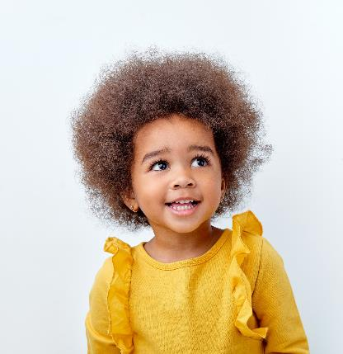
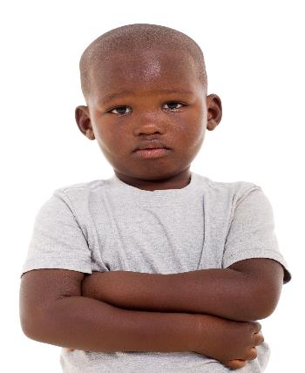
Decision time: What should Millie do? Things to consider before making the decision:
Millie is a Christian.
Millie loves football and is very good at it. Her team rely on her.
Fred is shy and doesn’t talk to anyone.
Who might Millie go to, to ask for guidance?
What might Millie do before she makes a decision?
Millie
Fred

