Slide 1
Wisemen
Teacher notes:
Select the paintings of your choice.
Encourage the pupils to look closely at the painting. What do they notice? Who do the wisemen focus their eyes on? How are the wisemen positioned? Why do you think this is? Why are the wisemen giving the baby gifts?
YEAR ONE - LESSON 5
© Copyright London Diocesan Board for Schools 2023

Slide 2
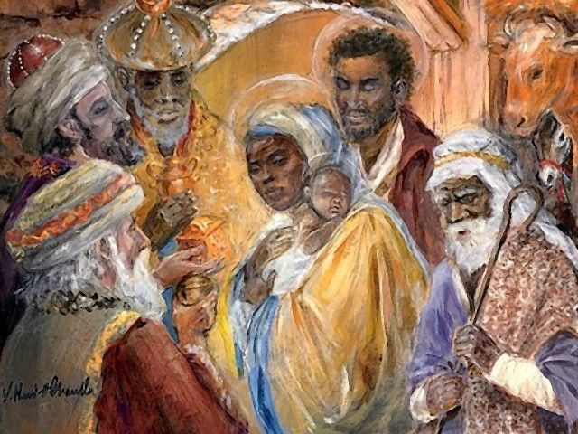
clipground.com/pics/get
YEAR ONE - LESSON 5

Slide 3
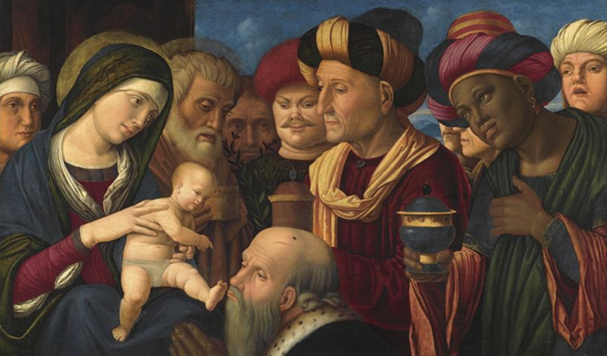
File:FRANCESCO di Simone da Santacroce, THE ADORATION OF THE MAGI, 1500-1508, Sotheby's.jpg - Wikimedia Commons
(Baby Edited for use in classrooms)
YEAR ONE - LESSON 5

Slide 4
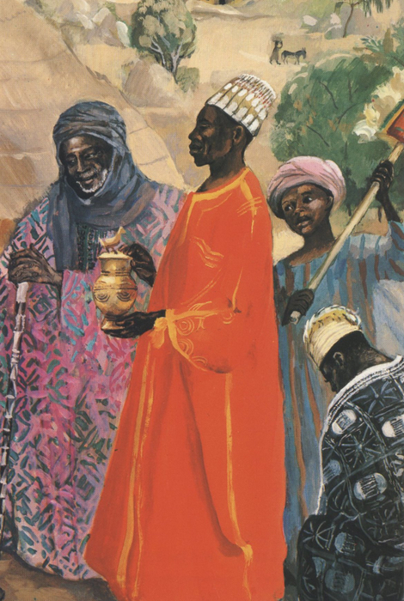
JESUS MAFA. The Three Wise Men, from Art in the Christian Tradition, a project of the Vanderbilt Divinity Library, Nashville, TN. https://diglib.library.vanderbilt.edu/act-imagelink.pl?RC=48399 [retrieved September 1, 2023]. Original source: http://www.librairie-emmanuel.fr (contact page: https://www.librairie-emmanuel.fr/contact).
YEAR ONE - LESSON 5

Slide 5
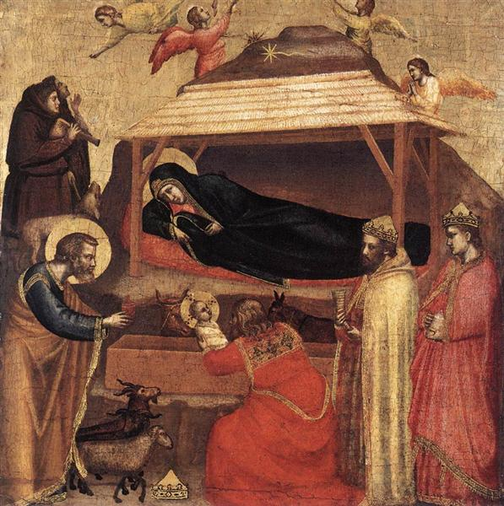
Original Title: L'Epifania
Date: c.1320
Style: Proto Renaissance
Genre: religious painting
Media: panel, tempera
Dimensions: 43.8 x 45.1 cm
YEAR ONE - LESSON 5

