Slide 1
King Herod
Teacher notes:
What do the paintings tell us about the type of person King Herod?
YEAR ONE - LESSON 4
© Copyright London Diocesan Board for Schools 2023

Slide 2
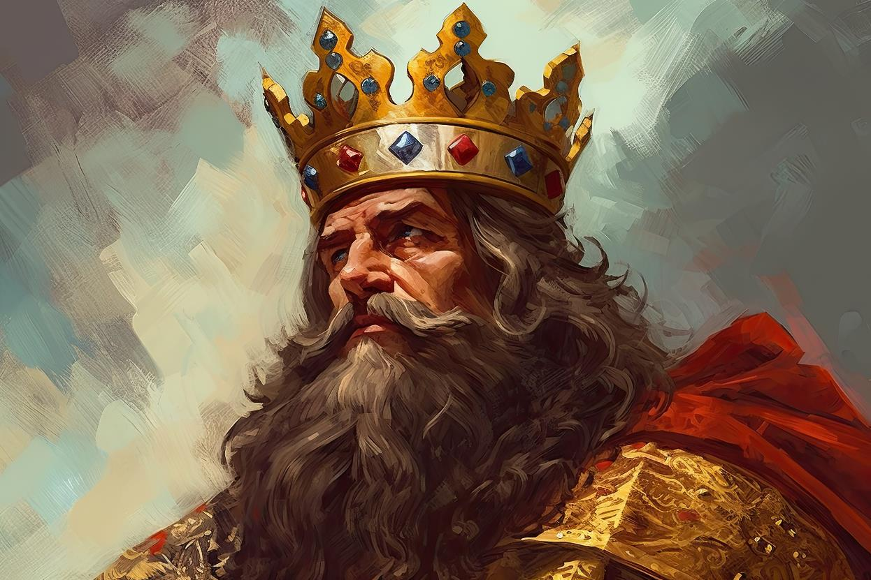
YEAR ONE - LESSON 4

Slide 3
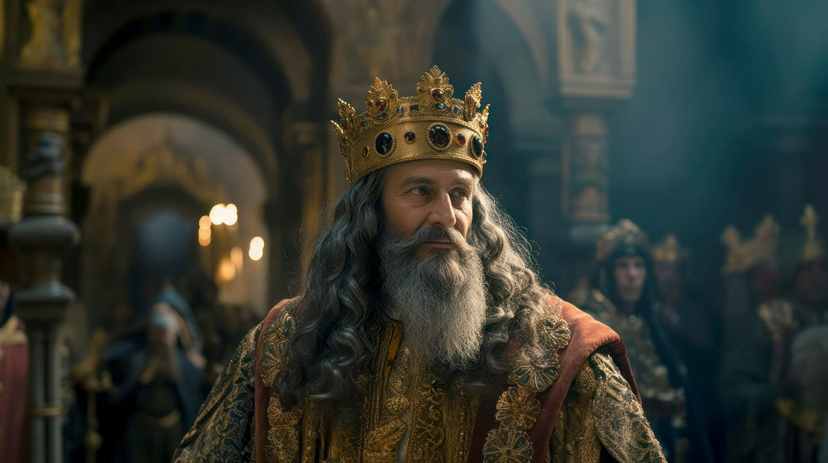
YEAR ONE - LESSON 4

Slide 4
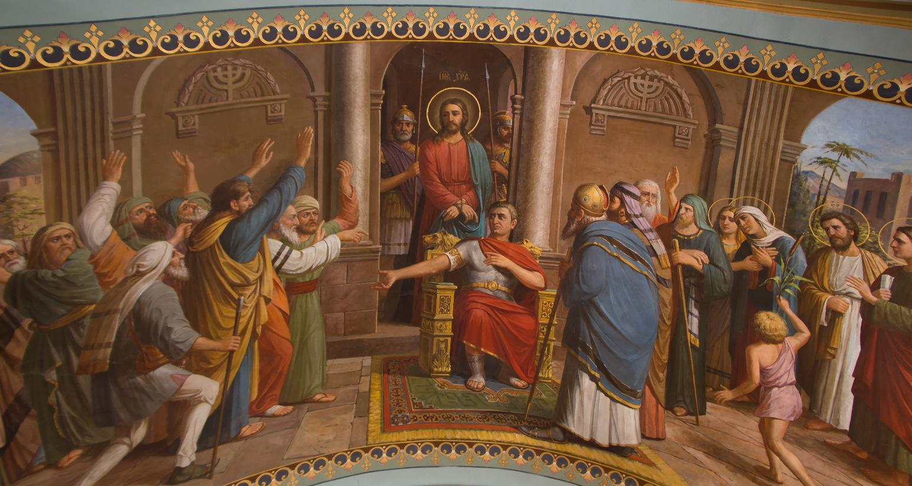
YEAR ONE - LESSON 4

Slide 5
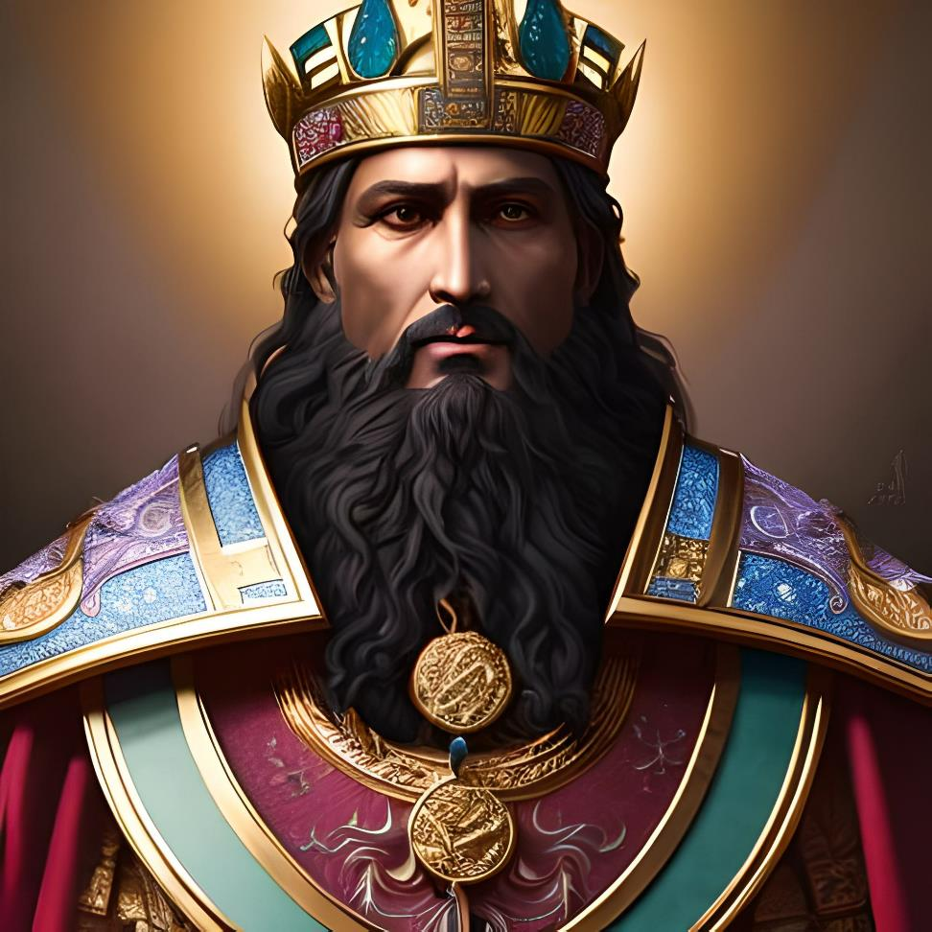
YEAR ONE - LESSON 4

