Slide 1
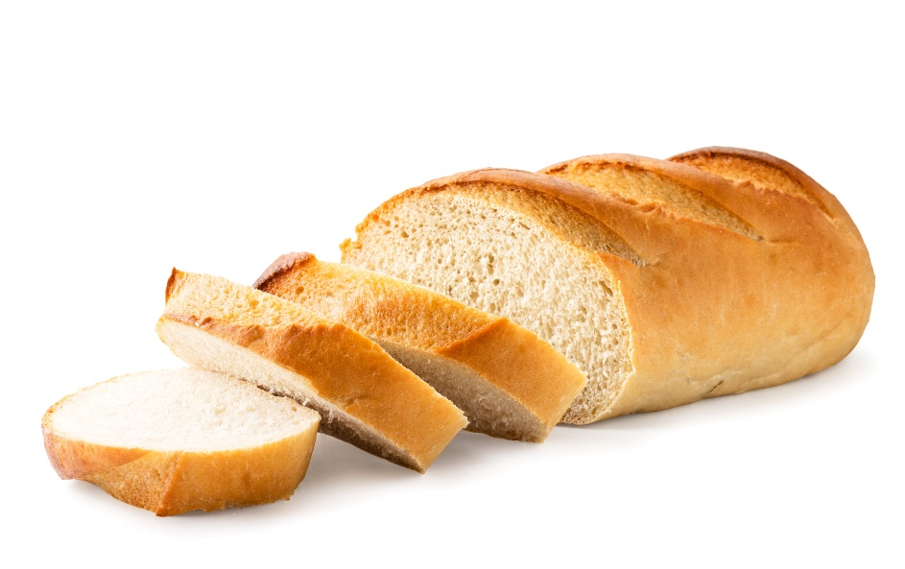
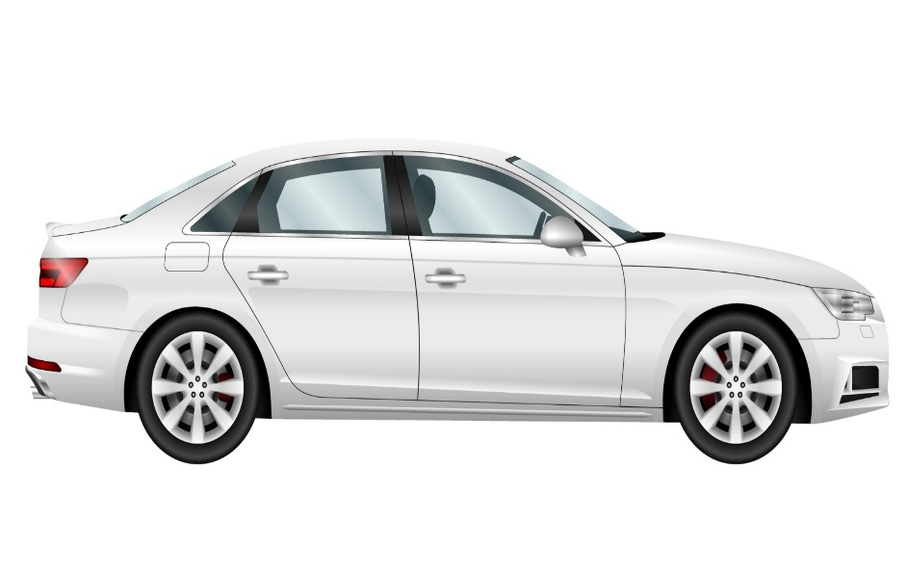
Odd one out Which item do you think does not link with the phrase ‘Give us today our daily bread’?

Slide 2
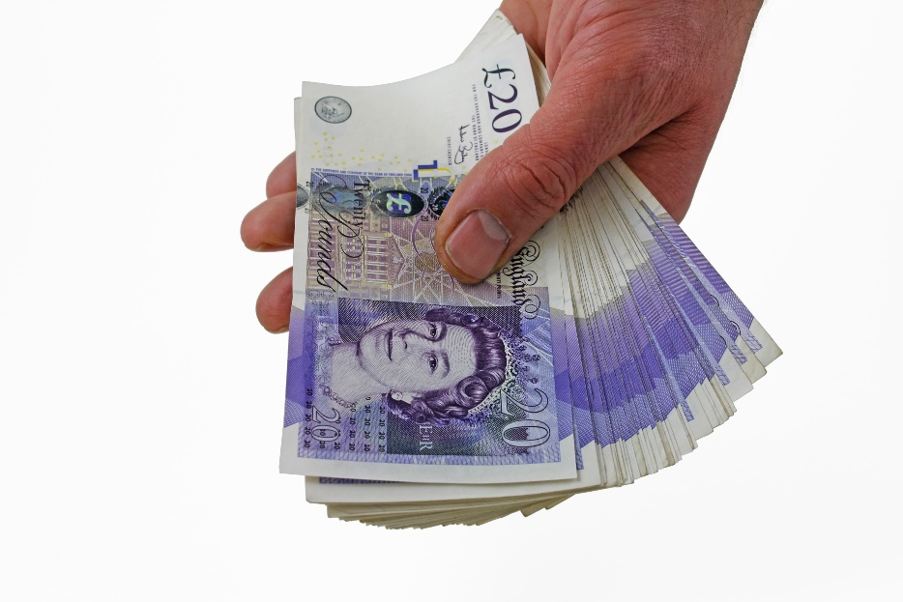
Which item do you think does not link with the phrase ‘Give us today our daily bread’?

Slide 3
Which item do you think does not link with the phrase ‘Give us today our daily bread’?

