Slide 1
Shepherds
Teacher notes:
Select some of the paintings.
Encourage the pupils to look closely at the painting, particularly the shepherds' facial expressions and body language. What are they telling you about how a shepherd feels about himself, about hearing the news and about seeing Jesus?
YEAR ONE - LESSON 3
© Copyright London Diocesan Board for Schools 2023

Slide 2
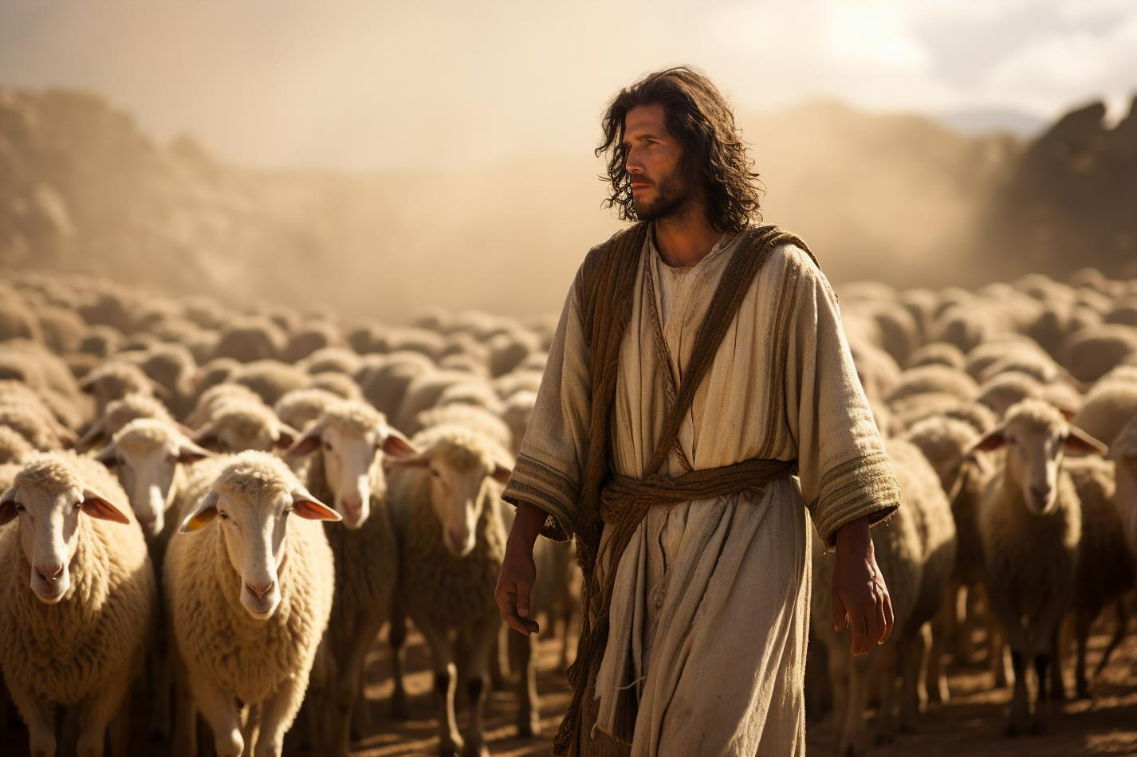
YEAR ONE - LESSON 3

Slide 3
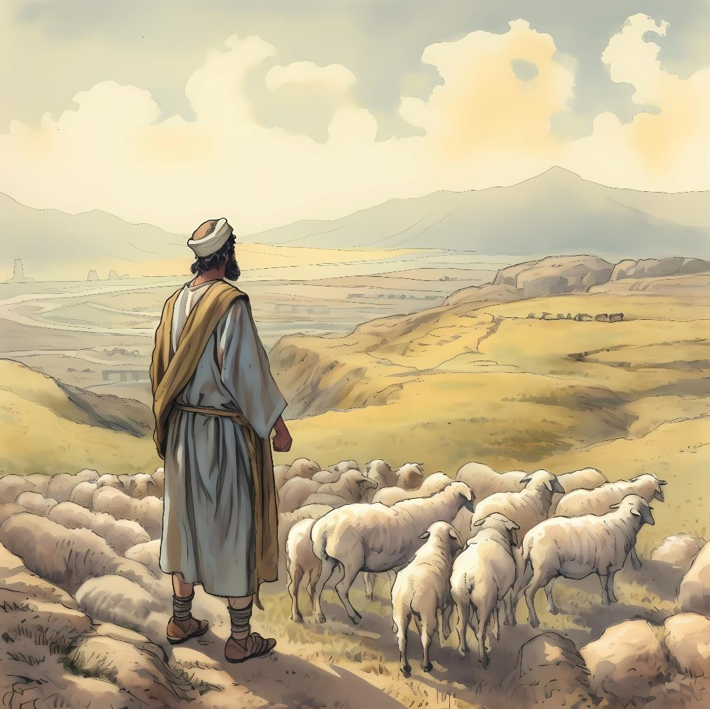
YEAR ONE - LESSON 3

Slide 4
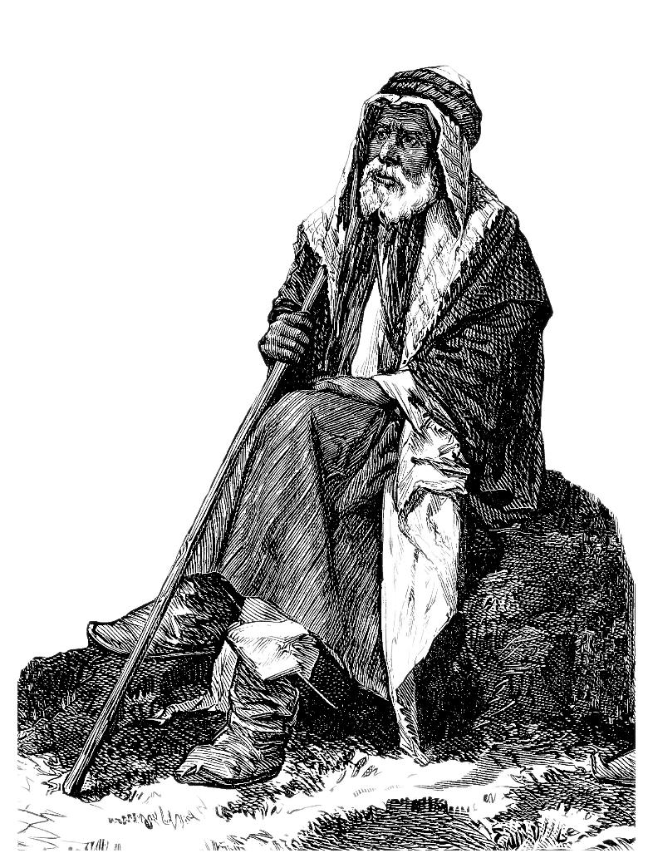
YEAR ONE - LESSON 3

Slide 5
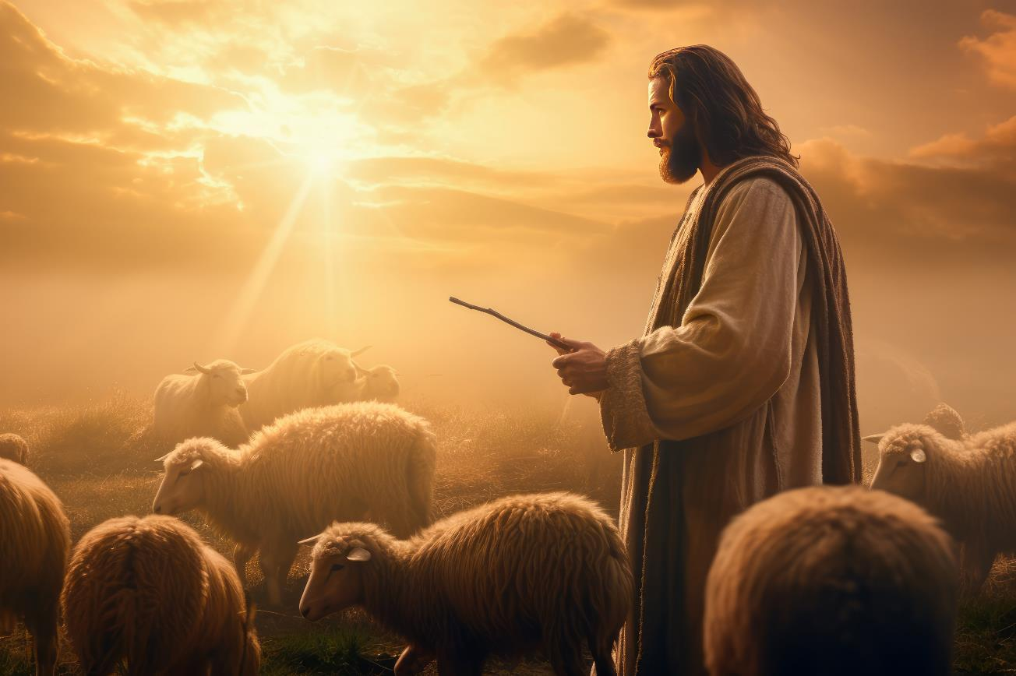
YEAR ONE - LESSON 3

Slide 6
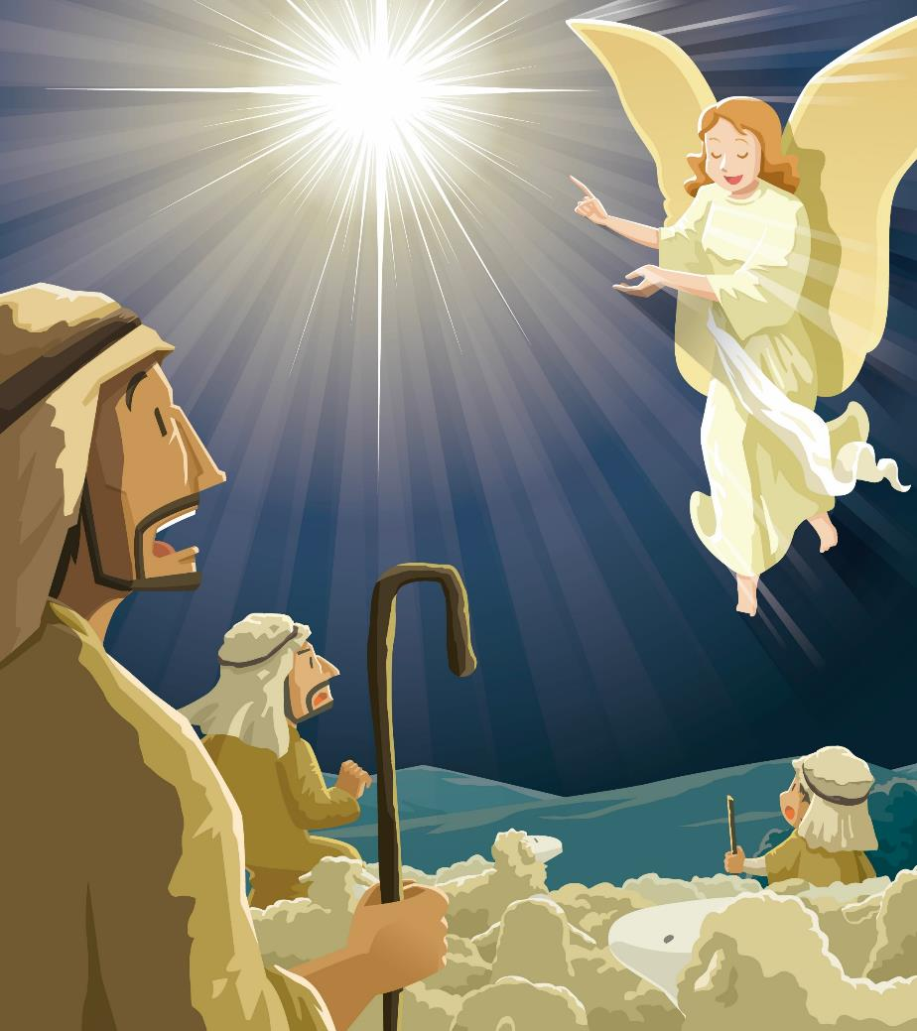
YEAR ONE - LESSON 3

Slide 7
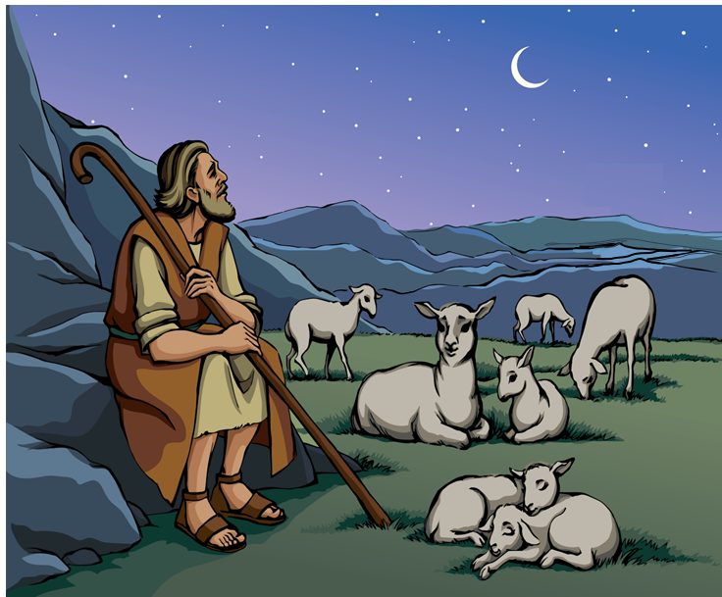
YEAR ONE - LESSON 3

Slide 8
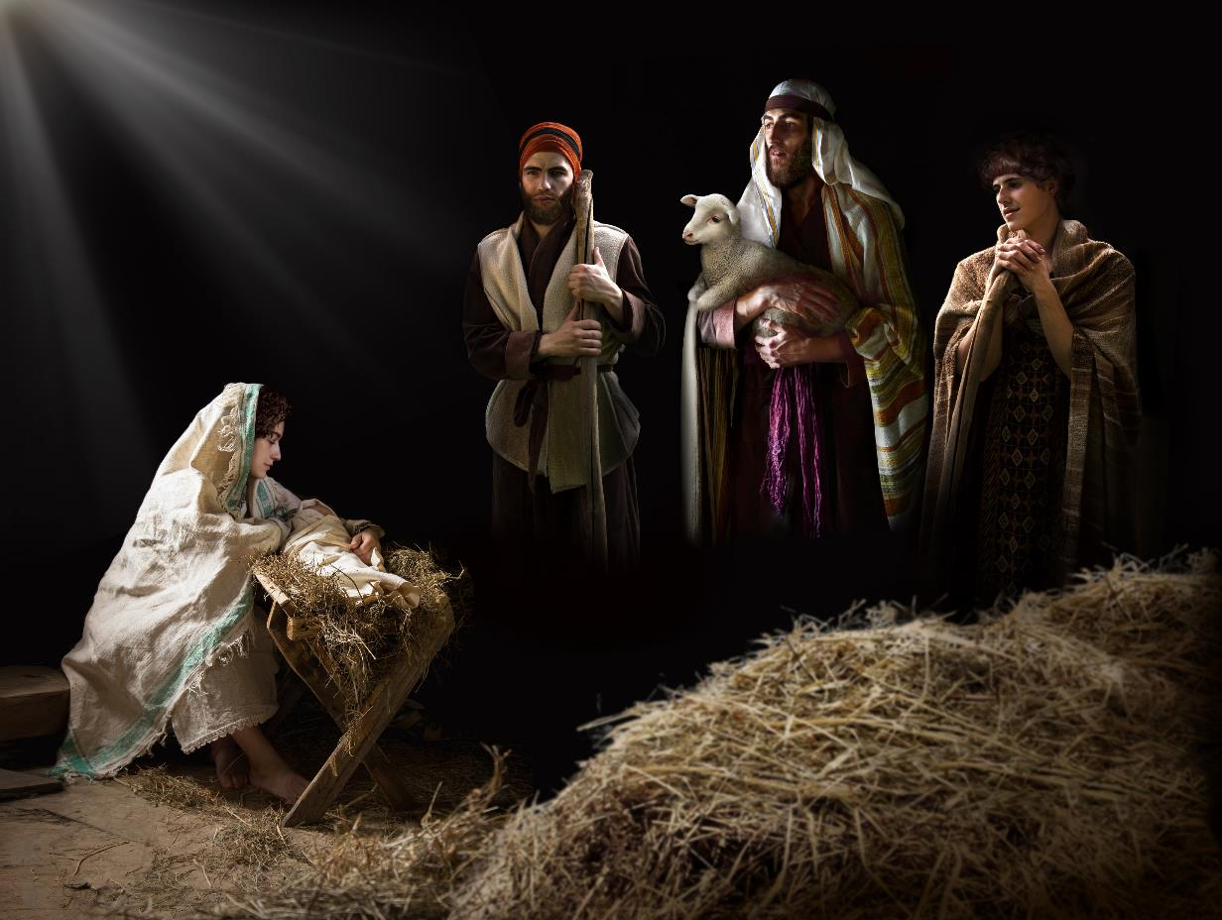
YEAR ONE - LESSON 3

Slide 9
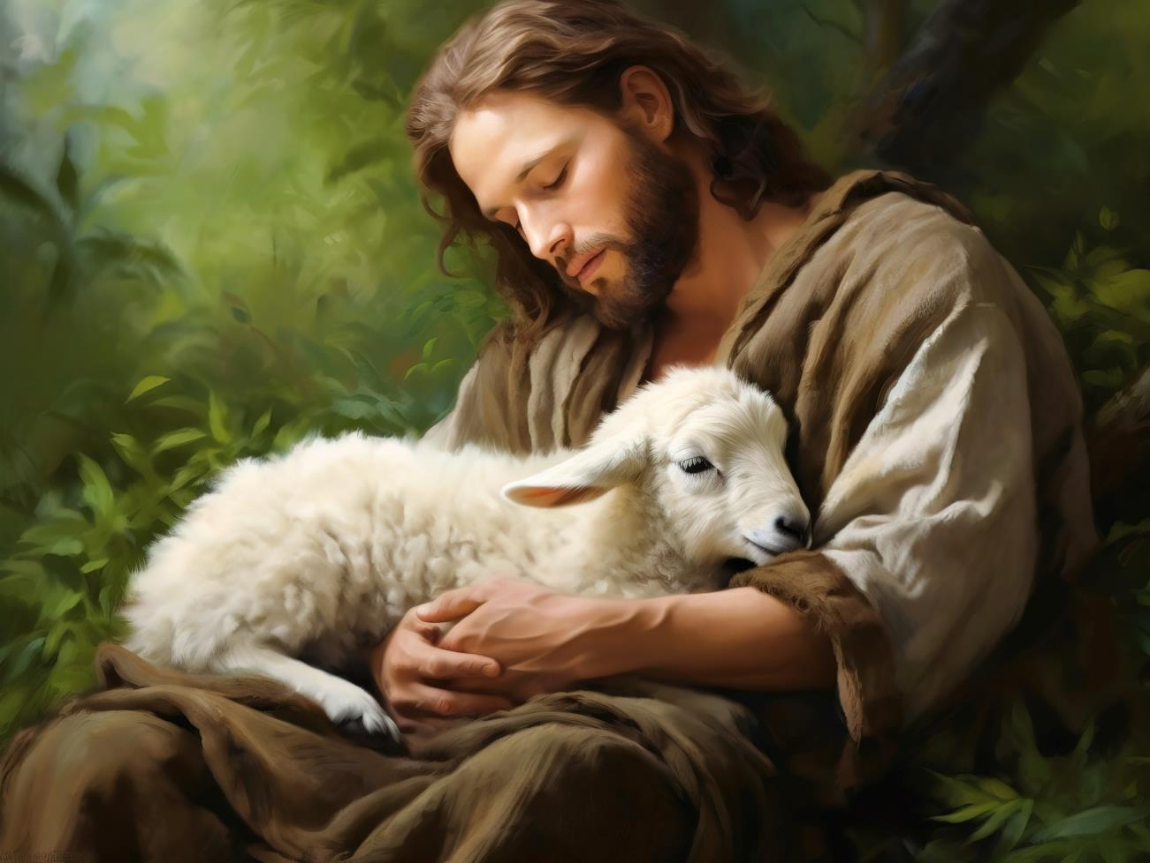
YEAR ONE - LESSON 3

Slide 10
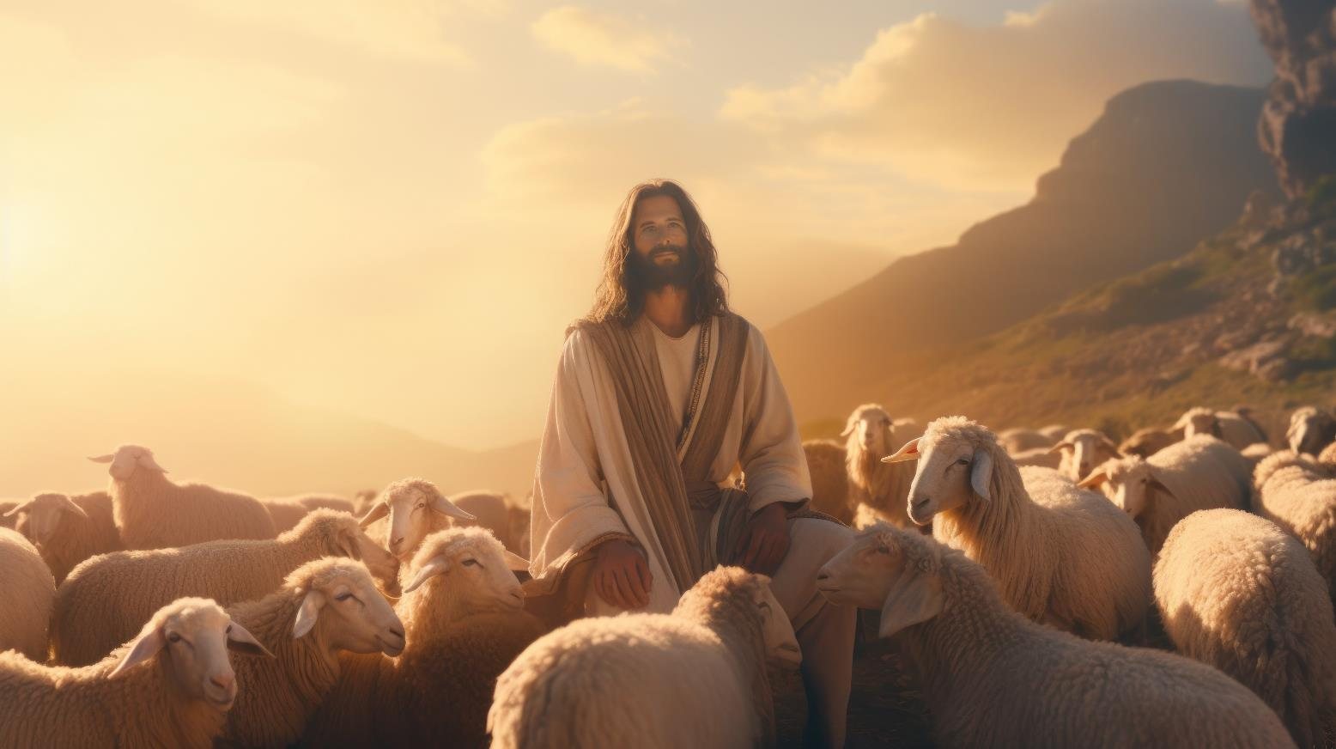
YEAR ONE - LESSON 3

