Slide 1
Mary – mother of Jesus
Teacher notes:
Choose a selection of paintings that will aid discussion.
Encourage pupils to focus in on the facial expressions and body language which informs the observer of the painting, of the emotions of Mary both when she was told the news and of her relationship and feelings towards Jesus.
YEAR ONE - LESSON 2
© Copyright London Diocesan Board for Schools 2023

Slide 2
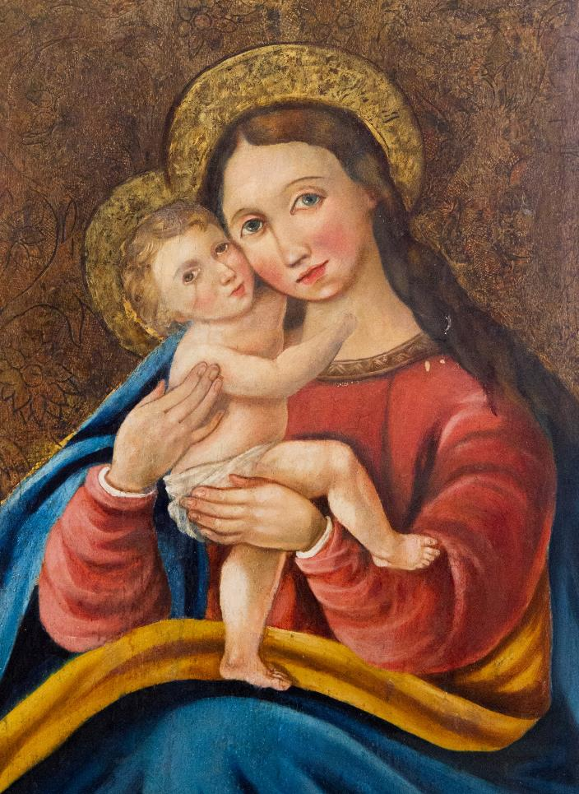
YEAR ONE - LESSON 2

Slide 3
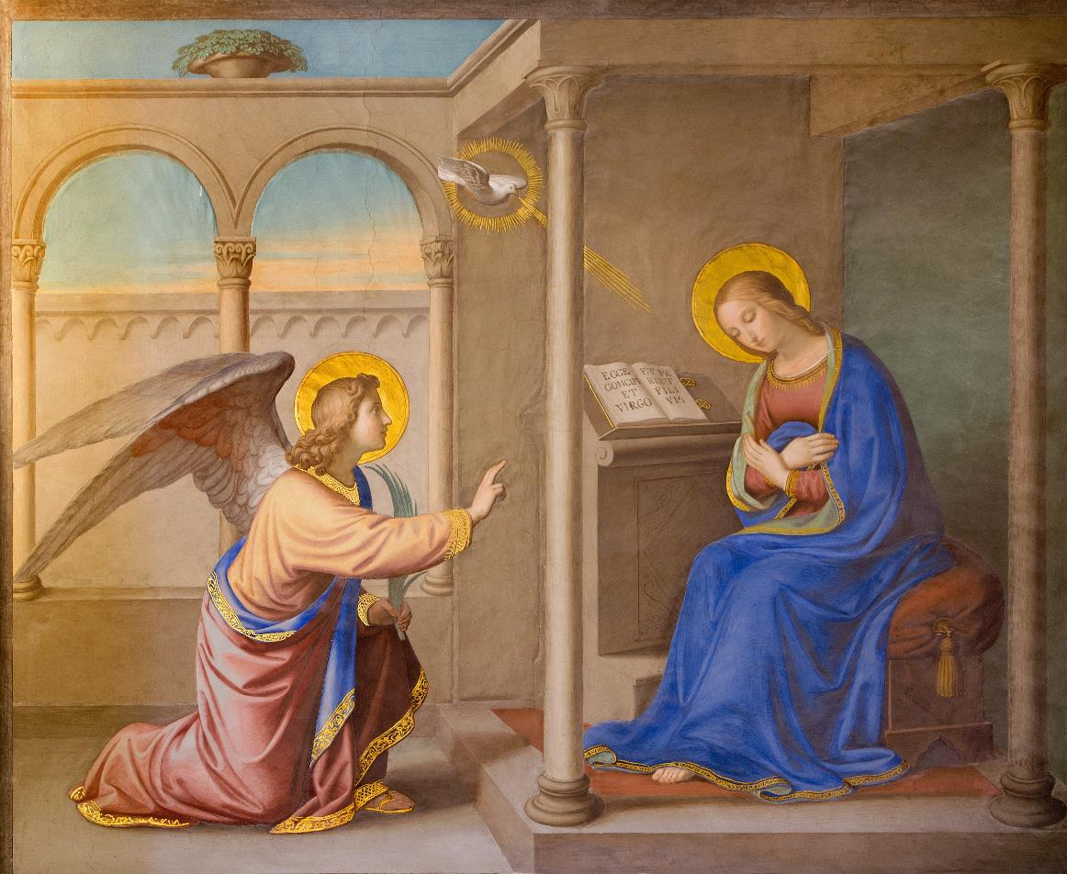
YEAR ONE - LESSON 2

Slide 4
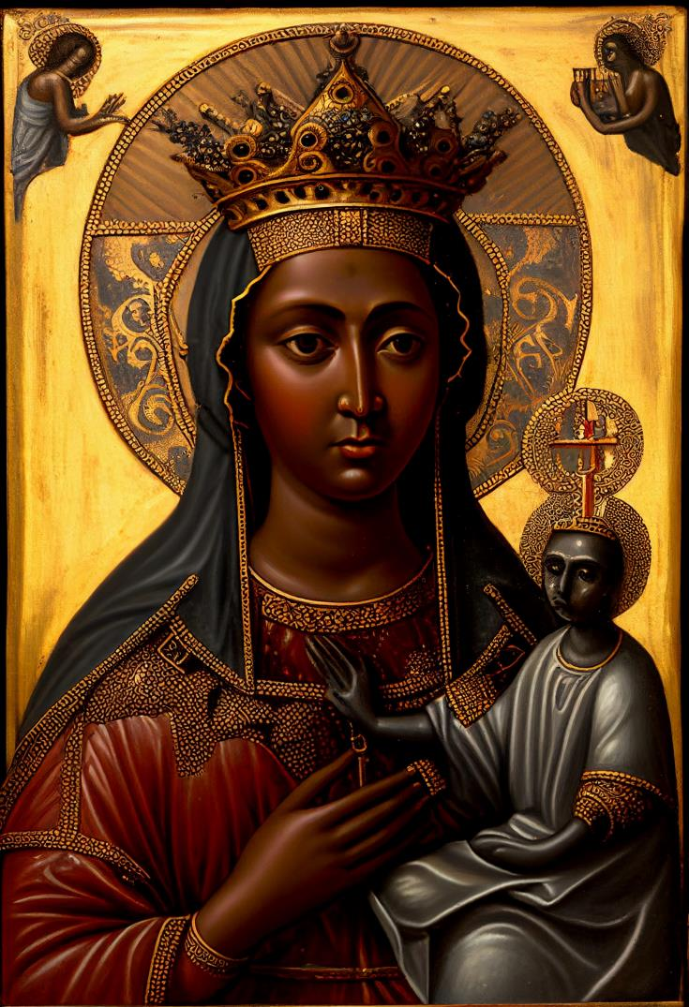
YEAR ONE - LESSON 2

Slide 5
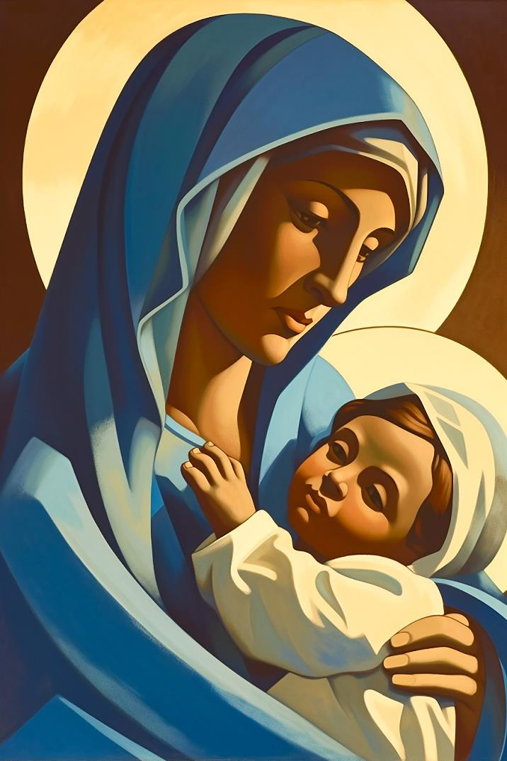
YEAR ONE - LESSON 2

Slide 6
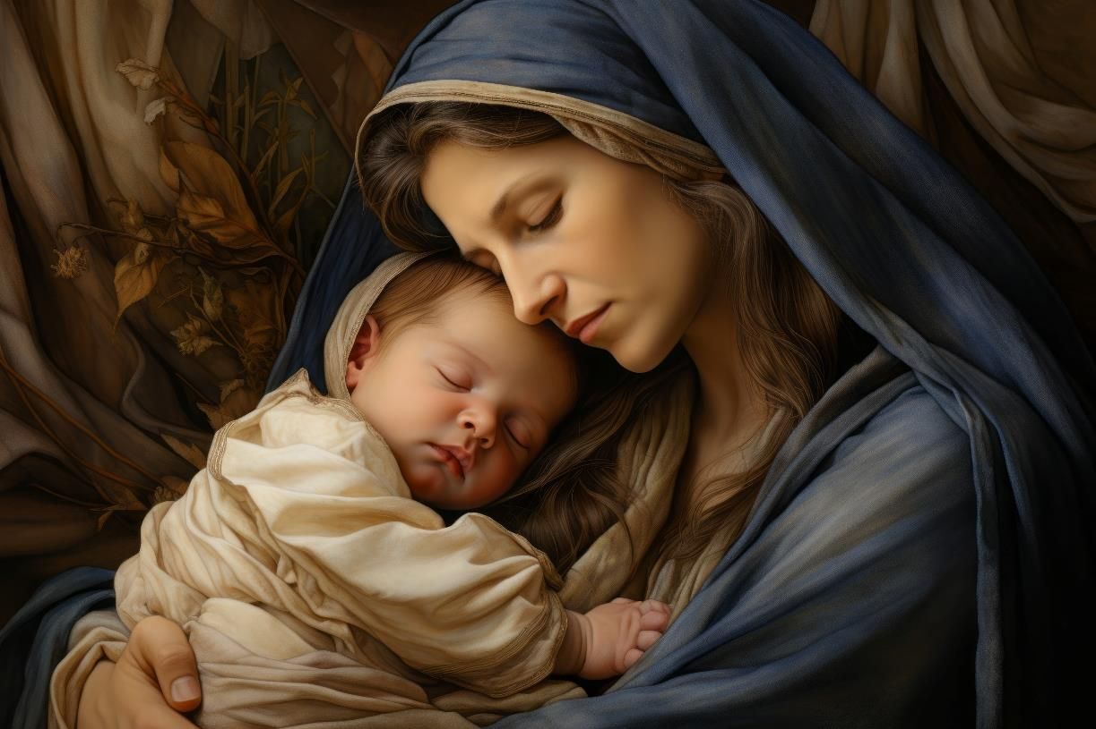
YEAR ONE - LESSON 2

Slide 7
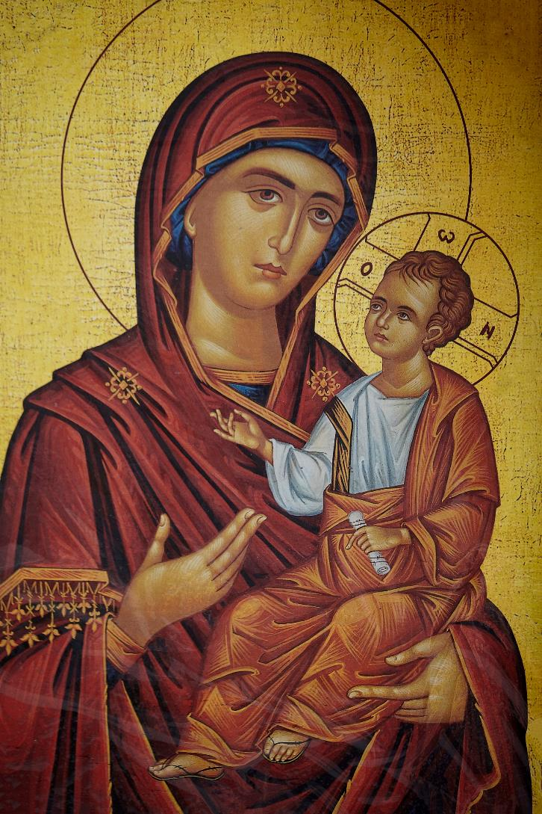
YEAR ONE - LESSON 2

Slide 8
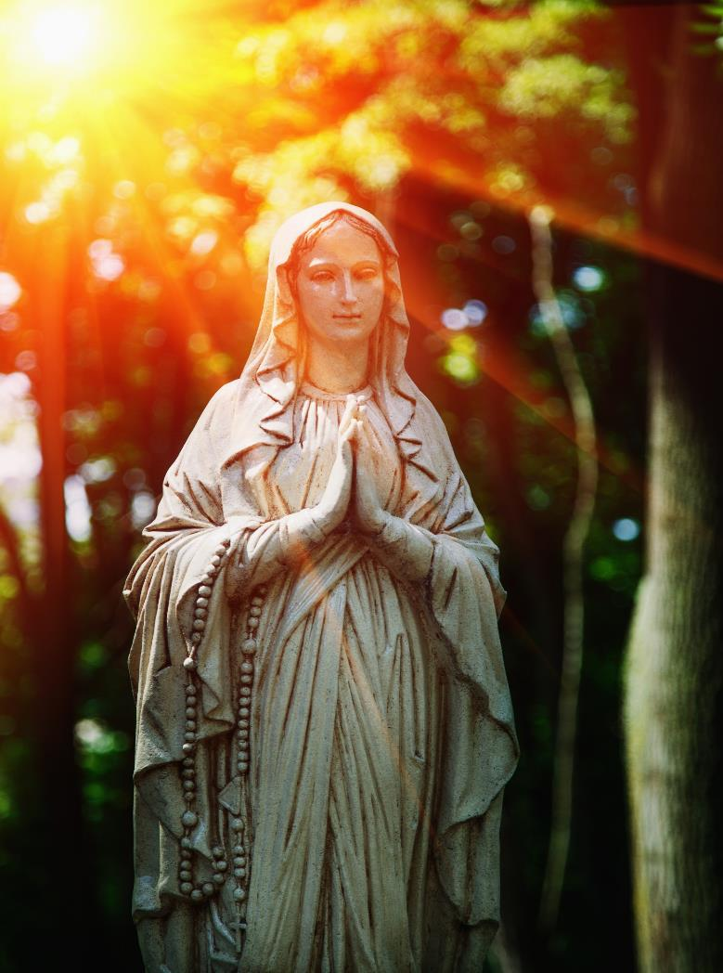
YEAR ONE - LESSON 2

Slide 9
YEAR ONE - LESSON 2

Slide 10
Joseph – earthly father of Jesus
Teacher notes:
Choose a selection of paintings that will aid discussion.
Encourage pupils to focus in on the facial expressions and body language which informs the observer of the painting, of the emotions of Joseph and his relationship and feelings towards Jesus.
YEAR ONE - LESSON 2

Slide 11
YEAR ONE - LESSON 2

Slide 12
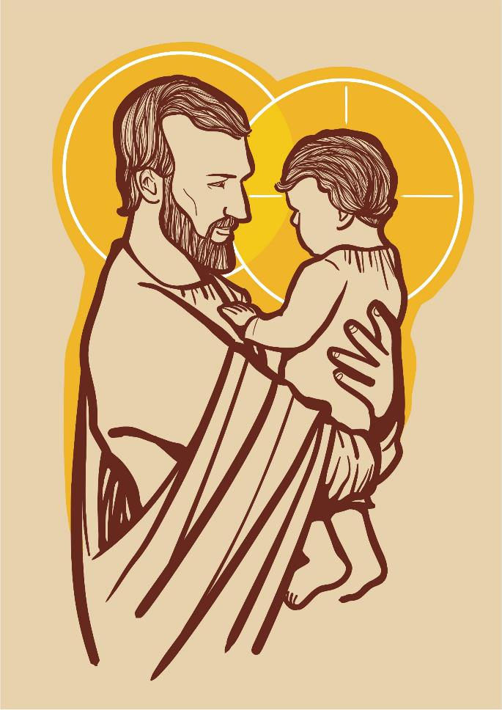
YEAR ONE - LESSON 2

Slide 13
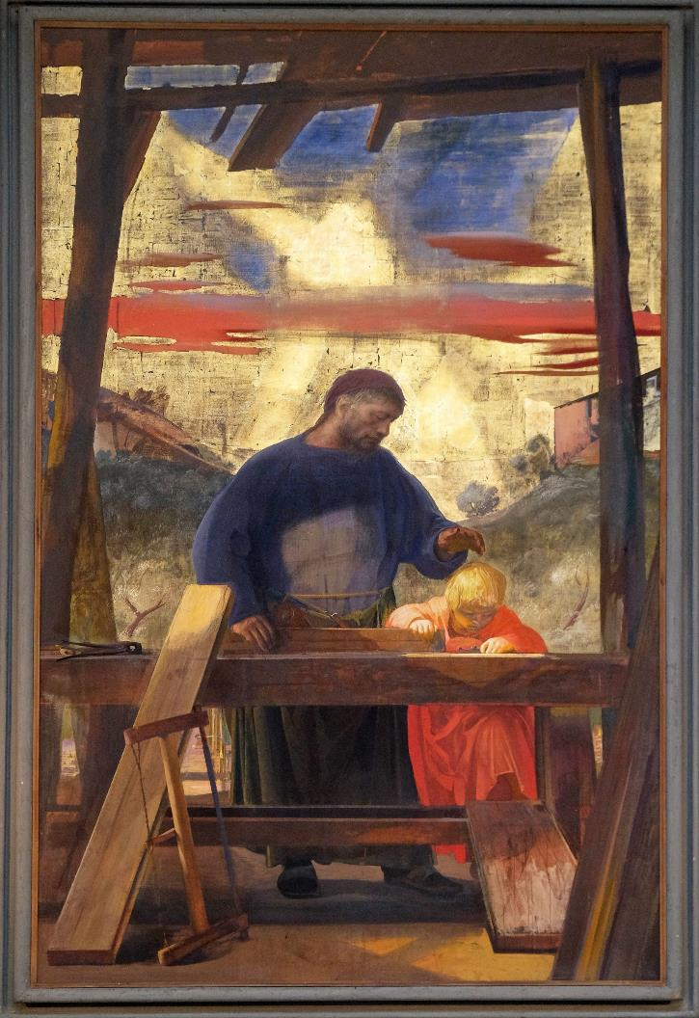
YEAR ONE - LESSON 2

Slide 14
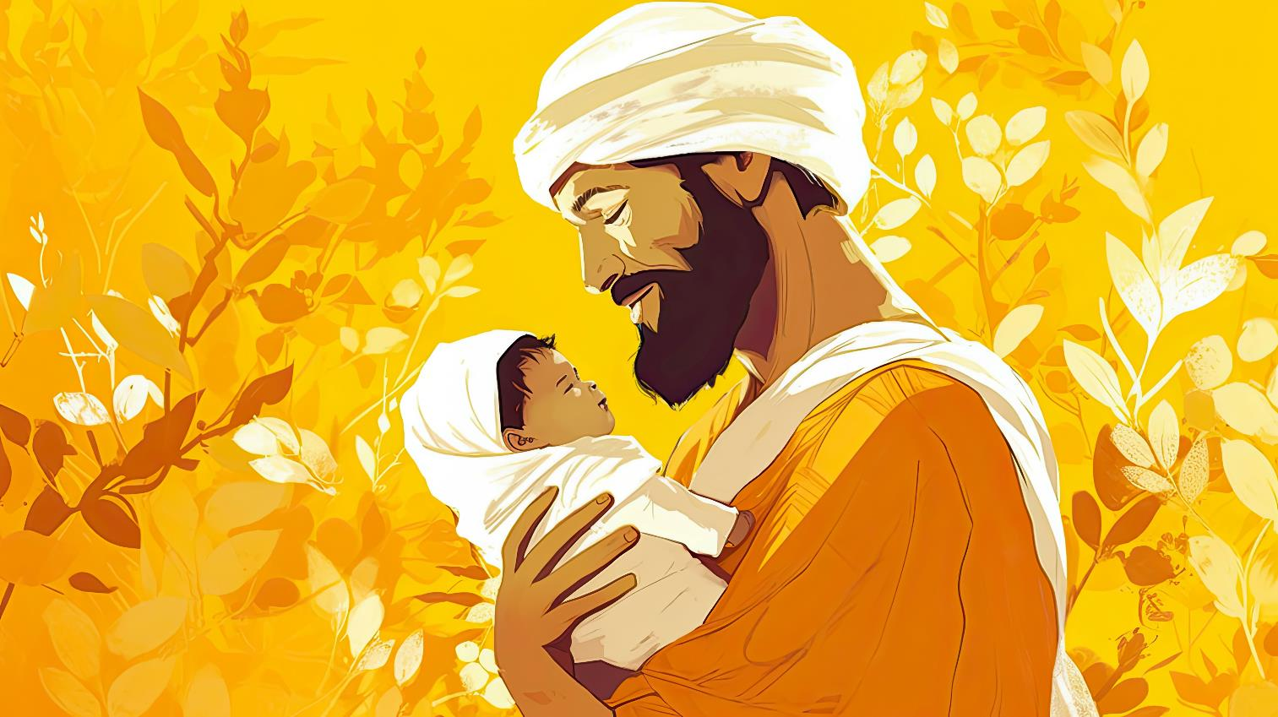
YEAR ONE - LESSON 2

Slide 15
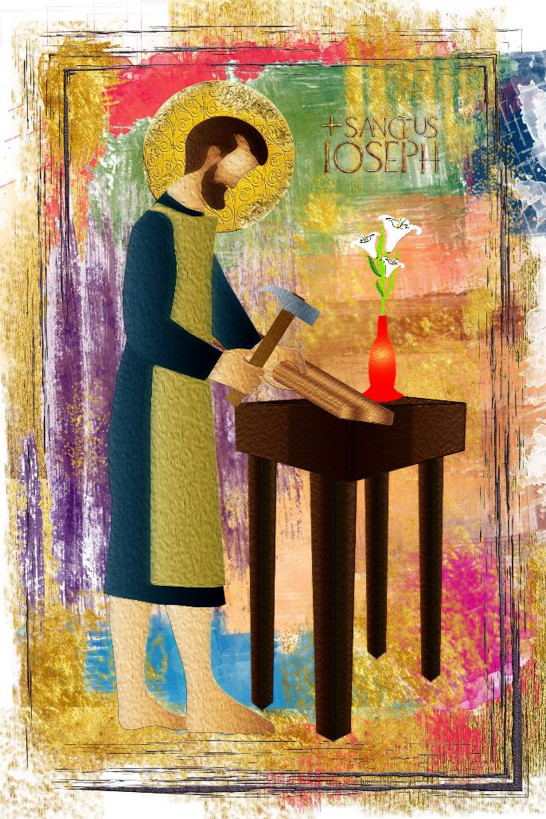
YEAR ONE - LESSON 2

Slide 16
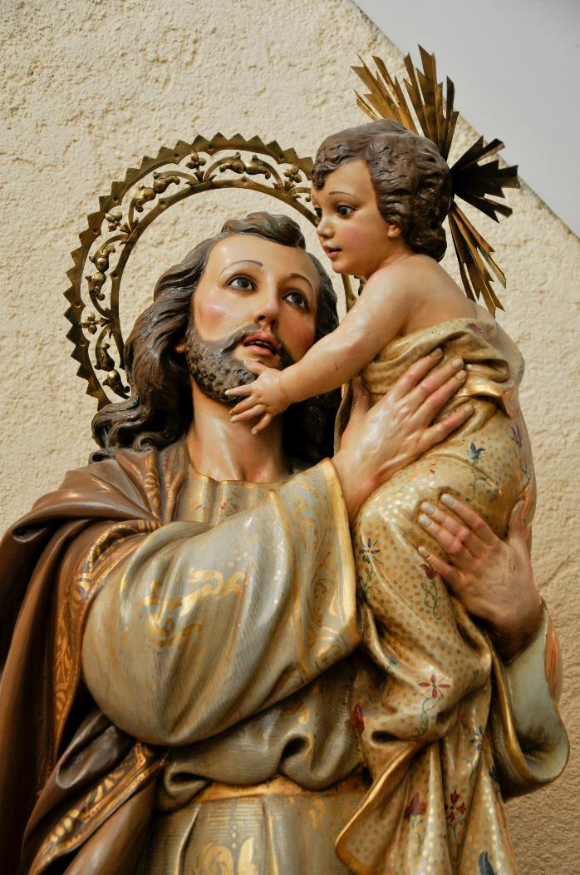
YEAR ONE - LESSON 2

