Slide 1
Artists’ interpretations of the words:
“Thy Kingdom come; thy will be done on earth as it is in heaven”
I wonder how you would describe God’s kingdom here on earth.
YEAR TWO - LESSON 2
© Copyright London Diocesan Board for Schools 2023

Slide 2
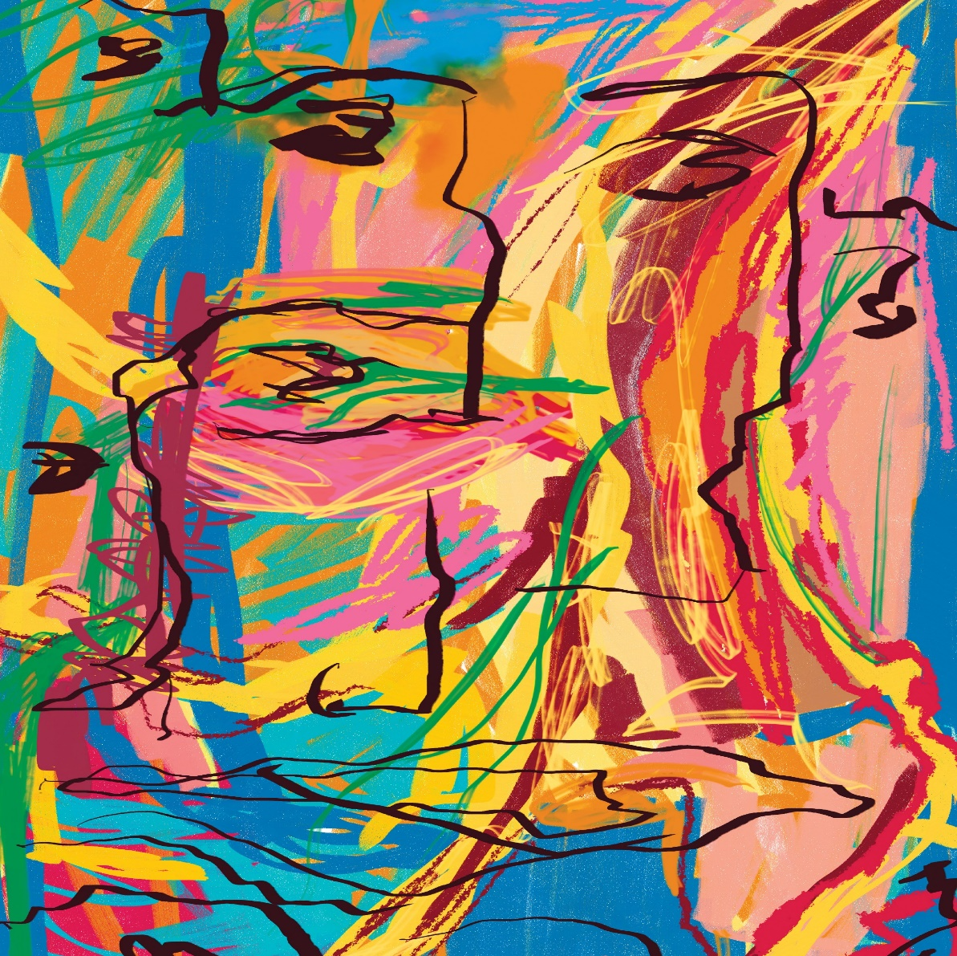
YEAR TWO - LESSON 2

Slide 3
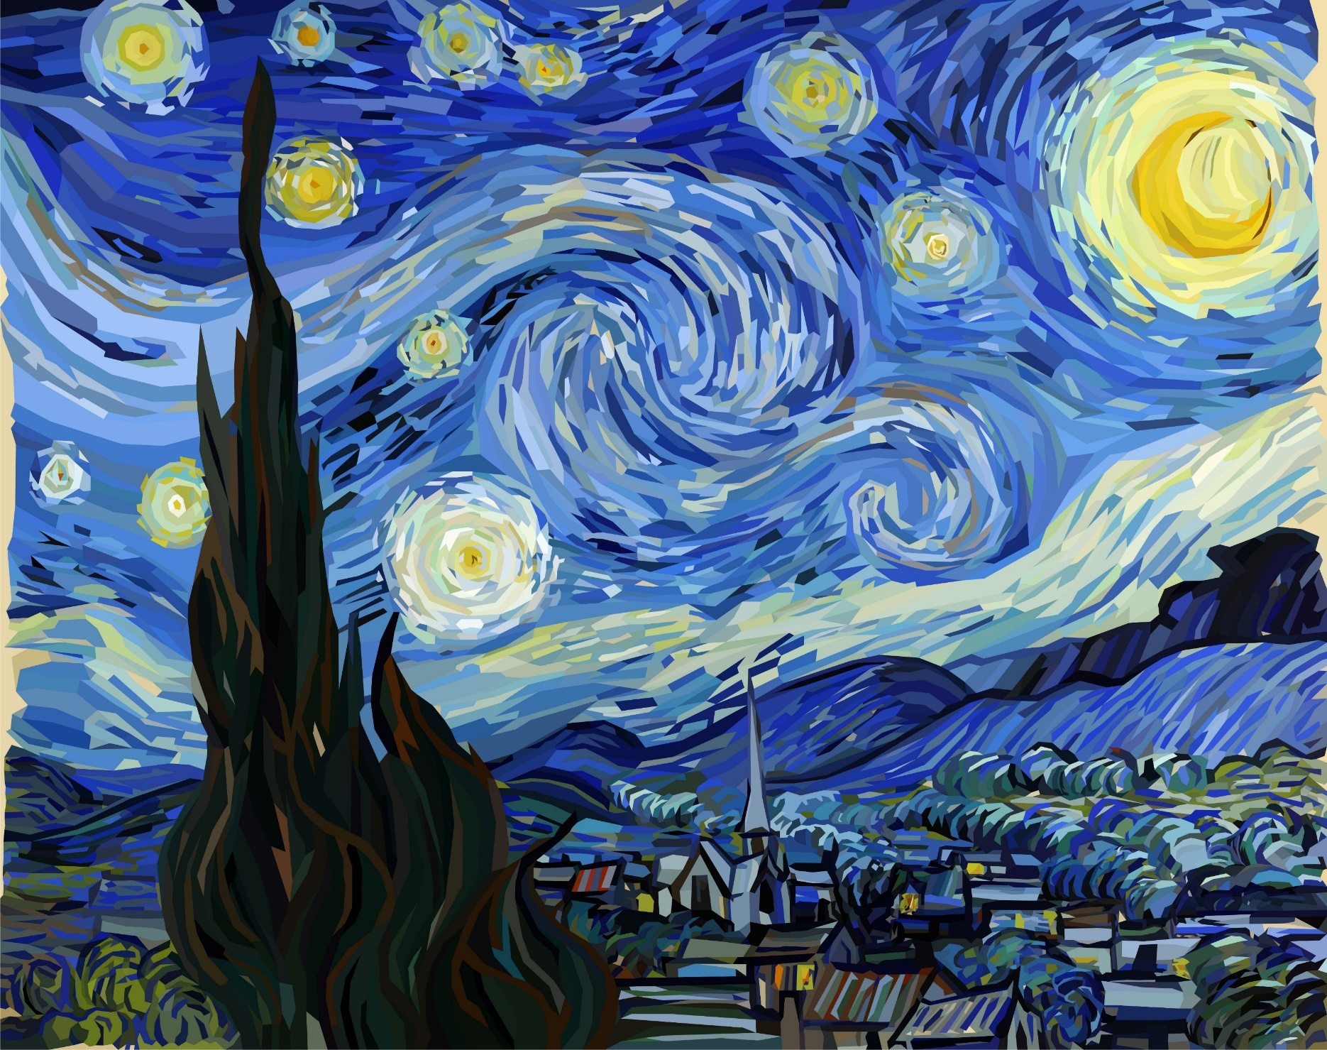
YEAR TWO - LESSON 2

Slide 4
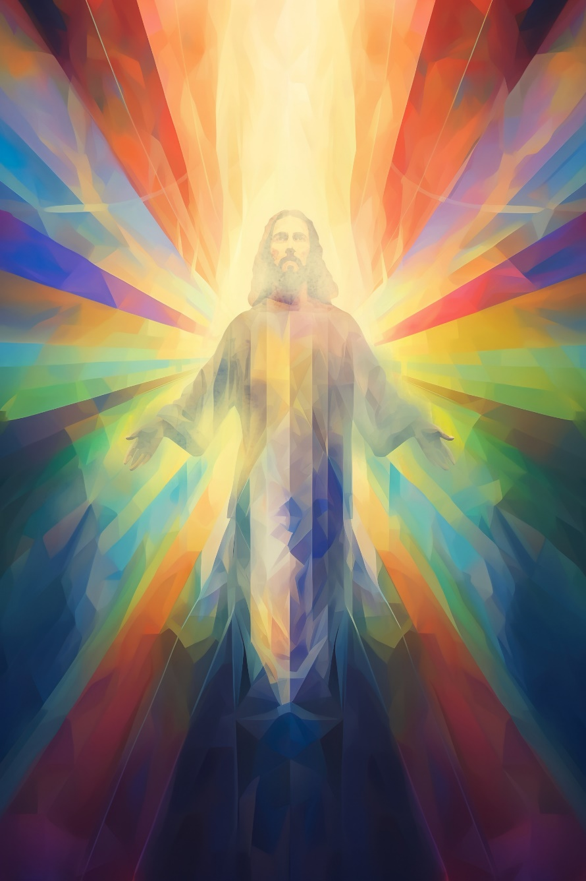
YEAR TWO - LESSON 2

Slide 5
YEAR TWO - LESSON 2

Slide 6
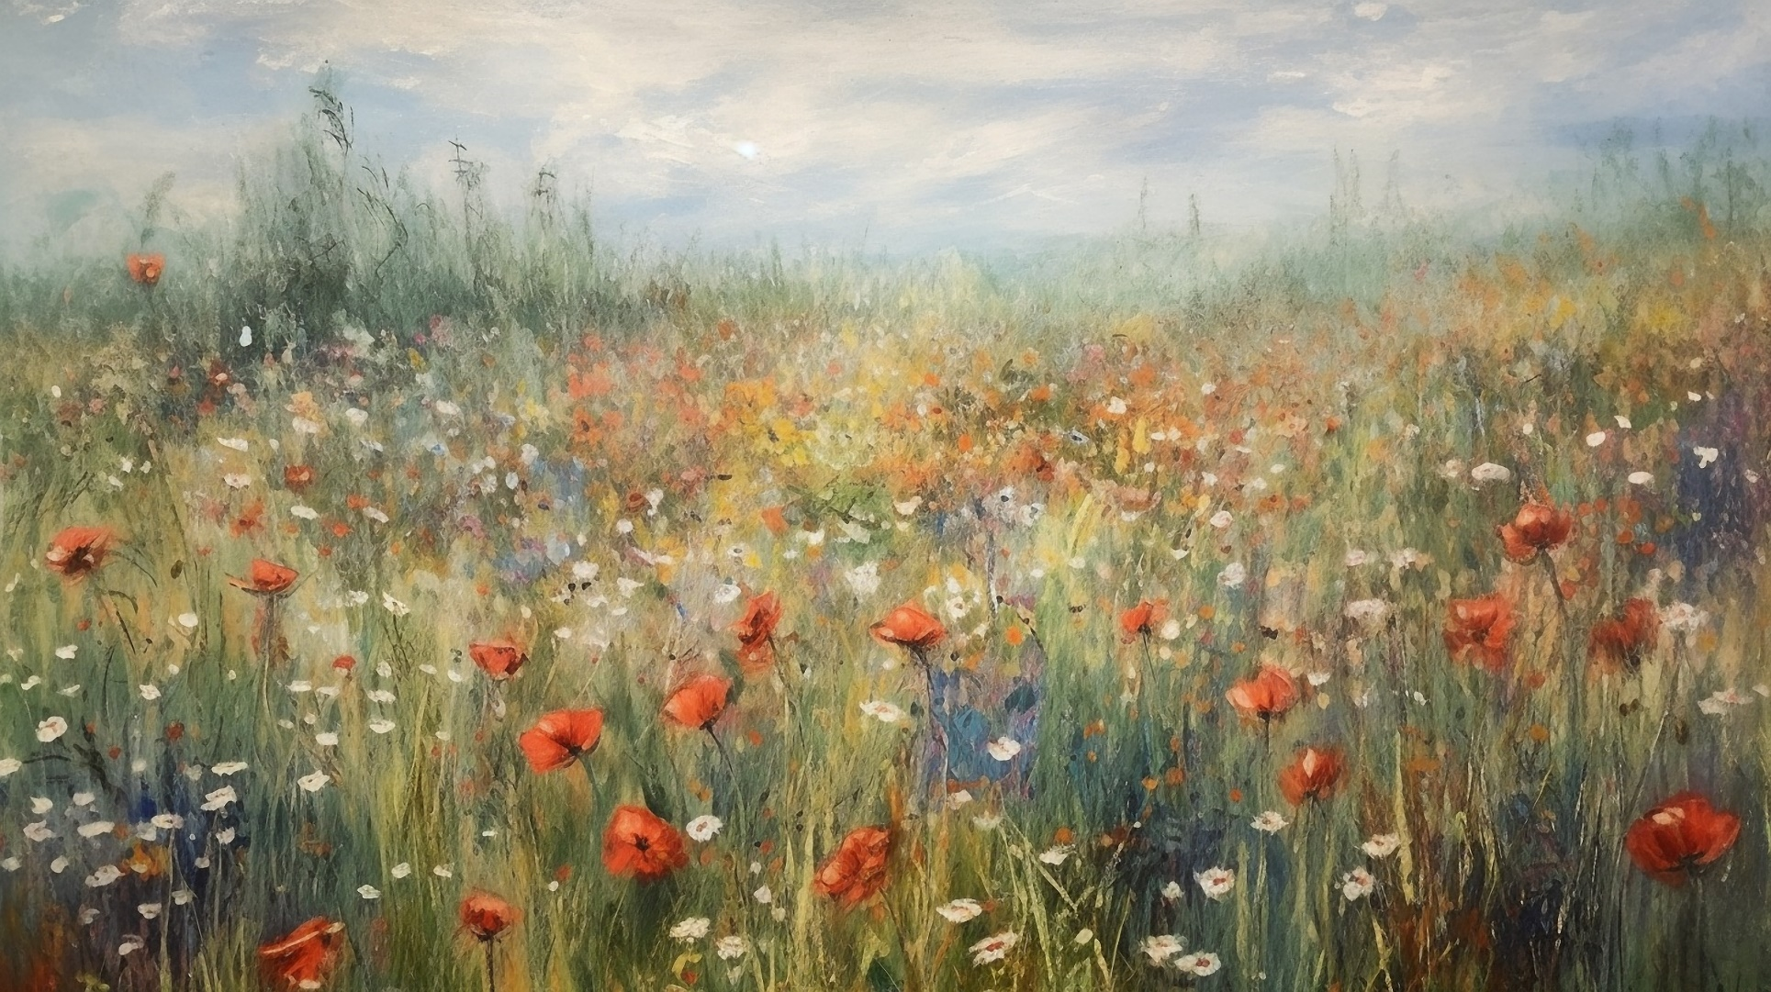
YEAR TWO - LESSON 2

Slide 7
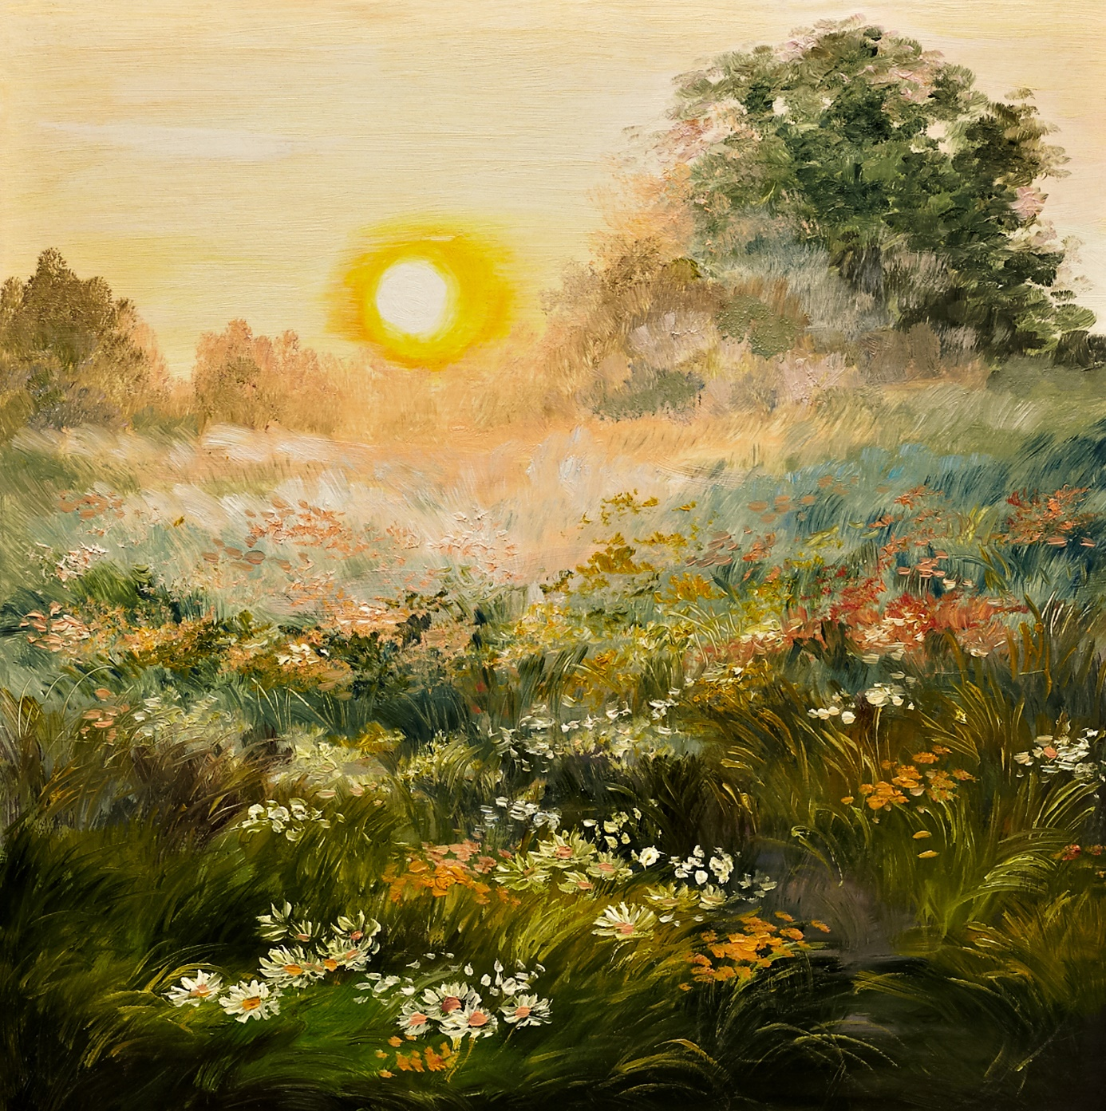
YEAR TWO - LESSON 2

Slide 8
YEAR TWO - LESSON 2

Slide 9
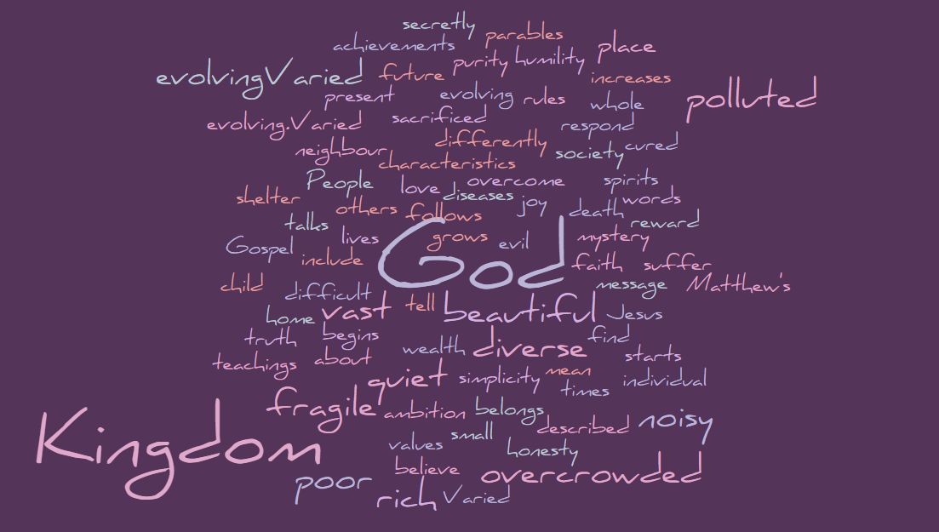
YEAR TWO - LESSON 2

