Slide 1
Key questions
What do you notice?
Is there one image you prefer and if so can you say why?
What sorts of things do you think might influence how a person understands God to be like?
YEAR TWO - LESSON 1c
© Copyright London Diocesan Board for Schools 2023

Slide 2
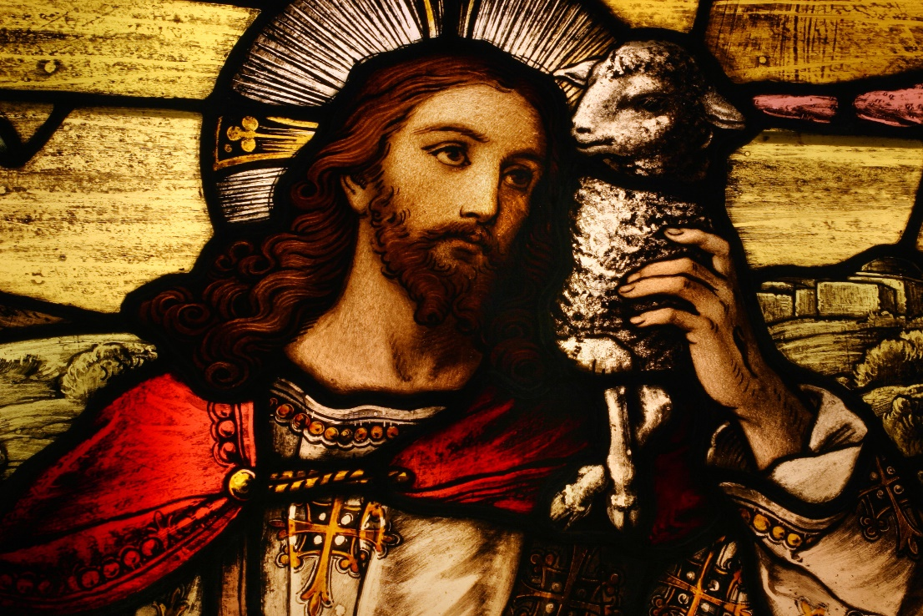
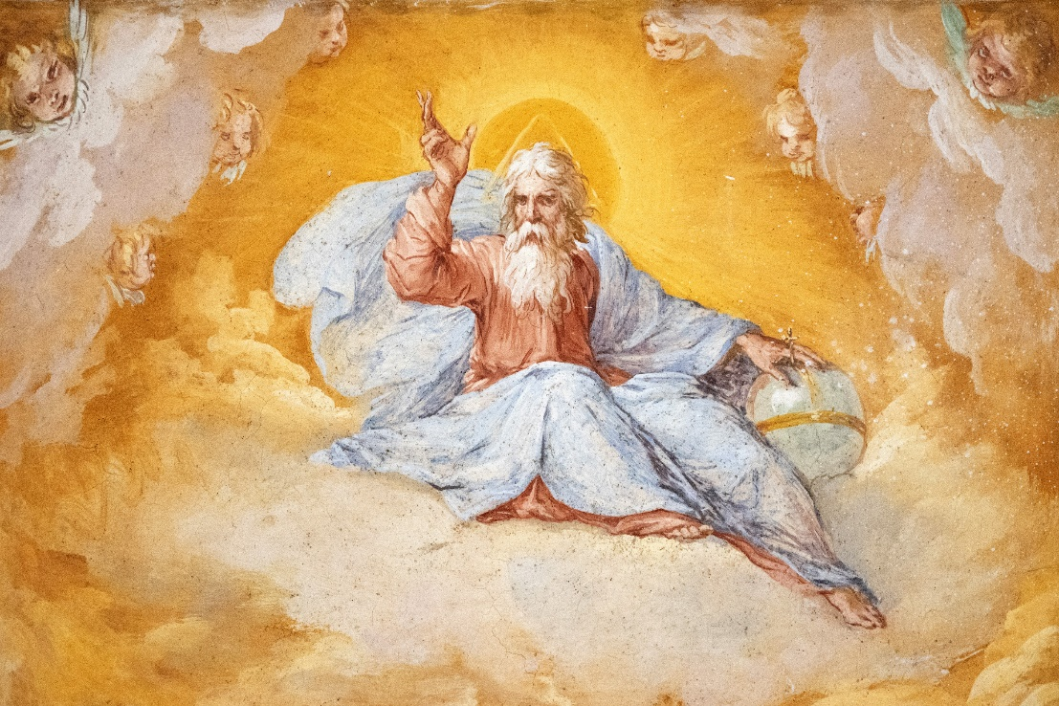
YEAR TWO - LESSON 1c

Slide 3
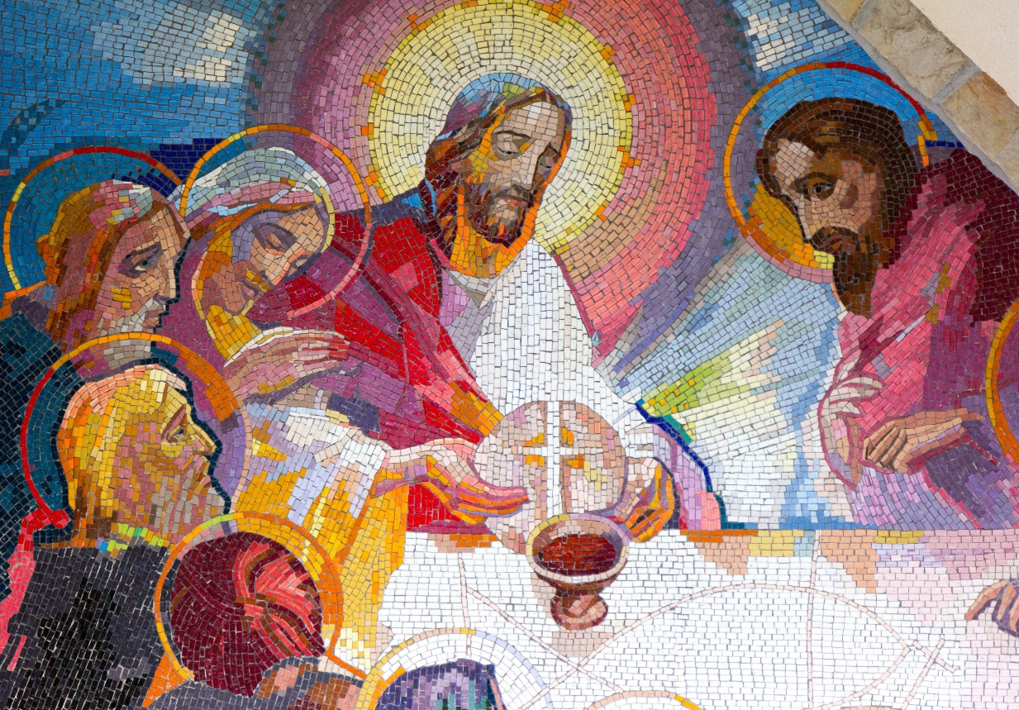
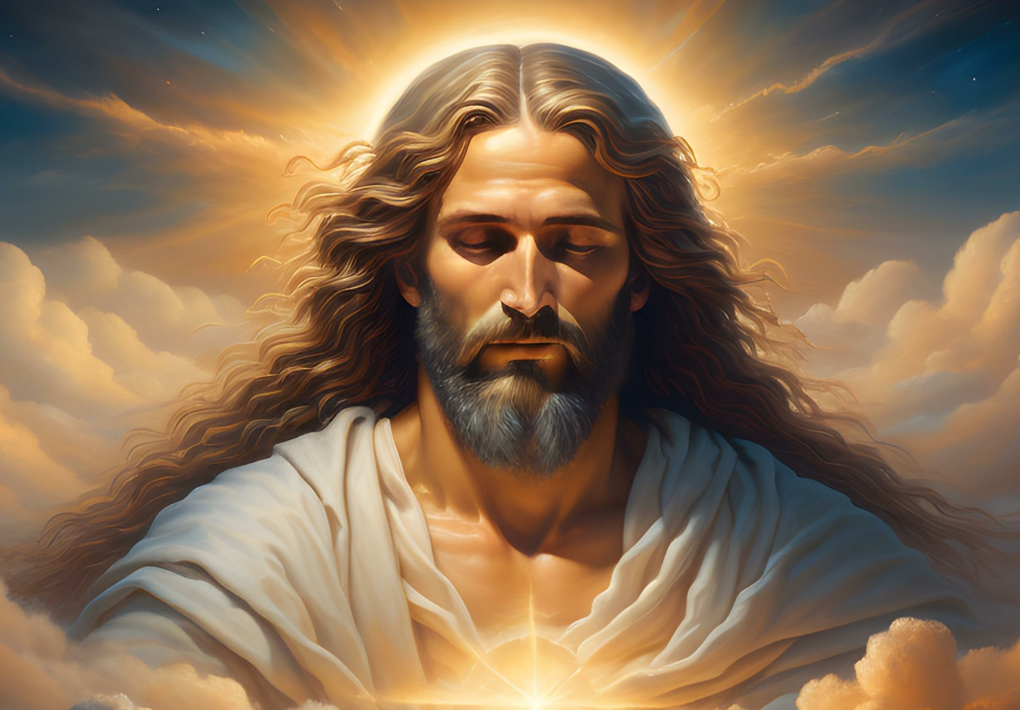
YEAR TWO - LESSON 1c

Slide 4
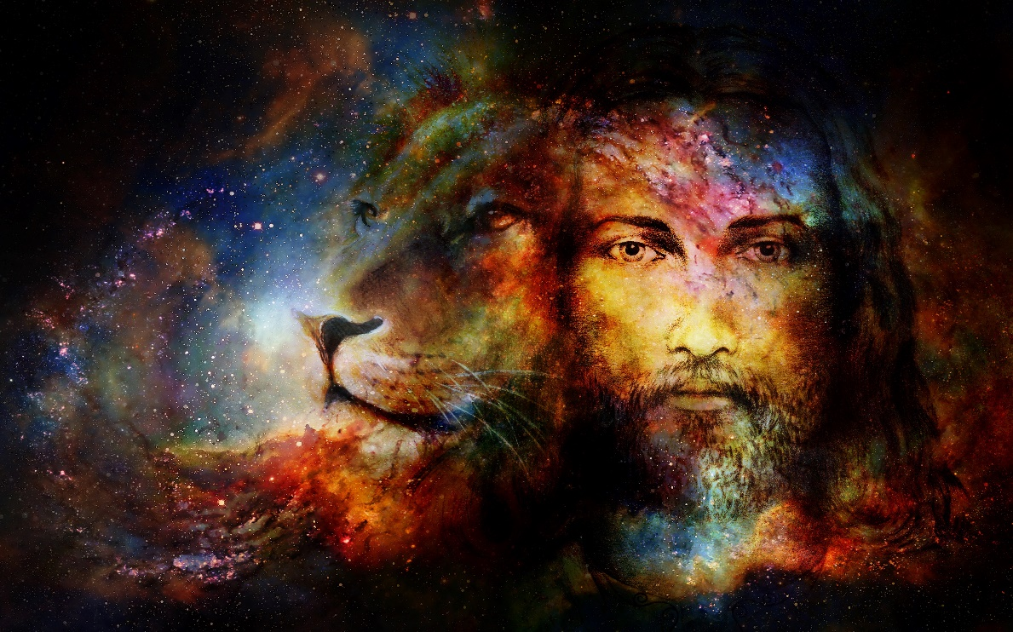
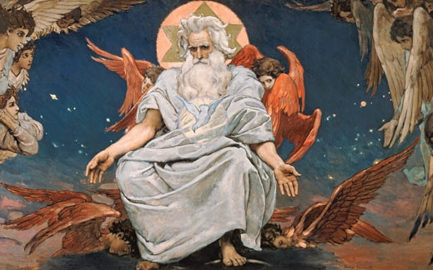
YEAR TWO - LESSON 1c

Slide 5
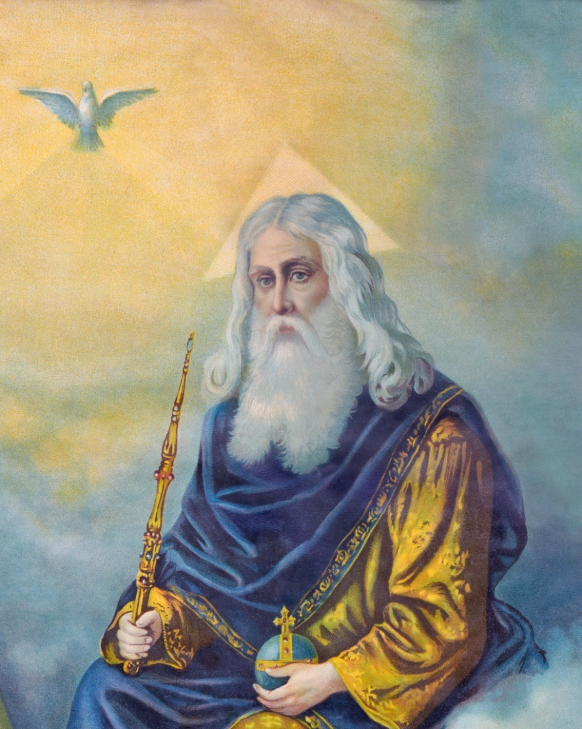
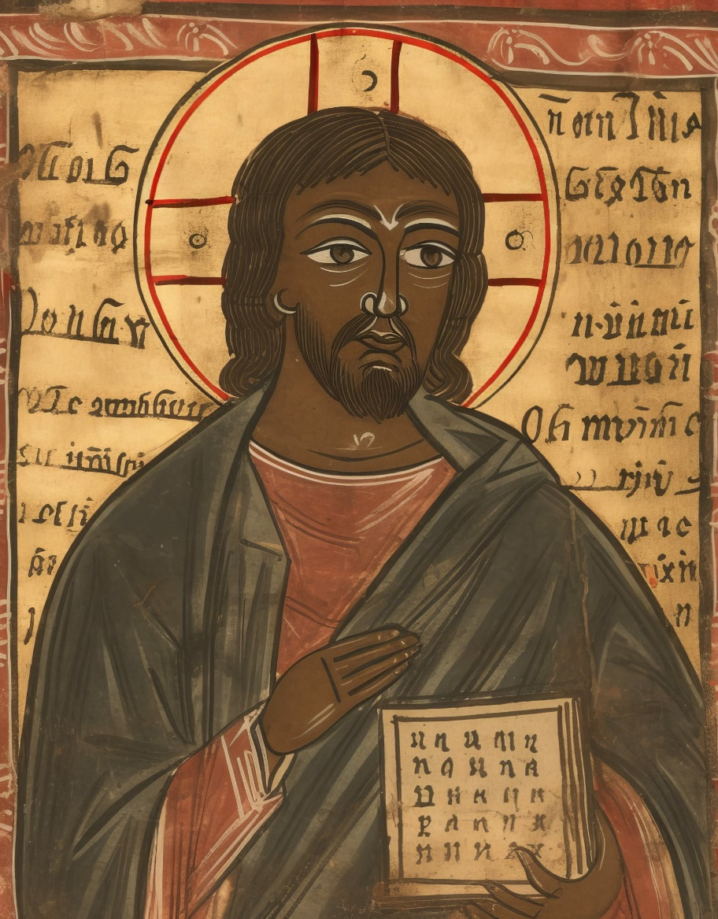
YEAR TWO - LESSON 1c

Slide 6
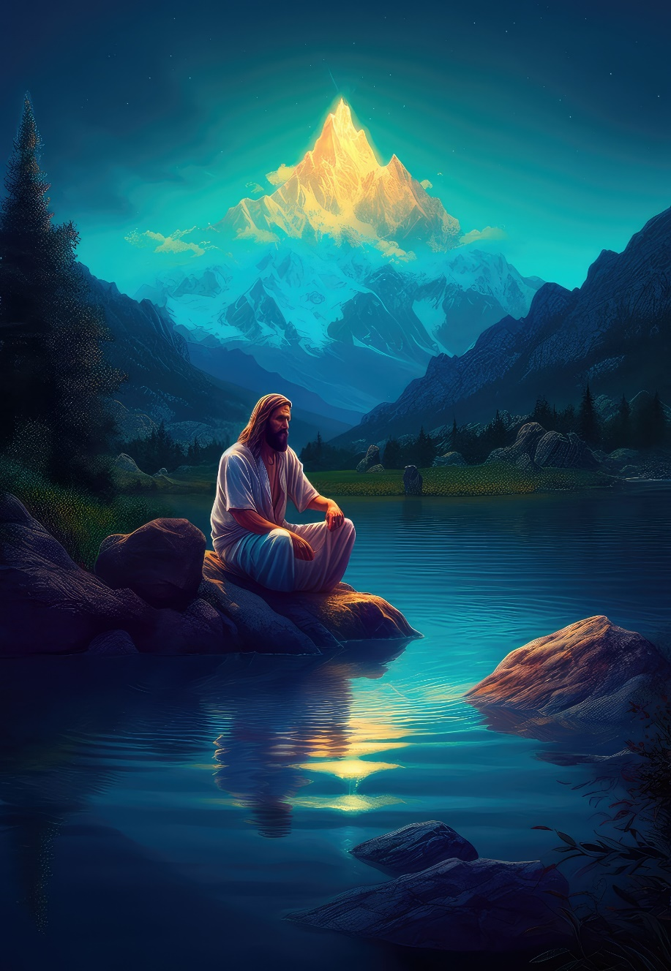
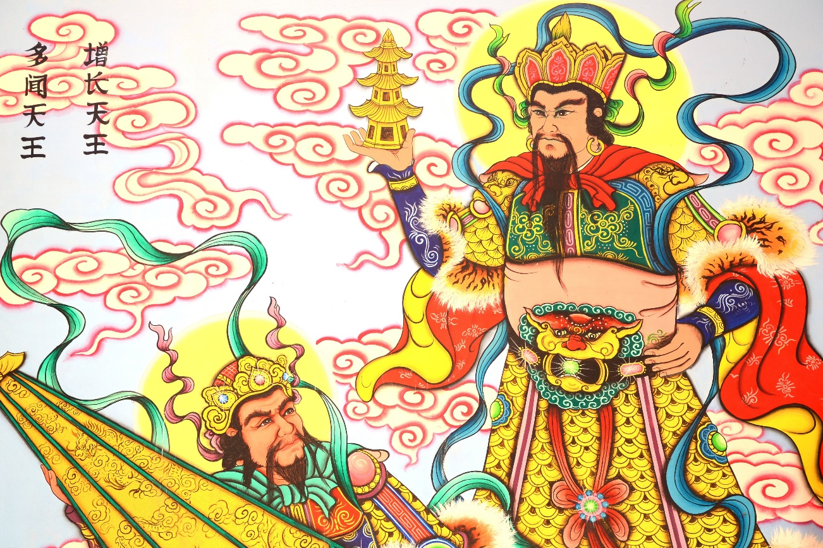
YEAR TWO - LESSON 1c

Slide 7
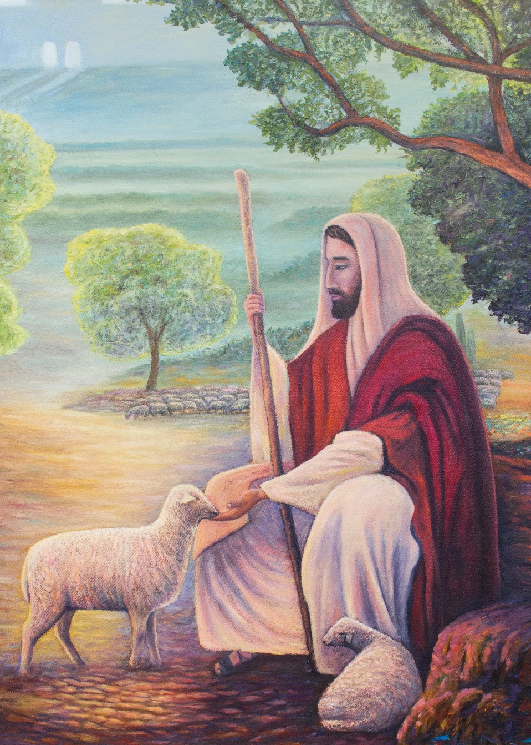
YEAR TWO - LESSON 1c

