Slide 1
Key questions
What do you think is happening in these pictures?
If you had to give each picture a title what would it be?
Can you see a common theme/one word that links these pictures together? If so, what do you think it might be?
YEAR TWO - LESSON 1b
© Copyright London Diocesan Board for Schools 2023

Slide 2
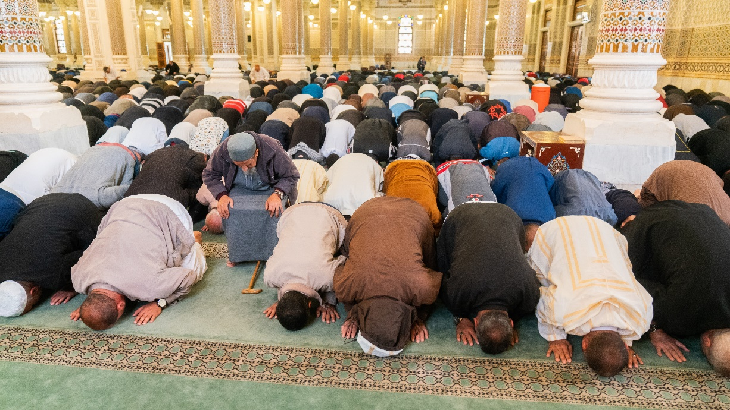
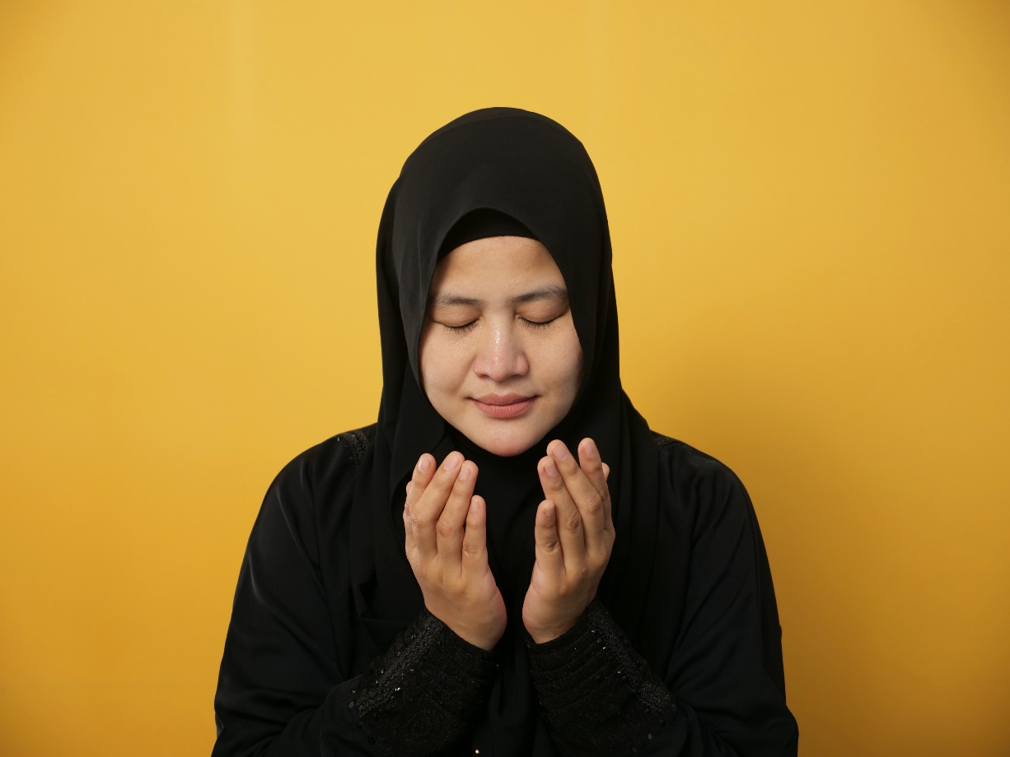
YEAR TWO - LESSON 1b

Slide 3
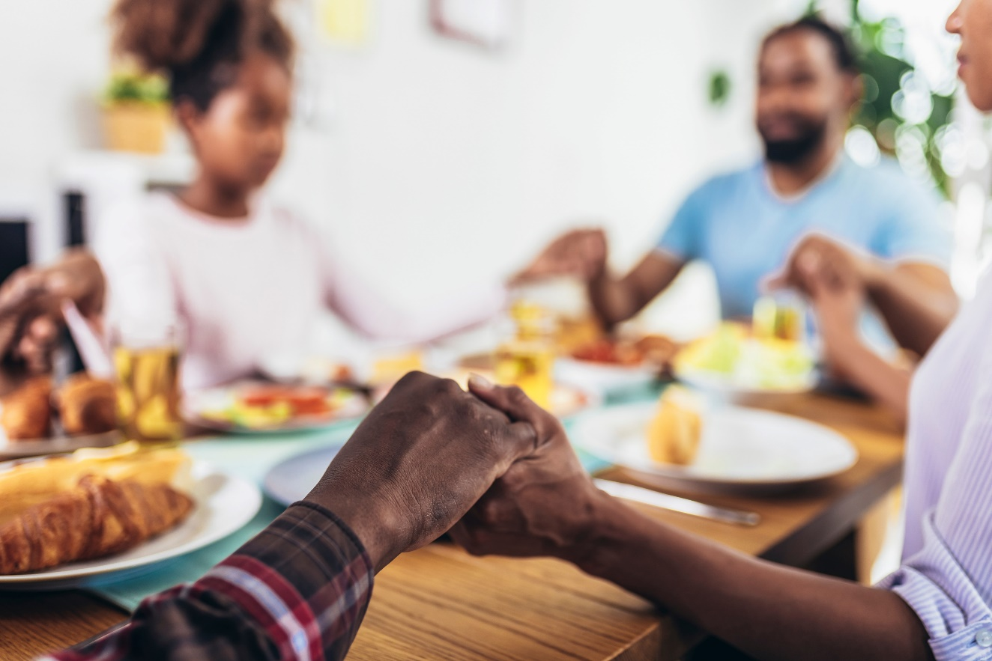
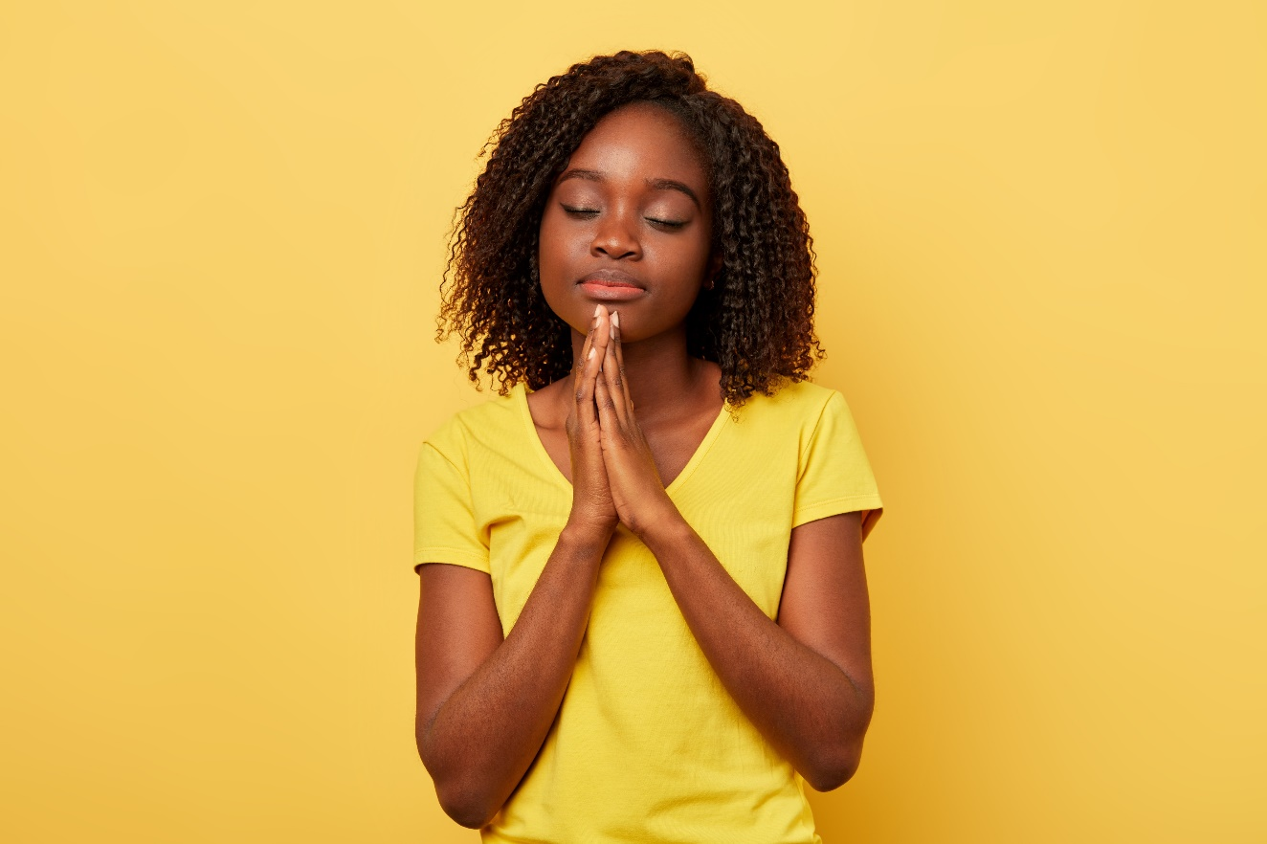
YEAR TWO - LESSON 1b

Slide 4
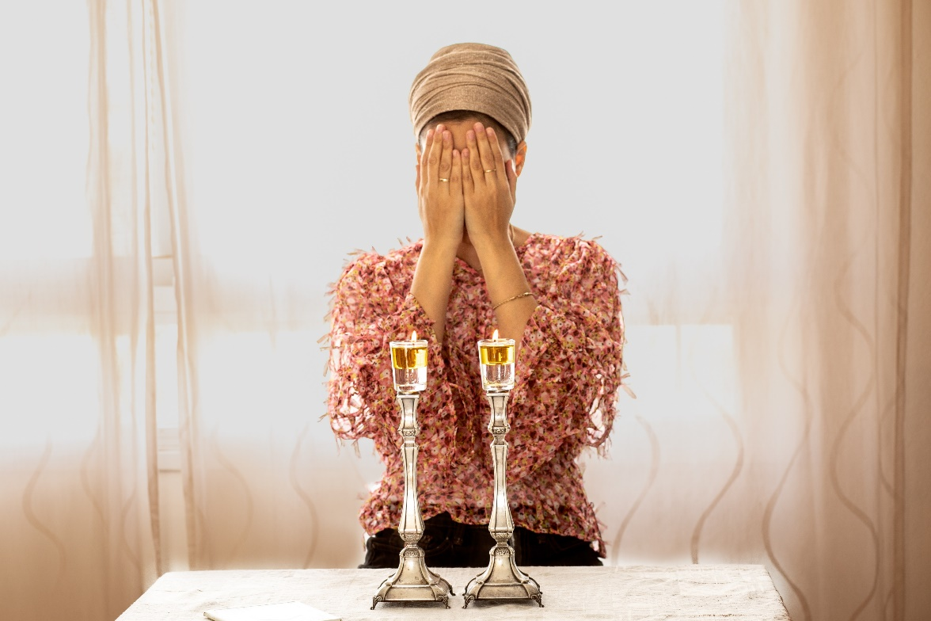
YEAR TWO - LESSON 1b

Slide 5
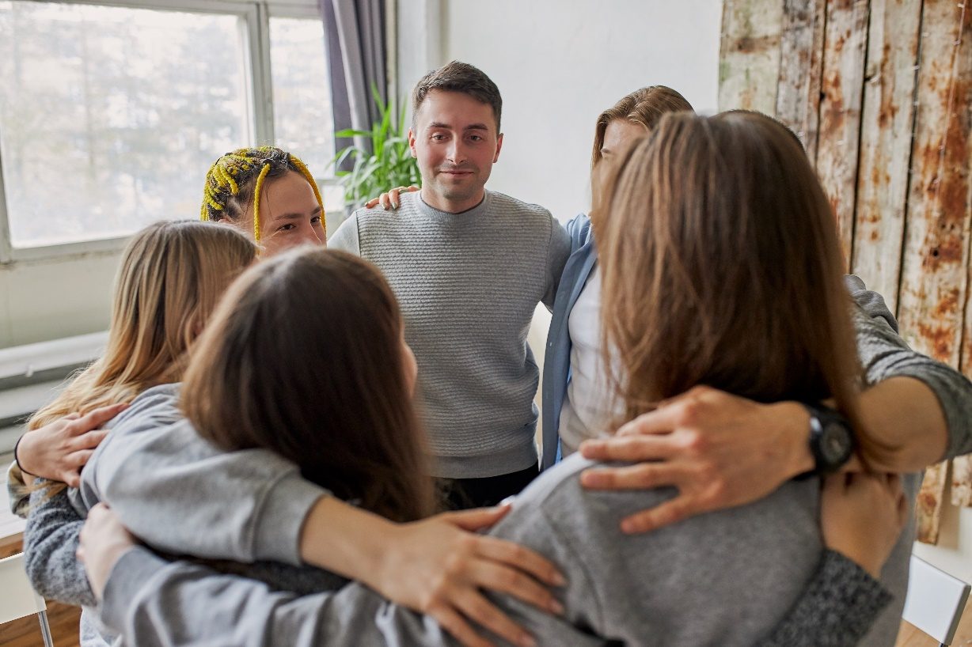
YEAR TWO - LESSON 1b

Slide 6
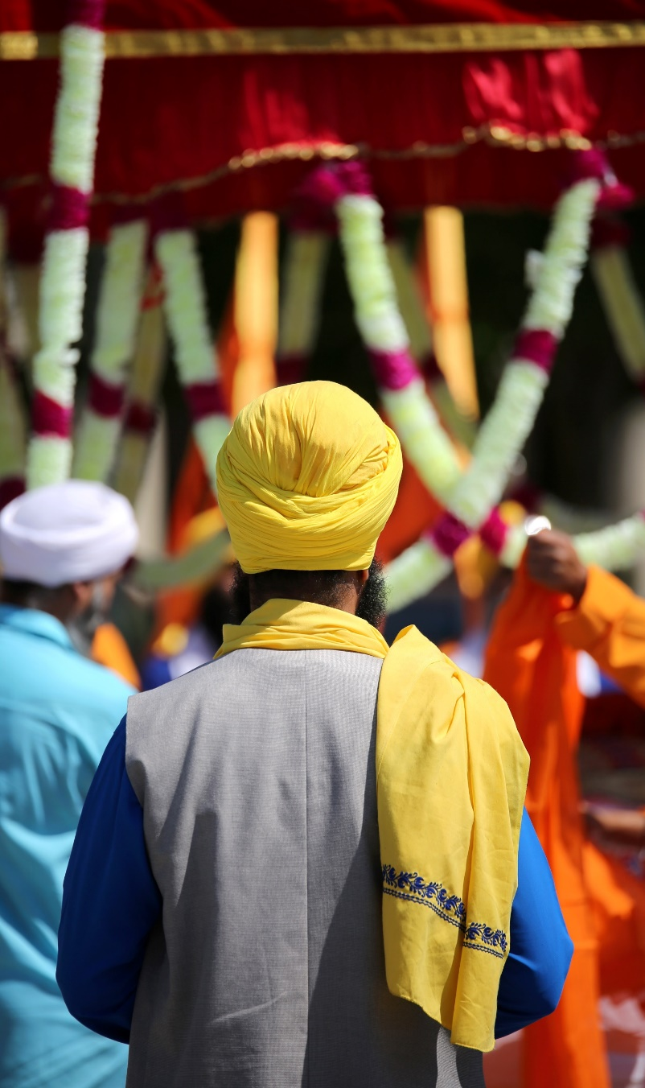
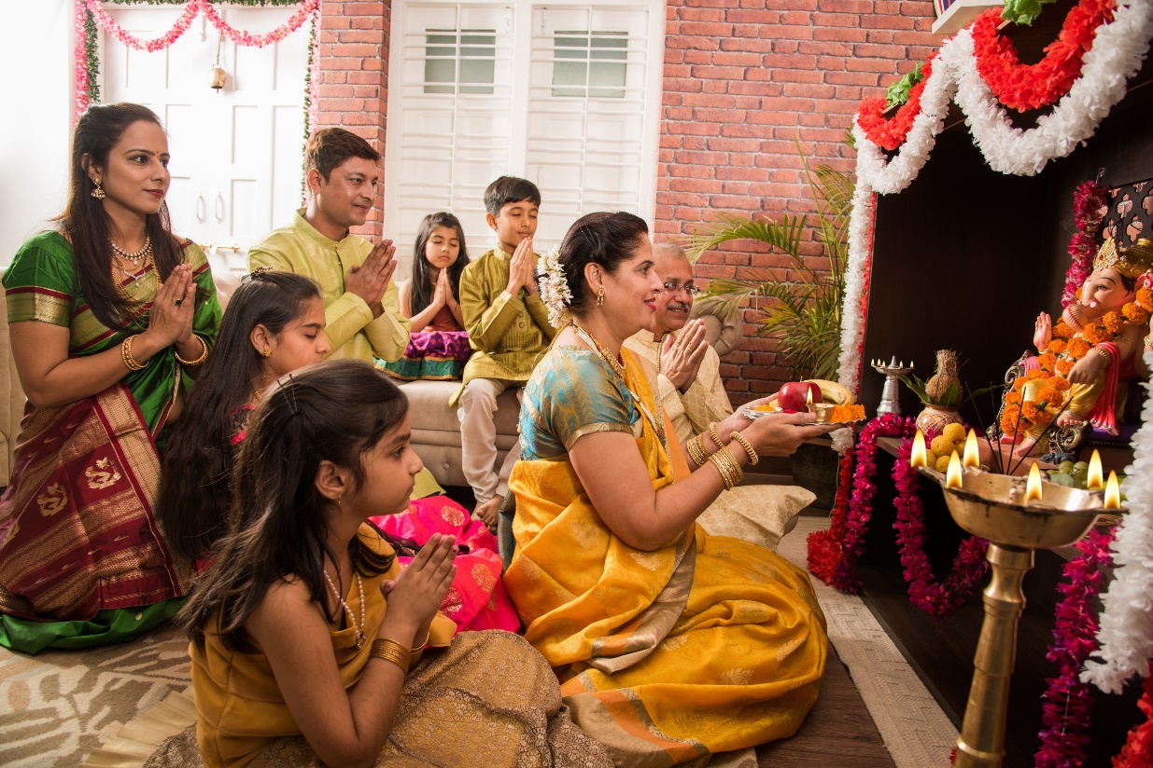
YEAR TWO - LESSON 1b

