Slide 1
Key questions
What do you think is happening in these pictures?
If you had to give each picture a title what would it be?
Can you see a common theme/one word that links these pictures together? If so, what do you think it might be?
YEAR TWO - LESSON 1a
© Copyright London Diocesan Board for Schools 2023

Slide 2
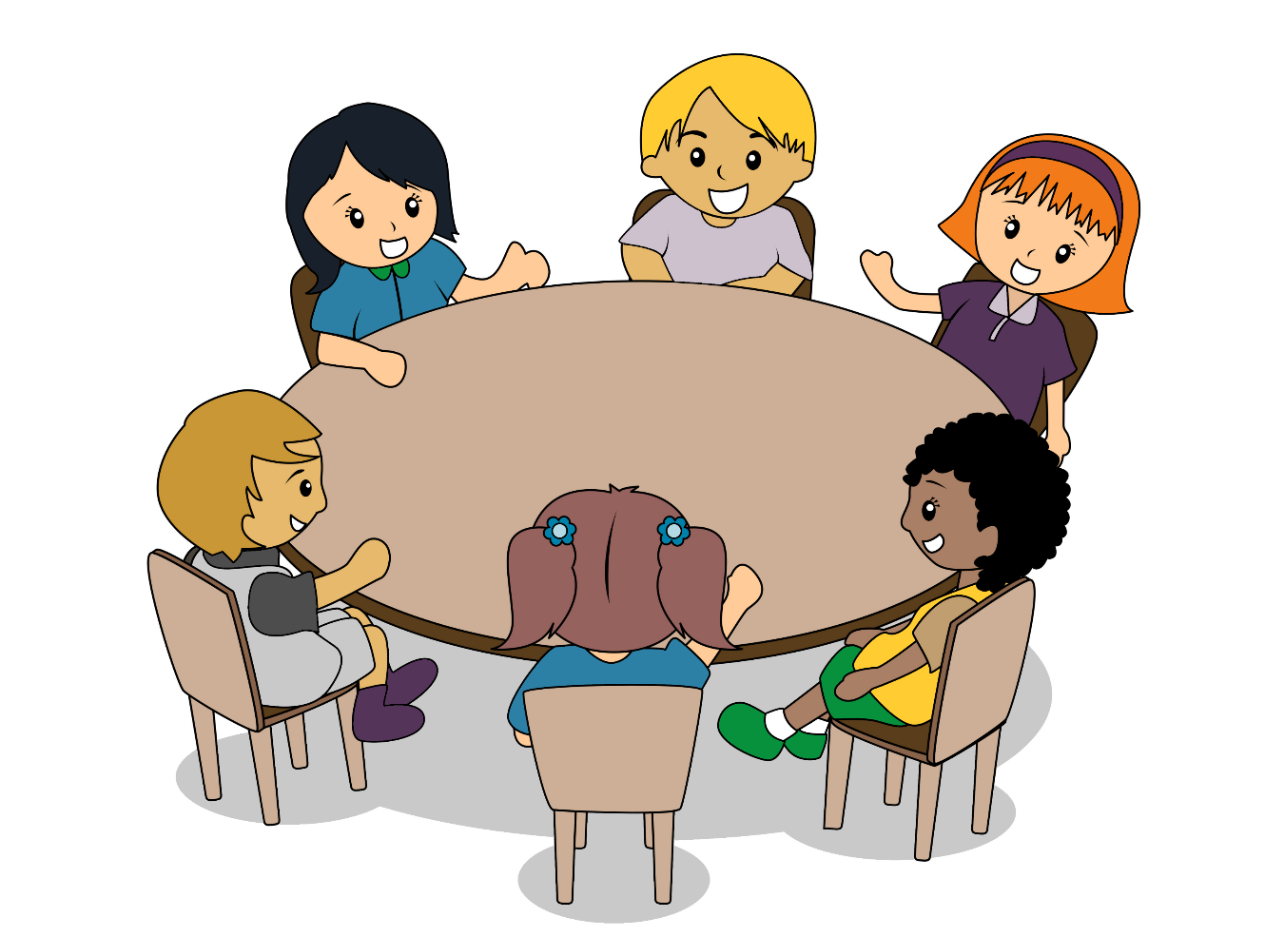
YEAR TWO - LESSON 1a

Slide 3
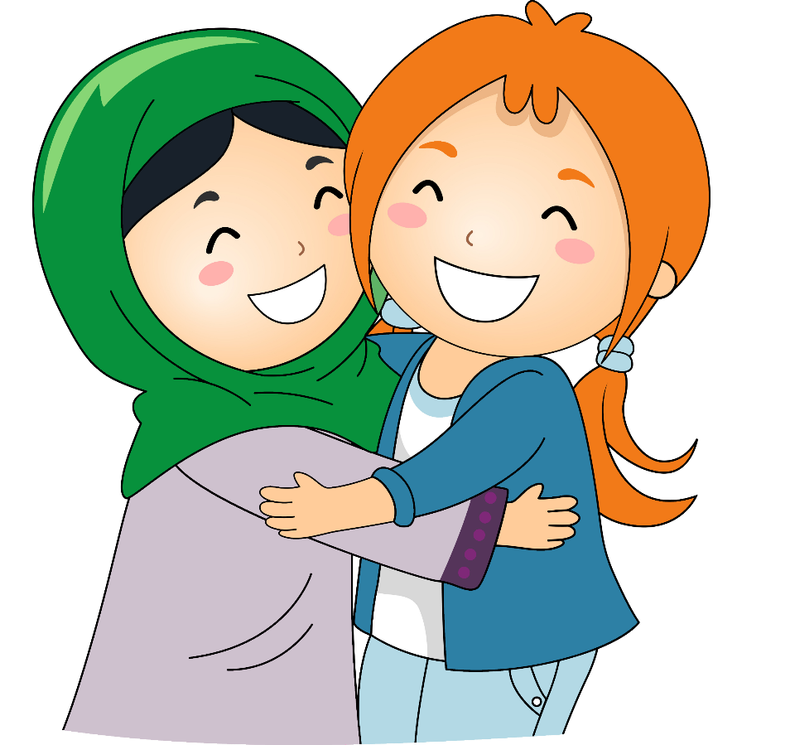
YEAR TWO - LESSON 1a

Slide 4
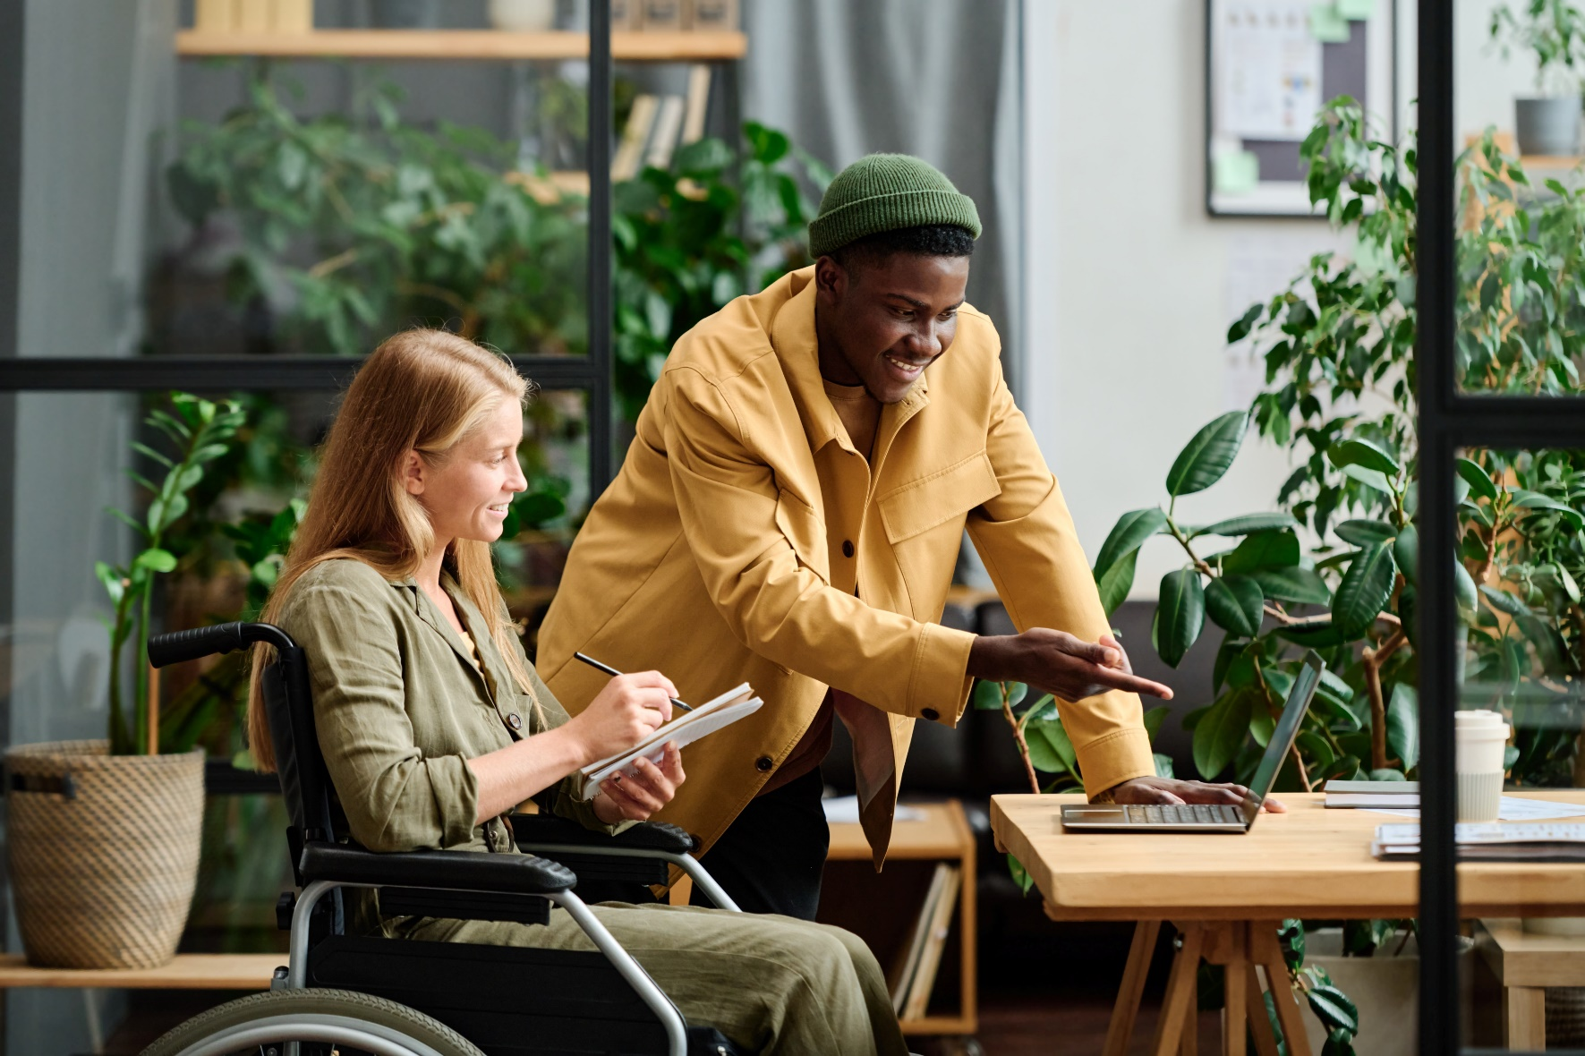
YEAR TWO - LESSON 1a

Slide 5
YEAR TWO - LESSON 1a

