Slide 1
Paintings of angels
What do you think an angel is?
What do you think an angel looks like?
What do you think an angel’s role is?
YEAR ONE - LESSON 1
© Copyright London Diocesan Board for Schools 2023

Slide 2
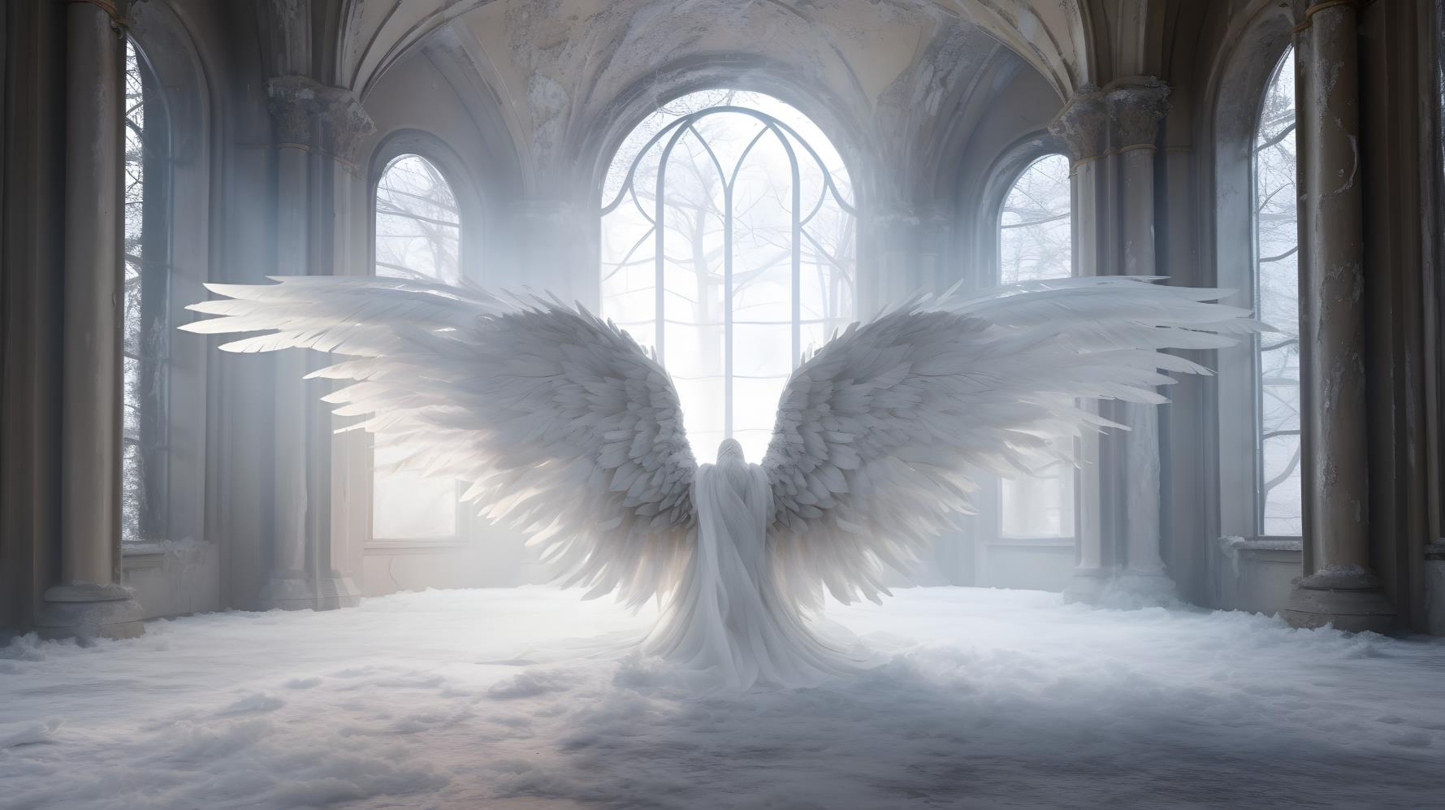
YEAR ONE - LESSON 1

Slide 3
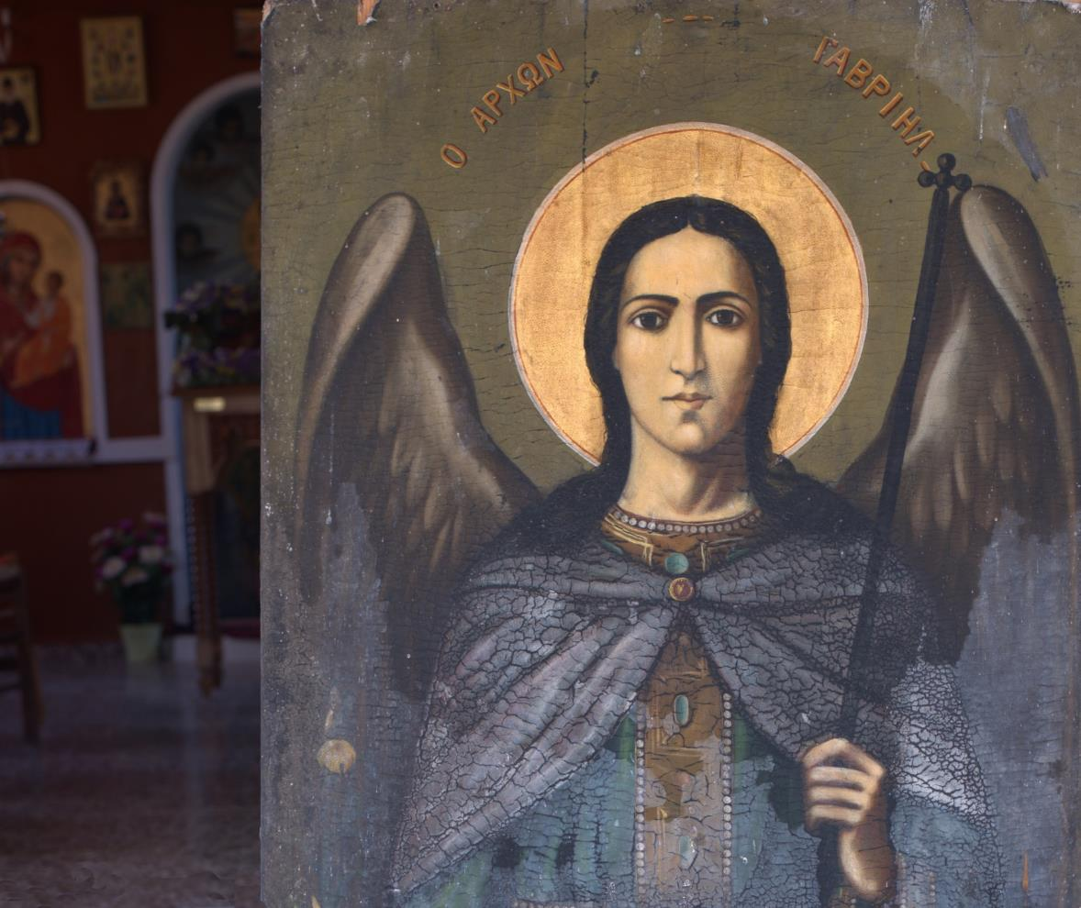
YEAR ONE - LESSON 1

Slide 4
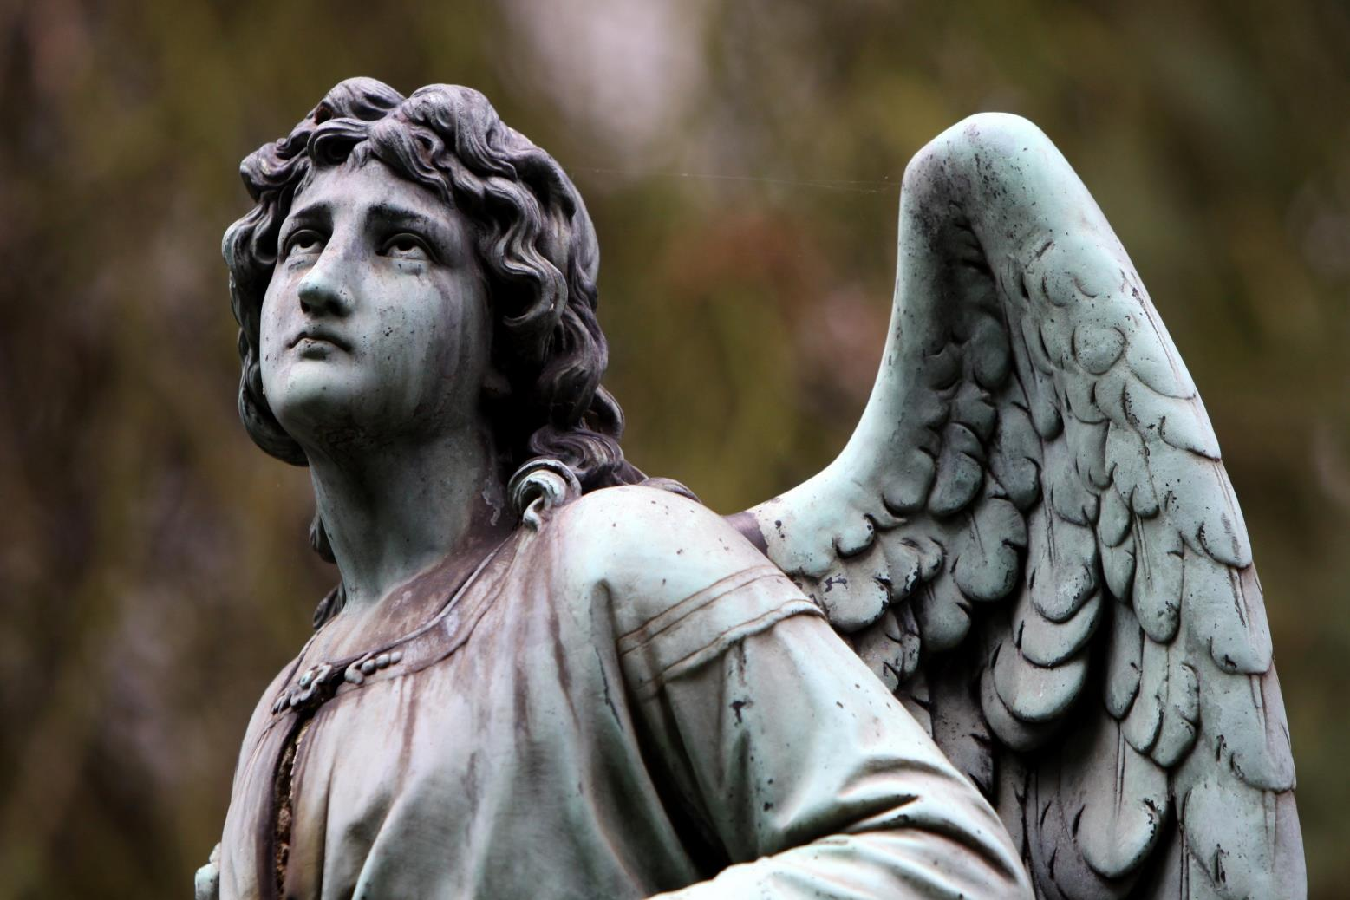
YEAR ONE - LESSON 1

Slide 5
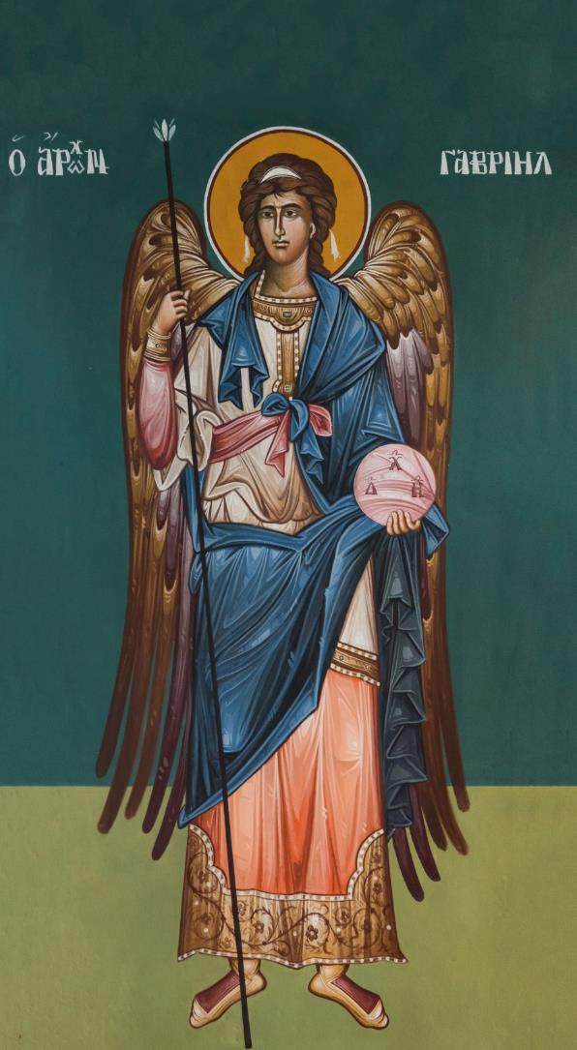
YEAR ONE - LESSON 1

Slide 6
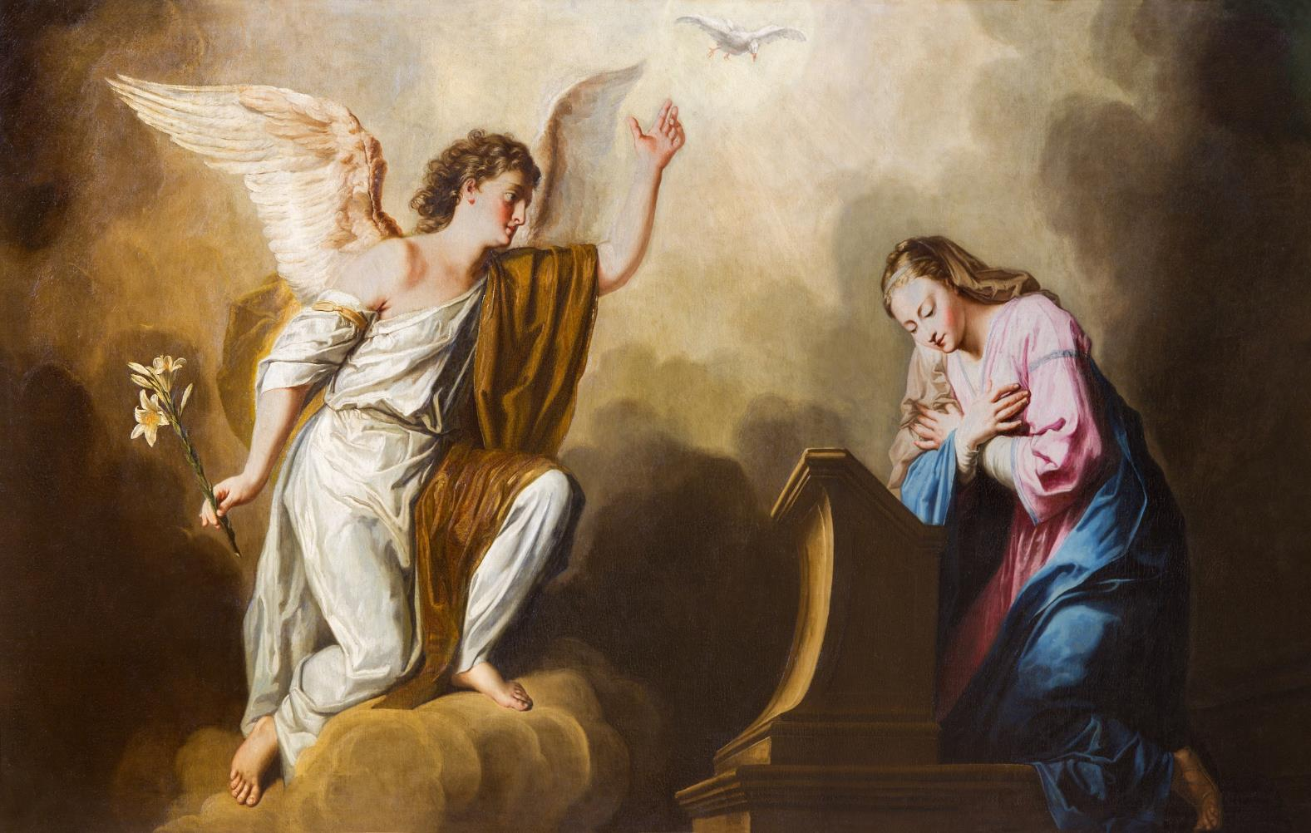
YEAR ONE - LESSON 1

Slide 7
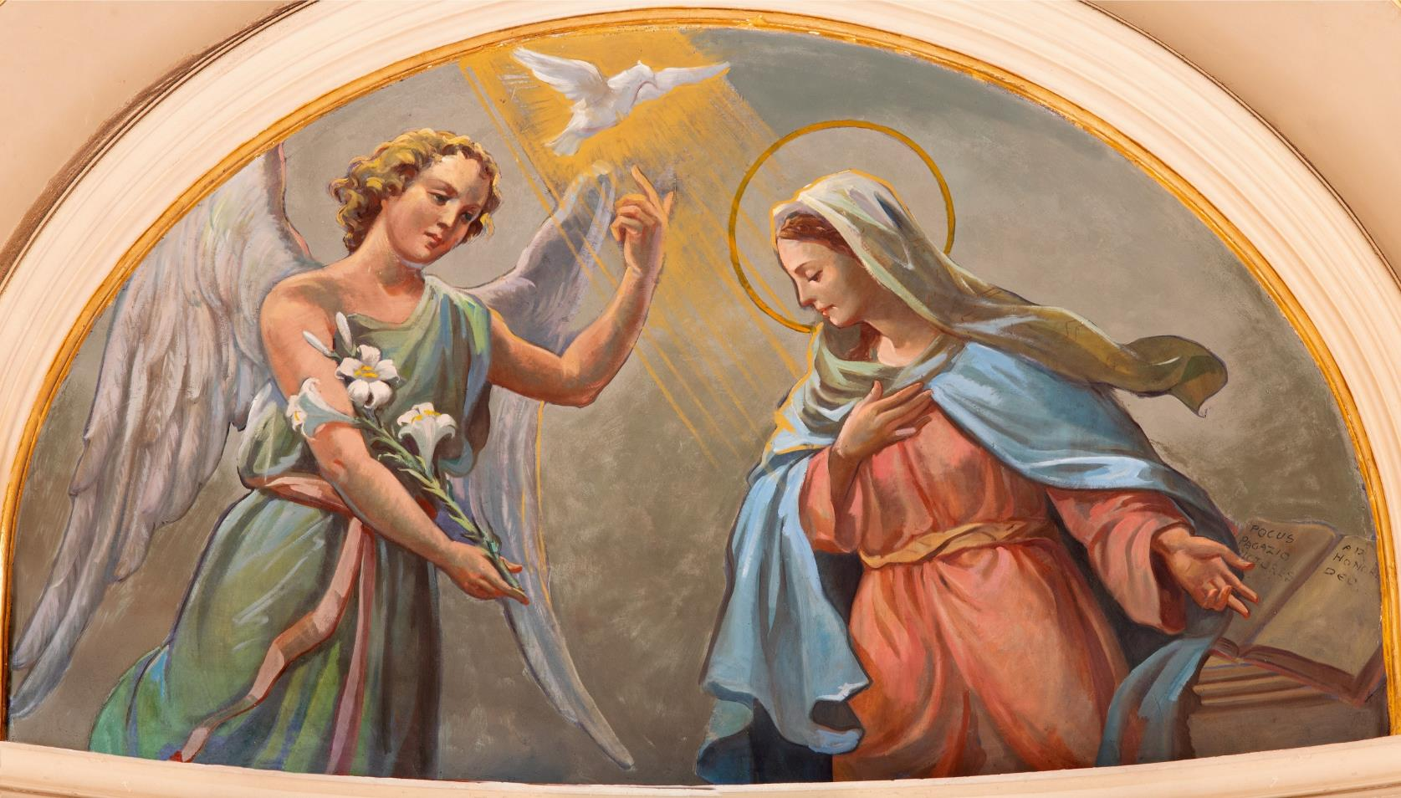
YEAR ONE - LESSON 1

