Slide 1
Peace in Europe
Collective Worship in response to the Russia: Ukraine Conflict

Slide 2
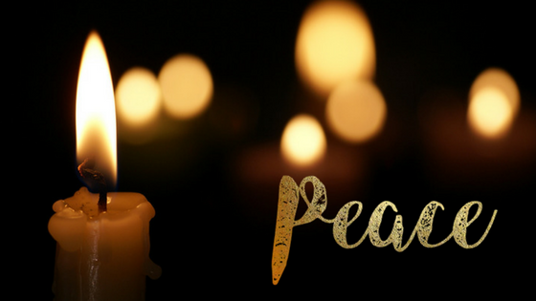
Welcome
We gather together as a school family in peace to think about what is happening in the world and to remember the importance of hope and love. We say thank you for our safety and think about those who are not safe today. Amen.

Slide 3
The country of Ukraine has been invaded

Slide 4
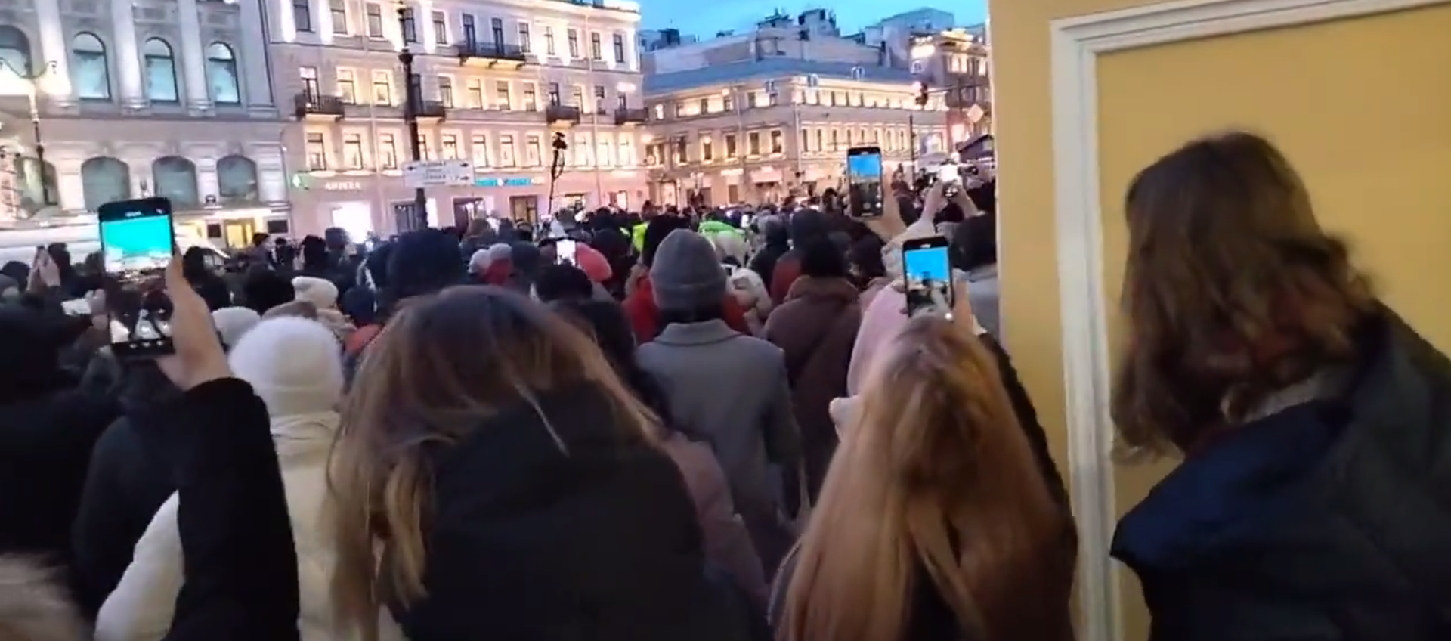
Not all the people of Russia want a war

Slide 5
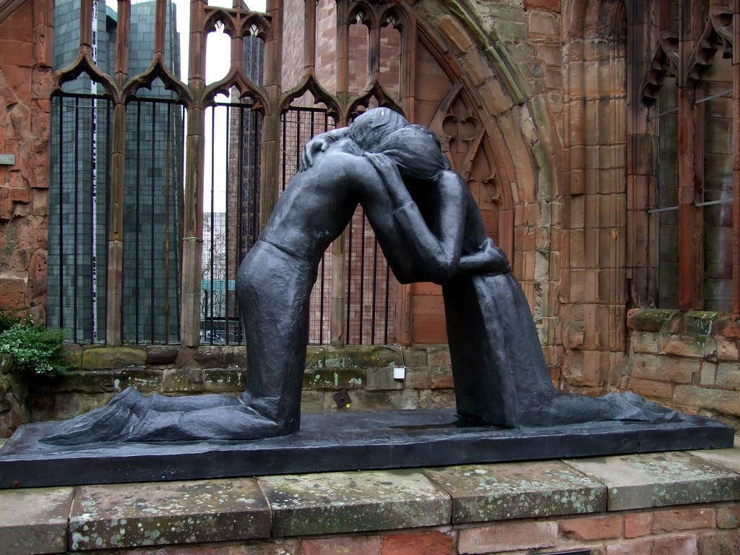

Slide 6
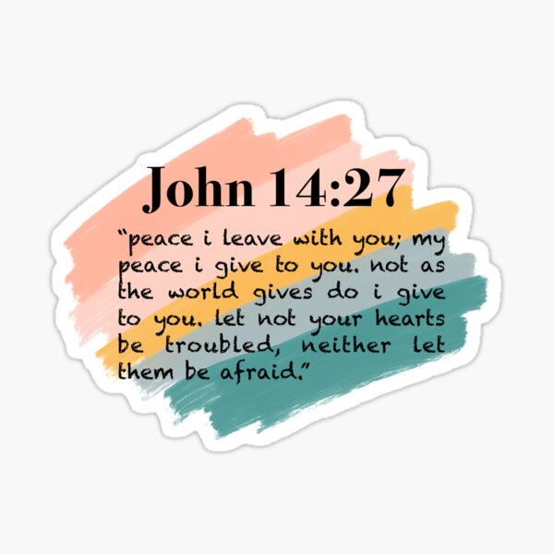
Do not let your hearts be troubled

Slide 7
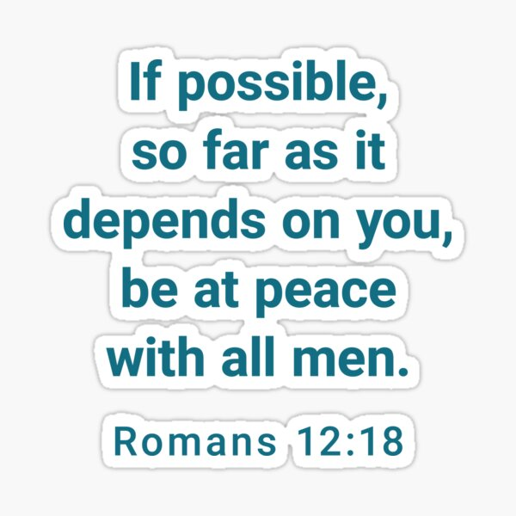
Live at peace with others

Slide 8
“Blessed are the peacemakers, for they will be called children of God” Matthew 5:9

