Slide 1
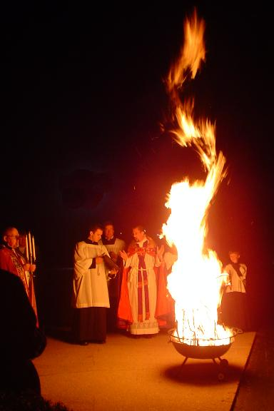
Notes:
A fire is lit outside the church and is blessed.

Slide 2
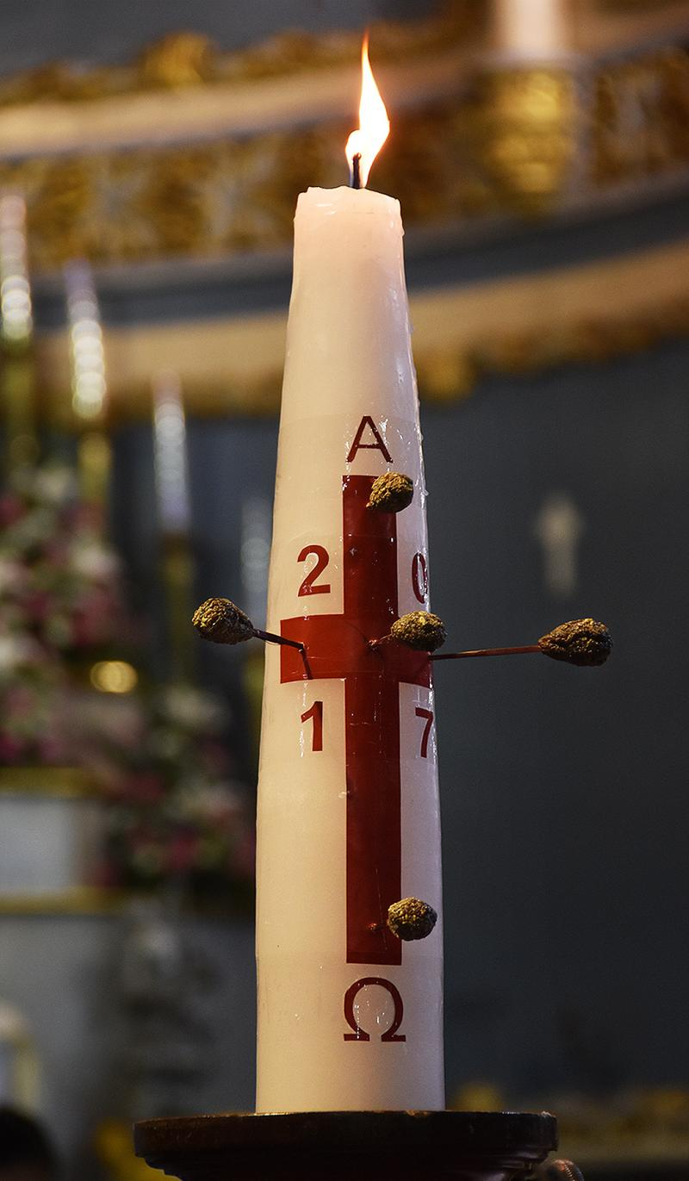
Notes:
Paschal candle
5 grains of incense are pressed into the candle to remind people of the 5 wounds Jesus received in his hands, feet and side when he died on the cross

Slide 3
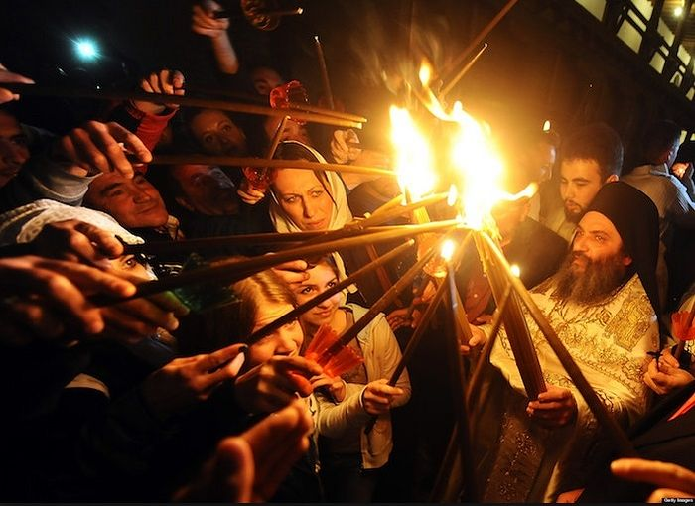
Notes:
Orthodox Christians in Jerusalem. The candles are lit from the Paschal candle that has been lit from the fire.

Slide 4
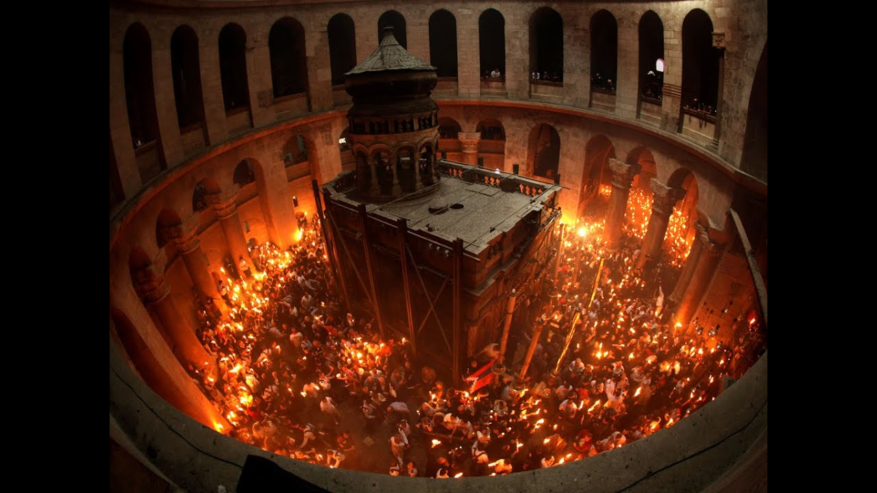
Notes:
Jerusalem - candles lit from the Paschal candle

Slide 5
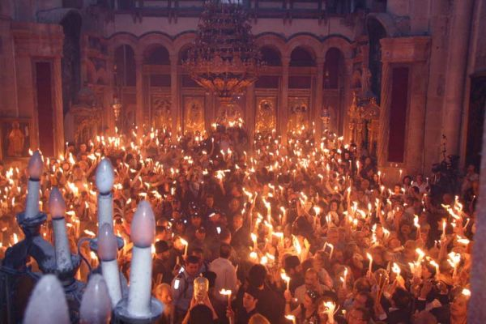
Notes:
Serbia

Slide 6
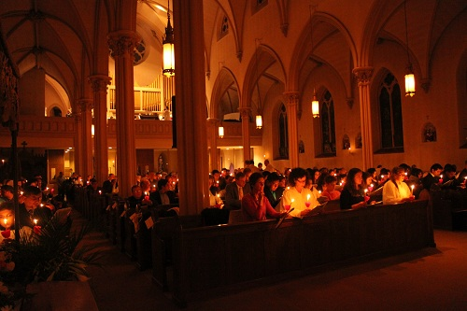
Notes:
The light of Christ – representing the risen Lord.

Slide 7
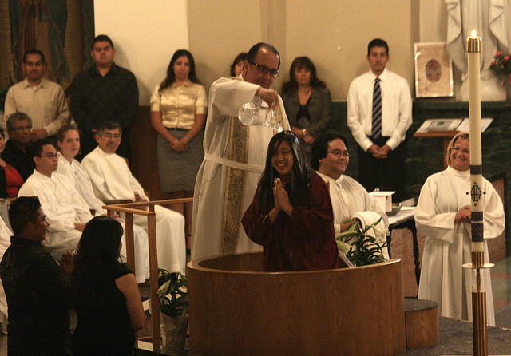
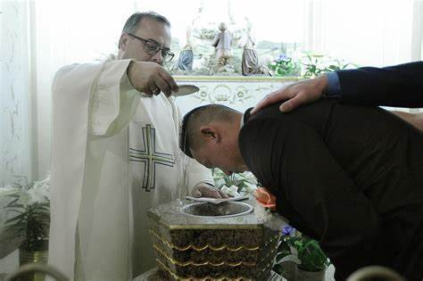
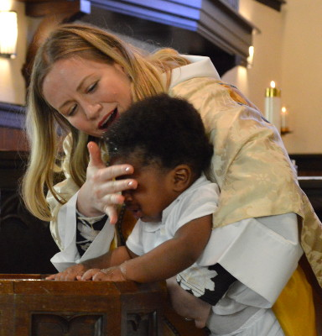
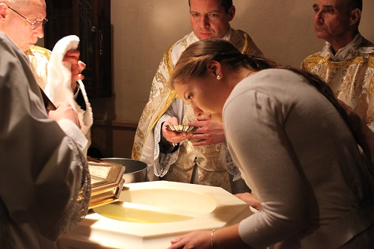
Notes:
Many people get baptised at Easter. All Christians are encouraged to renew the baptismal vows at Easter.

