Slide 1
2020 -2021 Autumn term RE network meeting
Agenda
Starting the new year
Catch up – dos and don’ts
Keeping RE ‘alive’ in the current climate
Updates: National and local

Slide 2
Sharing expectations for the meeting

Slide 3
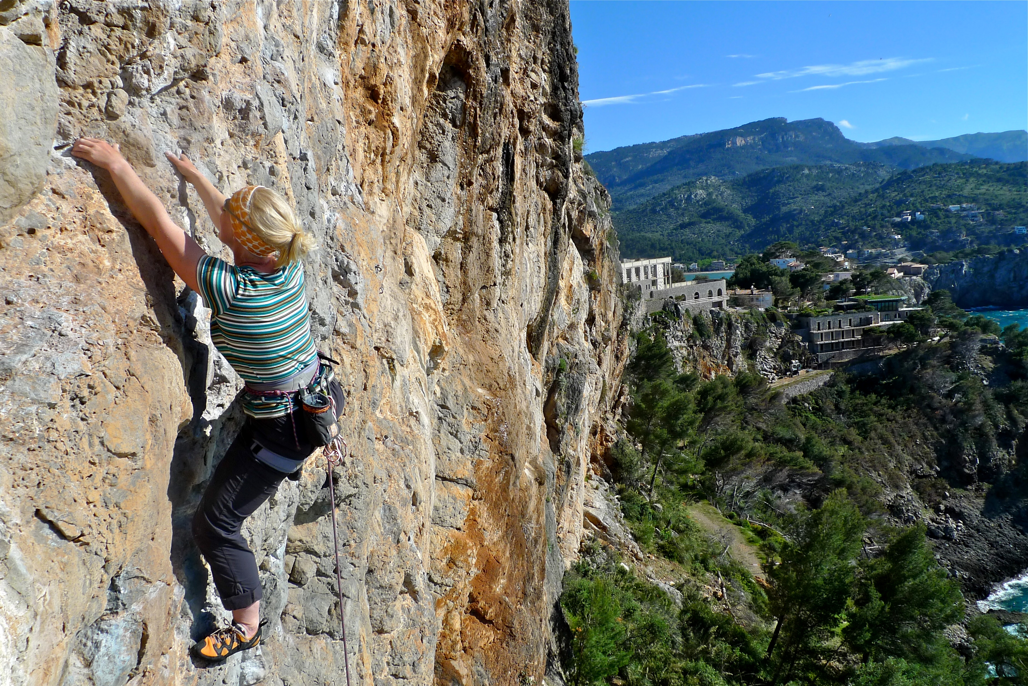
Things to consider in your role as a leader at the beginning of the new academic year.

Slide 4
Who are your staff and what induction do they require?

Slide 5
What do they need to know? Things to consider:
Provision for RE in a church school.
Statement of Entitlement.
Pedagogy behind the school’s syllabus.
The intent behind the teaching of RE.
The thinking behind the curriculum map and how units have been linked and sequenced together.
What are your non-negotiables for RE?
The Bible’s Big Story with reference to the core concepts and how this links into the teaching of Christianity.
Where to find everything: Units of learning/assessments/resources/who to speak to

Slide 6
What does your CPD programme look like this year?

Slide 7
What are the whole school training needs?
What do individual staff require?
Questions to ask:
What realistically is possible?
What is the best approach to secure the greatest impact?
How will you as a leader, monitor and evaluate the impact of the quality of teaching and learning and pupil progress?

Slide 8
Pause Any questions

Slide 9
Breakout room: Discuss: How are you supporting new staff? What does your CPD programme look like?

Slide 10
Key things to re-visit with all staff
How to secure high quality RE in the school.

Slide 11
A statement of entitlement
A high-quality sequential RE programme.
A study of Christianity as a living and diverse faith, focused on the teaching of Jesus and the Church.
Sequenced learning about a range of religions and worldviews fostering respect for others.
RE must be taught in accordance with the trust deed of the school.

Slide 12
What can pupils and their families expect from the RE curriculum?
A curriculum that:
has a high profile within the whole school curriculum and is seen as a priority for senior leaders;
contributes to an understanding of British values and spiritual, moral, social and cultural development;
enables pupils to acquire a rich, deep knowledge and understanding of Christian belief and practice, this should include the ways in which it is unique and diverse;
engages with Biblical text and theological ideas;
exploration of core concepts and questions;
provides opportunities for informed dialogue with a range of religions and worldviews;
provides opportunity to understand the role of foundational texts, beliefs, rituals and practices and how they help form identity in a range of religions and worldviews.

Slide 13
What can pupils and their families expect from the RE curriculum?
Outcomes:
Significant progress.
High attainment.
Pupils that are confidently religiously literate.

Slide 14
What can pupils and their families expect from the RE curriculum?
Learning activities:
Must provide fully for the needs of all pupils.
Pupils should develop a wide range of skills.
Pupils should have a safe space to explore their own views.

Slide 15
Curriculum statement:
Challenging, accurate and diverse.
RE is an academic subject.
Balanced RE curriculum.
A coherent curriculum that enables progress through ordered and sequential learning developing both knowledge and skills.
Clear curriculum vision and intent, a structure for implementation and provision and a process for evaluating impact.
Teaching of Christianity – at least 50% of the curriculum.
10% curriculum time on RE. No less than 5%.
At least one member of staff having specialist RE training or qualifications.

Slide 16
Key things to remember:
God’s rescue plan for humanity which comes in the form of Jesus when the time was right – the great rescuer.
Eight core concepts.
People of God who aimed always to follow God but didn’t always get it right.
God gives the people of God many times a preview of his great plan.
The messengers, the prophets, spoke many times to the people of God about getting ready for the arrival of the ‘rescuer.’
The ‘rescuer’ is born – Jesus.
The Good News is shared through the life and teachings of Jesus.
The Kingdom of God continues to grow and develop, following Jesus’ return to heaven, through the acts of the apostles and the teachings of St Paul.
The Bible’s Big Story
https://www.youtube.com/watch?v=dSs3wpycpl4&feature=youtu.be
The Bible’s Big Story

Slide 17
Teaching and Learning
Key things to re-visit with staff:
Teaching of religious vocabulary
Teaching of Biblical texts
Offering a balanced curriculum – theology, philosophy, human/social science
Your non-negotiable list
Your expectations for the subject
The importance of planning
The importance of assessment

Slide 18
Purpose of the RE learning journey
An interactive display to support the unit of learning:
Big question.
Subsidiary questions.
Religious vocabulary –add it to the wall as the unit progresses.
A place to record children’s thinking/questions.
Add to the journey as the unit progresses – good examples of children’s work/thoughts/questions/addressing misconceptions.
A place where the enquiry can be tracked and shared with the learning community.

Slide 19
Pause Any questions

Slide 20
Breakout room: What have you already done to prepare your staff team for the year and what has this now prompted you to go and do?

Slide 21
What should RE teaching and learning look like this year?
What did the RE provision in your school look like during lock down?
How many children engaged in the RE home learning during lock down?
Starting point

Slide 22
Filling the gaps in knowledge, understanding and skills in RE.
Skills:
Remember:
Skills are revisited on more than one occasion throughout the curriculum.
Be mindful:
Are there any skills that children appear to be less confident in? If so how can you incorporate more of the skill in your teaching?

Slide 23
Knowledge
Option 1:
Consider having two RE days to address the two units missed in the summer term.
Option 2:
Deliver an RE day for a world faith unit that may have been missed. This is important has the world faith only comes up once within the primary age range,

Slide 24
Christianity units
Deliver the knowledge at an appropriate time in the year, taking into consideration:
Where the topic might fit into other curriculum areas being covered.
Where a link might be able to be made with English or PSHE.
What key knowledge needs to be addressed from the units missed – it is essential that as leaders, you refer back to the assessment grids and identify only the knowledge that needs to be remembered.
Where half a day might be able to be allocated to addressing the subject knowledge gap if a day is not available.

Slide 25
Does your school follow the curriculum map?
Go to the link below and download
RE update July 2020. This document recommends what key knowledge if is has been missed should be picked up this year.
https://www.ldbs.co.uk/re-worship/re/training-ppt-and-supporting-documents/

Slide 26
What not to do
Begin this term by doing summer term units.
Miss RE off the timetable.

Slide 27
Pause Any questions

Slide 28
Breakout room: Reflections on what ‘catch up’ looks like in your school. What is your school doing in terms of Remote learning for RE?

Slide 29
Keeping RE alive in the current climate
Remote learning

Slide 30
Replicating the classroom remotely. Education Endowment Foundation (EEF)
Ensure pupils receive clear explanations.
Supporting growth in confidence with new material through scaffolded practice.
Application of new knowledge or skills.
Enabling pupils to receive feedback on how to progress.

Slide 31
Your school Questions to ask
Who has access to a digital device?
What interactive platform is being used and can all stake holders use it and access it?
What does your school remote learning policy ask of you as an RE lead?
Live lessons or recorded lessons?
Blended learning – what is expected and how do I keep this achieveable for all staff?

Slide 32
How will you replicate the learning that is going on in the classroom that week?
What child friendly teaching material is required?
What activity can be completed independently?
Differentiation?
Ensuring teacher expectations are clear.
RE leader:
How will monitor and evaluate the quality of remote learning across the school on the impact it has on pupil progress?
Things to consider
Providing opportunities for recapping learning. Eg:
Pre and post lesson quizzes.
How will you keep the remote learning engaging and motivating for all children?
How will the child receive feedback from you?

Slide 33
Keeping RE ‘alive’ in the current climate
How?

Slide 34
Visitors
Inviting visitors into the classroom via zoom/Microsoft teams

Slide 35
Making your own YouTube clip
Key features of the building and their significance
Who works in the church and what is their role?
Eg
Vicar
Youth worker
What happens in the building?
Your school church
Eucharist
Baptism
Wedding

Slide 36
Virtual tours of places of worship
Recommended places to go for these:
https://www.reonline.org.uk/specials/places-of-worship/christianity_orthodox_video.htm
https://request.org.uk/
https://jewishmuseum.org.uk/

Slide 37
Quality videos:
EYFS: Big stories and resources https://www.bbc.co.uk/cbeebies/shows/lets-celebrate
3 – 7 year olds: Big stories and resources https://www.bbc.co.uk/programmes/articles/1pYRg2f202rqWHrp3ywhTyX/religions-of-the-world
Key Stage 1: BBC bitesize films and home learning lessons https://www.bbc.co.uk/bitesize/subjects/zxnygk7
Key Stage 2: BBC My Life, My Religion series https://www.bbc.co.uk/programmes/b05pc1c9/episodes/guide
Key Stage 2: BBC bitesize films and home learning lessons https://www.bbc.co.uk/bitesize/subjects/z7hs34j
Key Stage 2: BBC films for the World Religions https://www.bbc.co.uk/teach/ks2-religious-studies/z6pbqp3

Slide 38
Maintaining active learning in the classroom.
Valuing purposeful talk and keeping it high priority in the classroom.
Social distance learning ideas:
https://www.natre.org.uk/about-natre/free-resources-for-you-and-your-pupils/
Brand new teaching resource: ERA’s Video Streaming Platform . The service features exclusive television content from the BBC archives, clipped and curated to support teaching the national curriculum at all key stages. Selected from an archive of over 2 million recordings, programmes are clipped to suit classroom use (1-5 mins), are permanently available to stream and searchable by key words, subject and key stage, helping to ensure that teachers find the best clips to share with their students.
https://era.org.uk/tv-radio-resources/?keyword=christianity&content_type=era_ss_resource&subject=&board=&level=
https://www.ldbs.co.uk/re-worship/re/re-resources-covid-19-pandemic/

Slide 39
Pause Any questions

Slide 40
Breakout room: What are you doing to keep the subject ‘alive’? Opportunity to ask a question.

Slide 41
Updates
SIAMS: How did RE continue during lock down? Recommendation: Record in SEF.
Revised units of learning
https://www.ldbs.co.uk/re-worship/re/re-units-learning/
PPTs following network meetings and supporting documents
https://www.ldbs.co.uk/re-worship/re/training-ppt-and-supporting-documents/
Interfaith week: 8th – 15th November 2020
Visit https://www.interfaithweek.org/ and if you have specific questions or ideas you’d like to discuss email IFN’s Assistant Director at david.hampshire@interfaith.org.uk.

Slide 42
NATRE
Join Natre: https://www.natre.org.uk
Strictly RE: National conference: 30th – 31st January 2021
Join us for a jam-packed RE CPD fest, whilst saving on travel and getting more seminar sessions, double the number of keynotes and access to all the resources after the event. As a NATRE member you could pay as little as £45* with your member's discount and the early bird rate, if you book before 31 October 2020. Don't delay, book your place today.

Slide 43
Moving forward
Recommendations:
Keep your action plan focused and relevant to the current climate.
Don’t overload your action plan.
Focus on embedding core principles that lead to high quality RE.
Include in your plan your response to remote learning.
Only introduce something ‘new’ if there is capacity within the school to implement and evaluate impact.
Keep your action plan as a ‘live’ document. Regularly evaluate it and tweak accordingly.

