Slide 1
Lesson 2:
Analysis of three artists
How is the theology of Christmas represented in art today?

Slide 2
Title: Incarnation 1989
Artist: Fernando Ariziti
Origin: Mexico/SUA

Slide 3
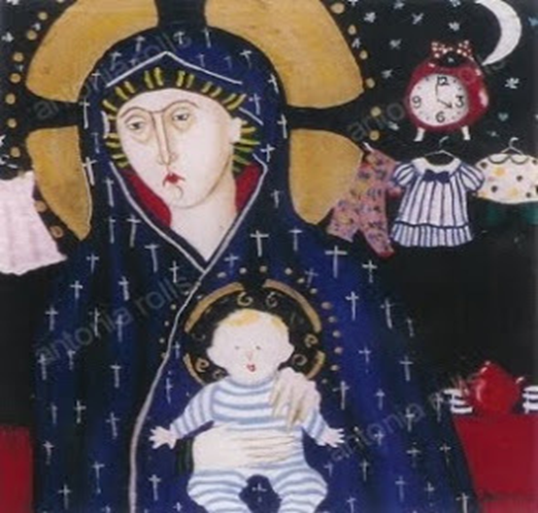
Title: 4am Madonna 1994
Artist: Antonia Rolls
Origin: United Kingdom

Slide 4
Title: The meaning of Christmas 1995
Artist: Kristoffer Ardena
Origin: Philippines

