Slide 1
Paintings of angels
What do you think an angel is?
What do you think an angel looks like?
What do you think an angel’s role is?

Slide 2
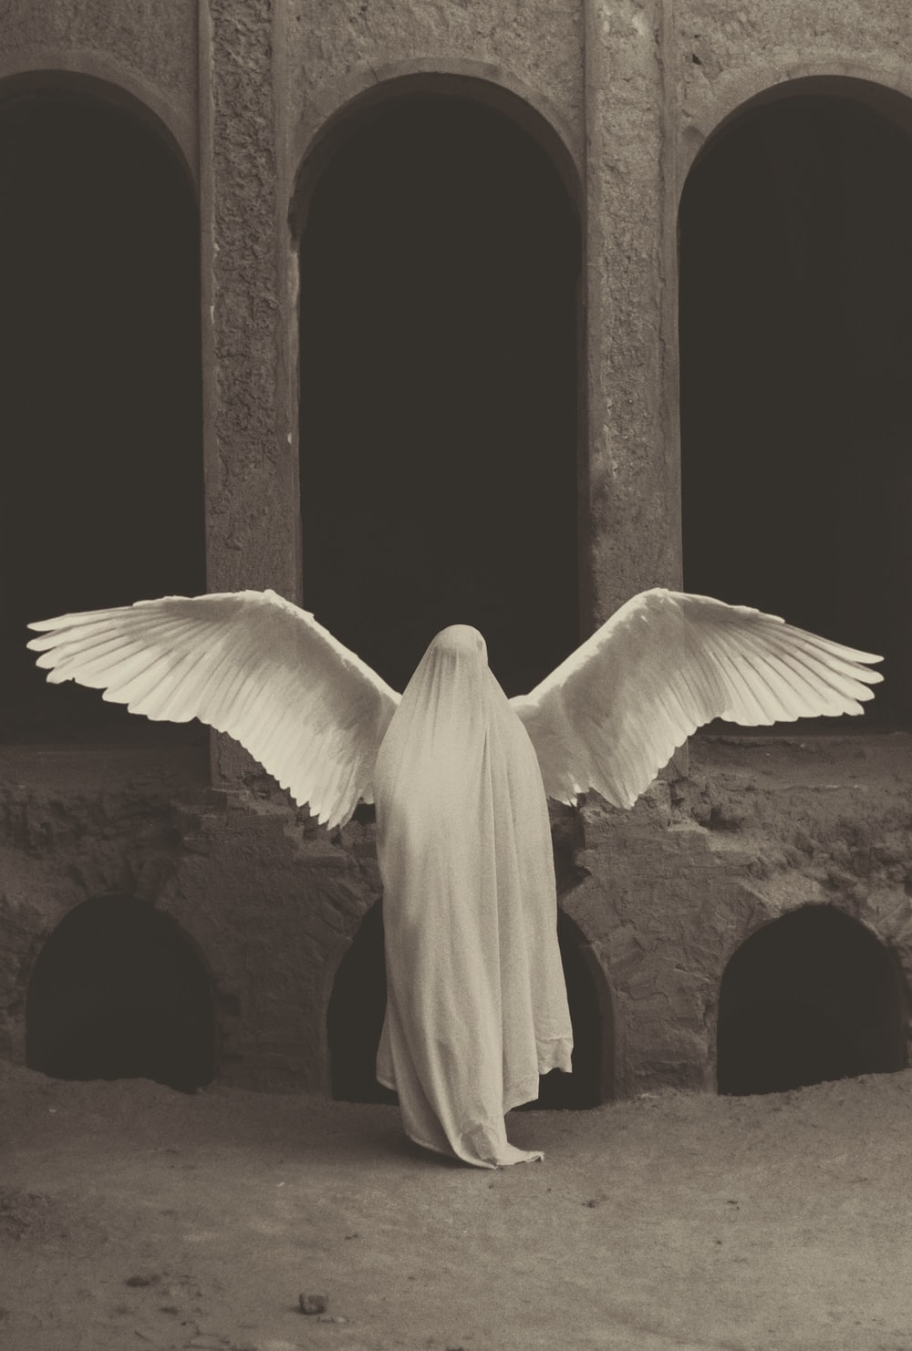

Slide 3
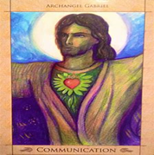

Slide 4
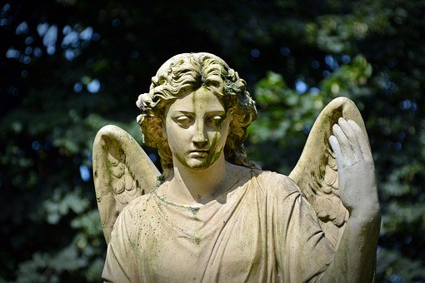

Slide 5
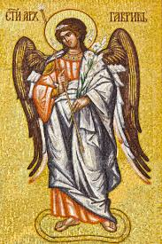

Slide 6
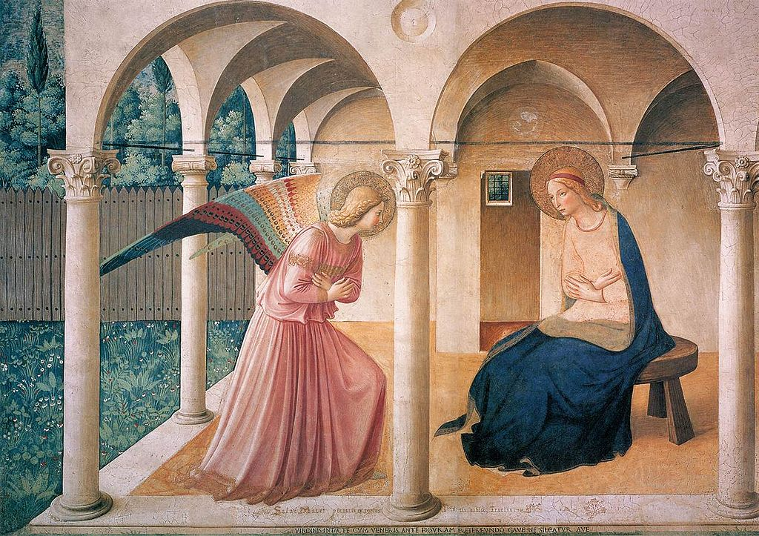

Slide 7
